Slide 1
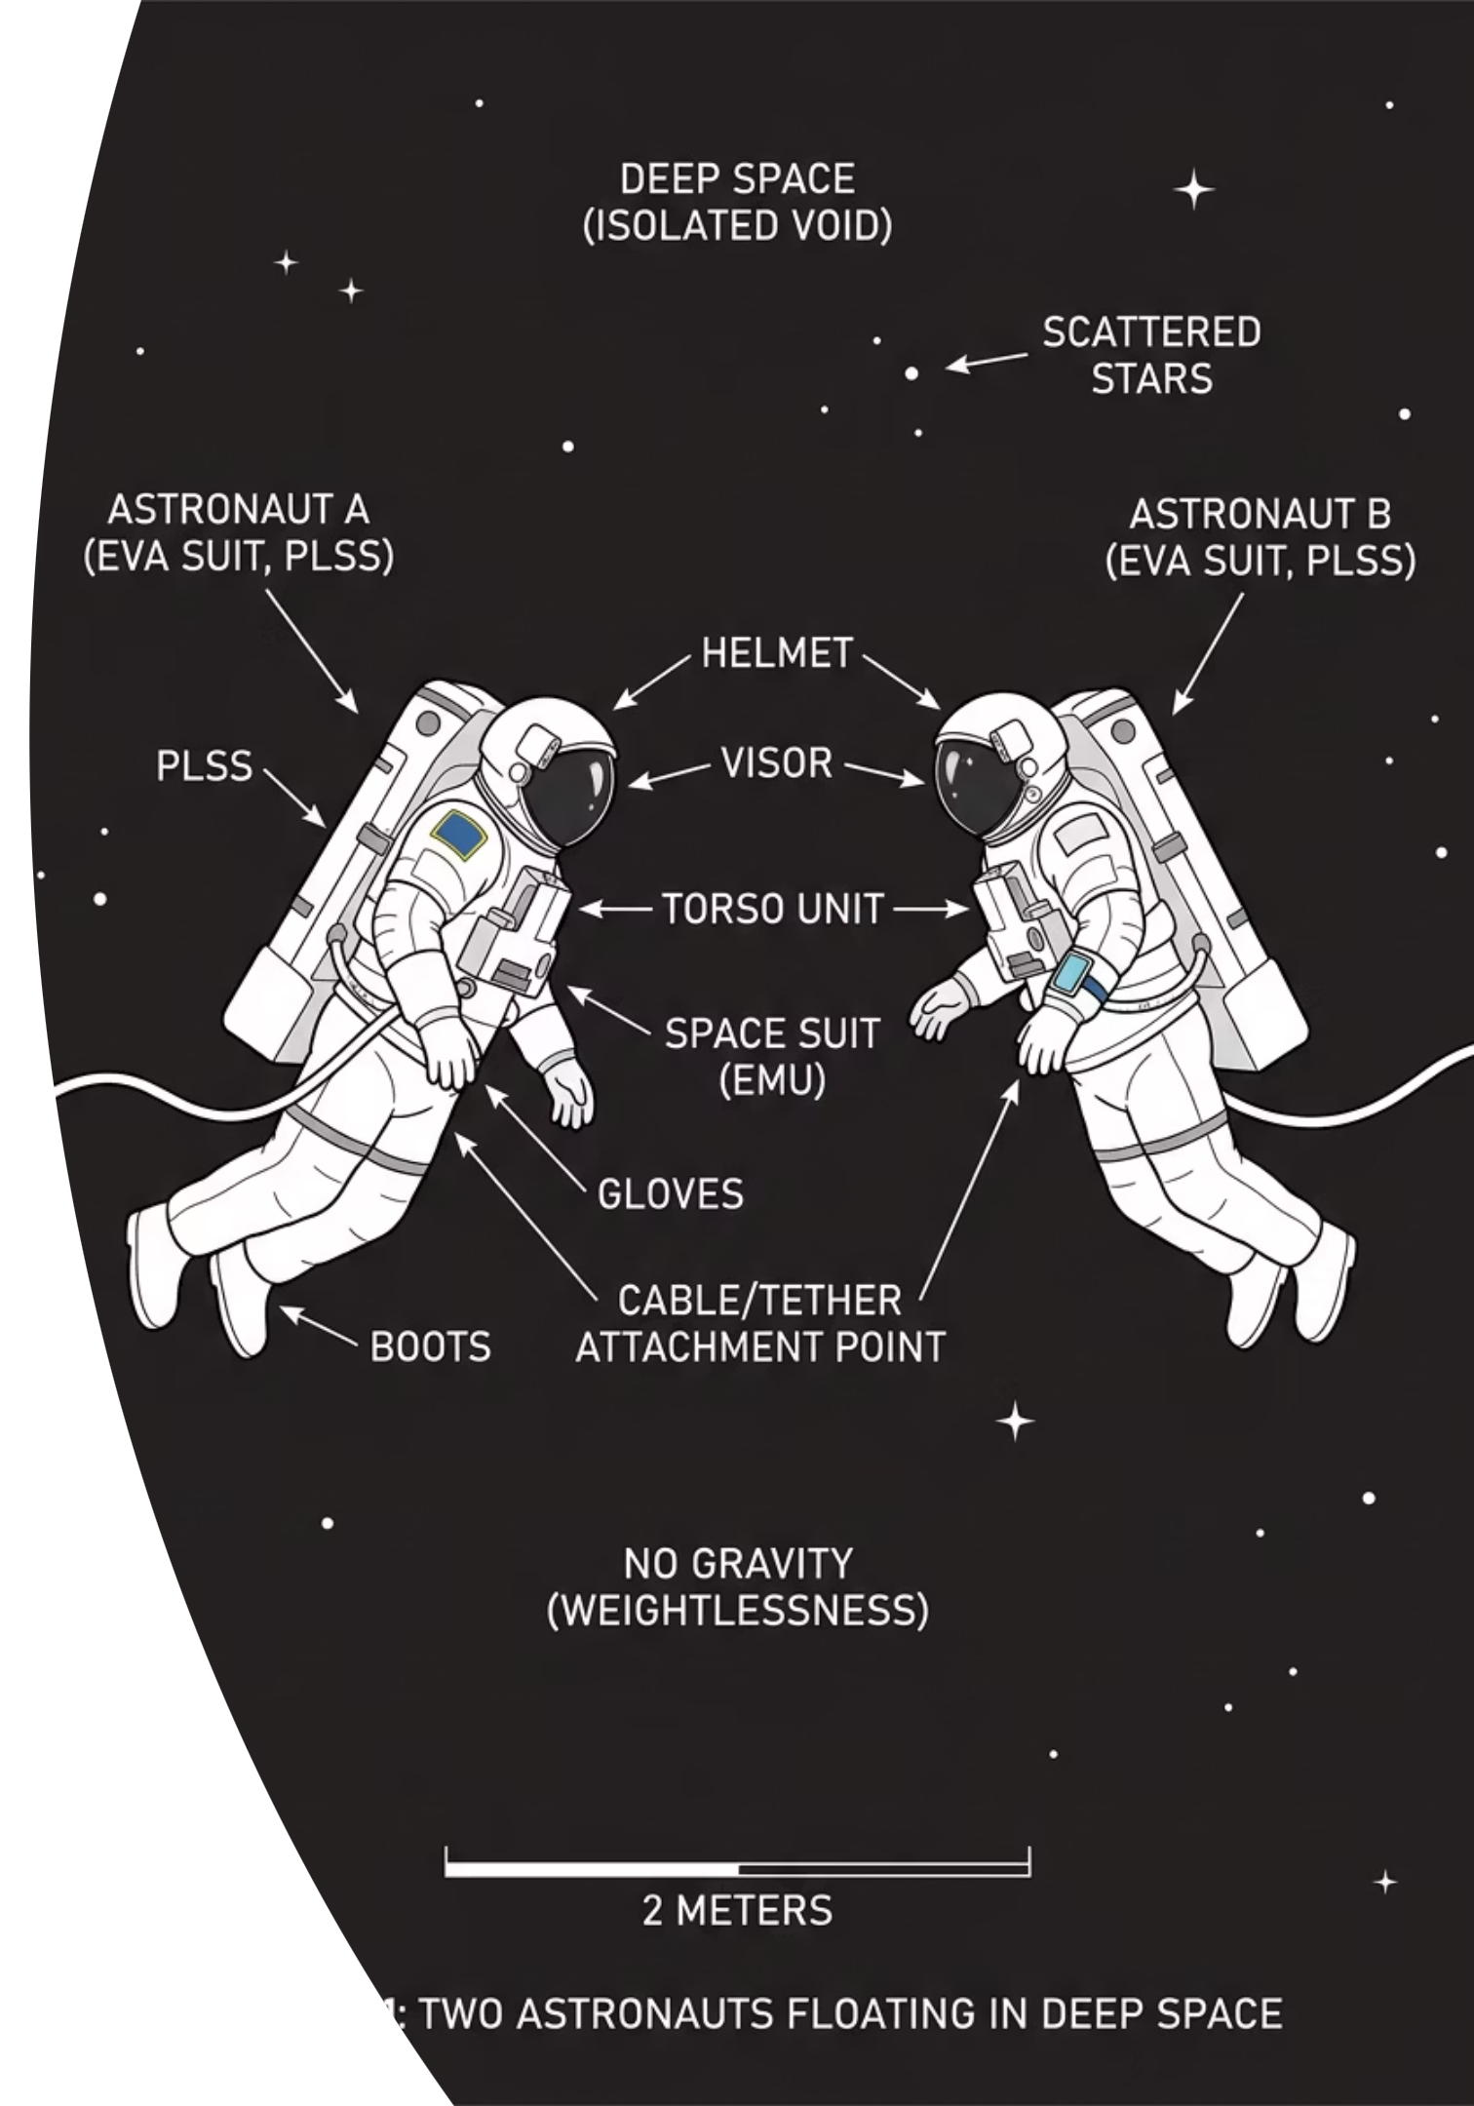
Conservation of Momentum and Collisions
Cambridge International AS & A Level Physics 9702
THELUCIDSTEM.COM

Slide 2
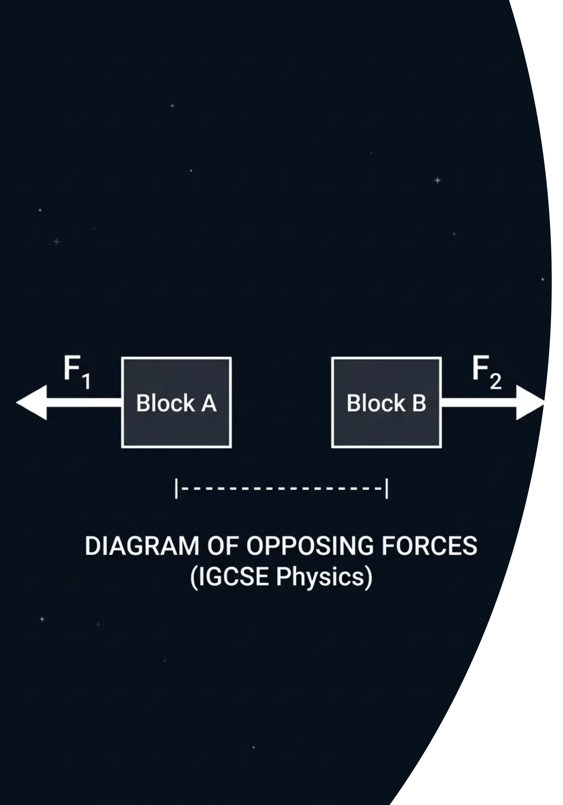

The Perfect Balance
Imagine two astronauts floating perfectly still in deep space, facing each other. Astronaut A pushes Astronaut B forcefully away. Astronaut B moves backward, but Astronaut A is also thrown backward in the exact opposite direction.
Think silently: If they started with zero combined motion, how can they both be moving? Today we will see that the total motion of the universe is locked in a strict mathematical balance.
@thelucidstem.com

Slide 3
Topic: Conservation of Momentum
By the end of this AS Level lesson, you will be able to:
1
2
State the Principle
Apply the Maths
State the principle of conservation of momentum and the condition required for it to apply.
Apply conservation of momentum to collisions and explosions in one dimension.
3
4
Classify Collisions
Relative Speed Rule
Distinguish elastic and inelastic collisions using kinetic energy as the test.
Recall that in an elastic collision, the relative speed of approach equals the relative speed of separation.
@thelucidstem.com

Slide 4
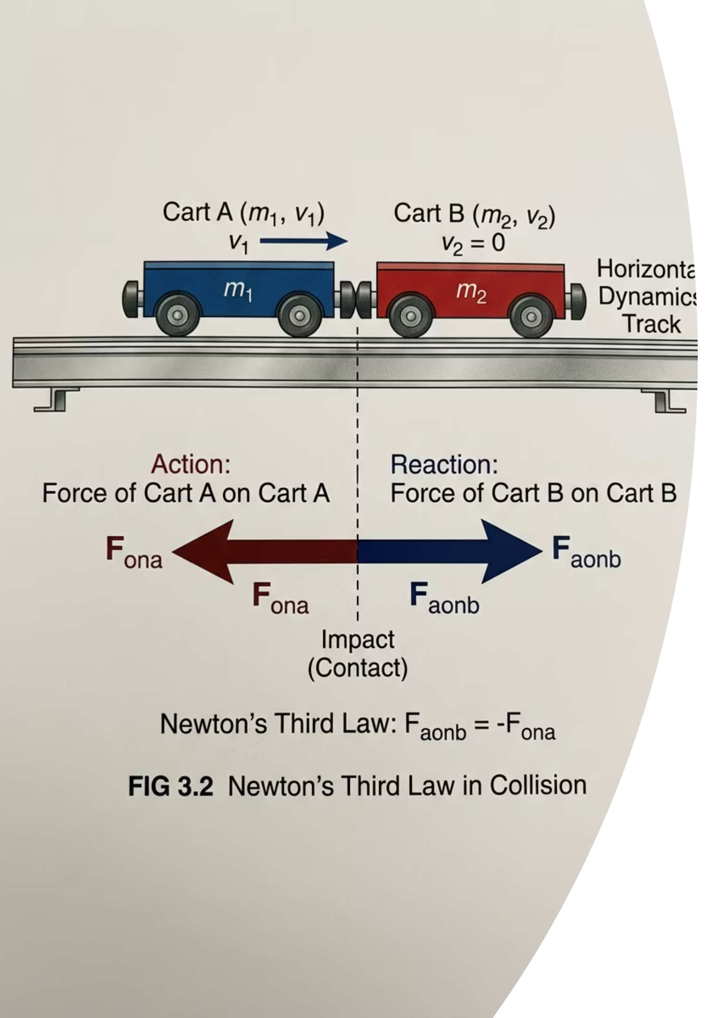
The Principle of Conservation
The total momentum of a system never spontaneously changes.
The Principle
Why It Works
For a closed system with no external resultant force, the total momentum before an interaction equals the total momentum after.
It follows directly from Newton's Third Law. During a crash, two bodies exert equal and opposite forces for the exact same duration of time. They therefore receive equal and opposite impulses, cancelling out any overall change in the total momentum of the system.
@thelucidstem.com

Slide 5
The 1D Equation
To solve a linear collision, write out the momentum of every object before and after the interaction.
m₁u₁ + m₂u₂ = m₁v₁ + m₂v₂
The Golden Rule
Perfectly Inelastic Case
Positive Direction
Always choose a positive direction (typically rightward) and apply it consistently. Any object moving left must be given a negative velocity value.
If two objects collide and stick together, they move as a single combined mass (m₁ + m₂) with one shared final velocity v.
Draw a large horizontal arrow above your working and label it "+ direction" to avoid sign errors throughout your calculation.
@thelucidstem.com

Slide 6
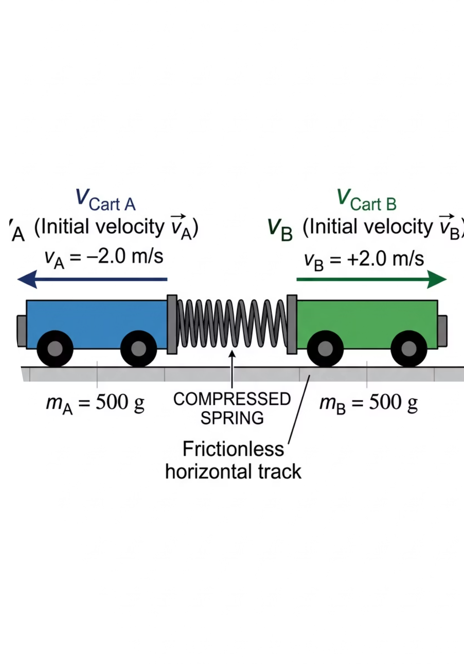



Explosions
An explosion is simply a perfectly inelastic collision played in reverse.
Before
Two objects are locked together at rest. Total momentum of the system = 0 kg m/s.
The Release
A stored energy source, such as a compressed spring or a chemical charge, forces the objects apart.
After
The fragments fly in opposite directions. Their positive and negative momenta cancel exactly, keeping the total at zero.
@thelucidstem.com

Slide 7
Elastic versus Inelastic
Momentum is conserved in every closed system. Kinetic energy, however, is easily lost during a collision.
Elastic Collision
Inelastic Collision
Total kinetic energy before equals total kinetic energy after. This is very rare in macroscopic objects and is mainly observed in collisions between atomic particles.
Total kinetic energy after is less than before. The lost energy is transferred to heat, sound, and the physical deformation of the colliding objects. If the objects stick together, this is called a perfectly inelastic collision.
@thelucidstem.com

Slide 8
Relative Speed
There is a mathematical shortcut to test whether a collision is perfectly elastic, without computing kinetic energy directly.
Speed of Approach = Speed of Separation
What It Means
Worked Example
How to Apply It
How fast the gap between the two objects closes before the collision is exactly equal to how fast that gap widens after the collision.
If object A chases object B and closes the gap at 4.0 m/s, then after a perfectly elastic collision, B must pull away from A at exactly 4.0 m/s.
Calculate (u₁ - u₂) before and (v₂ - v₁) after. If these two values are equal in magnitude, the collision is elastic.
@thelucidstem.com

Slide 9

The Energy Illusion
Examiner Report Warning: These are the most common fatal errors seen in AS Level examinations.
Trap 1: Ignoring Signs
Trap 2: Momentum Is Lost
Trap 3: "Energy is Conserved"
Momentum is a vector. If object A bounces back after a collision, its final velocity must be entered as a negative number in your equation.
Momentum is always conserved in a closed system. Only kinetic energy is lost in an inelastic collision. Never write that momentum is lost.
Total energy is always conserved. For an elastic collision, you must specifically state that kinetic energy is conserved. The word "kinetic" is essential.
@thelucidstem.com

Slide 10

Cooperative Task: Connect, Extend, Challenge
I will give you a reflection sheet. Work through the three boxes alone in total silence, then share with your group.
Connect
Extend
How does conservation of momentum link to Newton's Third Law, which you have already studied?
What genuinely new idea has this lesson added to your understanding of mechanics?
Challenge
What still puzzles you about the relationship between energy and momentum?
Pick your group's single best Challenge question. I will address it for the whole room.
@thelucidstem.com

Slide 11
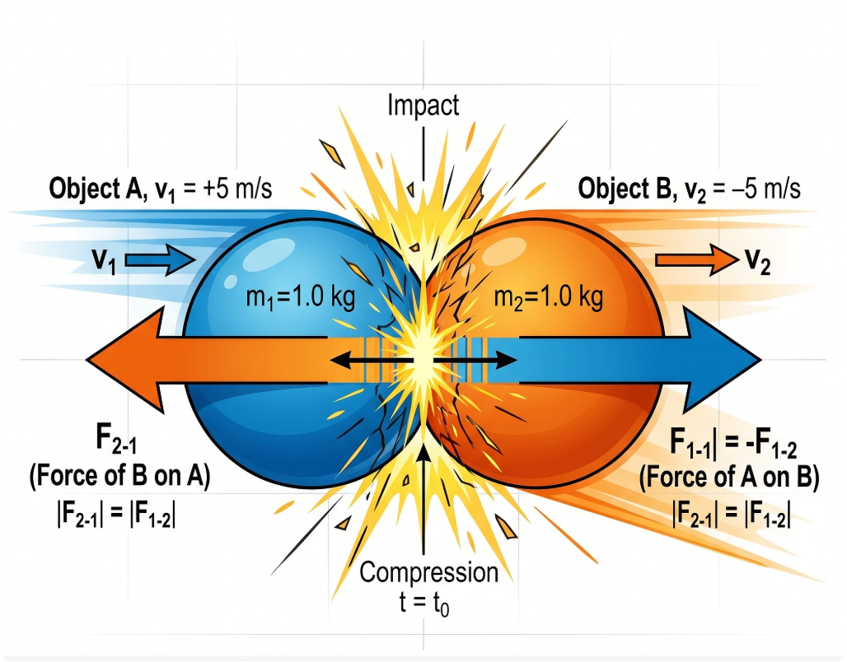
Phase 1: Connect
The Foundation
How did you connect today's lesson to prior knowledge?
Teacher Model: Conservation of momentum is Newton's Third Law expressed mathematically. During any collision, the two bodies push on each other with equal and opposite forces for exactly the same duration of time. They therefore receive equal and opposite impulses, leaving the total sum of momentum completely unchanged.
@thelucidstem.com

Slide 12
Phase 2: Extend
The New Frontier
How did this lesson push your thinking further?
Teacher Model
The Explosion Insight
We learned the critical distinction between momentum and kinetic energy. Momentum is conserved in every closed collision without exception. Kinetic energy is conserved only in a perfectly elastic collision.
Explosions are the exact reverse of an inelastic collision. Kinetic energy is created from a stored chemical or mechanical source, while the total momentum of the system remains at zero throughout the event.
@thelucidstem.com

Slide 13

Phase 3: Challenge
The Unresolved
The Question: If two trolleys stick together and slow down, where does the kinetic energy go, and why is momentum still conserved?
Where the Energy Goes
Why Momentum Is Still Conserved
The lost kinetic energy is converted into heat, sound, and the permanent physical deformation of the trolleys at the point of contact. Energy is never destroyed; it simply changes form.
The forces acting during the crash are all internal to the system. Internal forces cancel each other out in pairs and cannot change the overall total momentum of the closed system.
@thelucidstem.com

Slide 14

Prove It.
Silence in the room. Return to your desks and complete this independently before you leave.
1
2
Calculation Question
Recall Question
A 3.0 kg trolley moving at 4.0 m/s collides with a stationary 2.0 kg trolley. They stick together. Find their exact common final velocity, stating your positive direction clearly.
State clearly which physical quantity is always conserved in a closed system, and which quantity is conserved only in a perfectly elastic collision. Use precise scientific language.
Both questions must be answered in full before you leave the room. Show all working for the calculation, including units.
@thelucidstem.com

