Slide 1
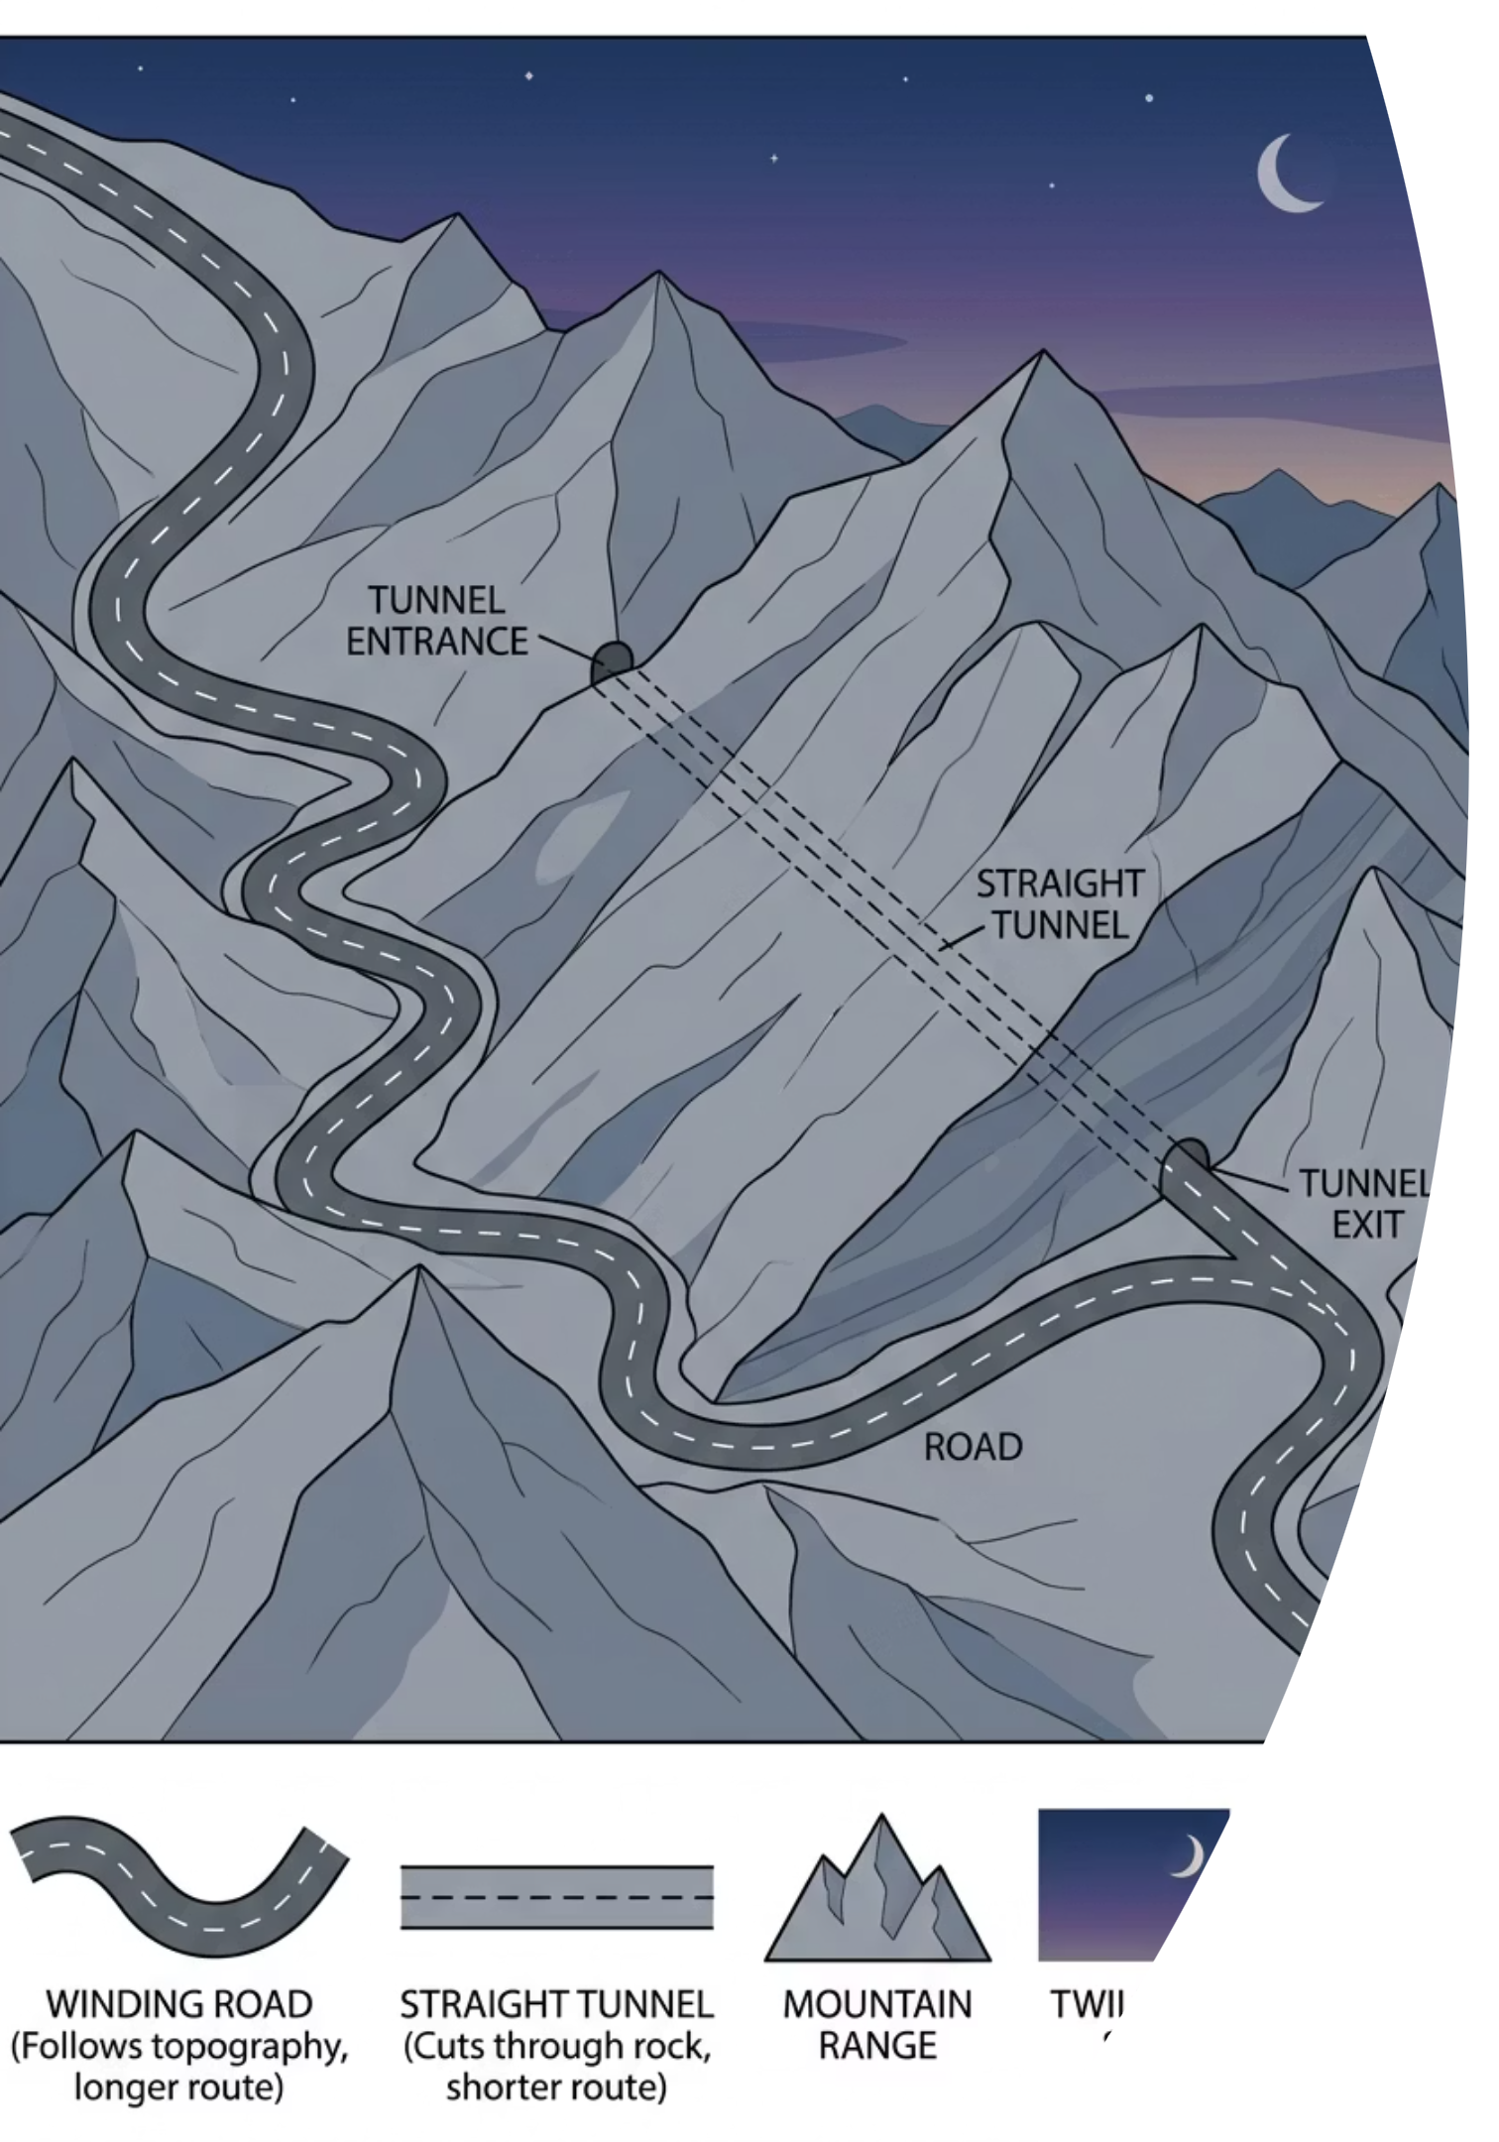
Displacement, Velocity and Acceleration
Cambridge International AS & A Level Physics 9702
thelucidstem.com

Slide 2
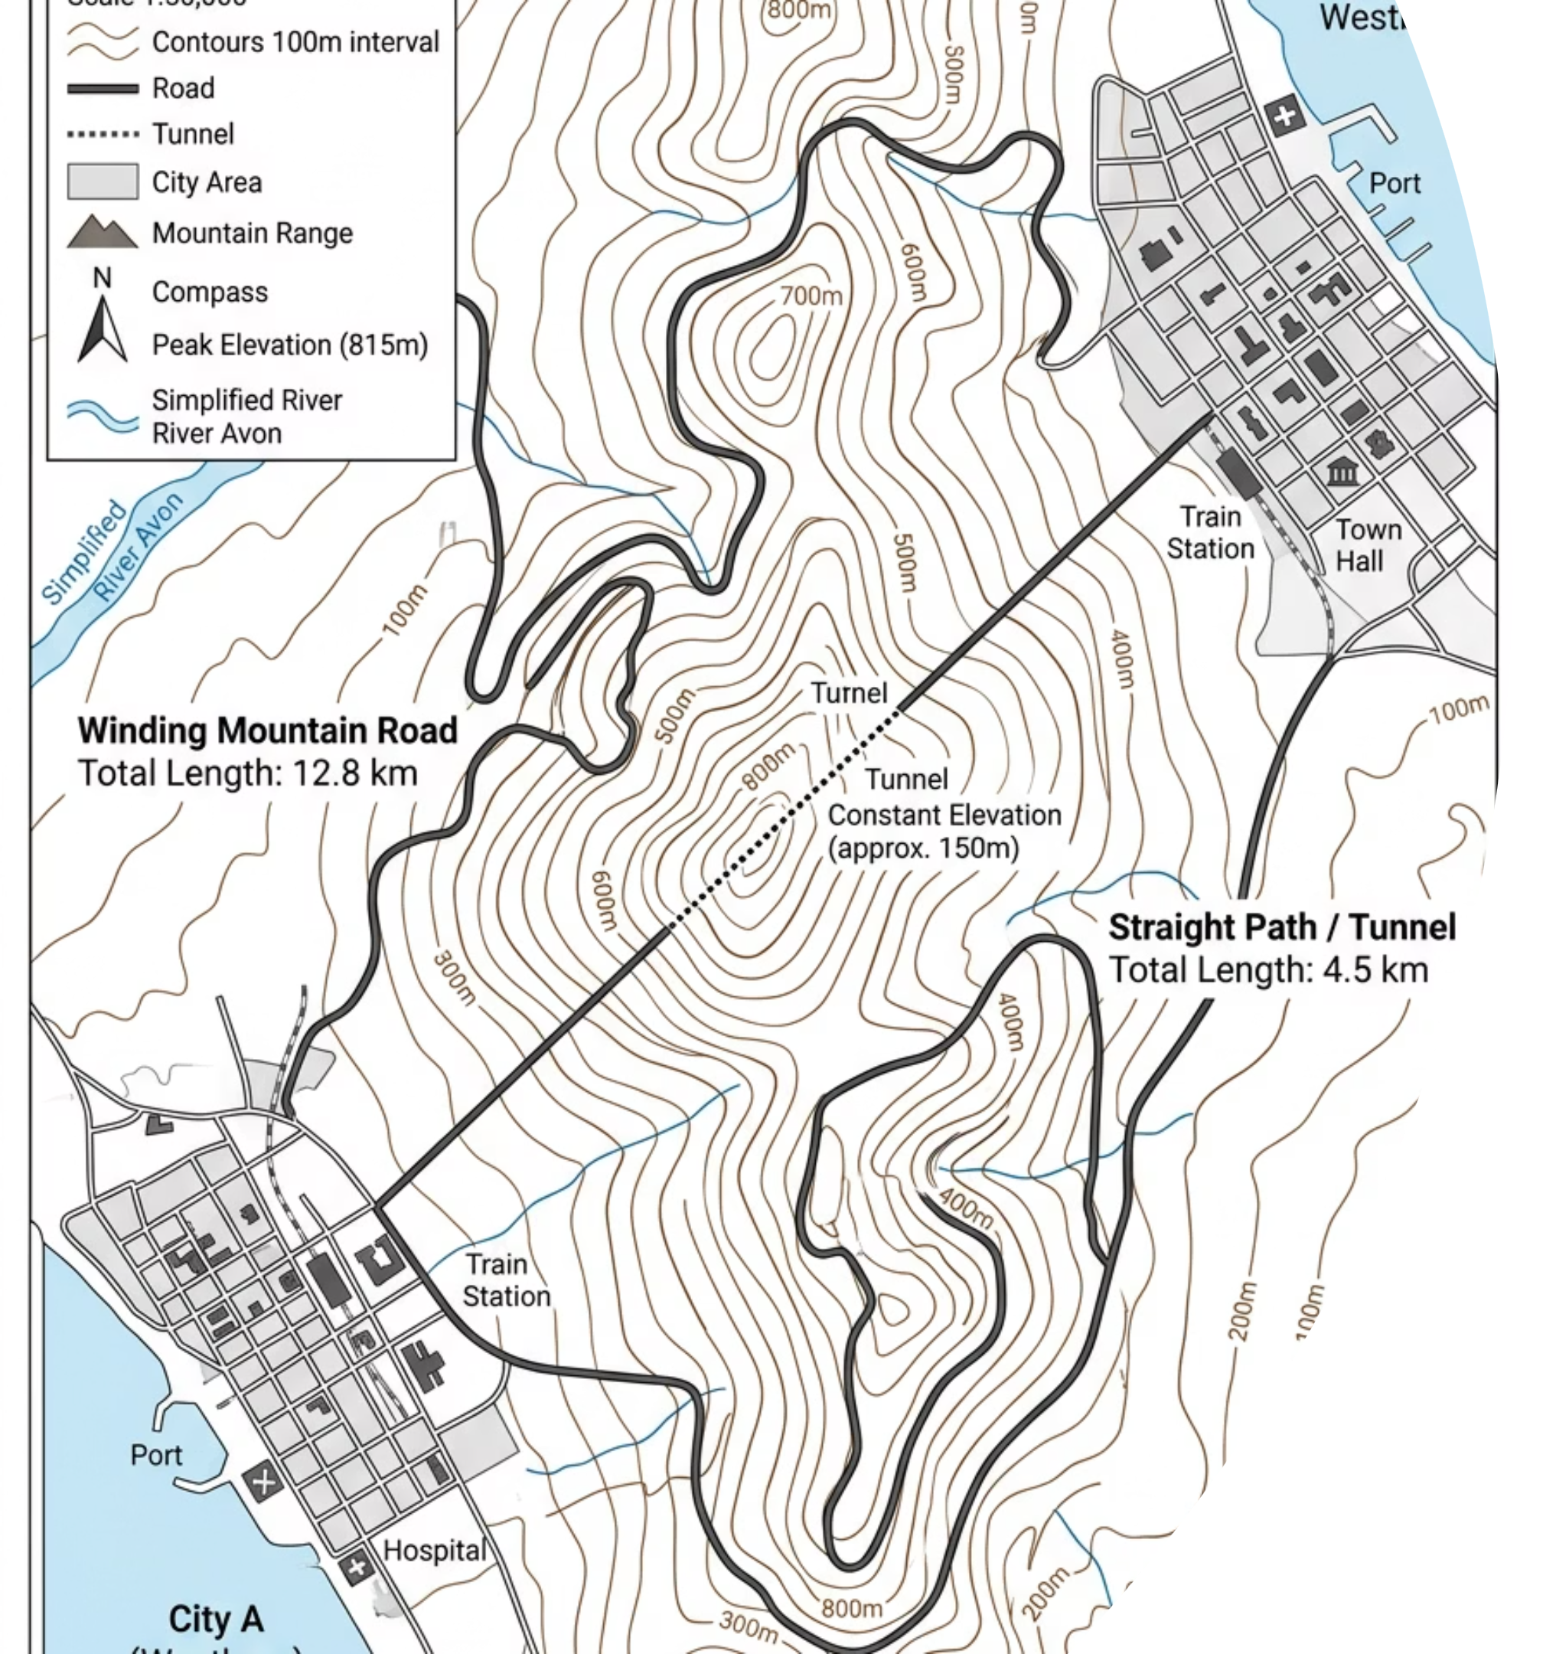

The Two Paths
Imagine travelling from City A to City B over a mountain range. These two routes reveal a fundamental distinction in physics.
The Winding Road
The Straight Tunnel
The total length of the road you actually drive is the distance. It depends on the path taken and is always a positive scalar quantity.
A straight line bored directly from A to B, regardless of terrain, is the displacement. It has both magnitude and direction.
Think silently: If you drive the winding road and return exactly to your starting point, what is your total distance, and what is your total displacement?
thelucidstem.com

Slide 3
Topic: Kinematics and Motion Graphs
AS LEVEL LEARNING OBJECTIVES
By the end of this lesson, you will be able to:
01
02
03
Scalars vs Vectors
Define Acceleration
Average vs Instantaneous
Distinguish distance from displacement, and speed from velocity.
State acceleration precisely as the rate of change of velocity.
Distinguish between average and instantaneous values of velocity and acceleration.
04
05
Read Motion Graphs
The Tangent Method
Extract velocity from displacement-time gradients; find acceleration and displacement from velocity-time graphs.
Find an instantaneous velocity from the gradient of a tangent drawn to a curve.
thelucidstem.com

Slide 4
Scalars and Vectors
Every quantity in kinematics must be classified. Scalars have magnitude only; vectors carry both magnitude and direction.
Quantity
Definition
Type
SI Unit
Distance
Total path length travelled along any route
Scalar
m
Displacement
Straight-line distance and direction from start to end point
Vector
m
Speed
Distance travelled per unit time
Scalar
m s-1
Velocity
Displacement per unit time, with direction
Vector
m s-1
Acceleration
Rate of change of velocity over time
Vector
m s-2
thelucidstem.com

Slide 5
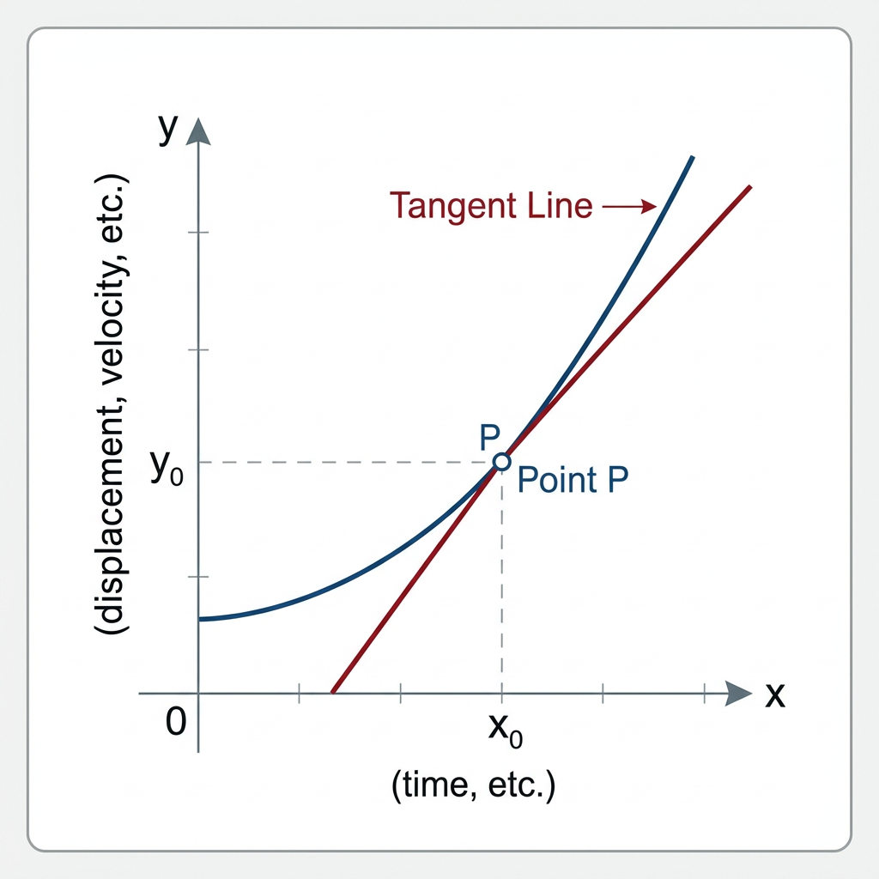
The Tangent to the Curve
Velocity and acceleration can vary continuously. Physics distinguishes two ways to measure any changing quantity.
Average Value
Calculated over an entire time interval. Use the overall change in displacement (or velocity) divided by the total time elapsed.
Instantaneous Value
The value at one precise moment. On a curving graph, draw a straight tangent line that touches the curve at exactly that point, then calculate the gradient of that tangent.

Slide 6
Reading the Axes
Memorise what gradient and area represent on each graph type. These rules are the foundation of every kinematics calculation.
Displacement-Time Graph
Velocity-Time Graph
Gradient = Velocity
A steep slope means high velocity. A flat (horizontal) line means the object is stationary. A curved line means changing velocity.
Area under the line: no standard physical meaning.
Gradient = Acceleration
A positive slope means increasing speed. A flat line means constant velocity (zero acceleration).
Area under the line = Displacement
Count the area carefully, including sign, to determine net displacement.
thelucidstem.com

Slide 7

Examiner Report Warning: These are the most frequently penalised errors in AS Level kinematics papers.
The Shape Illusions
Trap 1: The Straight Line Assumption
Trap 2: Drawing a Poor Tangent
Misconception: A straight upward line on any graph must mean the object is accelerating.
Correction: It depends entirely on which quantity is on the y-axis. On a displacement-time graph, a straight line means constant velocity. On a velocity-time graph, it means constant acceleration.
Misconception: Any line crossing through the curve is sufficient as a tangent.
Correction: A valid tangent must be a single straight line that touches the curve at only one point, with equal space between the line and the curve on both sides of that point. Practise this in every question.
thelucidstem.com

Slide 8
Cooperative Task: Corners
An active learning protocol to test your understanding of motion graphs.
1
2
Find Your Corner
Read the Graph
The four corners are labelled: At rest, Constant velocity, Speeding up, Slowing down.
A graph description will be presented. Move immediately to the corner you believe matches the motion shown.
3
4
Discuss and Agree
Defend Your Answer
Talk with others at your corner. Agree on the best physical reasoning for your choice before being called upon.
One person from each corner will be asked to explain their reasoning to the whole class.
thelucidstem.com

Slide 9
ROUND 1
Round 1: Velocity-Time
Examine the graph description carefully, then move to your corner.
The Graph
Your Options
This is a velocity-time graph.
The line is perfectly horizontal, positioned above the zero axis on the y-axis.
The line does not slope upward or downward at any point.
At rest
Constant velocity
Speeding up
Slowing down
Move to your corner now. Discuss your reasoning with the group before the answer is revealed.
thelucidstem.com

Slide 10
ROUND 1 ANSWER
Round 1: Answer
Constant Velocity
Reasoning
Key Formula
The y-axis shows velocity. A flat, horizontal line means the velocity value is not changing over time. The gradient is zero, confirming zero acceleration. The object moves at a steady, unchanging speed in a fixed direction. It is not speeding up, slowing down, or stationary.
Zero gradient on a velocity-time graph always means zero acceleration.
thelucidstem.com

Slide 11
ROUND 2
Round 2: Displacement-Time
Examine the graph description carefully, then move to your corner.
The Graph
Your Options
This is a displacement-time graph.
The line is a straight line sloping steadily upward from the origin.
The slope does not change at any point along the line.
At rest
Constant velocity
Speeding up
Slowing down
Remember: which graph type are you looking at? That changes everything.
thelucidstem.com

Slide 12
ROUND 2 ANSWER
Round 2: Answer
Constant Velocity
Reasoning
Key Formula
On a displacement-time graph, the gradient equals velocity. A straight line has a constant gradient, which means a constant velocity. Many students incorrectly choose "speeding up" because the line rises. This is Trap 1 from the Examiner's Warning. Always check the y-axis label first.
A constant gradient means the velocity is not changing: zero acceleration.
thelucidstem.com

Slide 13
ROUND 3
Round 3: The Curve
This is the most challenging round. Read carefully before moving.
The Graph
Your Options
This is a displacement-time graph.
The line is a curve that starts steep and flattens, becoming nearly horizontal over time.
The curve never actually reverses direction.
At rest
Constant velocity
Speeding up
Slowing down
Think about what the gradient is doing as the curve flattens. What does a decreasing gradient mean on this graph?
thelucidstem.com

Slide 14
ROUND 3 ANSWER
Round 3: Answer
Slowing Down
Reasoning
The Tangent Test
On a displacement-time graph, the gradient represents velocity. As the curve flattens, the gradient is getting smaller and smaller. A decreasing gradient means a decreasing velocity. The object is losing speed and approaching rest. When the line becomes fully horizontal, the gradient is zero: the object has stopped.
Draw tangents at three points along the curve: early (steep), middle, late (flat). Each successive tangent has a smaller gradient, confirming the velocity is dropping continuously toward zero.
thelucidstem.com

Slide 15
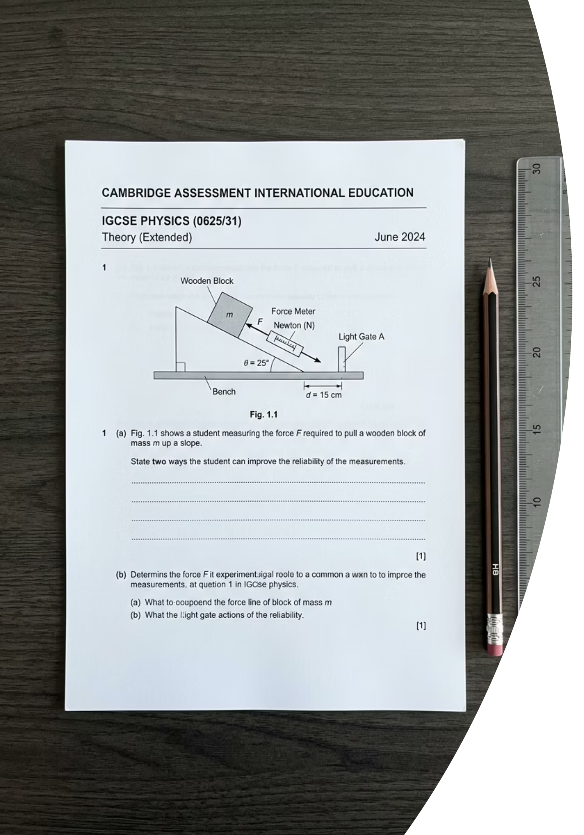
Prove It.
Silence in the room. Return to your desks and complete both questions independently before you leave. Show all working.
Acceleration Calculation
1
A car speeds up from 5.0 m s-1 to 25 m s-1 in 8.0 s. Calculate its acceleration. Give your answer in m s-2 and show all working clearly.
Graph Interpretation
2
A velocity-time graph shows a perfectly horizontal line at 12 m s-1. State the value of the acceleration. Describe the motion of the object fully, including any statement about forces if you can.
thelucidstem.com

