Slide 1
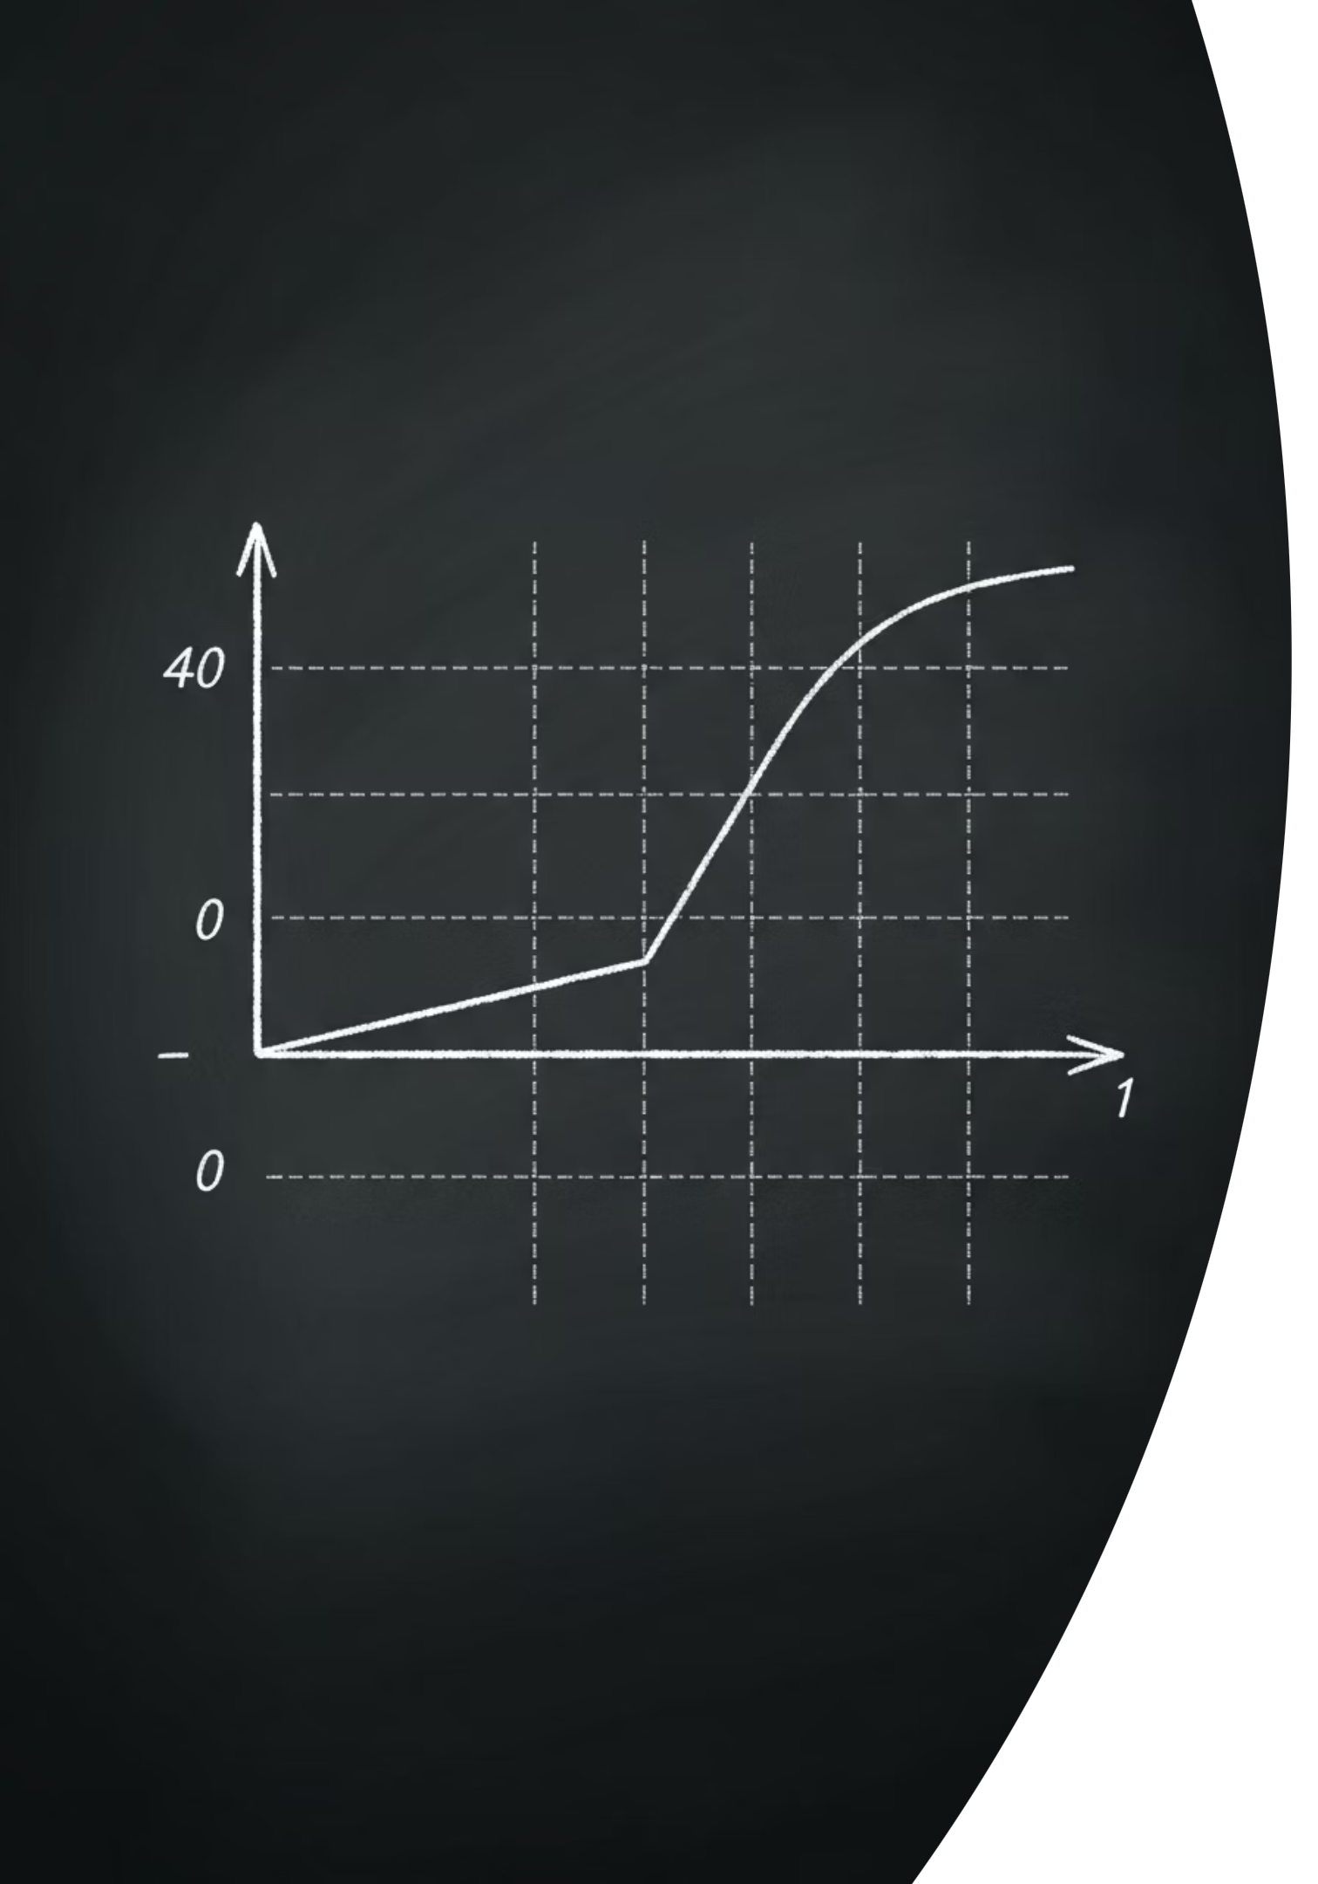
The Foundation of Motion
Every straight-line journey with constant acceleration can be described by just four equations. These equations are not magic -- they all emerge from one simple picture: the velocity-time graph.
Gradient
What physical quantity does the slope of a velocity-time graph represent?
Area
What physical quantity does the area beneath the line represent?
thelucidstem.com

Slide 2
AS & A LEVEL PHYSICS 9702
Topic: The Equations of Motion
By the end of this lesson, you will be able to:
01
02
Recall
Derive
State all four equations for uniformly accelerated motion (suvat).
Derive each equation directly from the velocity-time graph.
03
04
Condition
Select & Apply
State that these equations apply only when acceleration is constant.
Choose the correct equation by identifying the missing quantity, and apply it to problems involving deceleration and sign convention.
thelucidstem.com

Slide 3

The Five Symbols (suvat)
Every kinematics problem involves a combination of these five variables. Every equation we use today contains exactly four of these five symbols.
s
u
v
displacement
metres (m)
initial velocity
m s-1
final velocity
m s-1
a
t
acceleration
m s-2
time
seconds (s)
Every suvat equation omits exactly one of these five quantities. Identifying the missing quantity is the key to selecting the right equation.
thelucidstem.com

Slide 4
The Acceleration Illusions
Examiner Report Warning: These are the most common and most costly errors seen in AS examination scripts. Eliminate them before you sit the paper.
Trap 1: Non-uniform Acceleration
Trap 2: Mixed Sign Conventions
Trap 3: Confusion over Deceleration
Using suvat equations when the acceleration is changing. Correction: These equations hold only for uniform (constant) acceleration. If acceleration varies, a different method is required.
Switching the positive direction mid-problem. Correction: Define one positive direction at the outset and apply it consistently to u, v, a, and s throughout.
Treating deceleration as a special case. Correction: Deceleration is simply an acceleration directed opposite to the velocity. Assign it a negative value and proceed normally.
thelucidstem.com

Slide 5




Cooperative Task: Jigsaw
This lesson uses a structured cooperative learning protocol. Follow each stage carefully -- your home group's success depends on every individual expert.
Form Home Groups
Expert Groups
Sit in groups of four. Each member is assigned one equation: A, B, C, or D.
Leave your home group. Meet all other students assigned your same equation. Master its derivation, conditions, and worked example.
Teach Back
Individual Quiz
Return to your home group. You are now the sole expert on your equation. Teach it clearly to your three teammates.
The session closes with an independent exit ticket. Every member of your group is relying on your teaching.
thelucidstem.com

Slide 6

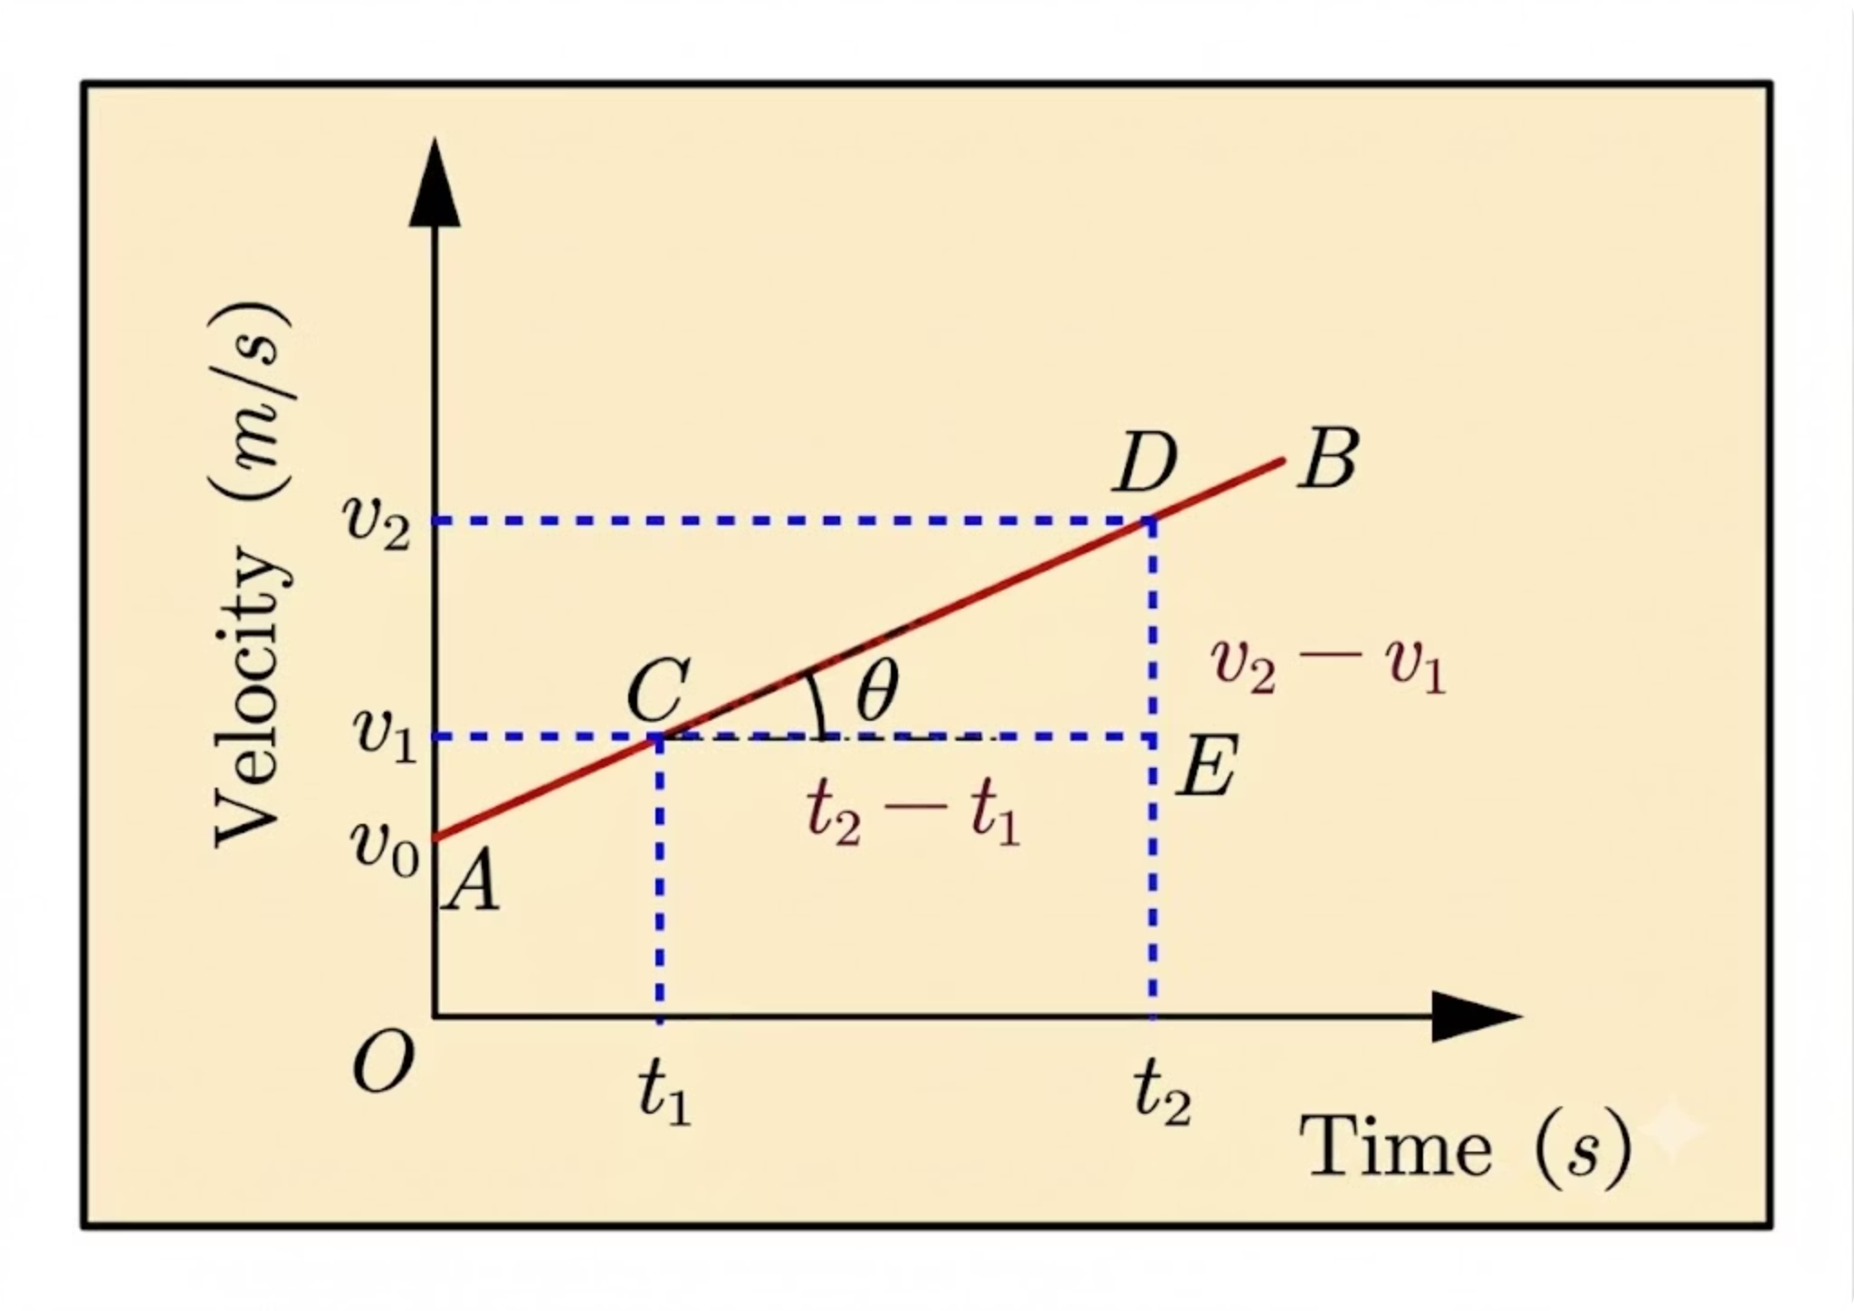
EXPERT CARD A
Equation A: The Gradient
The Equation:
Derivation: Acceleration is defined as the gradient of the velocity-time graph:
Rearranging gives v = u + at directly.
When to use it: Use this equation when displacement (s) is not involved in the problem.
Worked Example: A particle has u = 10 m s-1, a = 2.0 m s-2, t = 5.0 s. Find v.
v = 10 + (2.0)(5.0) = 20 m s-1
thelucidstem.com

Slide 7
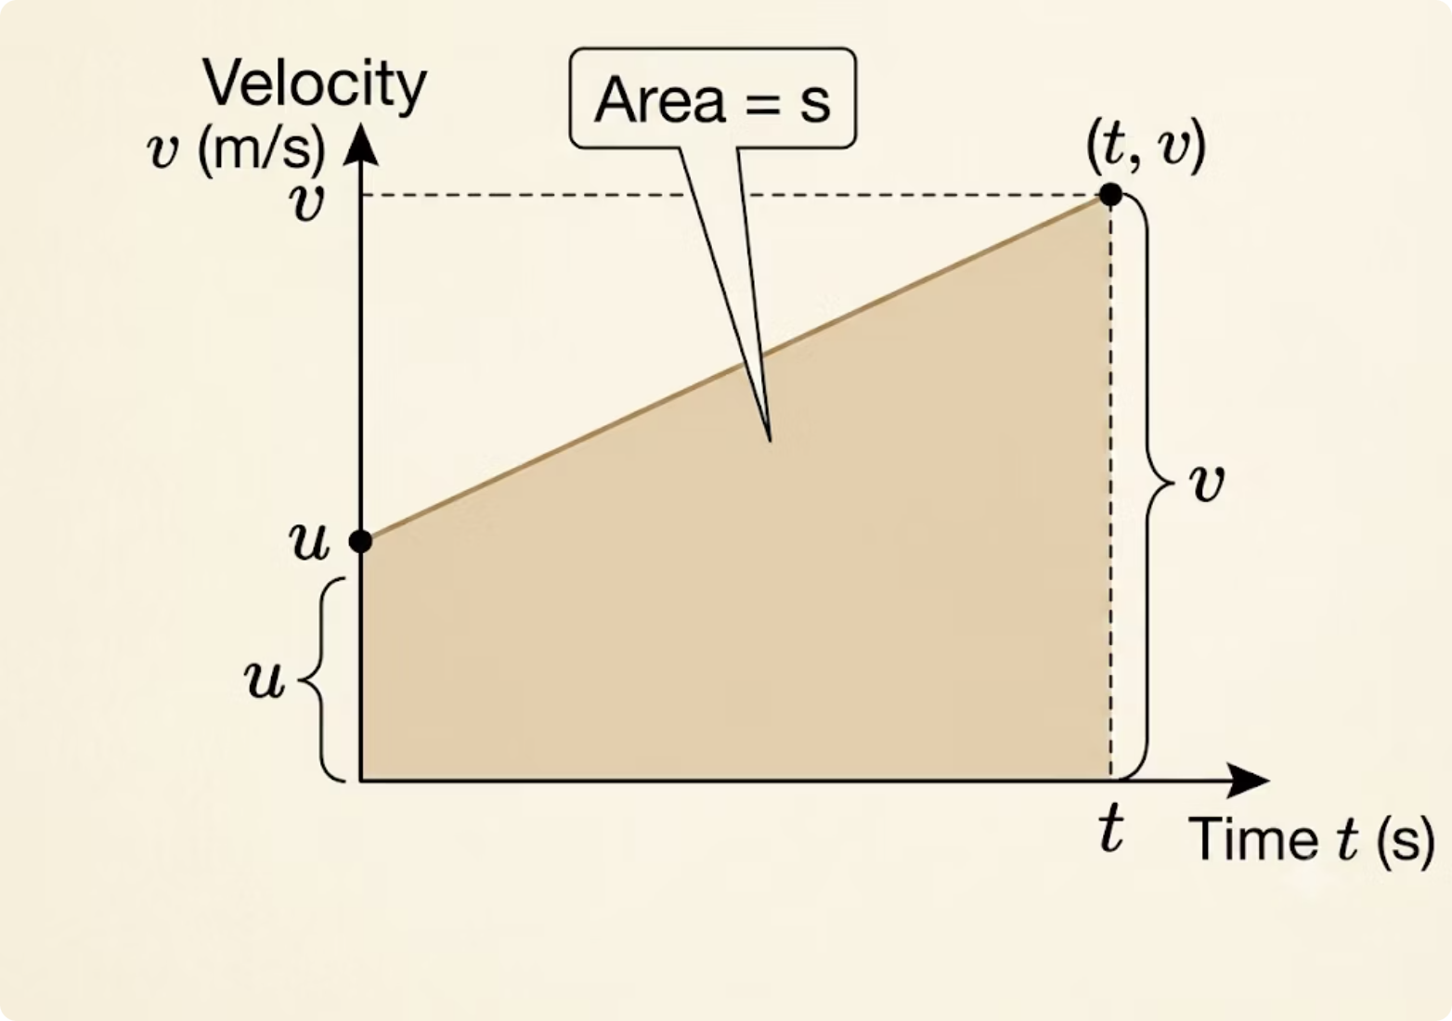
EXPERT CARD B
Equation B: The Area
The Equation:
Derivation: Displacement equals the area beneath the velocity-time graph. The shape formed is a trapezium with parallel sides of length u and v, and a width of t:
When to use it: Use this equation when acceleration (a) is not involved in the problem.
Worked Example: u = 4.0 m s-1, v = 10 m s-1, t = 8.0 s. Find s.
s = (1/2)(4.0 + 10)(8.0) = 56 m
thelucidstem.com

Slide 8
EXPERT CARD C
Equation C: Substitution
The Equation:
Derivation: Begin with the area equation from Card B. Substitute v = u + at (from Card A) in place of v:
When to use it: Use this equation when final velocity (v) is not involved in the problem.
Worked Example: u = 0, a = 3.0 m s-2, t = 5.0 s. Find s.
s = 0 + (1/2)(3.0)(25) = 37.5 m
thelucidstem.com

Slide 9
EXPERT CARD D
Equation D: Eliminating Time
The Equation:
Derivation: From Card A, express time as:
Substitute this expression for t into the area equation from Card B. Simplify to eliminate t entirely, yielding v2 = u2 + 2as.
When to use it: Use this equation when time (t) is not involved in the problem.
Worked Example: u = 2.0 m s-1, a = 4.0 m s-2, s = 4.0 m. Find v.
v2 = 4 + 2(4.0)(4.0) = 36, so v = 6.0 m s-1
thelucidstem.com

Slide 10
How to Choose the Right Equation
Never guess. Follow this strict, systematic method every time.
01
02
03
List all five symbols
Fill in known values
Mark the target
Write s, u, v, a, t vertically down the side of your working.
Assign the three given quantities to their correct symbols, taking care with signs.
Place a question mark next to the quantity you are required to find.
04
05
Cross out the blank
Select the equation
The symbol with no value and no question mark is the missing quantity. Cross it out.
Choose the suvat equation that does not contain the crossed-out symbol. That is your equation.
thelucidstem.com

Slide 11

Prove It.
Complete the following independently and in silence before leaving. Show all working, including your suvat list for each question.
Question 1
A train accelerates from 12 m s-1 at 0.50 m s-2 for 20 s. Find its final velocity.
Question 2
A cyclist speeds up from 4.0 m s-1 to 10 m s-1 in 8.0 s. Find the distance travelled.
Question 3
A car starts from rest and accelerates at 3.0 m s-2 for 5.0 s. Find the distance travelled.
Question 4
A ball moving at 2.0 m s-1 accelerates uniformly over 4.0 m to reach 6.0 m s-1. Find the acceleration.
thelucidstem.com

