Slide 1
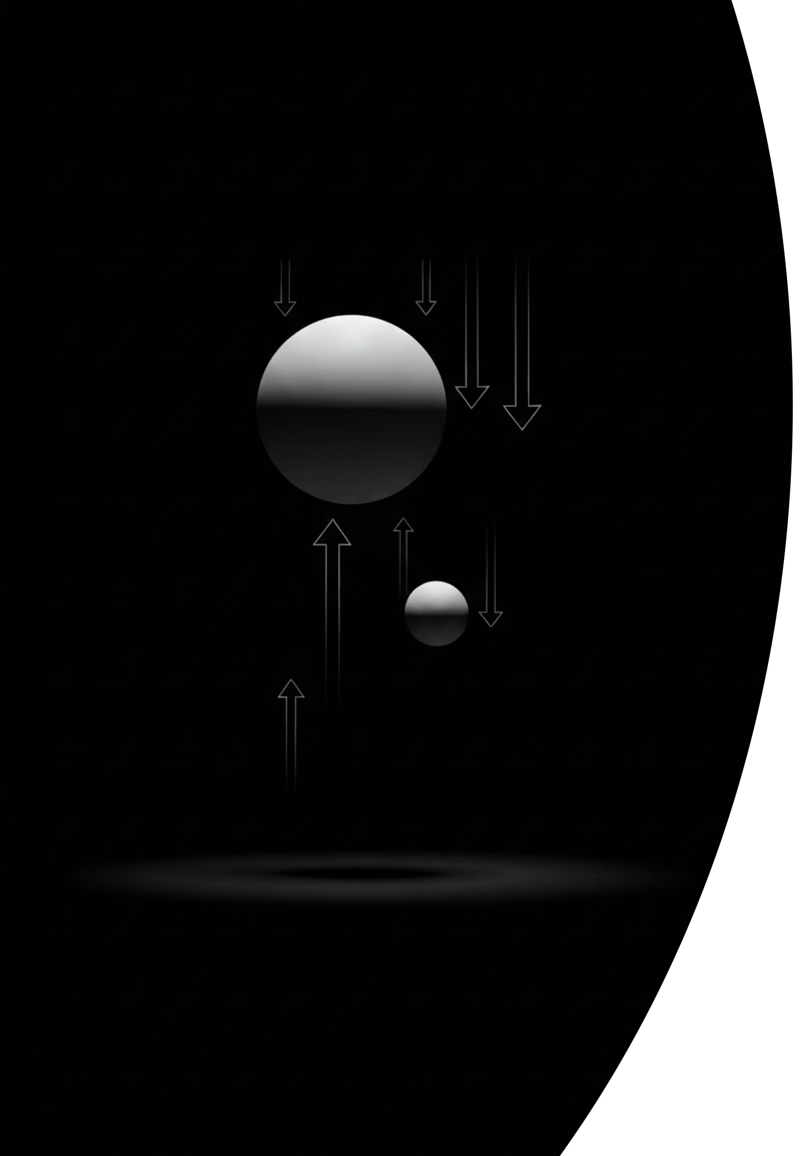
Free Fall and the Acceleration of Free Fall
Cambridge International AS & A Level Physics 9702
thelucidstem.com

Slide 2
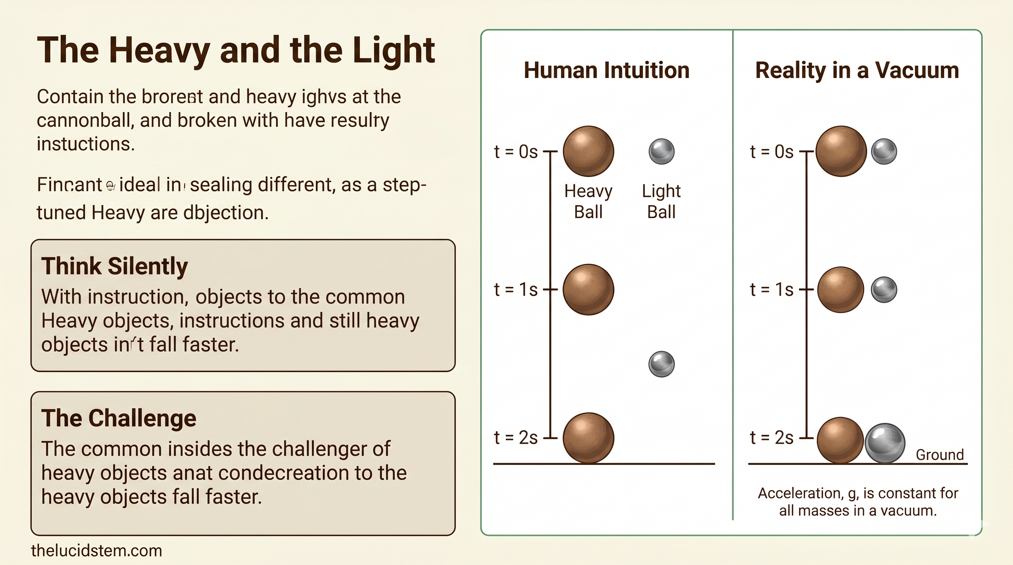

Slide 3
Topic: Motion Under Gravity
By the end of this AS Level lesson, you will be able to:
01
02
03
Define Free Fall
Independence of Mass
Apply SUVAT Equations
State that g is the acceleration of free fall, approximately 9.81 m/s2, directed downward.
State that with no air resistance, all objects fall with the exact same acceleration regardless of mass.
Use the equations of motion for vertical problems with a consistent sign convention.
04
05
Solve Problems
Describe the Experiment
Tackle dropped objects and objects projected vertically upward.
Outline the trapdoor and electromagnet method to determine g in the laboratory.
thelucidstem.com

Slide 4
The Definition of Free Fall
Free fall is motion under gravity alone, with absolutely no air resistance.
The Acceleration
Key Implications
g = 9.81 m/s²
The value of g does not depend on the mass of the falling object.
A heavy and a light object released together in a vacuum reach the ground at exactly the same time.
The direction of g is always downward, throughout the entire flight.
In a vacuum, this relationship is exact and universal near Earth's surface.
Always directed vertically downward, near the Earth's surface.
thelucidstem.com

Slide 5
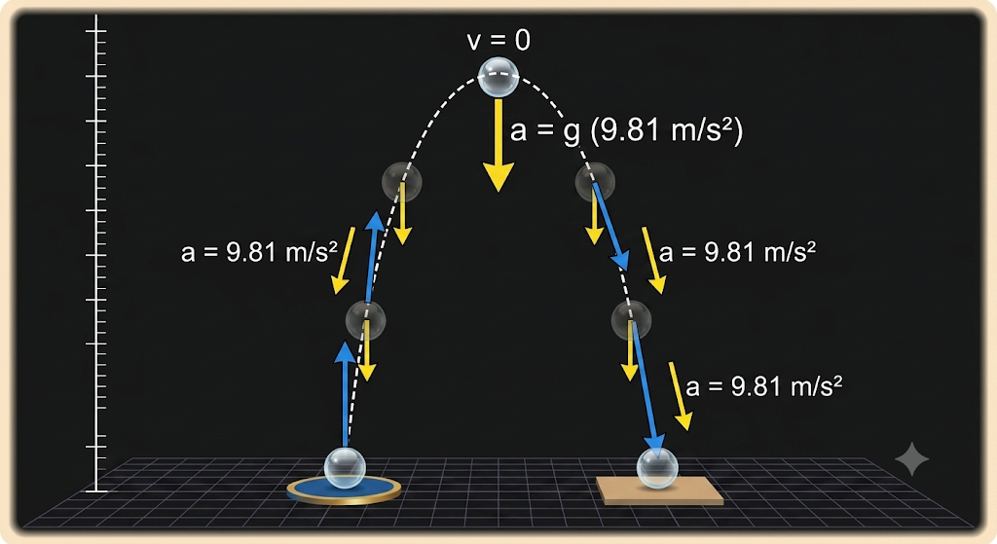
The Peak of the Flight
When an object is thrown vertically upwards in a vacuum, the motion is perfectly symmetric about the highest point.
On the Way Up
The ball decelerates at a steady 9.81 m/s2. Speed decreases uniformly until it reaches zero.
At the Highest Point
Velocity is exactly zero. However, acceleration remains 9.81 m/s2 downward. Gravity does not switch off simply because the object paused for a microsecond.
On the Way Down
The ball accelerates back at exactly 9.81 m/s2. It returns to its launch point with the same speed it had when it left.
thelucidstem.com

Slide 6
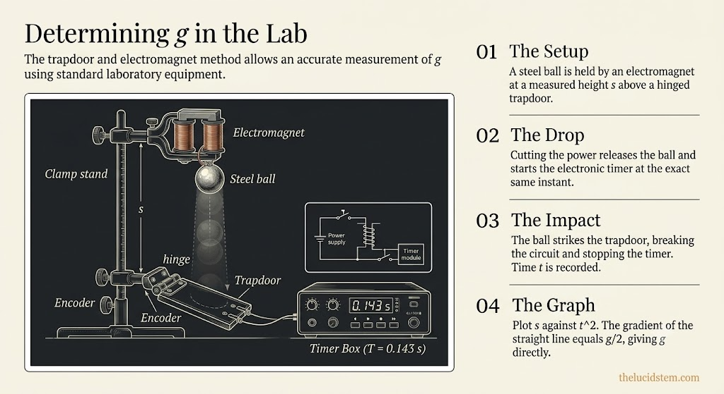

Slide 7
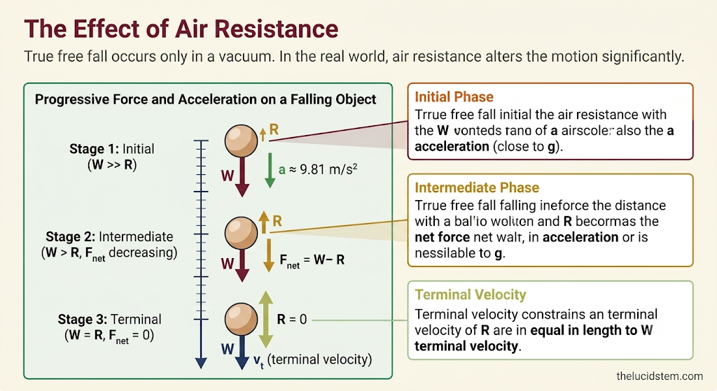

Slide 8
The Top-Point Illusion
Examiner Report Warning: These are the most common fatal errors seen in AS Level examination scripts. Learn to recognise and avoid each one.
Trap 1
Trap 2
Trap 3
Error: Stating that acceleration is zero at the highest point.
Correction: Only velocity is zero. Acceleration remains 9.81 m/s2 downward throughout.
Error: Changing the sign of g halfway through a vertical throw calculation.
Correction: Choose a positive direction at the start and maintain it for the entire flight without switching.
Error: Using g = 10 m/s2 in AS Level calculations.
Correction: At AS Level, you must use g = 9.81 m/s2 unless the question explicitly states otherwise.
thelucidstem.com

Slide 9




Cooperative Task: Anticipation and Reaction
Return to your Anticipation Guide and complete the activity in full. This is an active learning task, not a passive review.
Step 1: Complete
Step 2: Compare
Fill in the After column for all six statements, now that you have studied the physics.
Compare your Before and After columns. Identify where your thinking has changed and where it has been confirmed.
Step 3: Pair
Step 4: Share
Turn to your partner. Discuss which statements caused you to change your mind the most, and explain the physics.
Selected pairs will be asked to explain the reasoning behind the trickiest statements to the class.
thelucidstem.com

Slide 10
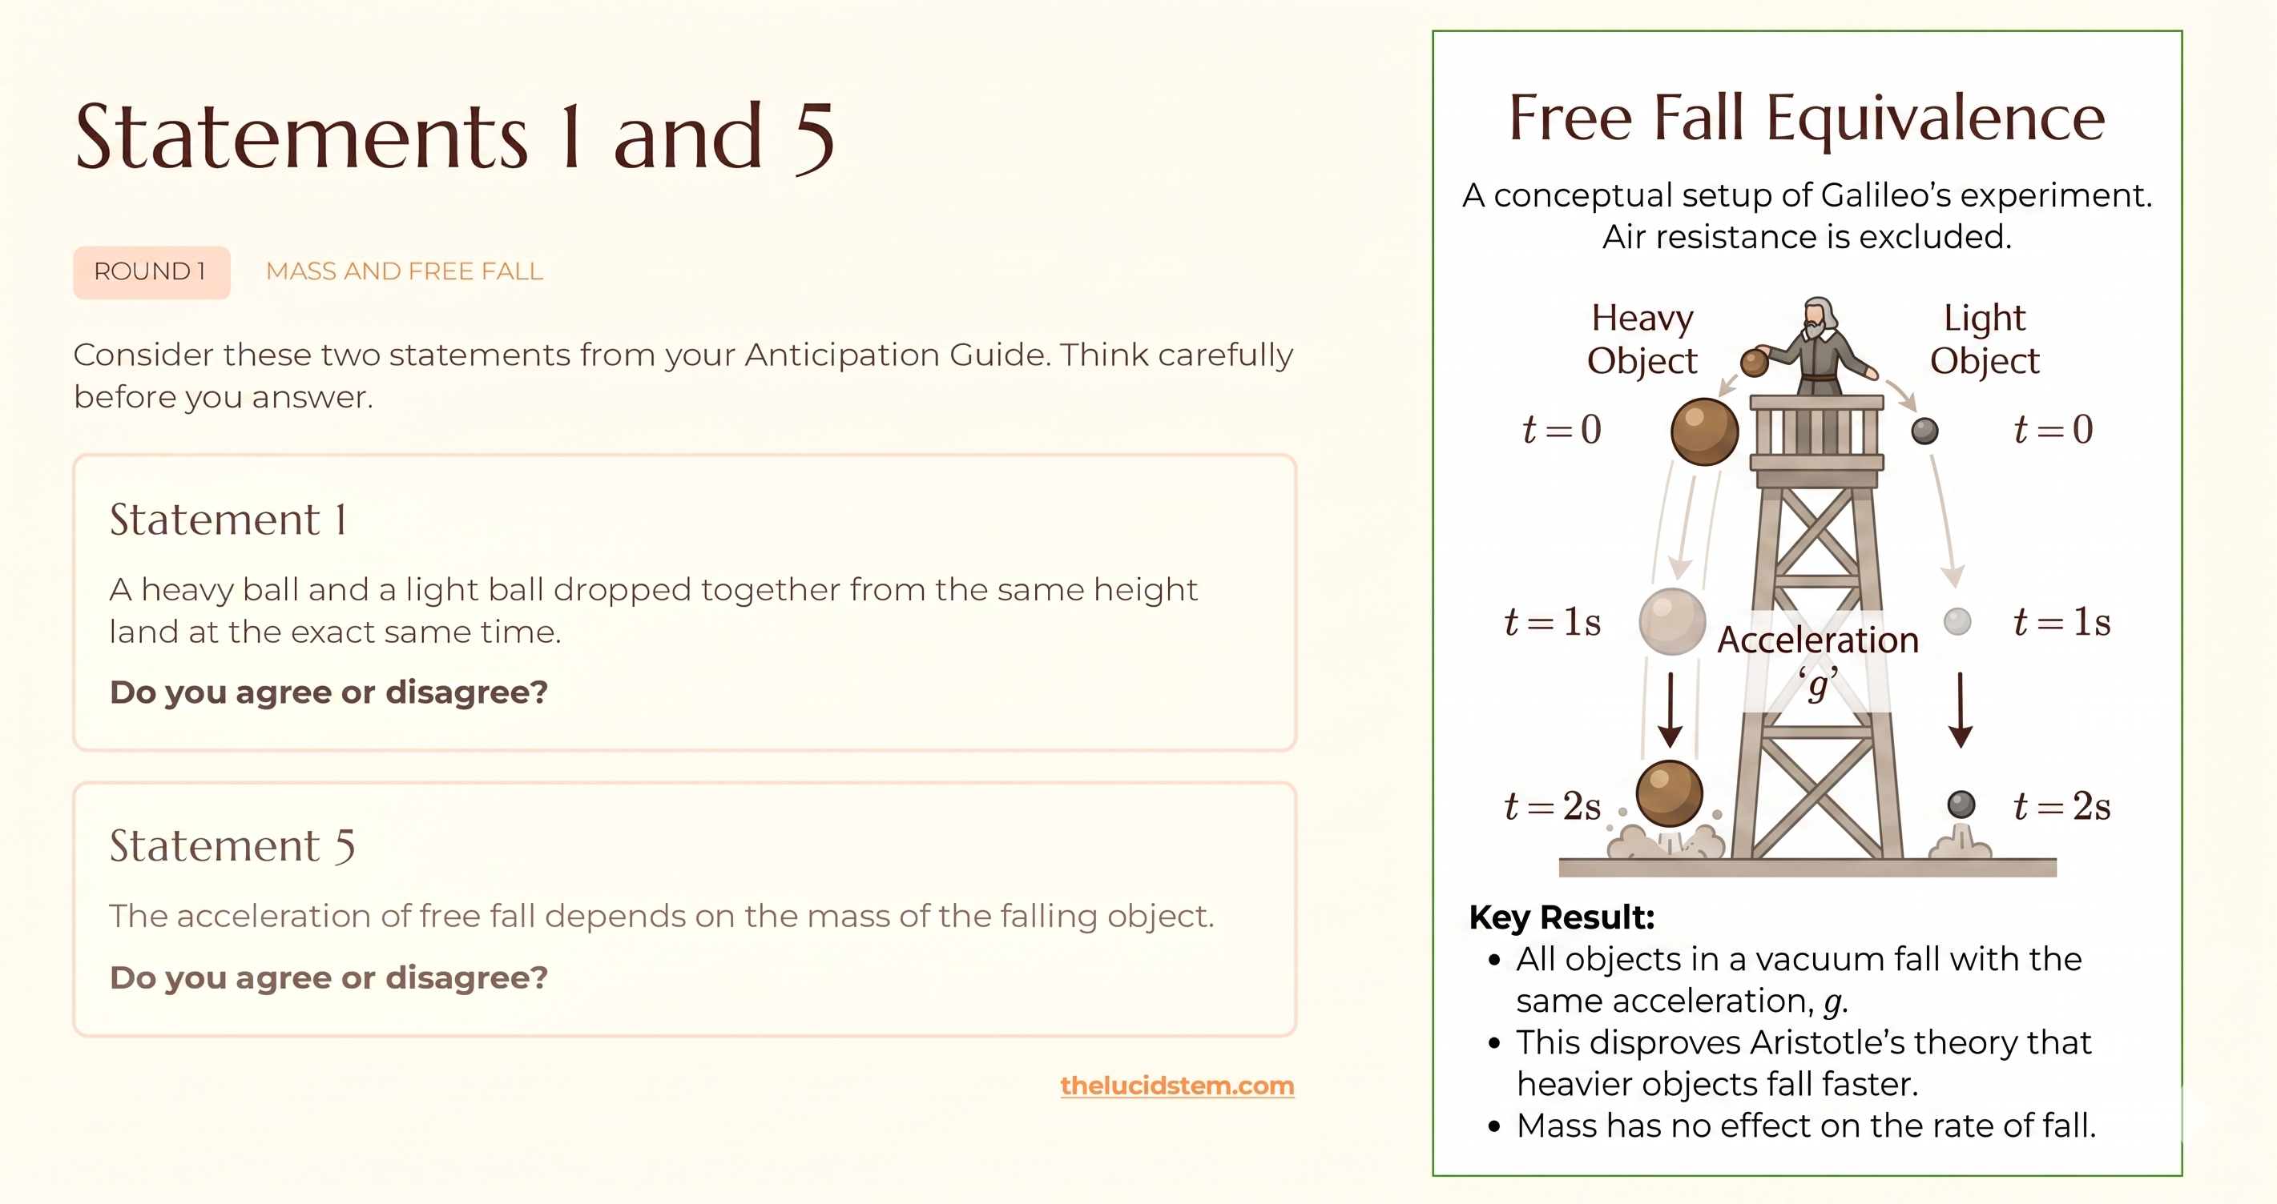
thelucidstem.com

Slide 11

The Truth About Mass
ROUND 1 ANSWER
Statement 1: AGREE
Statement 5: DISAGREE
Without air resistance, both balls experience the same acceleration g = 9.81 m/s2 regardless of their mass. They fall together and land simultaneously. This was demonstrated by Galileo and confirmed in vacuum experiments repeatedly.
The acceleration of free fall is identical for all masses. A 10 kg ball and a 0.01 kg ball fall with exactly the same acceleration in a vacuum. Mass does not appear in the equation a = g.
Key principle: In a vacuum, g = 9.81 m/s2 for every object, regardless of mass, size, or material.
thelucidstem.com

Slide 12
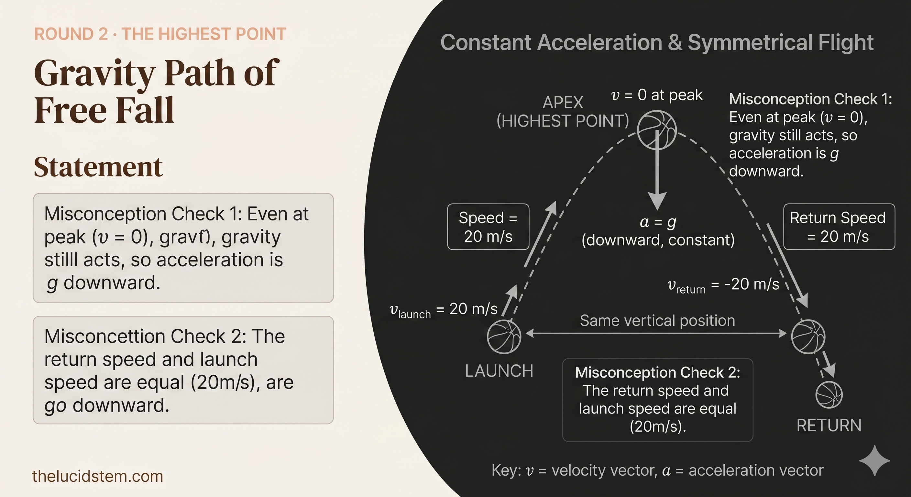
thelucidstem.com

Slide 13

The Truth About The Peak
ROUND 2 ANSWER
Statement 2: DISAGREE
Statement 6: AGREE
The velocity is zero at the top, but acceleration is still 9.81 m/s2 downward. Gravity acts continuously. The object is not in equilibrium; it is instantaneously at rest whilst being accelerated downward.
With no air resistance, the motion is perfectly symmetric. The ball loses 9.81 m/s per second on the way up, and gains 9.81 m/s per second on the way down. It returns to the launch height with exactly 20 m/s.
Do not confuse velocity = 0 with acceleration = 0 at the highest point. This is the single most penalised error in this topic.
thelucidstem.com

Slide 14
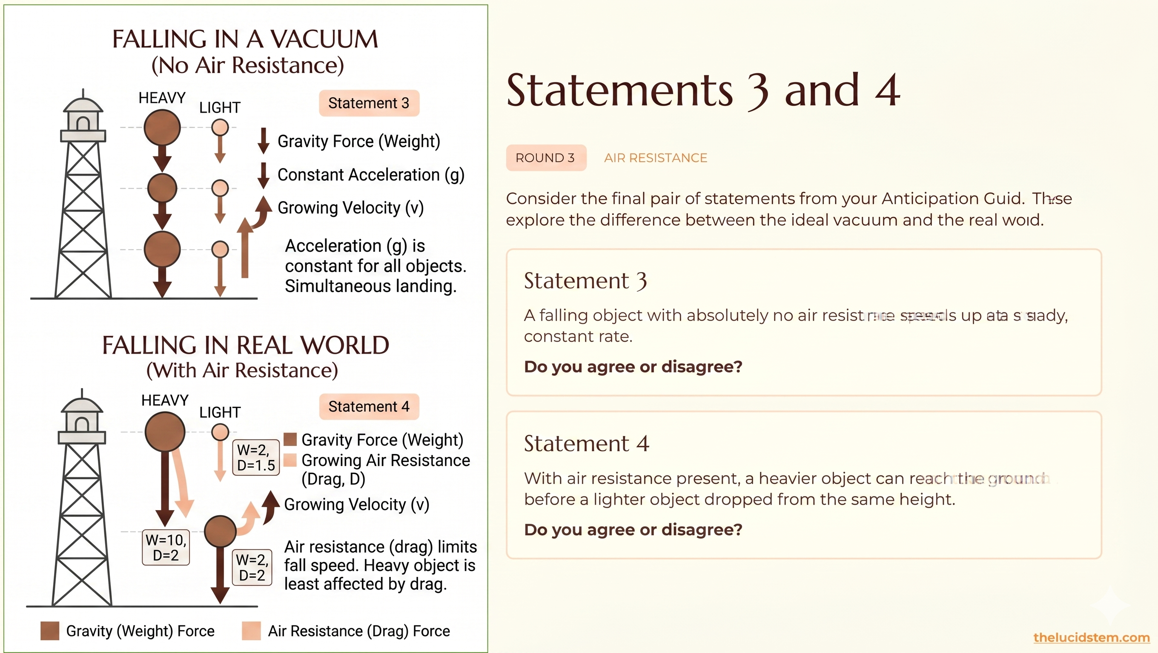
thelucidstem.com

Slide 15

The Truth About Drag
ROUND 3 ANSWER
Statement 3: AGREE
Statement 4: AGREE
With no air resistance, the only force is the constant gravitational force. By Newton's Second Law, a constant force produces a constant acceleration. The object speeds up by exactly 9.81 m/s every second, which is a steady, uniform rate.
Air resistance has a relatively smaller effect on a heavier object with greater weight. The net downward force is larger relative to its mass, so the heavier object accelerates faster than a light object such as a feather, and strikes the ground first.
This is why a hammer and a feather land simultaneously on the Moon (no atmosphere) but not on Earth (air resistance present).
thelucidstem.com

Slide 16
Prove It.
Complete both questions independently and in silence before leaving. Show all working clearly, using correct units and a stated sign convention.
Question 1
Question 2
A ball is dropped from rest from a cliff 20 m high. Using g = 9.81 m/s2:
A ball is thrown vertically upward and reaches its highest point.
Calculate the exact time taken to reach the ground.
Calculate the speed of the ball at the moment of impact.
State the exact velocity of the ball at the highest point.
State the exact acceleration of the ball at the highest point, including its direction.
Hint for Q1: Use s = ut + ½at2 for time, then v2 = u2 + 2as for impact speed.
thelucidstem.com

