Slide 1
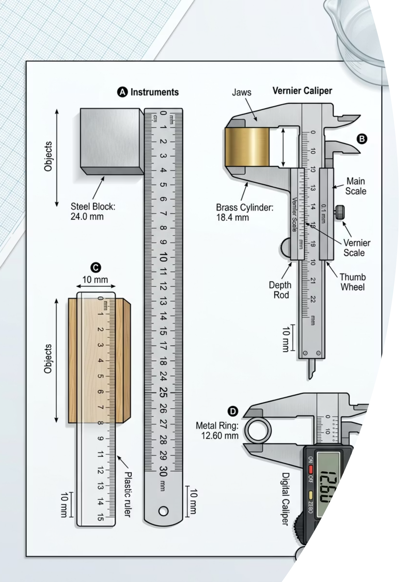
Measurement & Uncertainties
Cambridge International AS & A Level Physics 9702
THELUCIDSTEM.COM

Slide 2
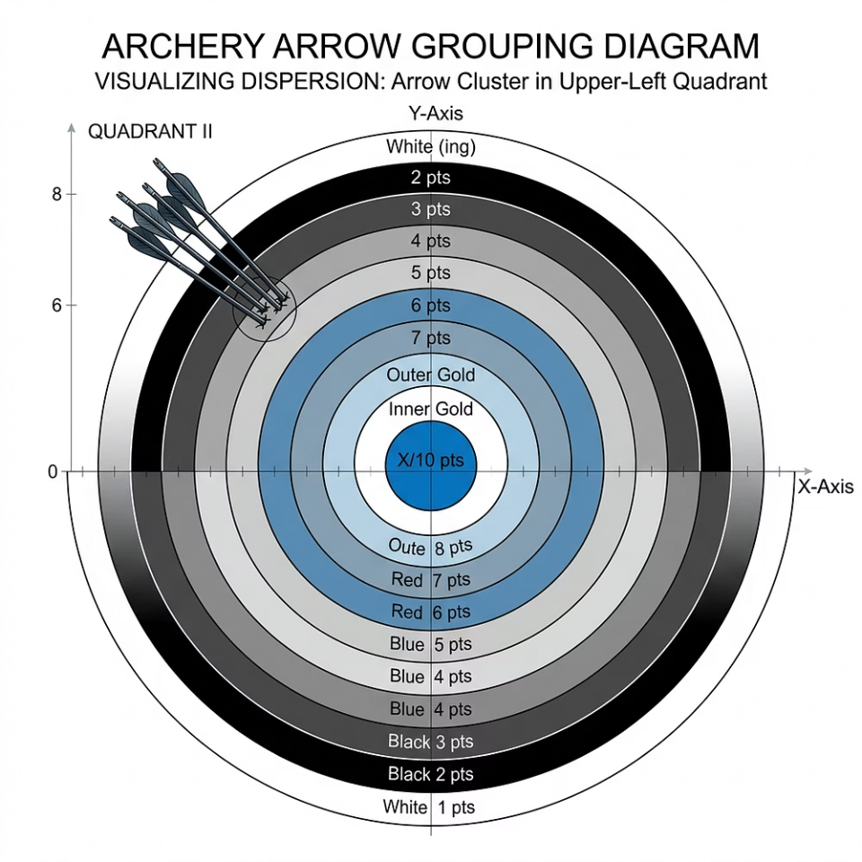
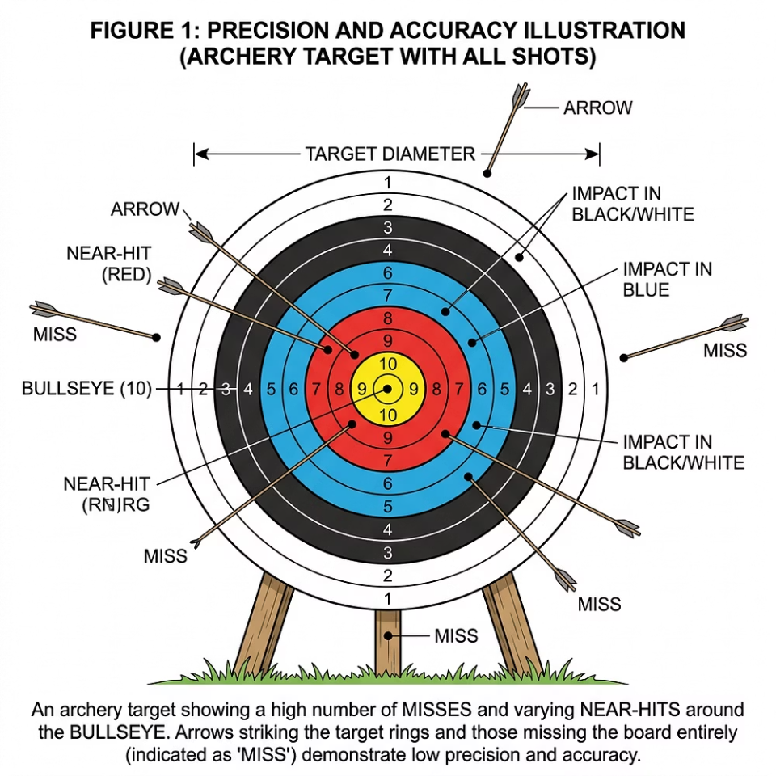

Starter Activity
The Target Practice
Examine the two sets of experimental readings below. Each represents a different type of measurement problem that every physicist must be able to identify and name precisely.
Set A
Set B
Readings are tightly grouped together, but miss the true centre completely. The cluster is consistent but displaced.
Readings are widely scattered, but evenly spread around the true centre. The spread is large but unbiased.
In physics, we must use precise vocabulary to describe exactly what is wrong with each set. Which set is "better" and why?
thelucidstem.com

Slide 3
Topic
Measurement & Uncertainties
By the end of this AS Level lesson, you will be able to:
01
02
03
Errors
Precision & Accuracy
Uncertainties
Distinguish random and systematic errors and state how each can be reduced.
Distinguish precision from accuracy and apply both terms correctly.
Find absolute, fractional, and percentage uncertainty in a measurement.
04
05
Combining Rules
Final Expression
Combine uncertainties for sums, differences, products, quotients, and powers.
Express a result correctly as a value plus or minus its uncertainty.
thelucidstem.com

Slide 4
Error Analysis
Random versus Systematic Error
Every measurement carries uncertainty. The source of that uncertainty determines how it must be treated and reduced.
Random Error
Systematic Error
Scatters readings unpredictably on either side of the true value. No single reading is shifted in a fixed direction.
Example: Human reaction time when starting and stopping a stopwatch.
How to reduce it: Take a large number of repeat readings and calculate their mean average.
Shifts every single reading by the same amount, in the same direction. The entire dataset is offset from the true value.
Example: A ruler whose end is worn or damaged, adding a constant offset to every measurement.
How to reduce it: Recalibrate the instrument against a known standard or improve the experimental technique.
thelucidstem.com

Slide 5

Key Vocabulary
The Vocabulary of Quality
These two terms are frequently confused in examinations. They have distinct, technical meanings and must never be used interchangeably.
Precision
Accuracy
How close your repeated readings are to one another. A small spread or scatter between readings indicates high precision. Precision is a property of the method and instrument, independent of the true value.
How close a reading is to the true, accepted value. A highly accurate result has minimal difference from the actual quantity being measured. Accuracy can be affected by systematic errors.
A set of readings can be highly precise yet completely inaccurate if a systematic error is present. Precision does not guarantee accuracy.
thelucidstem.com

Slide 6
Combining Uncertainties
Rule 1: Sums and Differences
When you add or subtract two measured quantities, the uncertainty in the result is always larger than either individual uncertainty. The rule is simple and absolute.
The Rule
Formula
Critical Note
For any sum or difference, add the absolute uncertainties together to find the total uncertainty in the result.
If z = x + y or z = x - y, then:
Δz = Δx + Δy
Even when subtracting two values, their absolute uncertainties are always added together. Uncertainties never cancel.
thelucidstem.com

Slide 7

Combining Uncertainties
Rule 2: Products, Quotients and Powers
When measurements are multiplied, divided, or raised to a power, switch from absolute to percentage uncertainties.
Products and Quotients
Powers
If z = x × y or z = x / y, then:
%Δz = %Δx + %Δy
Add the percentage uncertainties of all quantities involved.
If z = xn, then:
%Δz = n × %Δx
Example: If Volume = length3, the percentage uncertainty in volume equals 3 times the percentage uncertainty in length.
Always convert back to an absolute uncertainty at the end of a calculation when expressing your final answer.
thelucidstem.com

Slide 8
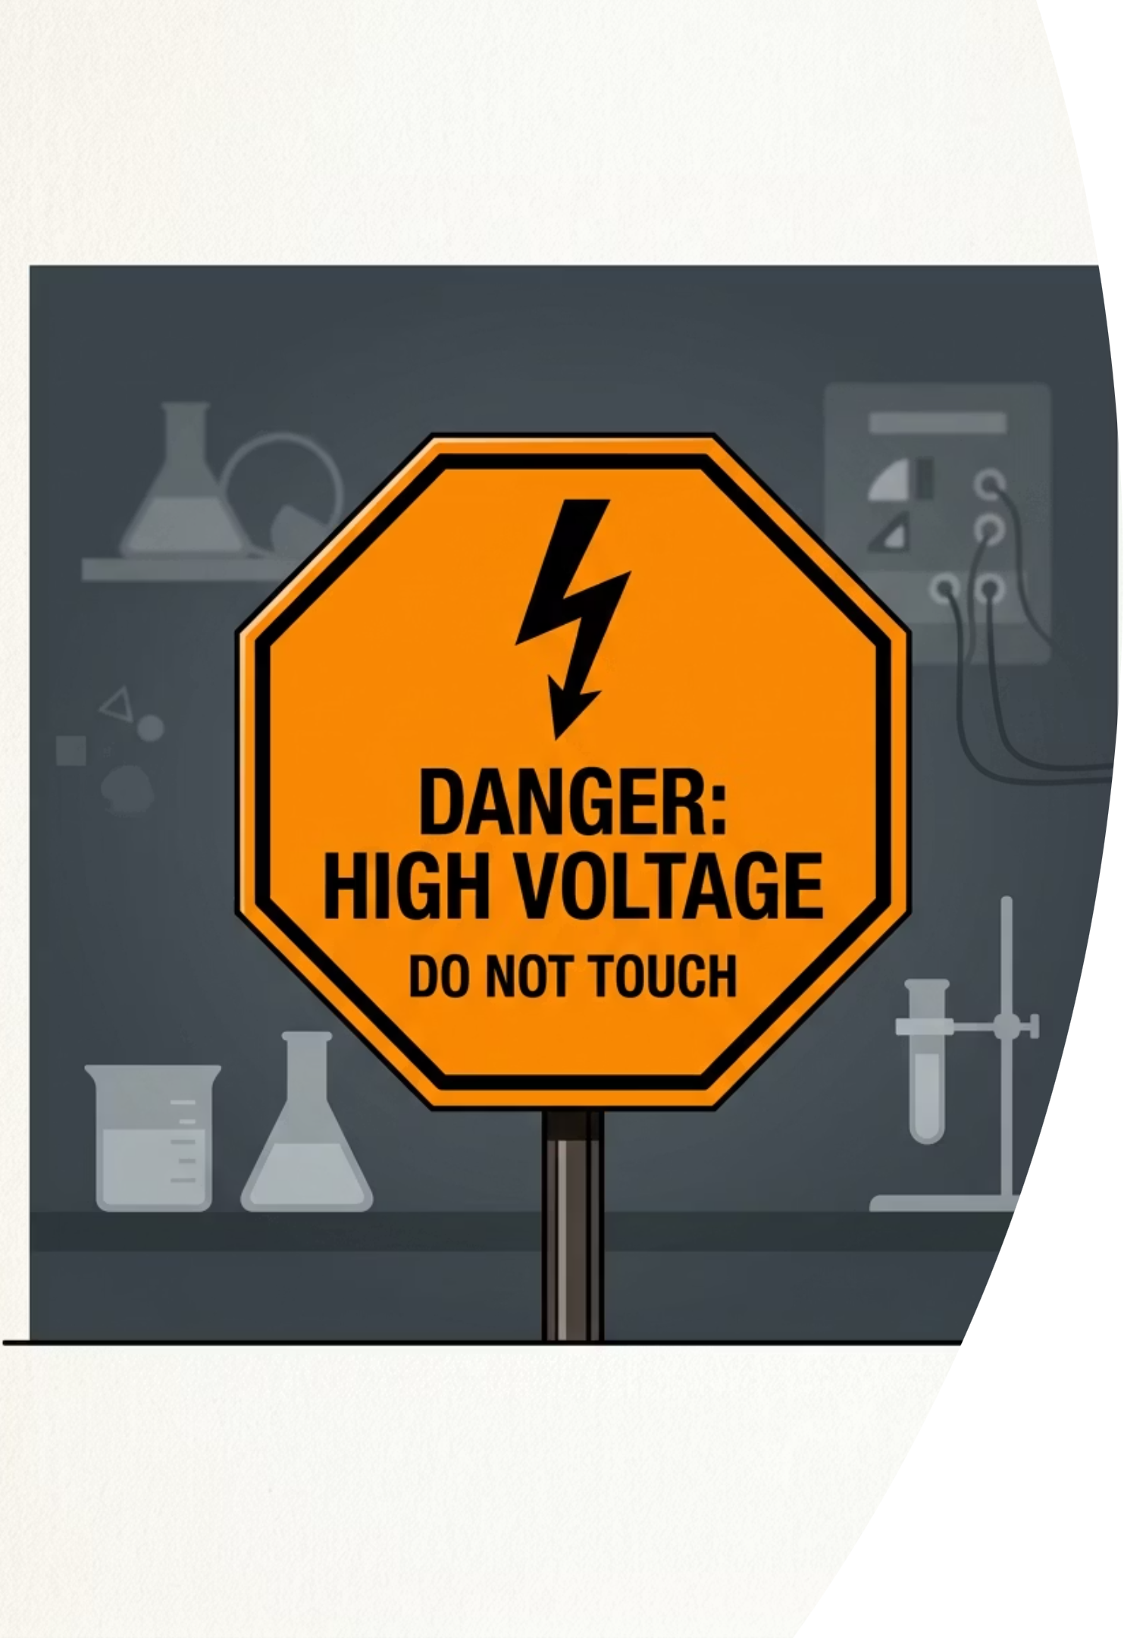
Examiner Report Warning
The Examiner's Traps
These are the most common and most costly errors seen in AS Level examination scripts. Avoid them precisely.
Trap 1: Repeats fix systematic error
Taking more readings only reduces random scatter. Averaging does absolutely nothing to correct a systematic shift in every reading.
Trap 2: Adding percentages for sums
For sums and differences, you must add the absolute uncertainties. Percentage uncertainties apply only to products, quotients, and powers.
Trap 3: Too many decimal places
An uncertainty must be quoted to just one significant figure. The final value must then match that number of decimal places.
thelucidstem.com

Slide 9
Active Learning Protocol
Cooperative Task: Rally Coach
You will work in pairs using a single problem sheet. Both partners engage with every problem, alternating roles after each question.
Partner A: Solver
Partner B: Coach
Switch Roles
Thinks aloud through each step and writes the complete solution on the paper. Verbalising the reasoning is essential.
Watches every step carefully. Praises correct working. Questions any step that appears incorrect. Does not take the pen.
After each question, swap roles completely. By the end, both partners will have solved and coached equally.
thelucidstem.com

Slide 10
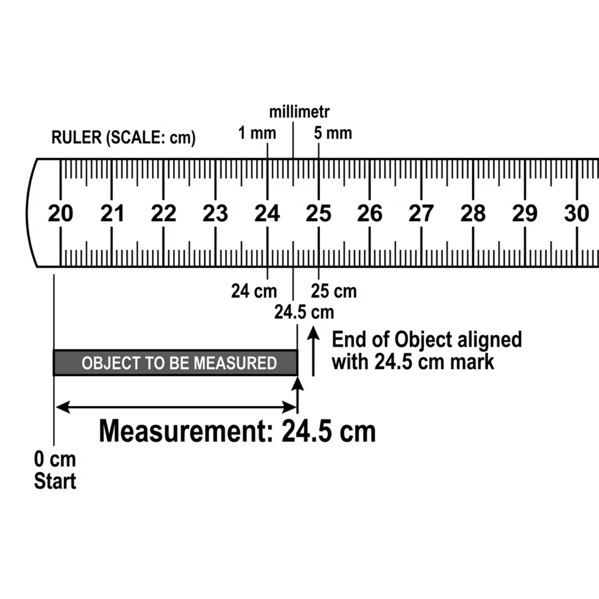
Rally Coach
Round 1: Reading Scales
Partner A solves. Partner B coaches.
Your Task
Part 1: State the absolute uncertainty in this reading.
Part 2: Calculate the percentage uncertainty in this length.
Show all working clearly. The Coach should check each step before Partner A moves on.
A length is measured as 24.5 cm on a ruler whose smallest division is 1 mm.
thelucidstem.com

Slide 11

Rally Coach
Round 1: Answer
Check your pair's solution against the worked answer below. The Coach should confirm every line of reasoning was correct.
01
02
Absolute Uncertainty
Percentage Uncertainty
Half the smallest division: ½ × 1 mm = 0.5 mm = 0.05 cm
(0.05 / 24.5) × 100 = 0.20%
Final Answer: Length = 24.5 ± 0.05 cm. Percentage uncertainty = 0.20%
thelucidstem.com

Slide 12
Rally Coach
Round 2: Subtraction
SWAP ROLES. Partner B solves. Partner A coaches.
Given Values
Your Task
x = 5.00 ± 0.05 cm
y = 3.00 ± 0.05 cm
Find z = x - y and state its absolute uncertainty.
Apply the correct combining rule for a difference. Be especially careful: do not subtract the uncertainties.
thelucidstem.com

Slide 13
Rally Coach
Round 2: Answer
Check your pair's solution. Every line should be visible and clearly reasoned.
01
02
Calculate z
Combine Uncertainties
z = 5.00 - 3.00 = 2.00 cm
For a difference, add absolute uncertainties: 0.05 + 0.05 = 0.10 cm
Final Answer: z = 2.00 ± 0.10 cm
thelucidstem.com

Slide 14
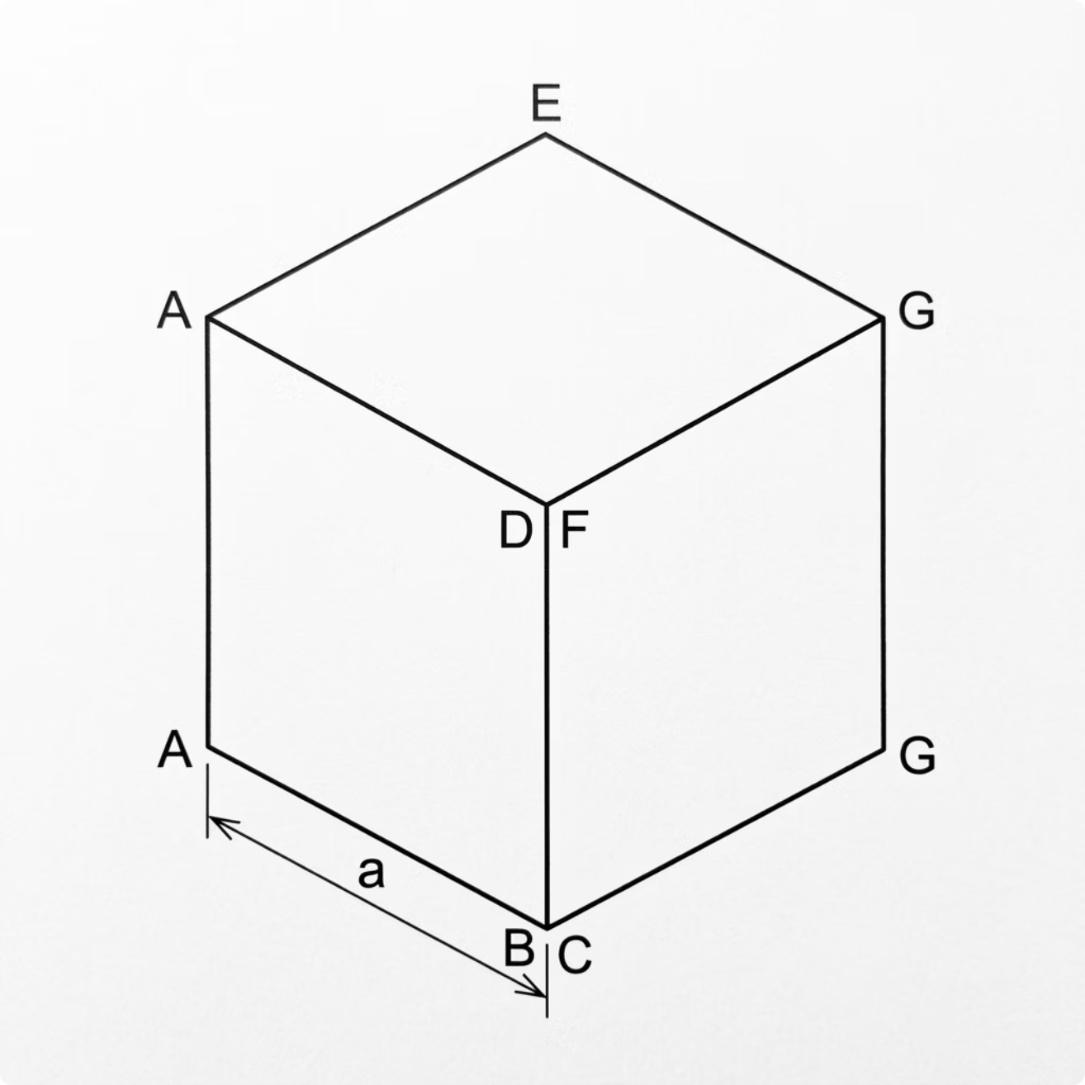
Rally Coach
Round 3: Powers
SWAP ROLES. Partner A solves. Partner B coaches.
Given Value
Side length: a = 2.00 ± 0.02 cm
Volume: V = a3
Your Task
Find the percentage uncertainty in the volume V. Apply the power rule carefully and show all steps.
thelucidstem.com

Slide 15
Rally Coach
Round 3: Answer
Check your pair's solution. Both the intermediate step and the final answer must be present.
01
02
Percentage Uncertainty in Side a
Apply the Power Rule
(0.02 / 2.00) × 100 = 1%
%ΔV = 3 × %Δa = 3 × 1% = 3%
Final Answer: Percentage uncertainty in Volume = 3%
thelucidstem.com

Slide 16
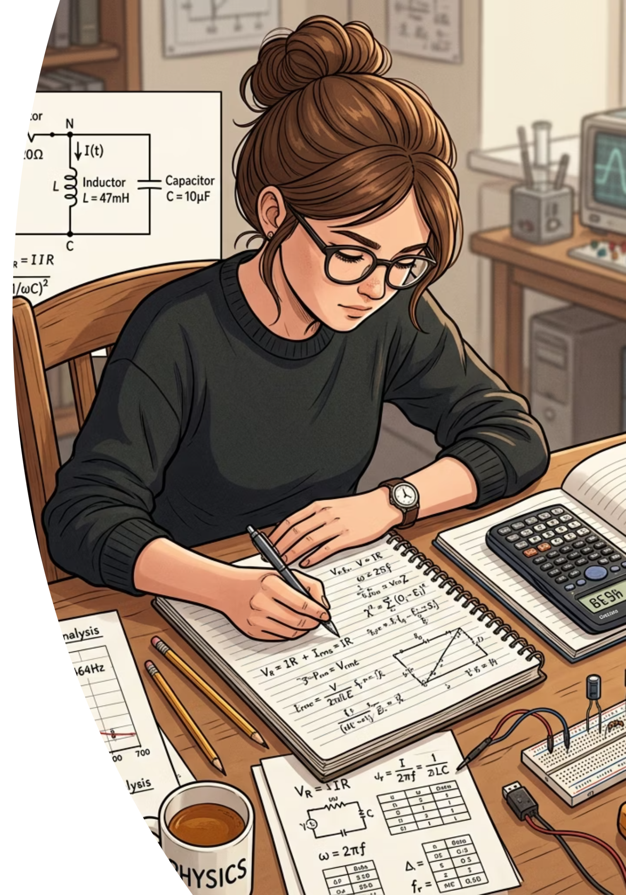
Formative Assessment
Prove It.
Complete the following independently and in silence before leaving. No discussion with your partner.
Question 1: Potential Difference
1
A current of I = 2.0 ± 0.1 A flows through a resistor of R = 10.0 ± 0.5 Ω. Find the potential difference V = IR and its absolute uncertainty. Show all working.
Question 2: Identifying Error Type
2
Five repeated readings cluster tightly together but all lie 5% above the true value. State whether the data are precise, accurate, both, or neither, and name the likely type of error present.
thelucidstem.com

