Slide 1
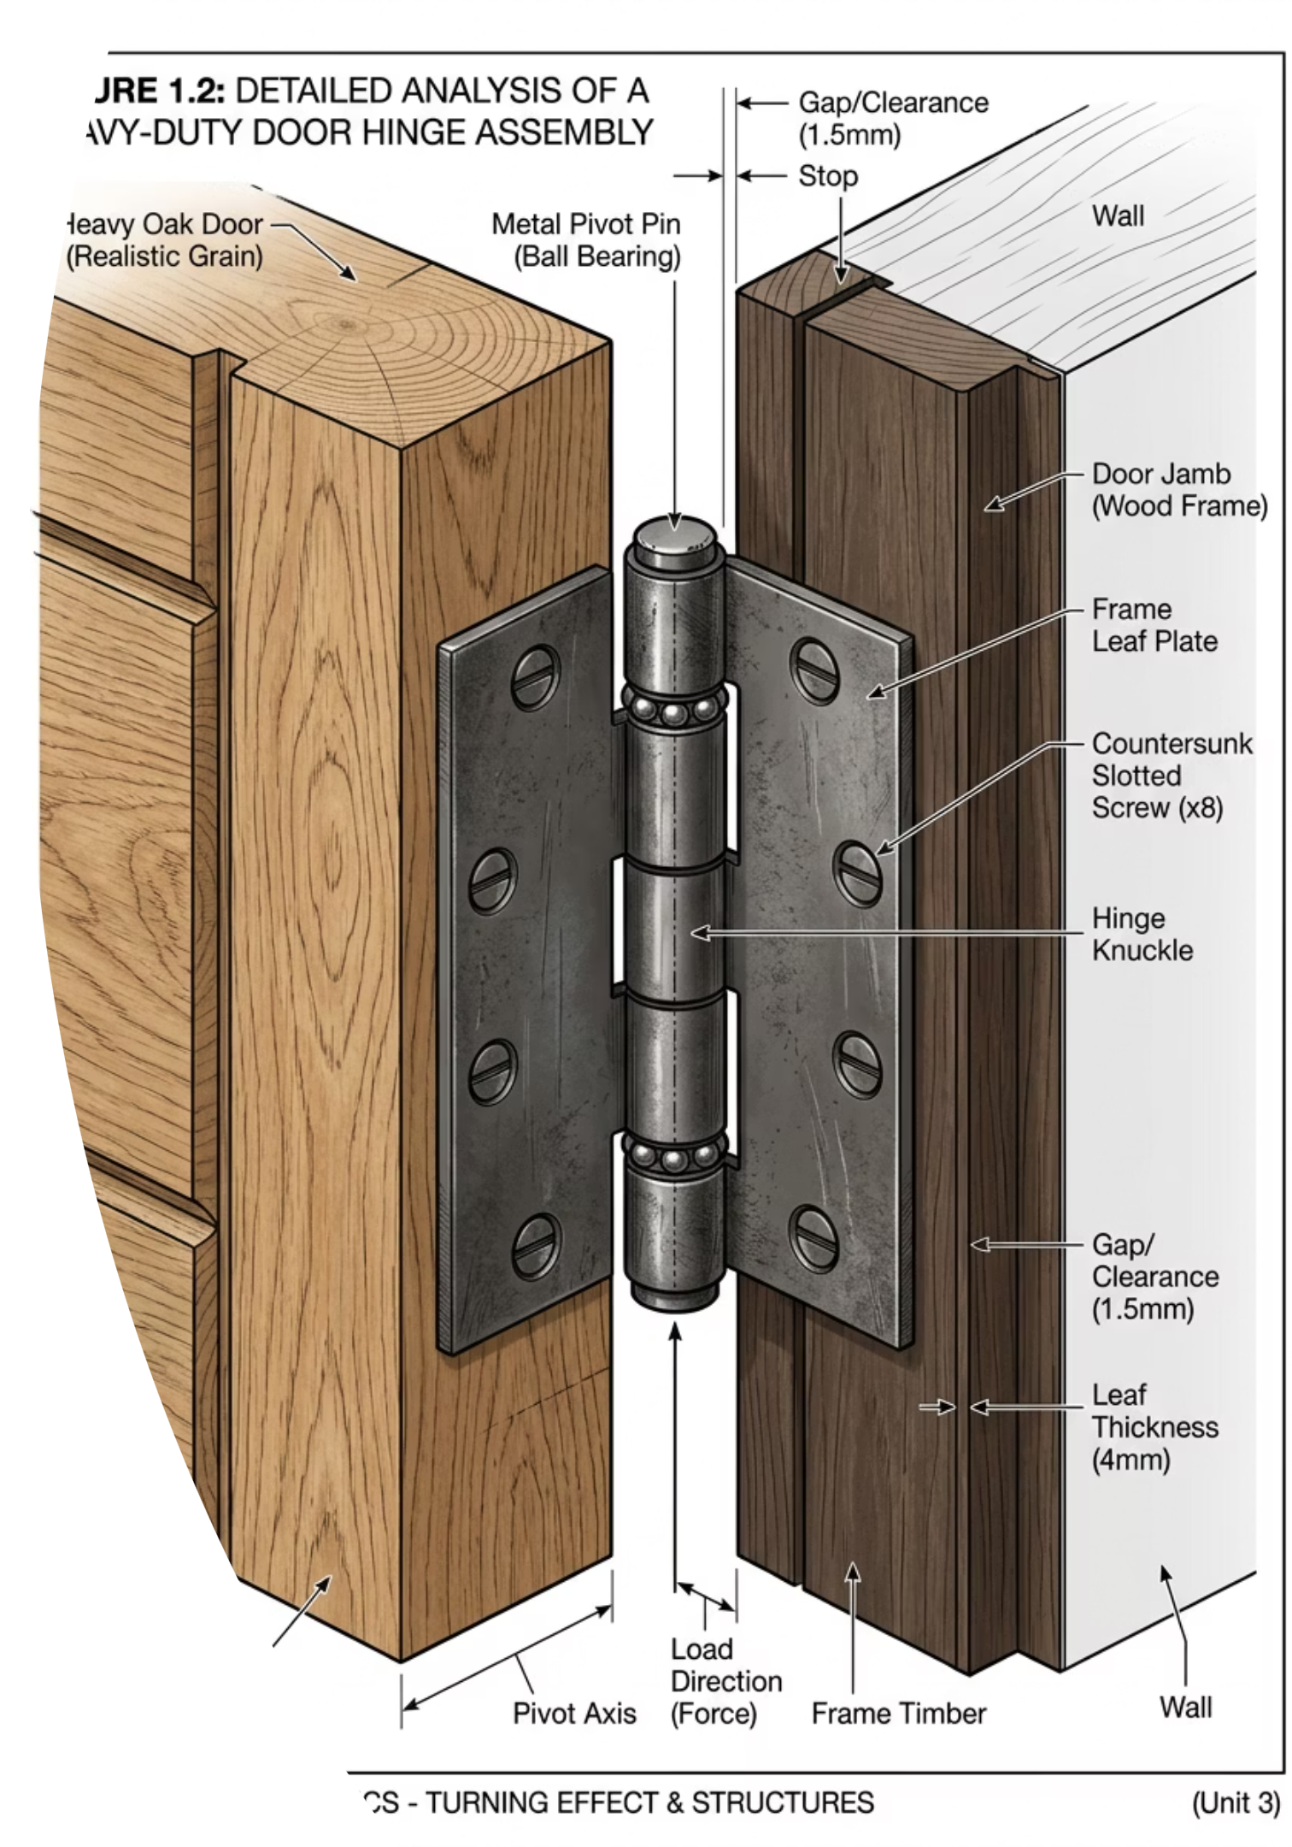
Moments and the Turning Effect of Forces
Cambridge International AS & A Level Physics 9702
How the location of a force is just as important as its size.
thelucidstem.com

Slide 2
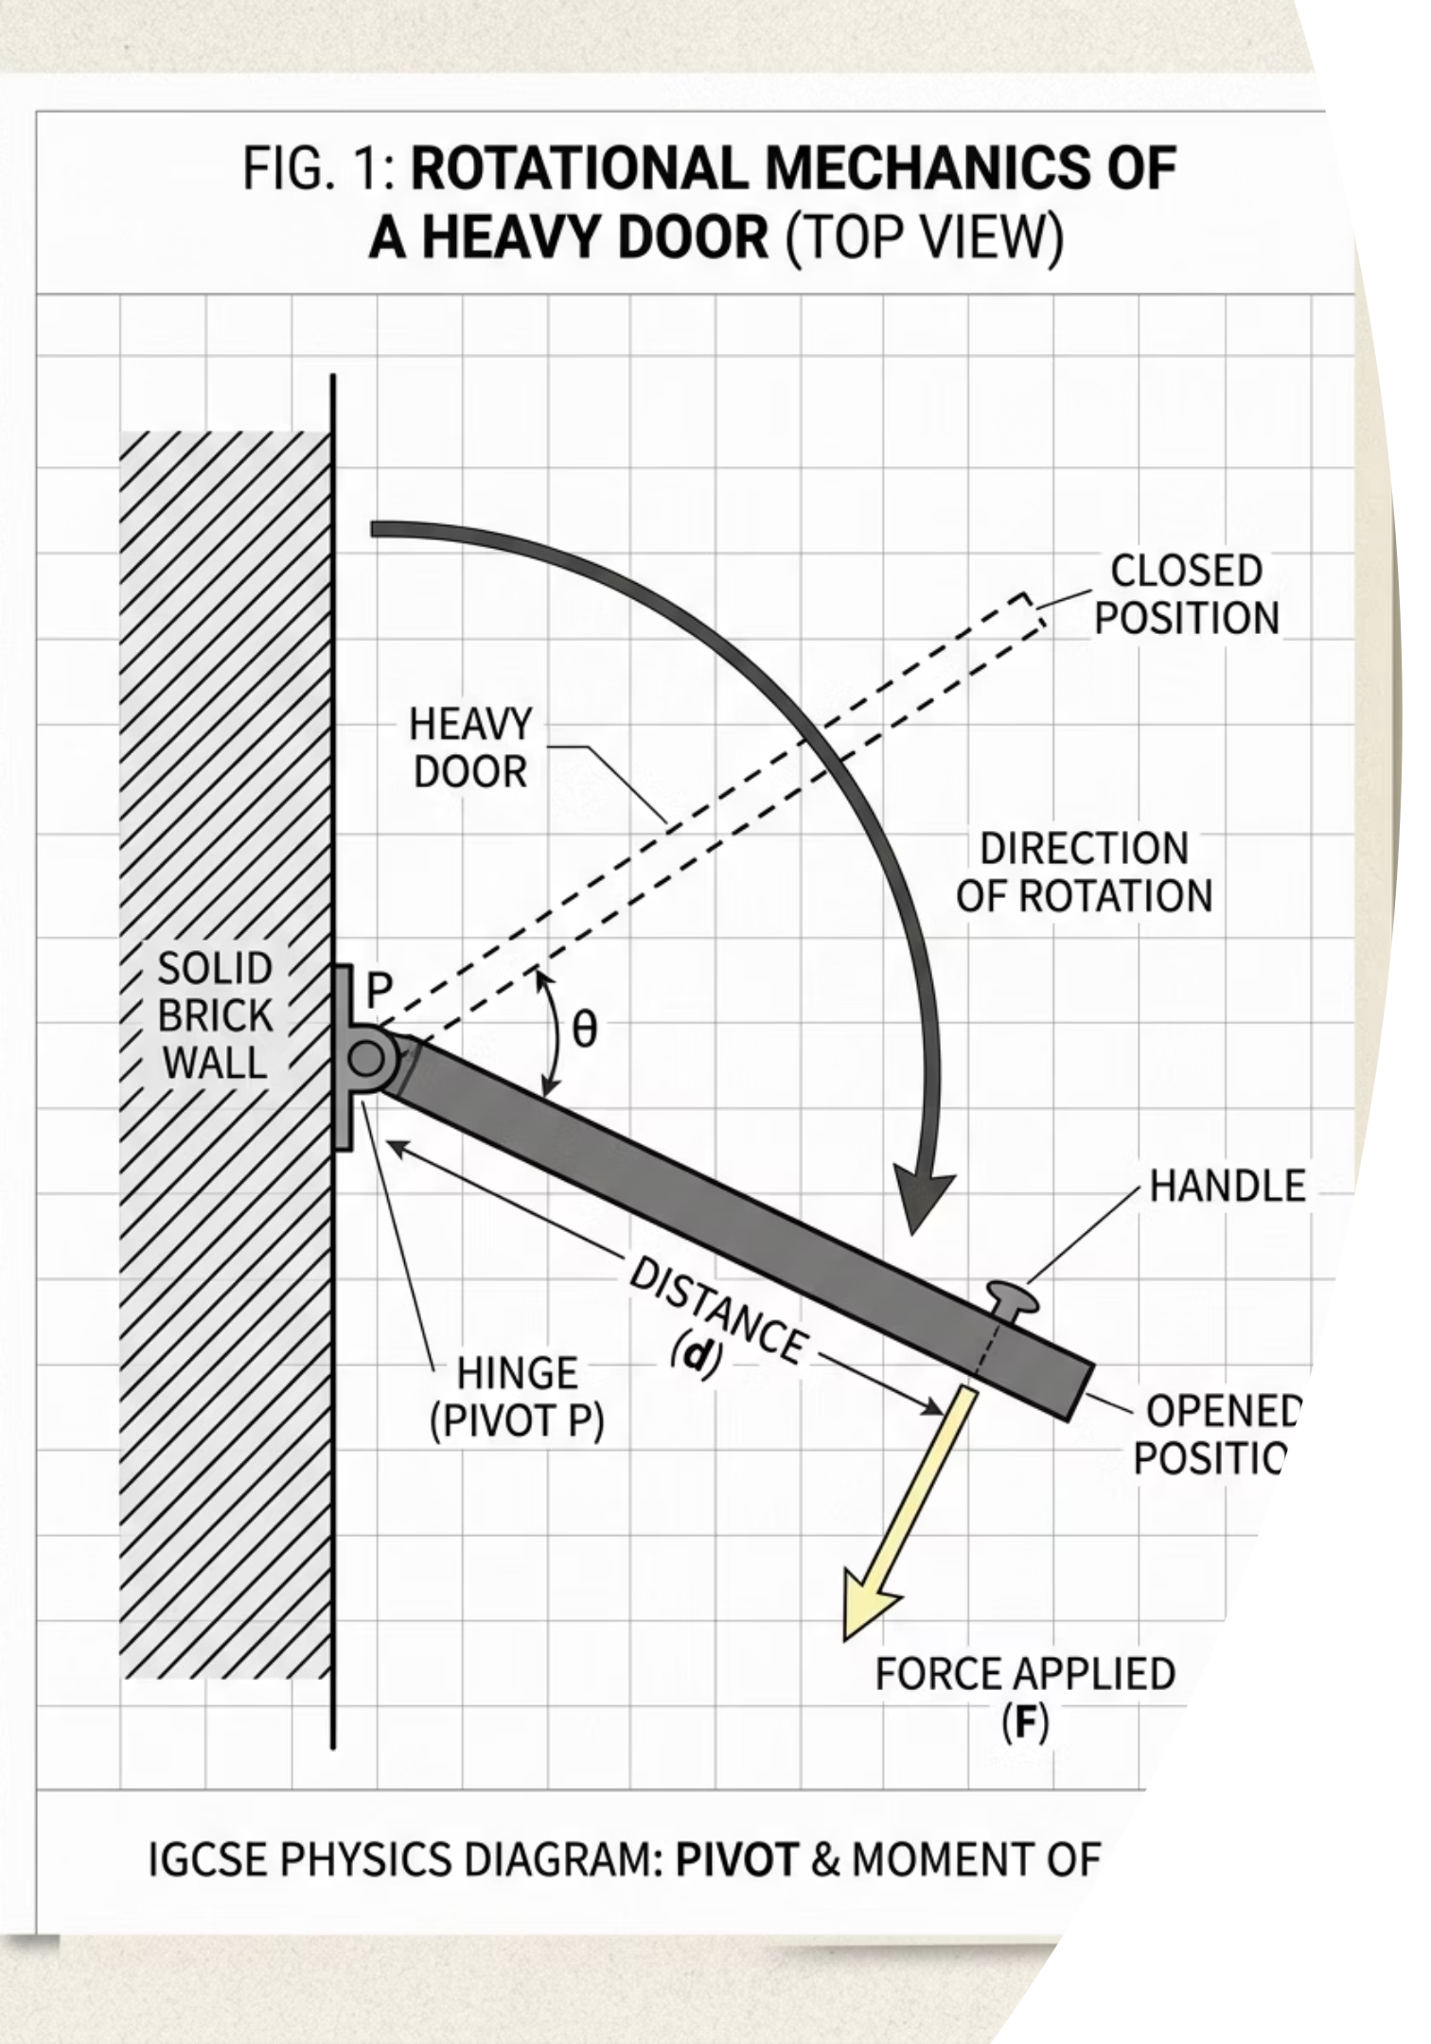

The Pivot Point
Think about opening a heavy door.
Where is the handle?
The handle is always placed as far from the hinges as possible. This is deliberate engineering, not coincidence.
Think silently
If you tried to push the door open by pressing right next to the hinges, what would happen? Why would it be so much harder?
The key idea
Today we discover why the location of a force is just as important as the size of the force.
thelucidstem.com

Slide 3
Topic: Turning Effects of Forces
By the end of this AS Level lesson, you will be able to:
01
02
Define the Moment of a Force
Apply the Principle of Moments
State that a moment equals force multiplied by the perpendicular distance from the pivot, and give its unit as N m.
State and use the principle for a body in equilibrium: total clockwise moments equal total anticlockwise moments.
03
04
Define a Couple and Torque
Solve Problems
Describe a couple as a pair of equal, opposite, parallel forces, and calculate the torque of a couple.
Tackle balanced beams, levers, and couples, including forces applied at an angle using trigonometry.
thelucidstem.com

Slide 4
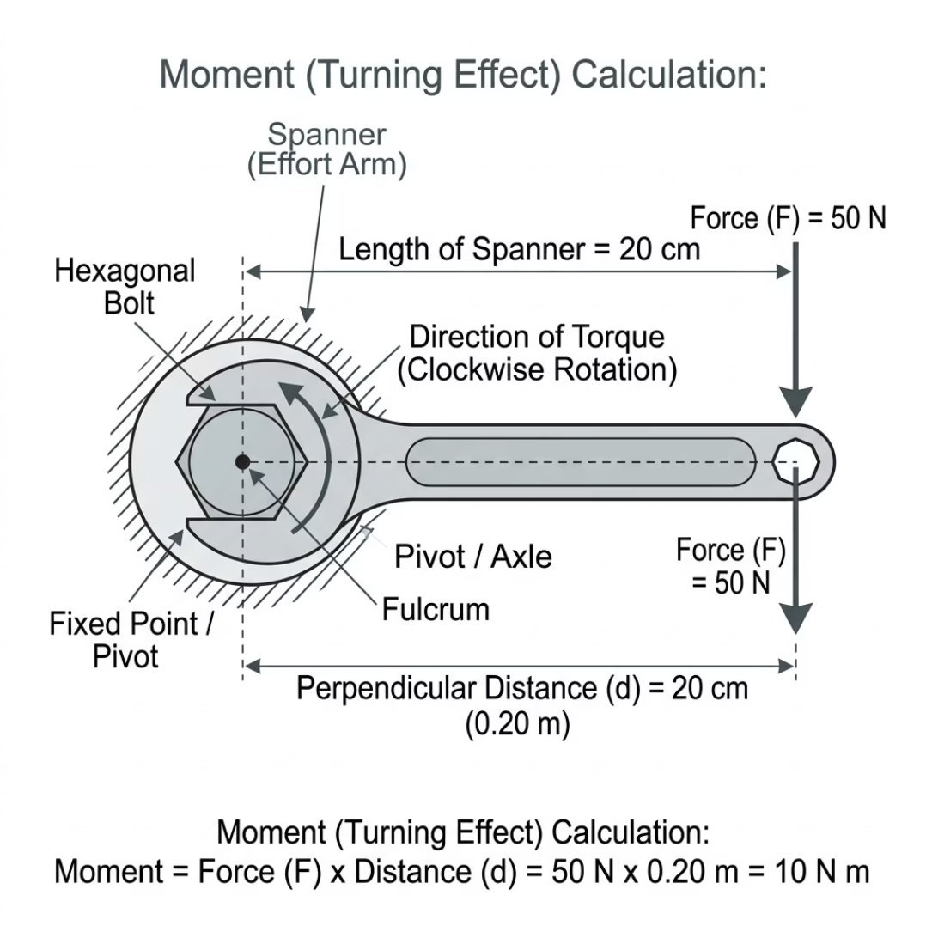
The Moment of a Force
A moment is the turning effect of a force about a pivot point.
The Formula
Moment = Force (F) x Perpendicular distance (d) from the pivot
The Unit
Newton metres (N m)
The Golden Rule
The distance must be perpendicular (exactly 90 degrees) to the line of action of the force. A force aimed directly at the pivot has zero turning effect because d = 0.
Force (F) acts downward. Perpendicular distance (d) runs horizontally from pivot to force arrow.
thelucidstem.com

Slide 5
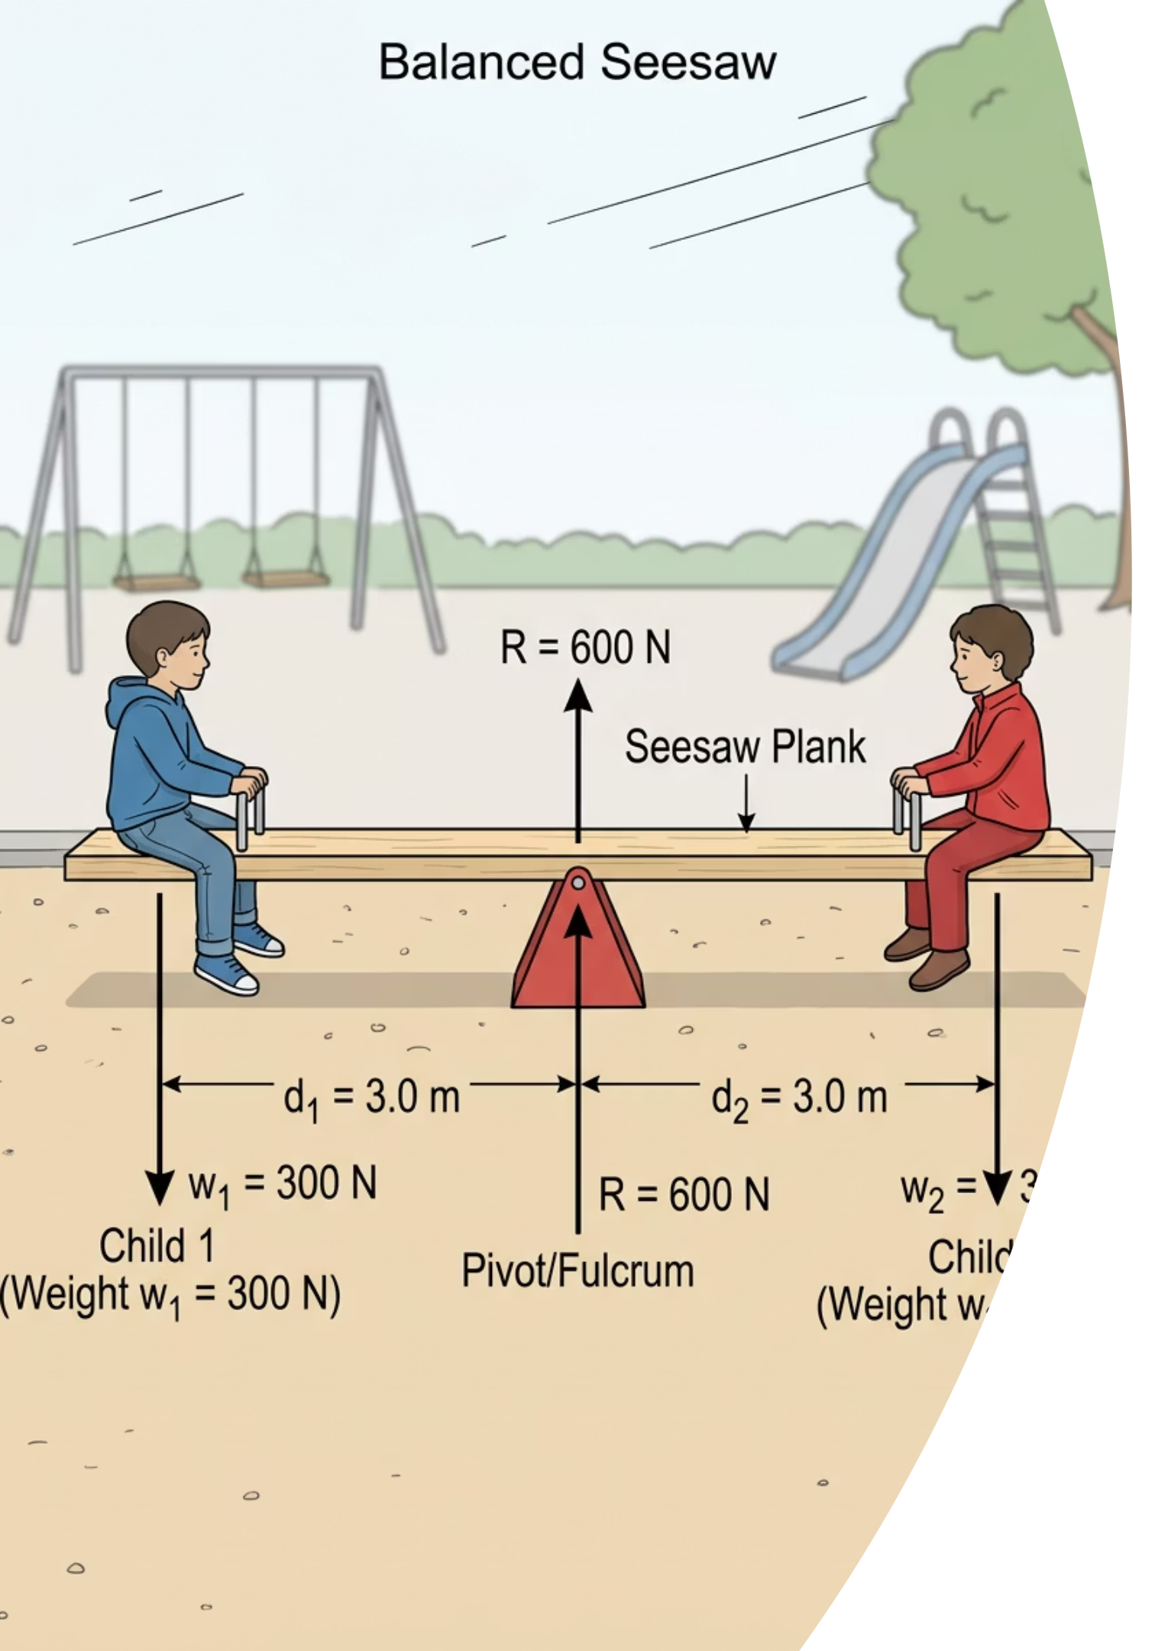

The Principle of Moments
When an object is in perfect balance, it is in equilibrium.
For a body in equilibrium, the sum of all clockwise moments about any point equals the sum of all anticlockwise moments about that same point.
Step 1
Step 2
Identify and select your pivot point carefully.
Calculate every moment relative to that same point.
Step 3
Set total clockwise = total anticlockwise and solve.
thelucidstem.com

Slide 6
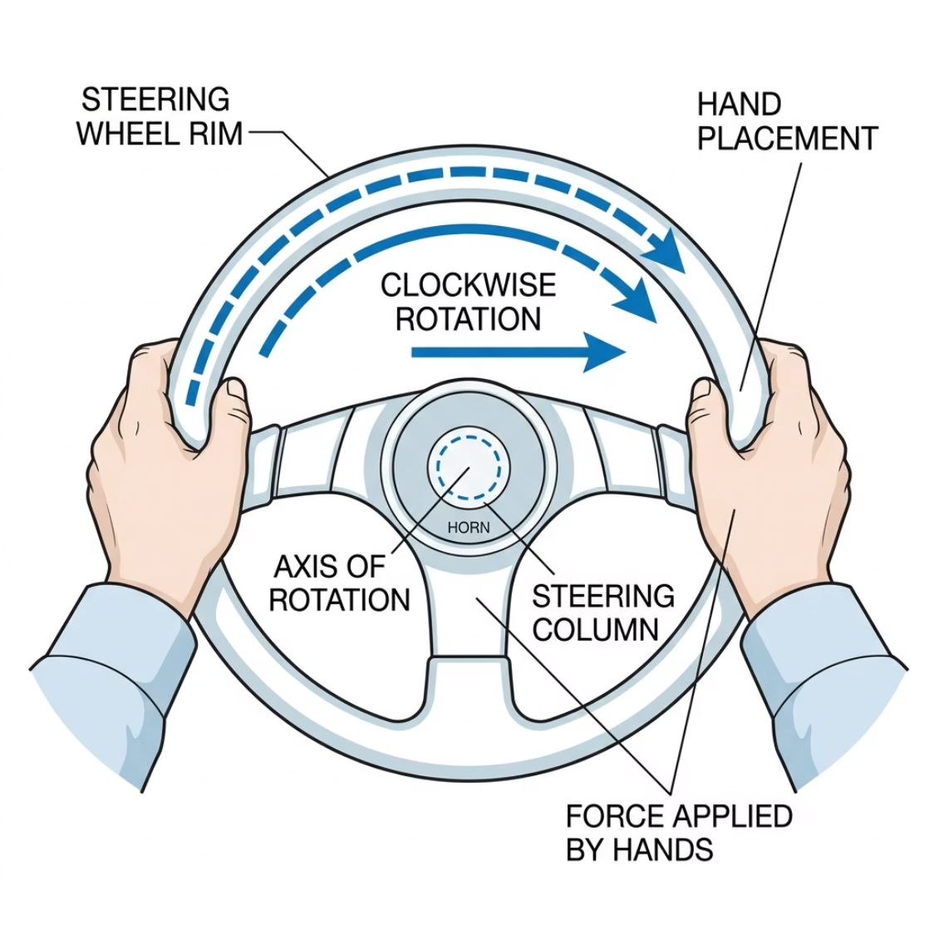
Couples and Torque
A couple creates pure rotation with no linear movement.
Definition of a Couple
A pair of forces that are:
Equal in magnitude
Opposite in direction
Parallel to each other
Lines of action do not meet
Torque of a Couple
Torque = F x d
where F is the magnitude of one force and d is the perpendicular distance between the two forces.
Two hands apply equal and opposite forces. The result is rotation only, with no sideways movement.
thelucidstem.com

Slide 7
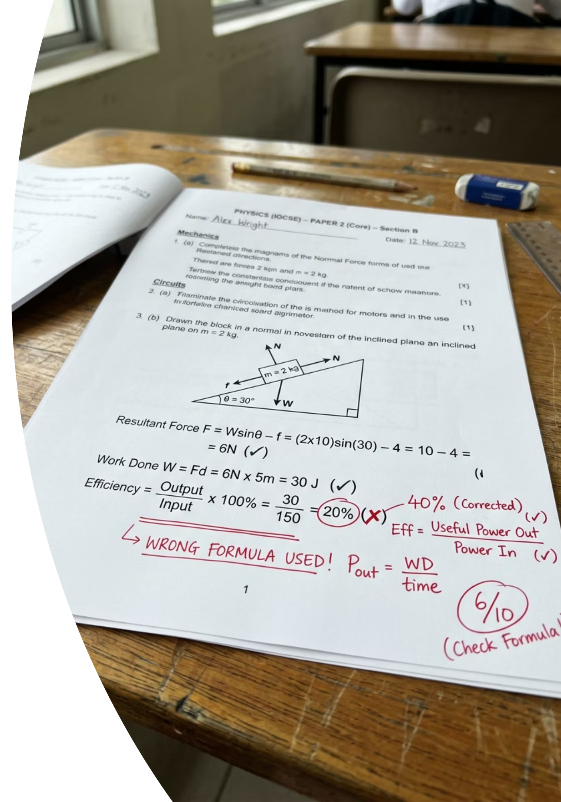

EXAMINER ALERT
The Distance Illusion
These are the most common errors seen in AS exam scripts. Learn to avoid them.
Trap 1: Missing "Perpendicular"
Writing "Force times distance" scores zero marks. You must write perpendicular distance. Every single time.
Trap 2: Using the Slanted Length
If a force acts at an angle, the slanted lever length is not the perpendicular distance. Use trigonometry (sin or cos) to resolve it correctly.
Trap 3: Doubling the Torque
The torque formula for a couple already gives the total turning effect. Do not multiply by two. The answer will be wrong.
thelucidstem.com

Slide 8





Cooperative Task: Mix-Pair-Share
An active learning protocol to practise applying moments to real problems.
Mix
Stand up and walk around the room until the signal sounds.
Pair
Stop and pair up with the person closest to you.
Solve
Work out the prompt together and agree on full reasoning.
Share
Explain your exact reasoning out loud to your partner, then we check together.
thelucidstem.com

Slide 9
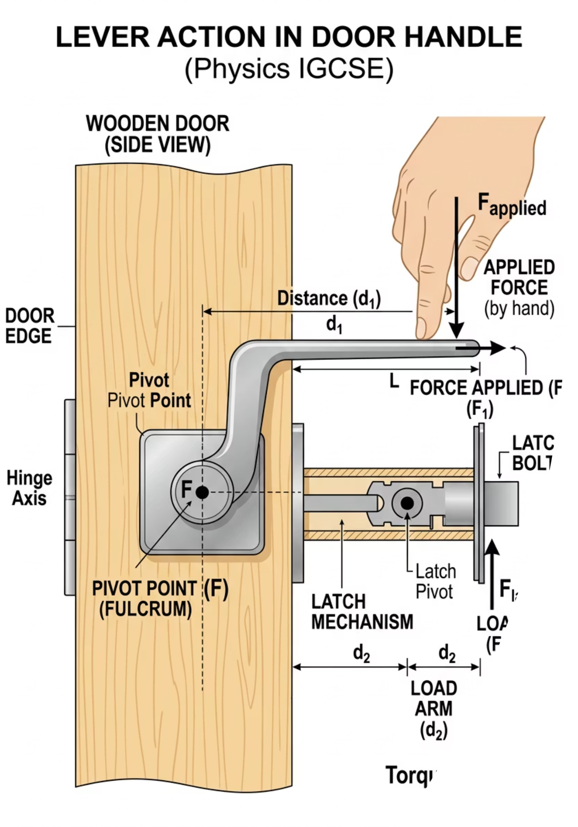
PROMPT 1
The Door
Pair up and discuss. You have 60 seconds.
A door handle is fitted far from the hinges. Explain, explicitly using the physics vocabulary of moments, why this makes the door easier to open.
thelucidstem.com

Slide 10
PROMPT 1: ANSWER
Did You Explain It Like This?
1
Large Perpendicular Distance
2
Larger Moment for the Same Push
3
Greater Turning Effect
Placing the handle far from the hinges gives a large perpendicular distance d between the line of action of the force and the pivot (hinge).
Because Moment = F x d, a larger distance means the same applied force creates a much larger moment about the pivot.
A greater moment produces a greater turning effect, making the door much easier to open with the same effort.
thelucidstem.com

Slide 11
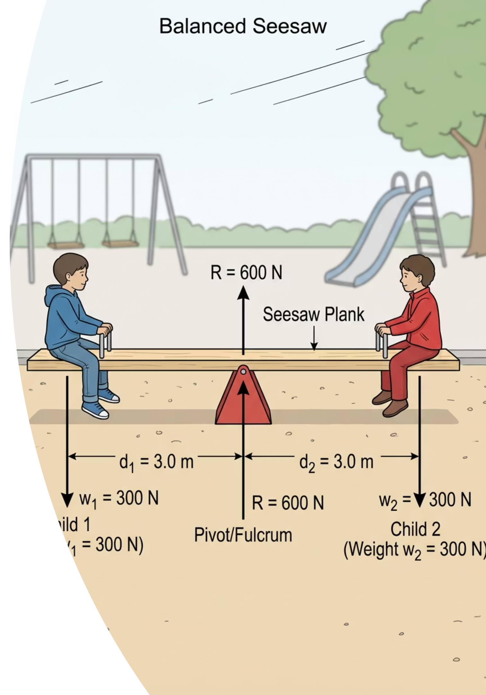
PROMPT 2
The Seesaw
Mix, find a new partner, and discuss. You have 2 minutes.
A seesaw balances exactly level. A 200 N child sits 1.5 m from the pivot on

Slide 12

PROMPT 2: ANSWER
Did You Solve It Like This?
Applying the Principle of Moments
The heavier child must sit closer to the pivot. A greater force over a shorter distance balances a smaller force over a longer distance.
Anticlockwise Moment = Clockwise Moment
Left side: 200 N x 1.5 m = 300 N m
Right side: 300 N x d = 300 N m
Therefore: d = 300 / 300
Both sides produce equal moments: 300 N m = 300 N m. The seesaw is in equilibrium.
Final Answer: d = 1.0 m from the pivot
thelucidstem.com

Slide 13
PROMPT 3
The Beam Balance
Mix, find a new partner, and discuss. You have 2 minutes.
A horizontal beam balances on a central pivot. A 5.0 N weight sits 0.60 m to the left. An unknown weight sits 0.40 m to the right. Calculate the unknown weight.
thelucidstem.com

Slide 14
PROMPT 3: ANSWER
Did You Solve It Like This?
Applying the Principle of Moments
The unknown weight is 7.5 N. It is closer to the pivot, so it must be heavier to produce the same moment as the 5.0 N weight.
Anticlockwise Moment = Clockwise Moment
Left side: 5.0 N x 0.60 m = 3.0 N m
Right side: W x 0.40 m = 3.0 N m
Therefore: W = 3.0 / 0.40
Check: 5.0 x 0.60 = 3.0 N m and 7.5 x 0.40 = 3.0 N m. Balanced correctly.
Final Answer: W = 7.5 N
thelucidstem.com

Slide 15

PROMPT 4
The Angled Force
Mix, find a new partner, and discuss. You have 2 minutes.
A force of 12 N is applied at the very end of a 0.25 m lever. The force pulls at an angle of 40 degrees to the lever. Calculate the exact moment about the pivot.
Remember the examiner trap: the slanted lever length is not the perpendicular distance. You must resolve the force first.
thelucidstem.com

Slide 16

PROMPT 4: ANSWER
Did You Solve It Like This?
Step 1: Find the Perpendicular Component
When a force acts at an angle, use sine to find the perpendicular component. The component along the lever produces no turning effect.
Perpendicular Force = 12 x sin(40 degrees) = 7.71 N
Step 2: Calculate the Moment
Moment = Perpendicular Force x distance along lever
Moment = 7.71 x 0.25
Alternative method: use the full force (12 N) multiplied by the perpendicular distance from the pivot to the line of action of the force. Both routes give 1.9 N m.
Final Answer: Moment = 1.9 N m
thelucidstem.com

Slide 17



EXIT TICKET
Prove It.
Silence in the room. Return to your desks and complete this independently before you leave.
Question 1
1
A 25 N force acts at a perpendicular distance of 0.30 m from a pivot.
Calculate the moment produced.
Question 2
A seesaw balances with a 250 N child sitting 1.2 m from the pivot on one side.
How far from the pivot must a 300 N child sit on the other side to keep it balanced?
2
thelucidstem.com

