Slide 1
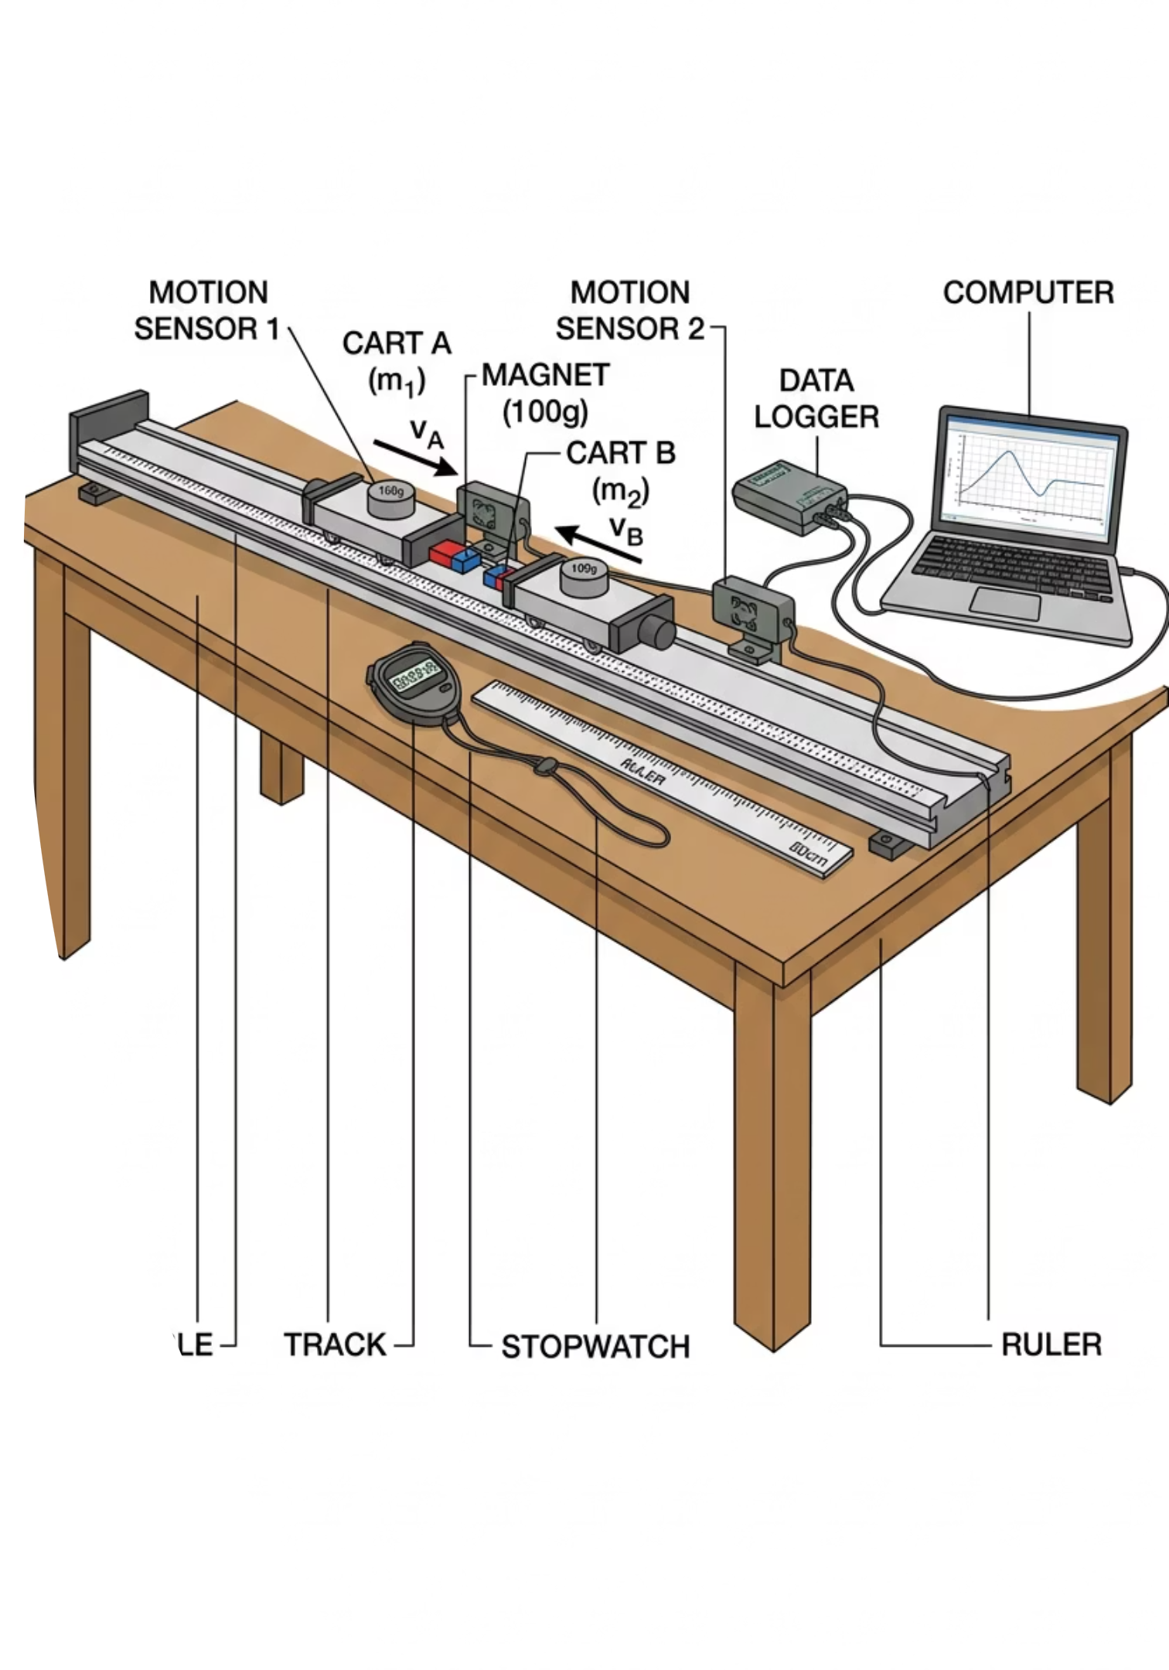
Momentum and Impulse
Cambridge International AS & A Level Physics 9702
THE LUCID STEM

Slide 2

The Egg Drop
Rigid Wall
Imagine throwing a raw egg as hard as you can against a solid brick wall. Now imagine throwing an identical egg at the same speed into a sagging bed sheet.
Mass hits rigid barrier. Contact time is extremely short. Force is enormous. Egg shatters.
The egg hitting the wall shatters instantly.
The egg hitting the sheet survives completely intact.
Both eggs had the same mass. Both went from high speed to zero. The overall change in motion is identical.
Flexible Sheet
Mass hits flexible barrier. Contact time is extended. Force is spread out. Egg survives.
Same change in momentum. Different time. Different force.
So why is the force so different? The answer lies in one single variable: time.
@thelucidstem.com

Slide 3
Topic: Momentum and Impulse
By the end of this AS Level lesson, you will be able to:
1
Define Momentum
State p = mv and give its unit of kg m/s.
2
Newton's Second Law
State the resultant force equals the rate of change of momentum.
3
Derive F = ma
Show F = ma is a special case of the second law for constant mass.
4
Define Impulse
Relate impulse to change in momentum and the area under a force-time graph.
5
Apply the Concept
Explain how increasing impact time reduces the resultant force.
@thelucidstem.com

Slide 4
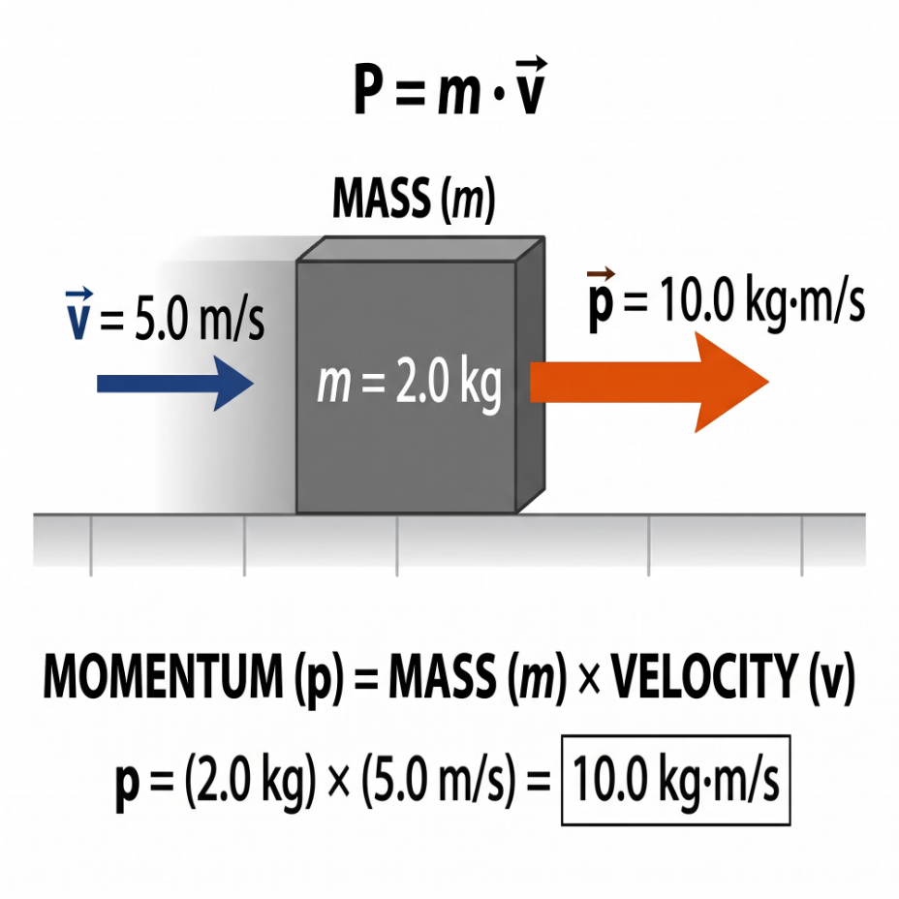
Linear Momentum
Moving objects possess momentum, a quantity that combines both their mass and their velocity into a single measure of "quantity of motion".
Momentum Diagram
Formula
A mass m moving to the right carries momentum p = mv in the same direction.
p = mv
Unit
kg m/s (equivalent to N s)
Vector Quantity
Momentum points in the exact same direction as the velocity. Always establish a positive direction before solving any problem. A negative sign means the object moves in the opposite direction.
@thelucidstem.com

Slide 5
Rate of Change of Momentum
At IGCSE, we used F = ma. Newton's actual Second Law is more general and more powerful than this.
The True Second Law
1
Identify initial and final momenta
The resultant force acting on a body is directly proportional to its rate of change of momentum.
Calculate mu (initial) and mv (final), keeping direction signs consistent.
2
Find the change
Change in momentum = mv - mu. Remember: final minus initial.
Deriving F = ma
If mass is constant, we can factor it out:
3
Divide by time
Divide by the time interval t to obtain the average resultant force.
F = ma is simply a special case of the true law, valid only when mass does not change.
@thelucidstem.com

Slide 6
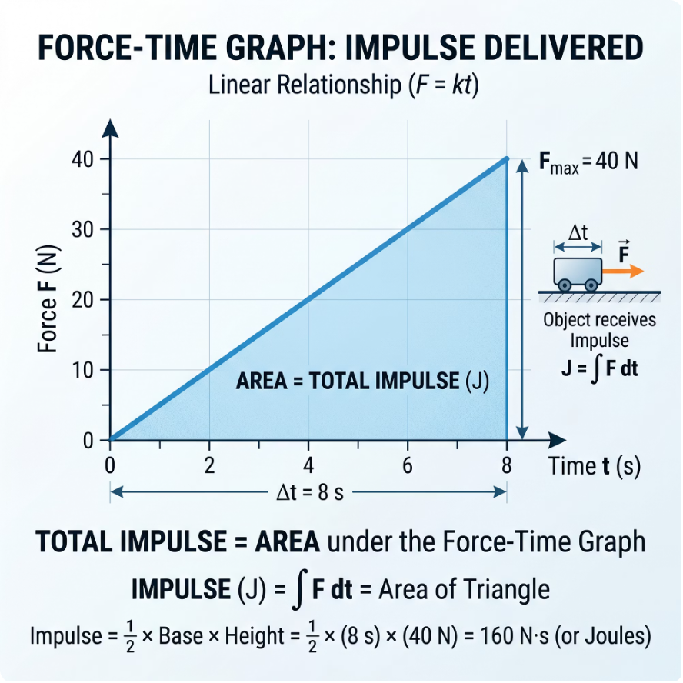

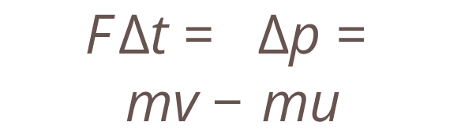
Impulse
Rearranging the second law by multiplying both sides by time gives us a new and important quantity: Impulse.
Force-Time Graph
Definition
Key Equivalence
On a Force-Time graph, the area under the line equals the total impulse delivered to the object.
Impulse = Force multiplied by time
Impulse equals the change in momentum
Unit
N s, which is identical to kg m/s. Both are correct.
@thelucidstem.com

Slide 7

EXAMINER'S TRAP
The Rebound Illusion
Examiner reports consistently flag this as one of the most common fatal errors at AS Level. Do not make it.
The Trap
The Correct Working
A ball hits a wall at 5 m/s and rebounds at 5 m/s. A student claims the change in momentum is zero because the speeds are equal.
Define rightward as positive:
Initial velocity: u = +5 m/s
Final velocity: v = -5 m/s (opposite direction)
Change in velocity = v - u = (-5) - (+5) = -10 m/s
Why This is Wrong
Velocity is a vector. Speed is the same, but direction has reversed. The change is not zero.
The change in momentum is double the initial momentum, not zero. A negative result simply means the change points in the original direction of travel.
@thelucidstem.com

Slide 8
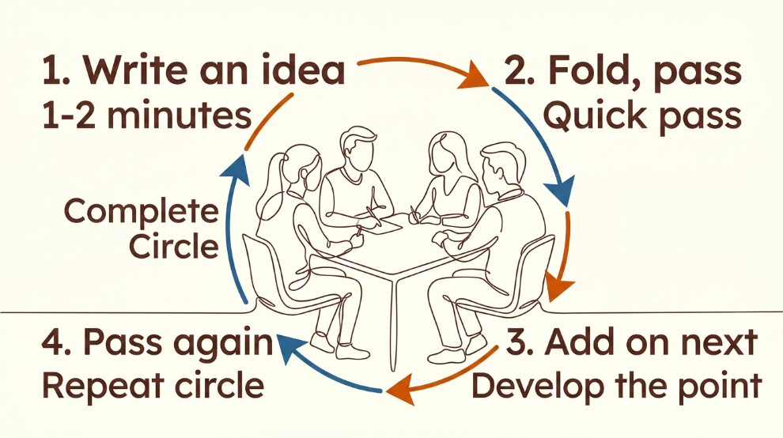
Cooperative Task: Round Table
A structured active-learning protocol. Follow the instructions carefully as a group.
Round Table Protocol
One Sheet, One Pen
1
Each group of four shares a single recording sheet and a single pen. One writer at a time.
The Prompt
2
Think of real-life situations where we deliberately change the TIME of an impact to change the FORCE of the impact.
Write and Pass
3
Each learner writes one example with a brief reason, then passes the sheet to the left.
Keep Going
4
Continue passing the sheet in a circle until the timer sounds. Aim for as many examples as possible.
@thelucidstem.com

Slide 9
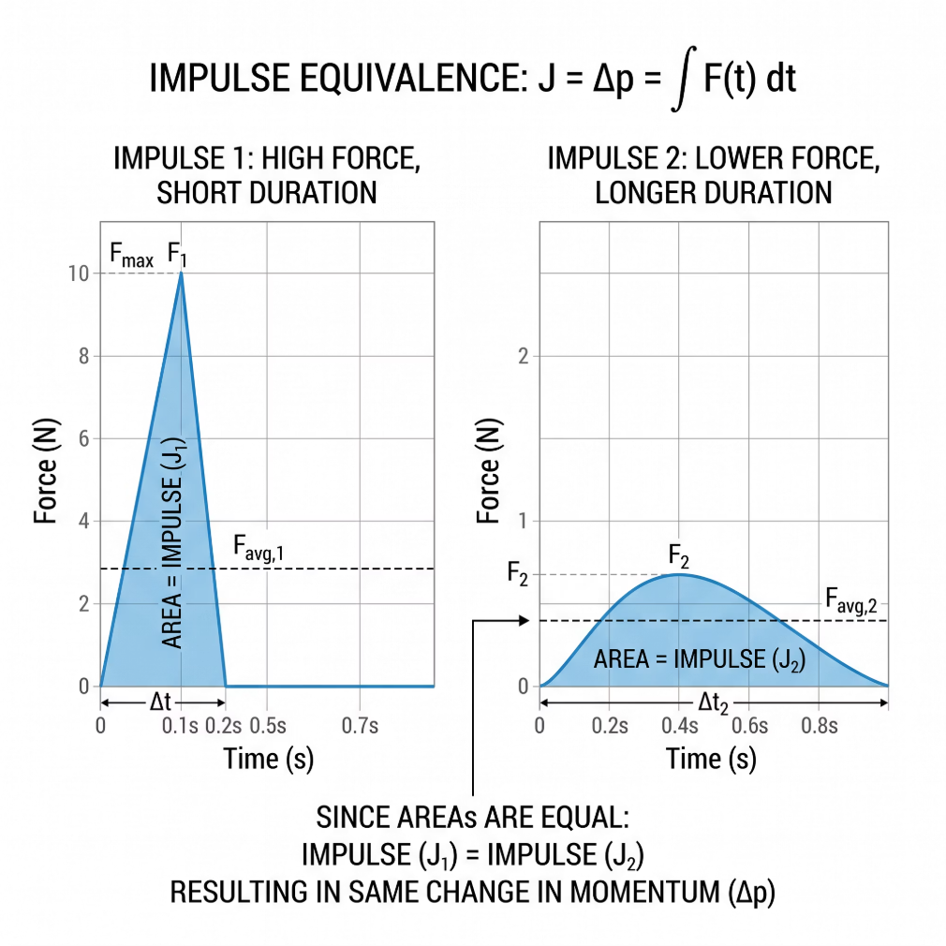
Lengthening the Time to Reduce Force
When the change in momentum is fixed (for example, bringing a moving body to rest), the only way to reduce the resultant force is to increase the stopping time.
Airbags
Force-Time Comparison
Extend the time the passenger decelerates during a crash, dramatically reducing the peak force on the body.
Both graphs have the same shaded area (same impulse), but the shape is very different.
Crumple Zones
The front of the car is designed to collapse progressively, lengthening the duration of the impact.
Bending Your Knees
On landing, flexing your knees extends your stopping time, reducing the peak force on your joints.
Crash Mats and Bubble Wrap
Soft, compressible materials increase contact time on impact, working on exactly the same principle.
@thelucidstem.com

Slide 10
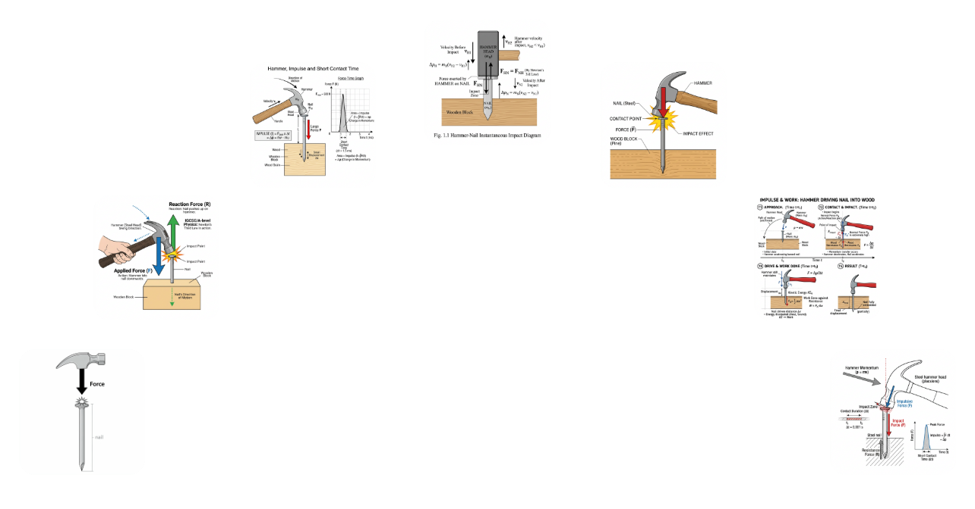

Shortening the Time to Maximise Force
Sometimes we want the largest possible force from a given impulse. The strategy is the opposite: make the contact time as short as possible.
Hammer and Nail
Karate Strike
A rigid steel hammer striking a rigid steel nail stops in an extremely short time, producing a massive force concentrated at the tip.
A brief, forceful snap delivers a large impulse in a tiny time interval, generating an enormous peak force sufficient to break boards.
Hammer Strikes Nail
Short, high-force impact
Impact Diagram
Kicking a Football
Hard boots have a shorter contact time than soft slippers, producing a greater average force and therefore a faster ball.
Short contact time + fixed impulse = very large peak force. This is the physical principle behind all striking tools.
@thelucidstem.com

Slide 11

Prove It: Exit Ticket
Return to your seat. Complete both questions independently and in silence before leaving. Show all working clearly.
1
2
Football Kick
Landing a Jump
A 0.45 kg football is kicked from rest to a speed of 24 m/s. The boot is in contact with the ball for 0.010 s.
Calculate the average force on the ball during the kick.
Explain, using the word "impulse" explicitly in your answer, why bending your knees when landing from a jump reduces the force on your legs.
For Question 1: use F = change in momentum / time. For Question 2: a complete answer must state that the impulse is fixed, and explain what changing the time does to the force.
@thelucidstem.com

