Slide 1
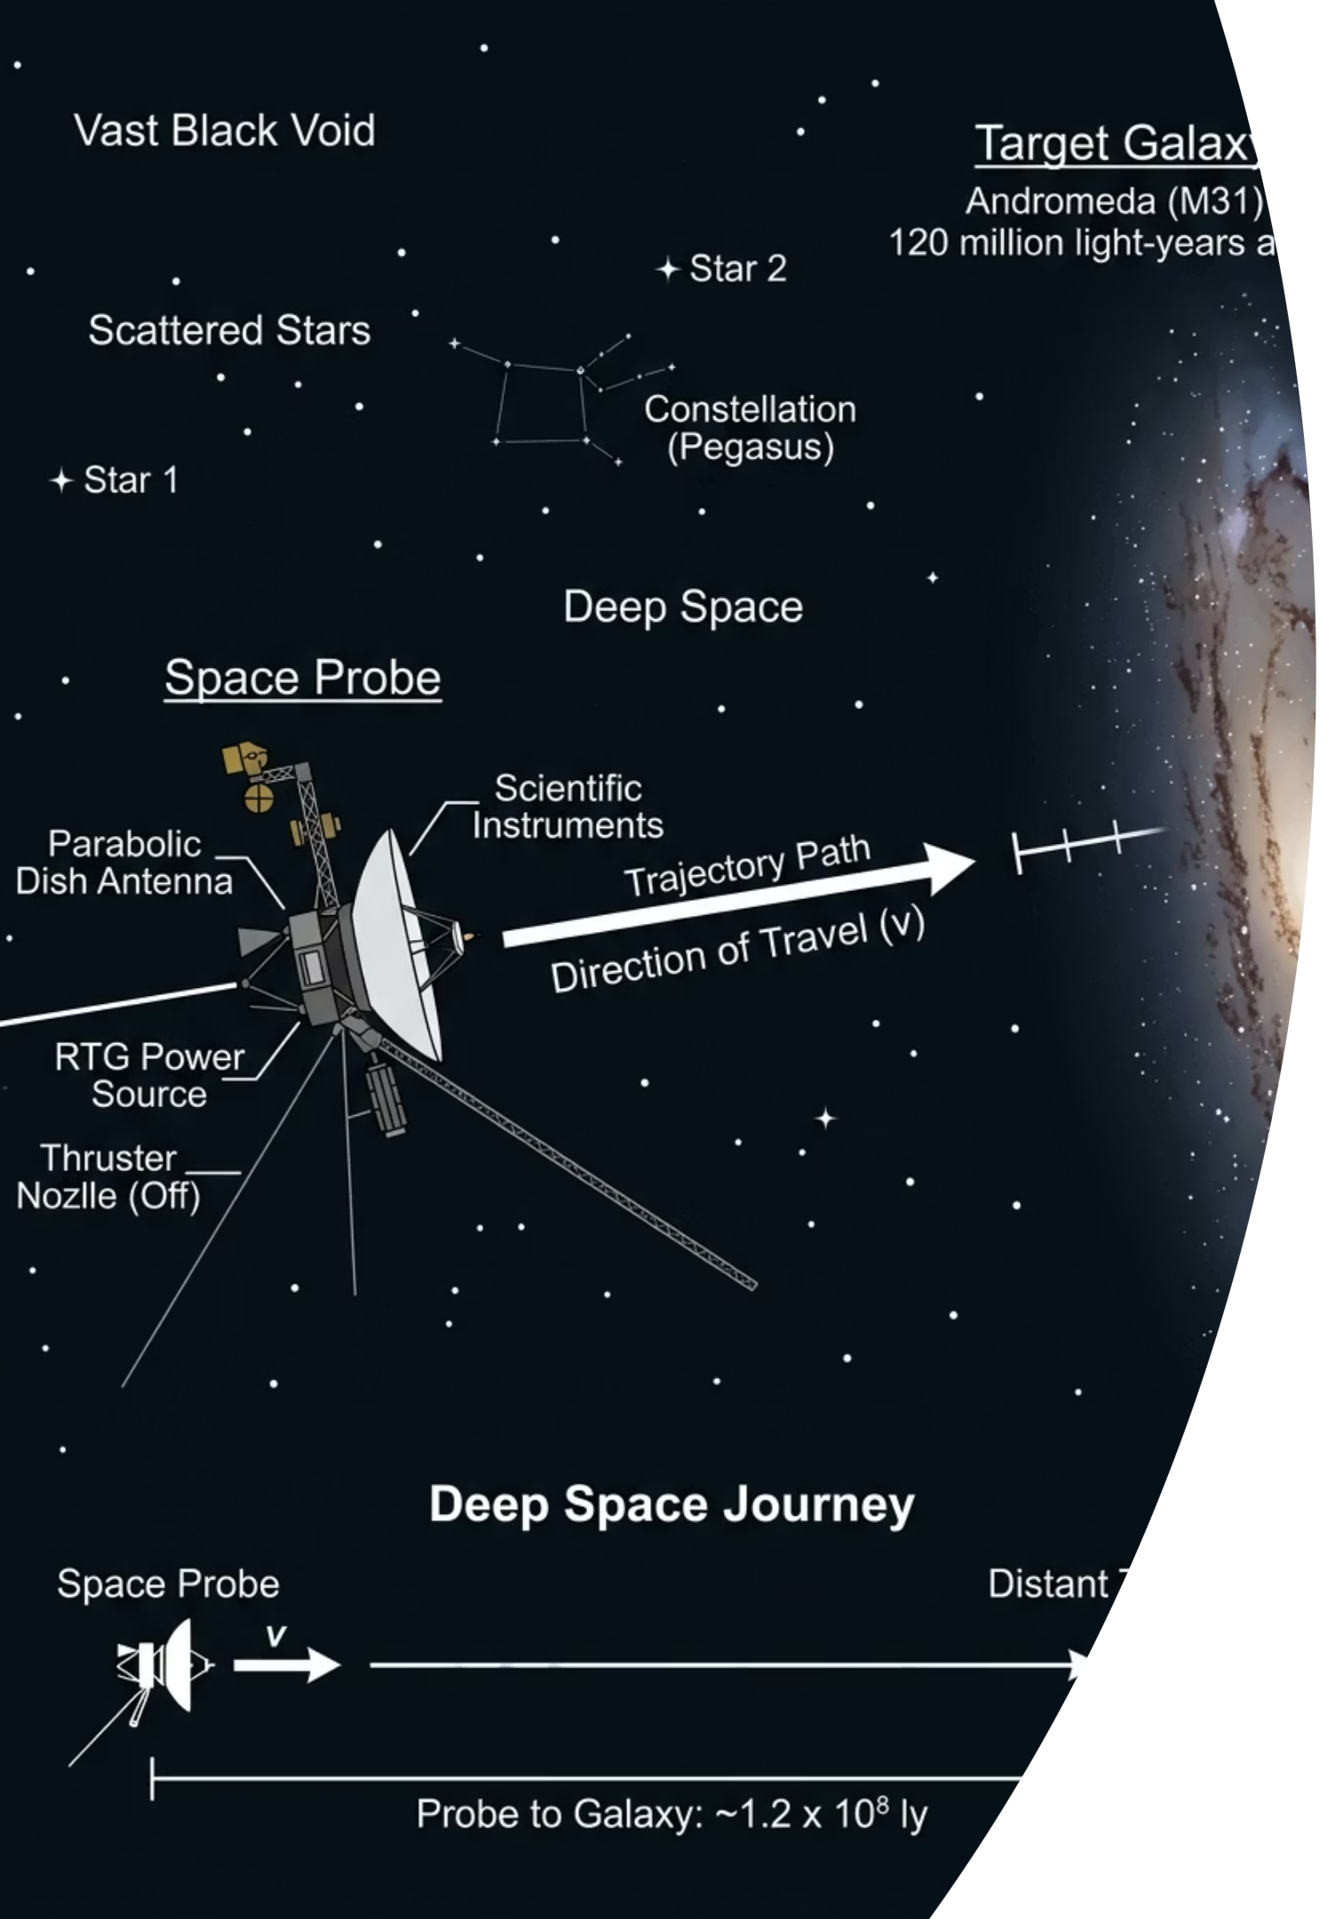
Newton's Laws of Motion
Cambridge International AS & A Level Physics 9702
A LEVEL PHYSICS
CAMBRIDGE 9702

Slide 2
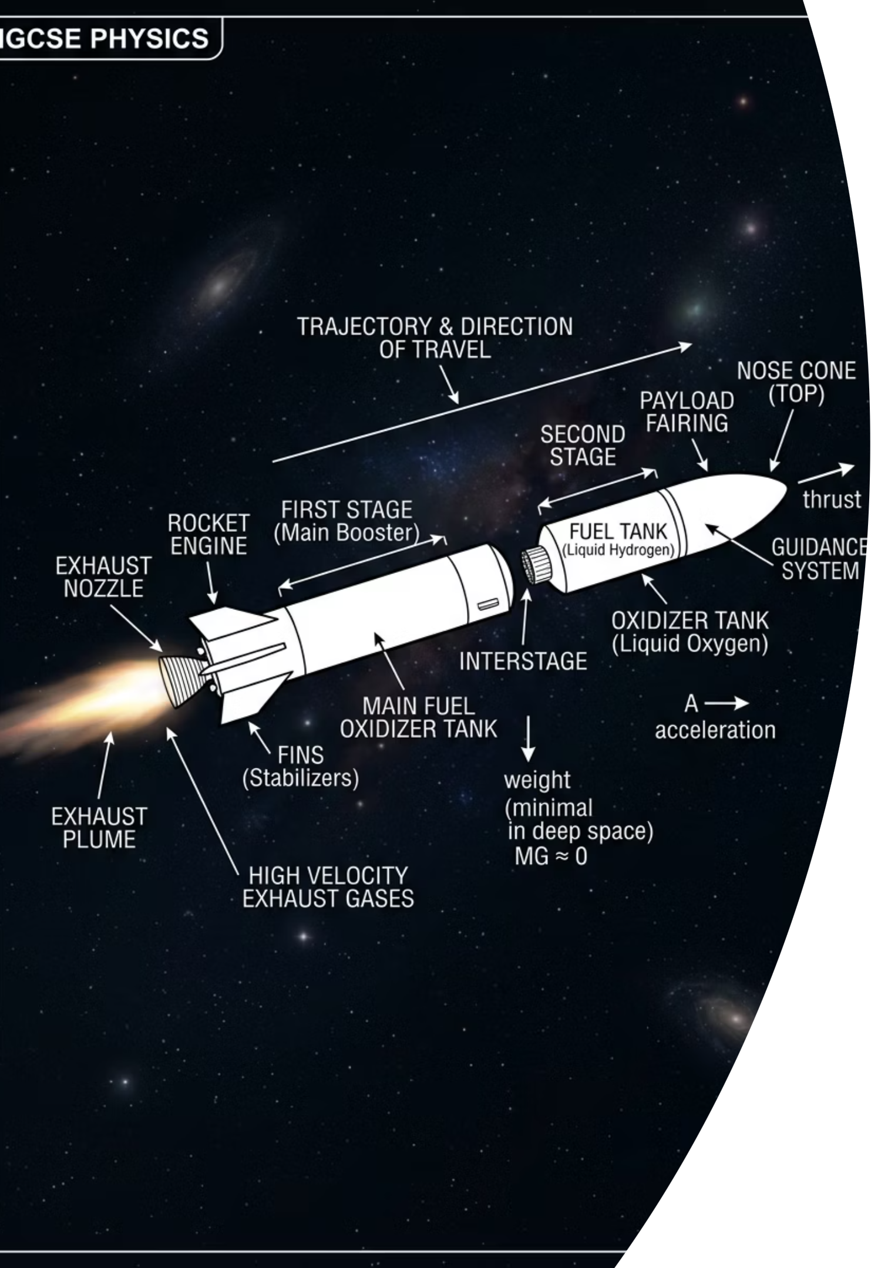

The Space Probe Paradox
Imagine a space probe travelling through deep space, far away from any planets or stars. Its engines are completely switched off.
Think silently: What happens to its speed? Does it gradually slow down and stop, or does it keep moving forever?
The Earthly Instinct
The Reality
On Earth, moving objects slow down. We assume a force is always needed to keep things going.
In deep space with zero resultant force, the probe continues at exactly the same velocity forever.
Today's Big Idea
Our Earth-bound intuition about forces and motion is fundamentally flawed. Newton corrected it.
thelucidstem.com

Slide 3
Topic: Newton's Laws of Motion
By the end of this AS Level lesson, you will be able to:
1
Newton's First Law
State the first law and explain it using the concept of inertia and equilibrium.
2
Mass vs Weight
Understand mass as a measure of inertia. Distinguish mass from weight using W = mg.
3
Newton's Second Law
State and apply the second law for constant mass using F = ma.
4
Newton's Third Law
State the third law and correctly identify the two forces in a third-law pair.
5
Application
Apply all three laws to situations involving resultant force and equilibrium.
thelucidstem.com

Slide 4

Newton's First Law: Inertia and Equilibrium
"An object remains at rest or continues to move at constant velocity unless acted upon by a resultant force."
Key Definitions
What This Means in Practice
Inertia: The natural resistance of any object to a change in its state of motion. A larger mass has greater inertia.
Equilibrium: When all forces on an object are perfectly balanced, the resultant force is zero.
An object moving at constant velocity has zero resultant force acting on it. It does NOT need a force to keep moving.
An object at rest also has zero resultant force. Both states are equivalent in terms of Newton's First Law.
Constant velocity requires zero resultant force. This is the single most important insight of the First Law.
thelucidstem.com

Slide 5
Newton's Second Law: Force and Acceleration
Newton's Second Law tells us precisely what happens when forces do not balance. The resultant force equals the rate of change of momentum.
The Equation
Critical Rules
For an object of constant mass, the second law simplifies to:
F = ma
Direction
The acceleration is always in the exact same direction as the resultant force.
Where F is resultant force (N), m is mass (kg), and a is acceleration (m s-2).
Resultant Force
F must always be the resultant (net) force, not any single individual force.
Constant Mass
This simplified form applies only when mass does not change during motion.
thelucidstem.com

Slide 6
Newton's Third Law: Action-Reaction Pairs
"If body A exerts a force on body B, then body B exerts an equal and opposite force on body A."
Equal in Size
Opposite in Direction
The two forces in a third-law pair are always exactly equal in magnitude.
The two forces always point in exactly opposite directions along the same line of action.
Different Bodies
Same Type of Force
The two forces MUST act on two completely different bodies. Never on the same object.
Both forces must be the same type (e.g. both gravitational, or both contact/normal forces).
thelucidstem.com

Slide 7
The Examiner's Trap: Force Illusions
Examiner Report Warning: These are the most frequently penalised errors in AS Level examinations. Avoid them completely.
Trap 1: Motion Requires a Force
Trap 2: Confusing Mass and Weight
Trap 3: False Third-Law Pairs
Wrong: "The object keeps moving because a force acts on it."
Correct: Only a change in motion (i.e. an acceleration) requires a resultant force. Constant velocity requires zero resultant force.
Wrong: "My weight is 70 kg."
Correct: Mass is a scalar measured in kg. Weight is a vector force measured in N. Use W = mg to convert between them.
Wrong: "The book's weight and the table's normal force are a Newton's Third Law pair."
Correct: Both forces act on the same book. A true third-law pair must act on two different bodies.
thelucidstem.com

Slide 8

Cooperative Task: The Frayer Model
The Protocol
The Frayer Model Grid
Each group has two four-box grids: one for MASS and one for WEIGHT.
Work through the boxes in this order:
Definition
Characteristics
Write a precise scientific definition in your own words.
List key properties: scalar/vector, SI unit, how it varies.
Definition
Characteristics
Examples
Non-examples (most important!)
Examples
Non-examples
Give at least two real-world examples with values.
What does this concept NOT include? This is the key challenge.
The Non-examples box is the hardest and most valuable. You must reach group agreement before writing.
We will compare grids as a class to settle any disagreements at the end.
thelucidstem.com

Slide 9

Frayer Review: Mass
Compare your group's completed grid with the teacher model below.
Definition
Characteristics
A measure of inertia. The resistance to a change in motion. The quantity of matter contained in an object.
Scalar quantity. SI unit: kilogram (kg). Has the exact same value everywhere in the universe, regardless of location.
Examples
Non-examples
A 2 kg bag of sugar. A 70 kg person. A 1500 kg car.
700 N (that is a force, not a mass). A value that changes on the Moon. Any quantity measured in newtons.
Mass is a scalar. It is measured in kg. It never changes with location.
thelucidstem.com

Slide 10
Frayer Review: Weight
Compare your group's completed grid with the teacher model below.
Definition
Characteristics
The gravitational force acting on a body. Calculated using the formula W = mg, where g is the gravitational field strength.
Vector quantity (acts downwards). SI unit: newton (N). Varies with location because g differs on different planets and moons.
Examples
Non-examples
A 2 kg mass has a weight of 19.6 N on Earth (g = 9.81 m s-2). The same mass weighs only 3.2 N on the Moon.
2 kg (that is a mass). The amount of matter in an object. Any quantity measured in kilograms or that is constant everywhere.
Weight is a force. It is measured in N. It changes with gravitational field strength.
thelucidstem.com

Slide 11
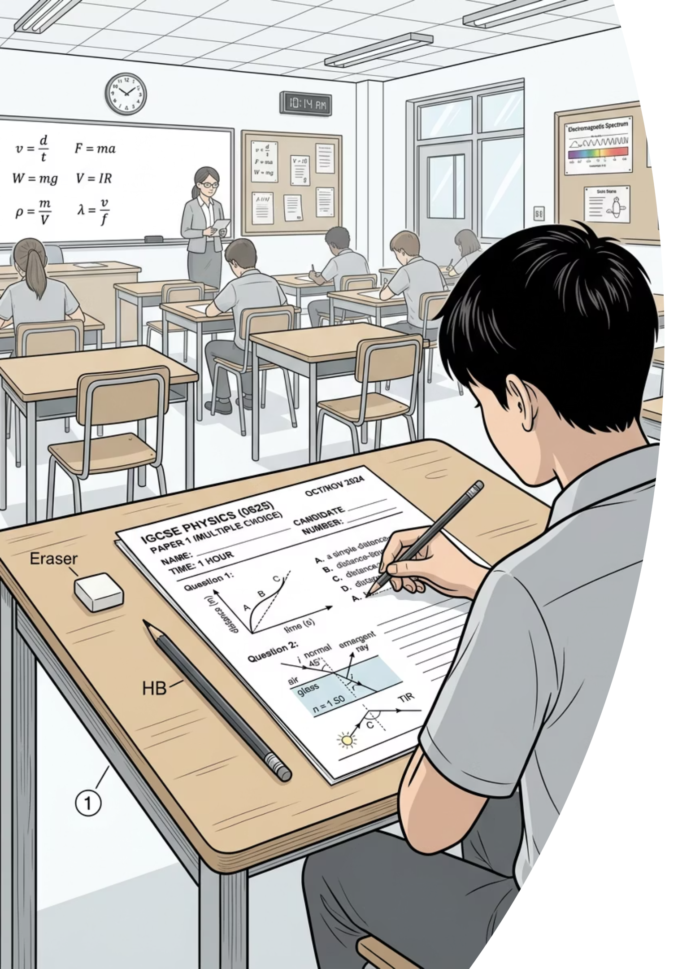

Prove It: Exit Ticket
Silence in the room. Return to your desks and complete both questions independently before you leave.
Question 1: Applying F = ma
1
A 6.0 kg object has a resultant force of 18 N acting on it.
Calculate its acceleration. State the SI unit in your answer.
Question 2: Mass vs Weight
2
State one clear difference between mass and weight.
Your answer must include the SI unit of each quantity.
Full marks require correct units, correct significant figures, and precise scientific language. Vague answers will not score.
thelucidstem.com

