Slide 1
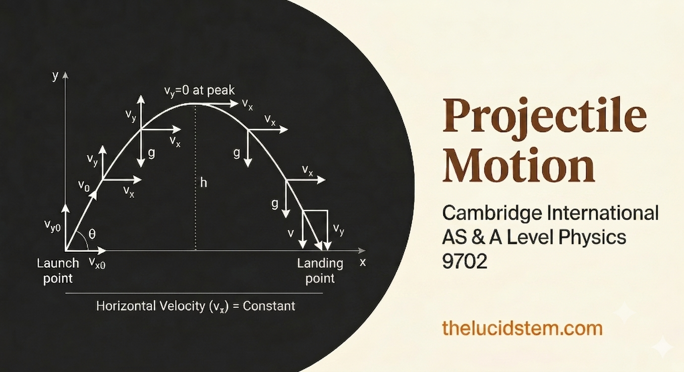

Slide 2
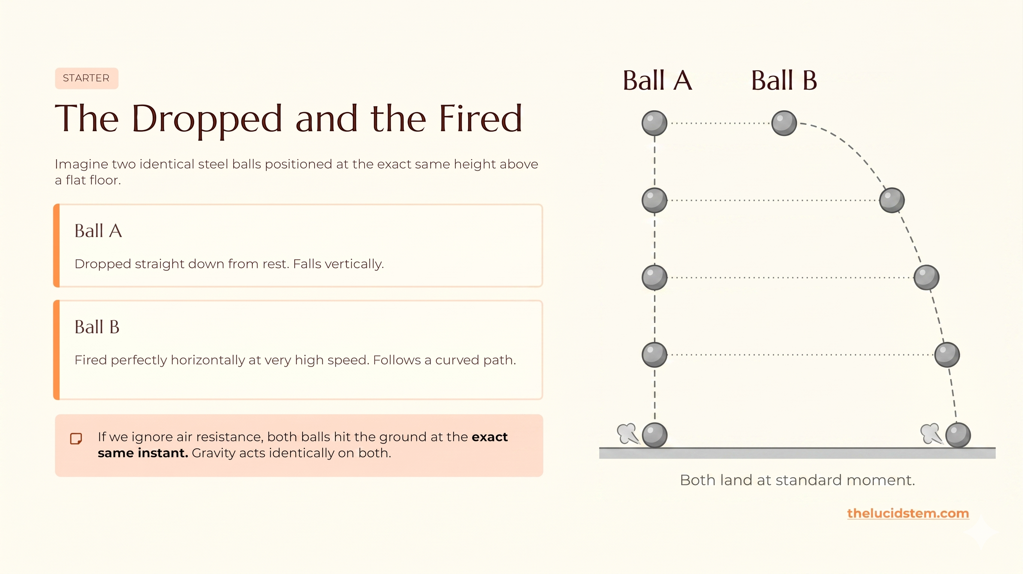

Slide 3
Topic: Projectile Motion
By the end of this AS Level lesson, you will be able to:
01
02
03
Describe the motion
Resolve velocity components
Apply kinematics correctly
Projectile motion combines constant horizontal velocity with vertical free fall.
Split any launch velocity into its horizontal and vertical components using trigonometry.
Use constant velocity horizontally and the SUVAT equations vertically.
04
05
Calculate key quantities
Describe air resistance qualitatively
Find time of flight, range, maximum height, and resultant velocity at any instant.
Explain how drag alters the ideal parabolic trajectory.
thelucidstem.com

Slide 4

The Golden Rule of Independence
The motions are independent. They share only TIME.
Horizontal Motion
Vertical Motion
No air resistance means zero horizontal acceleration. The object travels at a constant horizontal velocity for the entire flight. No force acts in this direction.
The only force acting is weight. The object is in free fall with a constant downward acceleration equal to g (9.81 m s-2). Use the SUVAT equations here.
The two motions are coupled by one variable only: the time of flight, t. Solve for t in one axis and use it in the other.
thelucidstem.com

Slide 5
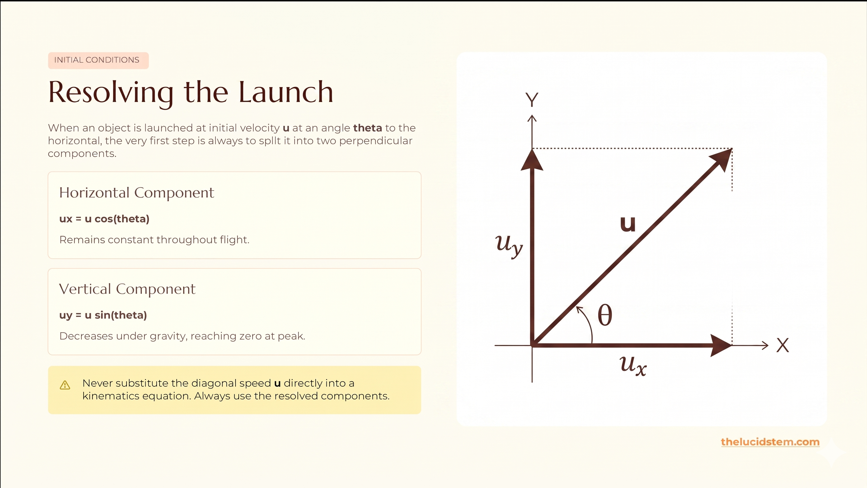

Slide 6
EXAMINER ALERT
The Mixed Axis Illusion
Examiner reports consistently flag these three errors as the most common causes of lost marks at AS Level. Avoid them completely.
Trap 1: Using g horizontally
Applying 9.81 m s-2 in the horizontal direction. Correction: Horizontal acceleration is exactly zero. Use distance = speed x time only.
Trap 2: The object stops at the peak
Assuming total velocity is zero at maximum height. Correction: Only the vertical component is zero at the peak. The horizontal velocity is unchanged.
Trap 3: Mixing axes
Using horizontal distance with vertical velocity in the same equation. Correction: Keep x-data and y-data in strictly separate columns. They never mix.

Slide 7

ACTIVE LEARNING
Cooperative Task: Concept Mapping
Work in groups. The goal is to build a complete structural map of projectile motion using physical concept cards and a large sheet of paper.
1
Place and connect
Arrange the concept cards and join them with drawn arrows.
2
Label every arrow
Write the exact relationship, such as "splits into", "is determined by", or "depends on".
3
Justify aloud
Every learner must verbally justify at least one link to their group.
4
Compare maps
Groups will share findings at the end to verify reasoning.
thelucidstem.com

Slide 8
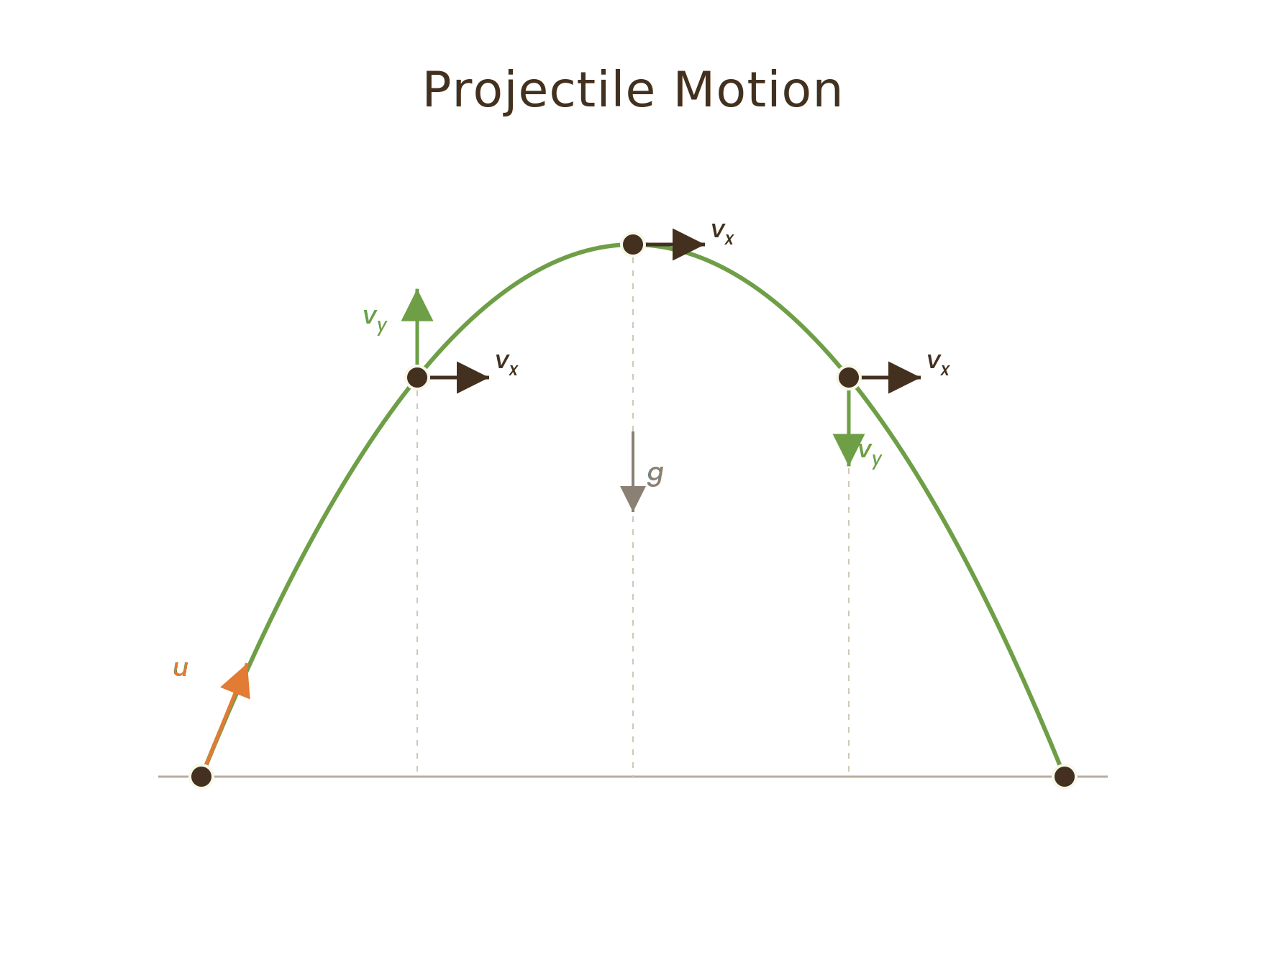
PHASE 1 OF 3
The Base Branches
Begin constructing your concept map from the centre outward. This first phase establishes the fundamental structure of the entire topic.
Horizontal Motion
Constant velocity; zero acceleration
Vertical Motion
Free fall; acceleration = g downward
Place the central card labelled Projectile Motion in the middle of your sheet. Draw two branches: one to horizontal motion and one to vertical motion. Label the connecting arrows with the rule of independence. Then attach the rule cards: horizontal links to "constant velocity" and vertical links to "free fall, a = g".
thelucidstem.com

Slide 9
PHASE 2 OF 3
The Launch Data
Extend your map by adding the initial launch conditions. Show precisely how the launch velocity and the launch angle together produce the two working components.
Launch velocity u and launch angle theta
Horizontal component
These two quantities are your starting inputs. Place both cards on your map.
Link to a card labelled u cos(theta). The arrow label should read "resolved as".
Vertical component
Link to a card labelled u sin(theta). The arrow label should again read "resolved as".
thelucidstem.com

Slide 10
PHASE 3 OF 3
The Flight Outcomes
Complete the map by connecting your components to the four key physical outcomes. Use precise linking language on every arrow.
Maximum Height
Time of Flight
Which specific component determines the maximum height reached? Link it, and label the arrow with the condition at the peak.
Which component controls the total time in the air? Note that time is the shared variable between both axes.
Range
Resultant Velocity
Show how the time of flight and the horizontal velocity combine to produce the total horizontal range.
Show how the horizontal and vertical components combine at any instant using vector addition to give the resultant velocity.
thelucidstem.com

Slide 11
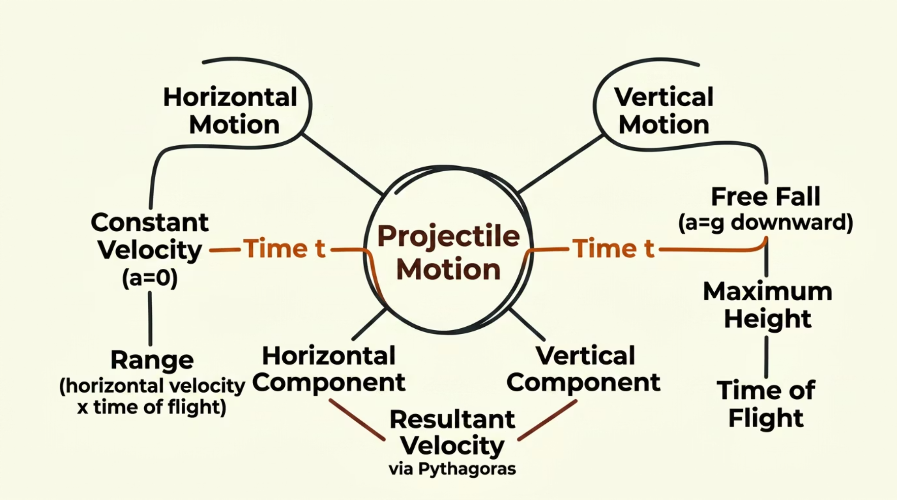
The Complete Structure
Check your group's map against the following verified theoretical links. Every connection below should appear on your map with a clear, accurate label.
Vertical axis drives time
Time links the axes
Resultant by vector addition
The vertical motion alone determines the time of flight and the maximum height.
Time of flight, combined with constant horizontal velocity, gives the total range.
At any instant, the horizontal component and the vertical component are added as vectors to give the resultant velocity.
thelucidstem.com

Slide 12
REALITY CHECK
Enter Air Resistance
The ideal parabola exists only in a vacuum. In any real environment, drag force acts opposite to the direction of motion, altering the trajectory in three important ways.
Reduced height
Reduced range
Air resistance removes kinetic energy, reducing the maximum height reached.
Both horizontal and vertical speeds are reduced, shortening the total range significantly.
Asymmetric path
The descent is much steeper than the ascent. The trajectory is no longer a symmetric parabola.
thelucidstem.com

Slide 13

EXIT TICKET
Prove It.
Return to your desks. Complete both questions independently and in silence before you leave. Show all working clearly and keep your axes separate.
Cliff Problem
1
A stone is thrown perfectly horizontally at 8.0 m s-1 from a cliff of height 5.0 m. Calculate the time taken for it to reach the ground, and then calculate the horizontal distance it travels. Take g = 9.81 m s-2.
Explanation Question
2
In exactly one clear sentence, explain why the horizontal velocity of a projectile remains constant throughout its flight when air resistance is ignored.
thelucidstem.com

