Slide 1
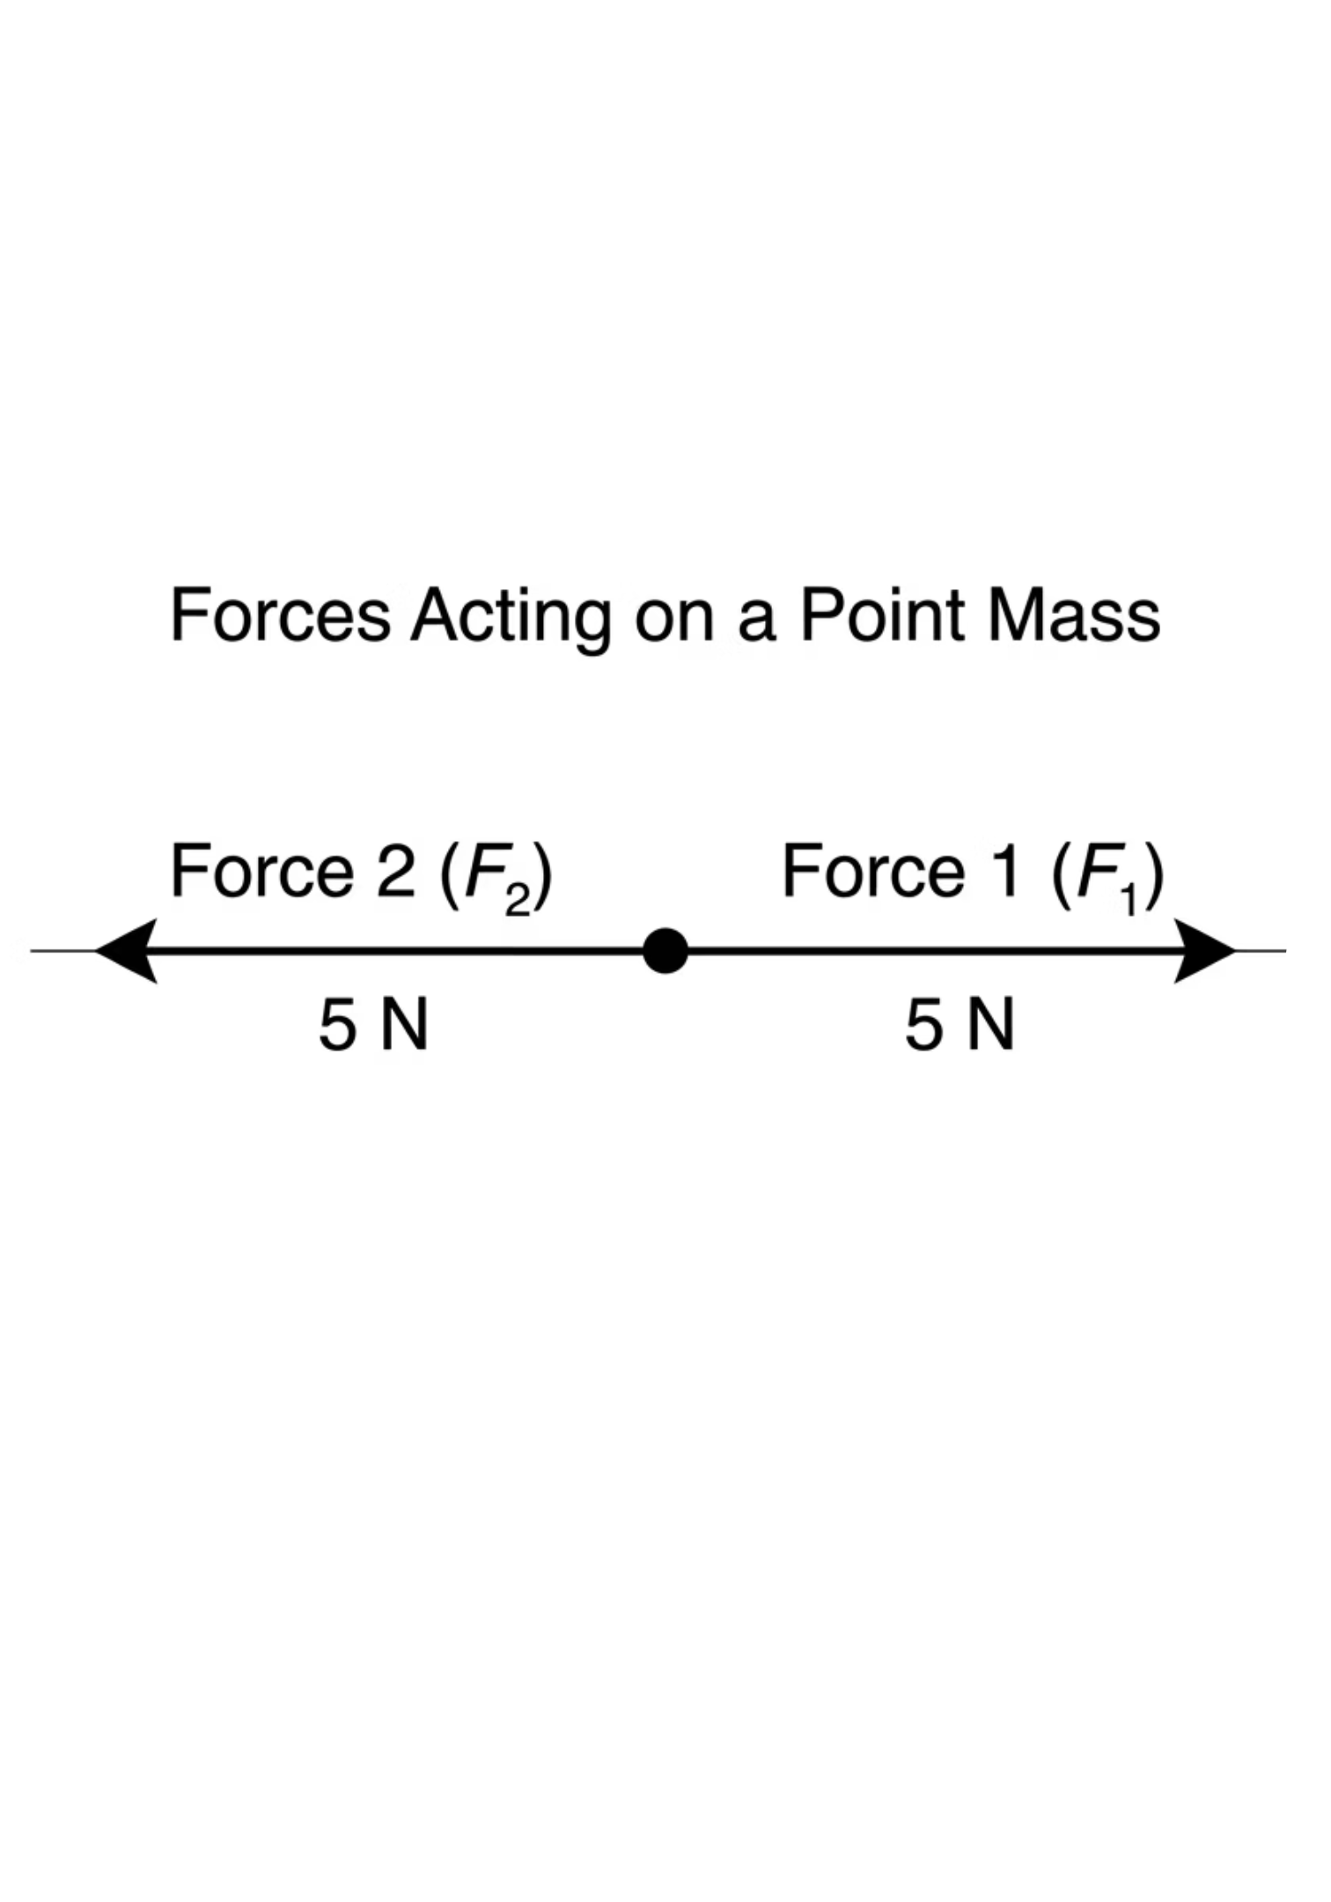
Scalars and Vectors
Cambridge International AS & A Level Physics 9702
thelucidstem.com

Slide 2
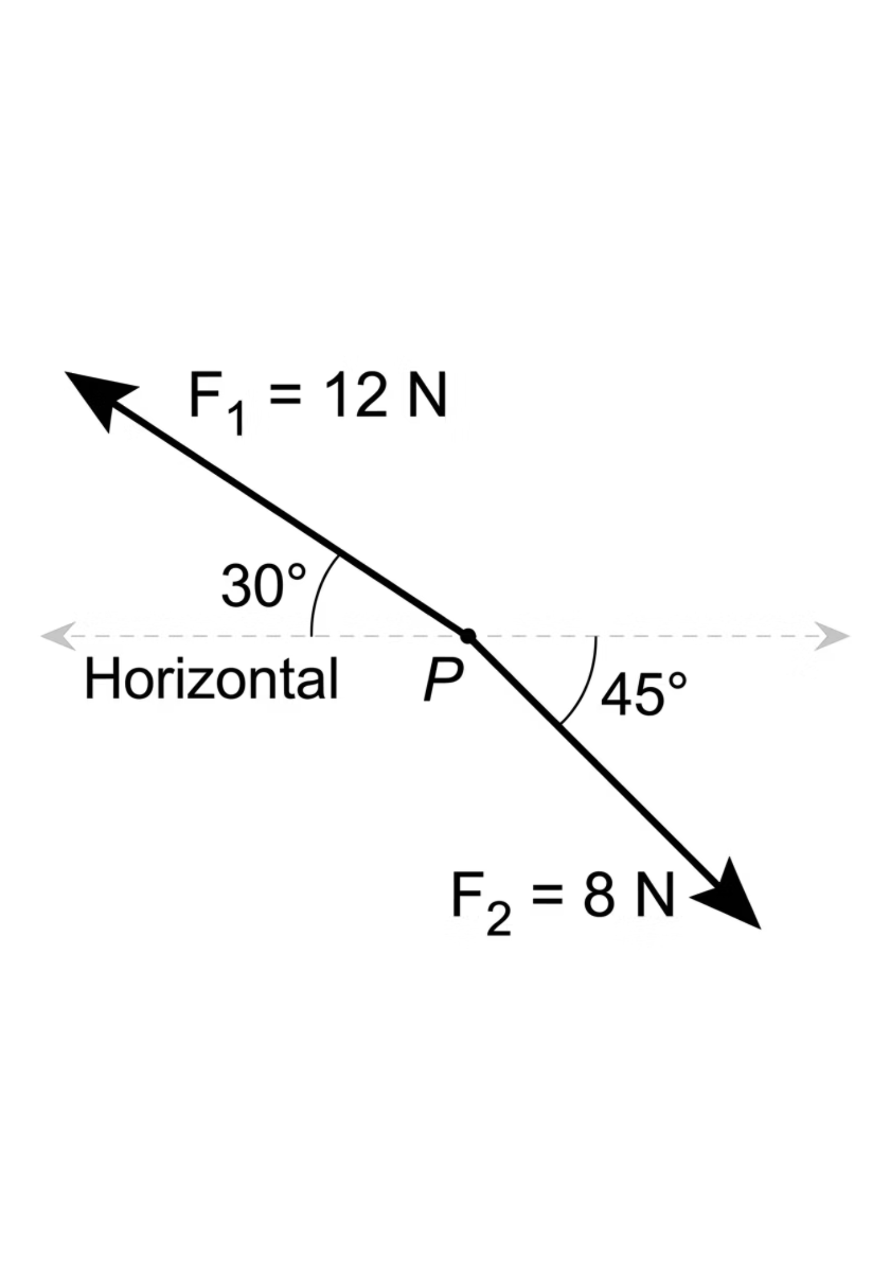
STARTER
The 5 and 3 Paradox
The Setup
Think Silently
Consider two forces acting on the exact same point. Force A is 5 N and Force B is 3 N.
A learner claims that the total combined force must be 8 N.
Is this always true?
What is the absolute maximum resultant these two forces could produce?
What is the absolute minimum resultant they could produce?
Vectors do not follow ordinary arithmetic rules. The angle between them changes everything.
thelucidstem.com

Slide 3
AS LEVEL PHYSICS 9702
Topic: Scalars and Vectors
By the end of this lesson, you will be able to:
01
02
03
Classify Quantities
Add Coplanar Vectors
Resolve a Vector
Distinguish scalar and vector quantities and give confident examples of each.
Add and subtract coplanar vectors using a scale diagram, applying the tip-to-tail or parallelogram method.
Split a vector into two perpendicular components using F cos(theta) and F sin(theta).
04
05
Find the Resultant
Angle Dependence
Calculate the magnitude and direction of a resultant using Pythagoras and the tangent ratio.
Explain that two fixed-size vectors give a resultant whose size depends entirely on the angle between them.
thelucidstem.com

Slide 4
CORE CONCEPT
Scalars versus Vectors
At AS Level, you must be absolutely confident in these classifications. Every physical quantity belongs to one of two categories.
Scalar Quantities
Vector Quantities
Magnitude only. No direction is required or meaningful.
Magnitude AND direction. Both must be stated.
Mass (kg)
Time (s)
Speed (m/s)
Energy (J)
Temperature (K)
Displacement (m)
Velocity (m/s)
Force (N)
Acceleration (m/s²)
Momentum (kg m/s)
thelucidstem.com

Slide 5
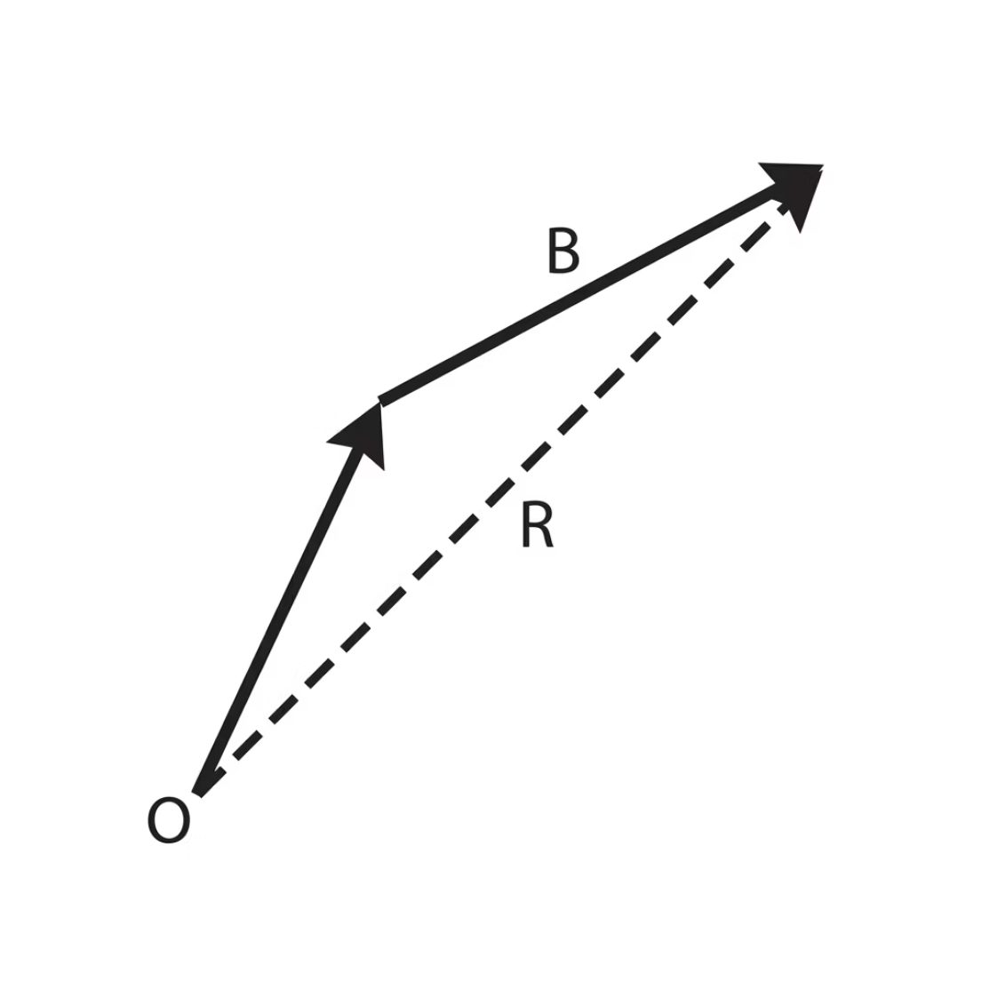
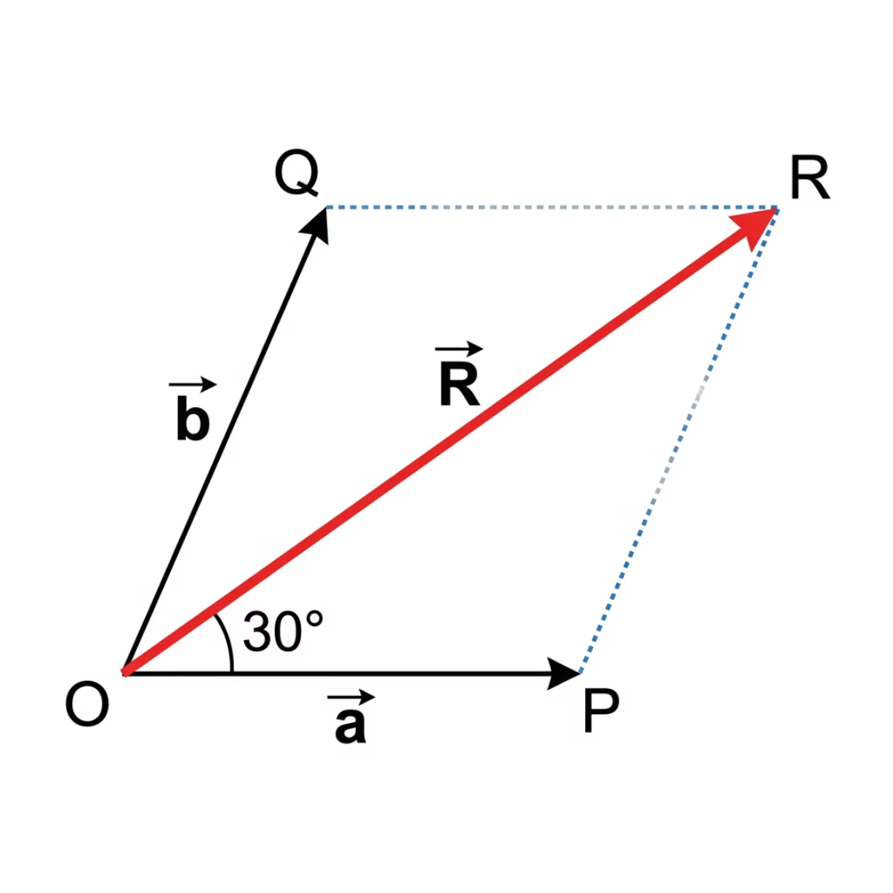
VECTOR ADDITION
Adding Coplanar Vectors
When adding two vectors, draw them to scale. Two standard methods are accepted at AS Level.
Tip-to-Tail Method
Parallelogram Method
Draw the first arrow to scale. Start the second arrow at the exact tip of the first. The resultant is the straight line drawn from the very start of the first arrow to the very end of the second arrow.
Start both arrows from the exact same point. Complete the parallelogram by drawing parallel lines. The resultant is the diagonal drawn from the shared origin across the box.
thelucidstem.com

Slide 6
RESOLUTION OF VECTORS
Resolving into Components
Any single diagonal force can be replaced by two perpendicular components that produce the exact same physical effect. This technique is fundamental to every mechanics problem at AS Level.
Horizontal (Adjacent)
Vertical (Opposite)
F cos(theta)
The component along the axis nearest the angle.
F sin(theta)
The component perpendicular to the adjacent side.
Essential for analysing objects on slopes and forces acting at angles to a surface.
thelucidstem.com

Slide 7

EXAMINER WARNING
The Trigonometry Illusions
Examiner Report Warning: These are the most frequent sources of lost marks at AS Level. Study each trap carefully.
Trap 1: Treating Vectors as Scalars
Trap 2: Cosine is Always Horizontal
Trap 3: Omitting the Direction
Error: Writing 10 N + 10 N = 20 N without checking direction.
Correction: 20 N is only correct if both forces point in the exact same direction. Otherwise, use a scale diagram or trigonometry to find the true resultant.
Error: Reflexively applying cos(theta) to the horizontal component.
Correction: Cosine gives the side adjacent to the stated angle. If theta is measured from the vertical, the vertical component becomes F cos(theta).
Error: Stating a resultant magnitude with no angle or bearing.
Correction: A resultant is a vector. Always state both magnitude and direction. Omitting the direction loses marks every time.
thelucidstem.com

Slide 8




ACTIVE LEARNING
Cooperative Task: Think-Pair-Share
Think
1 minute. Total silence. Read the prompt and jot down your independent reasoning.
Pair
2 minutes. Turn to your partner. Compare reasoning and agree on one perfect, shared answer.
Share
Cold-call. Selected pairs share their exact conclusion with the whole room.
thelucidstem.com

Slide 9
THINK-PAIR-SHARE
Prompt 1
The Misconception
Two forces of 5 N and 3 N act at the exact same point. A learner says the resultant must be 8 N.
Question A
Question B
Question C
Is the learner's statement always true? Justify your answer clearly.
What is the absolute maximum value the resultant could take? Under what condition does this occur?
What is the absolute minimum value the resultant could take? Under what condition does this occur?
thelucidstem.com

Slide 10

PROMPT 1: ANSWER
Did your pair get it right?
Is 8 N Always True?
Maximum Resultant
Minimum Resultant
No. It is only true if the two forces act in the exact same direction (0 degrees between them).
5 + 3 = 8 N
Forces act in the same direction. The vectors add fully.
5 - 3 = 2 N
Forces act in opposite directions. The vectors partially cancel.
Key takeaway: The resultant of two fixed vectors depends completely on the angle between them. Any value between 2 N and 8 N is physically possible.
thelucidstem.com

Slide 11
THINK-PAIR-SHARE
Prompt 2
Which Part Does the Work?
A box is pulled along the ground by a rope at 30 degrees above the horizontal with a tension of 20 N.
Question A
Question B
Which part of the 20 N force actually moves the box along the ground?
How exactly would you calculate its numerical value? Show your full method.
thelucidstem.com

Slide 12

PROMPT 2: ANSWER
Did your pair get it right?
The Horizontal Component Moves the Box
Full Calculation
Only the component parallel to the ground produces horizontal displacement.
The vertical component (10 N) acts upward and partially reduces the normal contact force but does not drag the box along the surface.
Horizontal component = F cos(theta)
= 20 x cos(30°)
= 20 x 0.866
= 17 N (to 2 s.f.)
Vertical component = F sin(theta)
= 20 x sin(30°) = 10 N (acts upward only)
Always identify which component is relevant to the physical situation before calculating. Not all components do useful work in every context.
thelucidstem.com

Slide 13
THINK-PAIR-SHARE
Prompt 3
Combining Perpendiculars
An object travels 3.0 m east and then 4.0 m north.
Question A
Question B
Question C
How far is the object from its starting point? What method will you use?
In what exact direction is the object from its start? How do you calculate the angle?
Write out the full mathematics clearly, showing every step.
thelucidstem.com

Slide 14
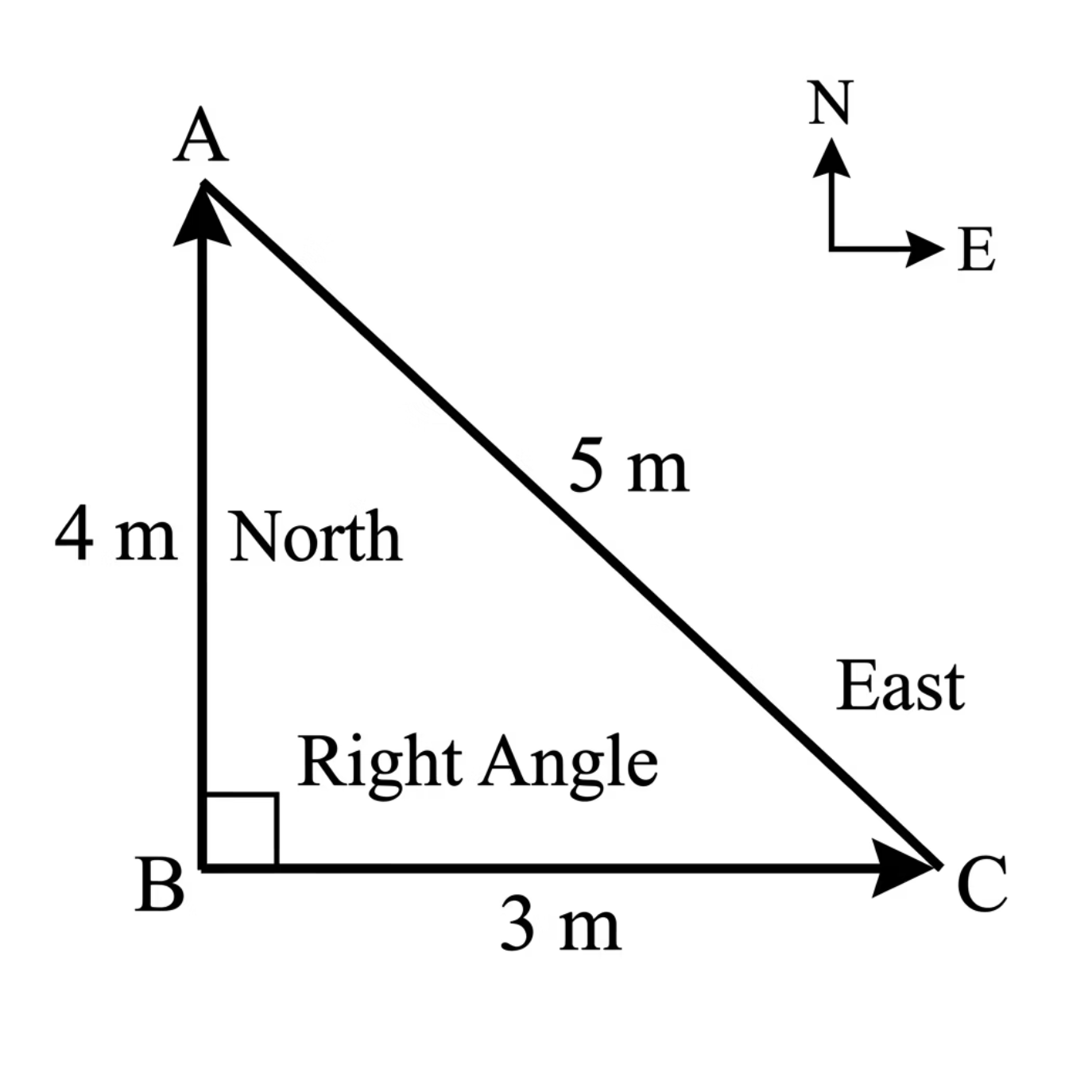

PROMPT 3: ANSWER
Did your pair get it right?
Magnitude: Pythagoras' Theorem
R = sqrt(3.0² + 4.0²)
= sqrt(9.0 + 16.0)
= sqrt(25.0)
= 5.0 m
Direction: Tangent Ratio
theta = arctan(4.0 / 3.0)
= arctan(1.333...)
= 53 degrees north of east
Full answer: 5.0 m at 53 degrees north of east. Both magnitude and direction must be stated.
thelucidstem.com

Slide 15
EXIT TICKET
Prove It.
Complete both questions independently and in silence before you leave. Show all working clearly.
1
2
Vector Resolution
Resultant Velocity
A force of 20 N acts at 60 degrees to the horizontal.
Calculate its exact horizontal component and its exact vertical component. State the correct units and show full working.
A swimmer heads north at 1.2 m/s across a river that flows east at 0.5 m/s.
Calculate the magnitude of the swimmer's true resultant velocity. State the direction of travel.
Hint for Q1: Identify which side is adjacent to 60 degrees before applying cos or sin. Hint for Q2: The two velocity components are perpendicular. Use Pythagoras.
thelucidstem.com

