Slide 1
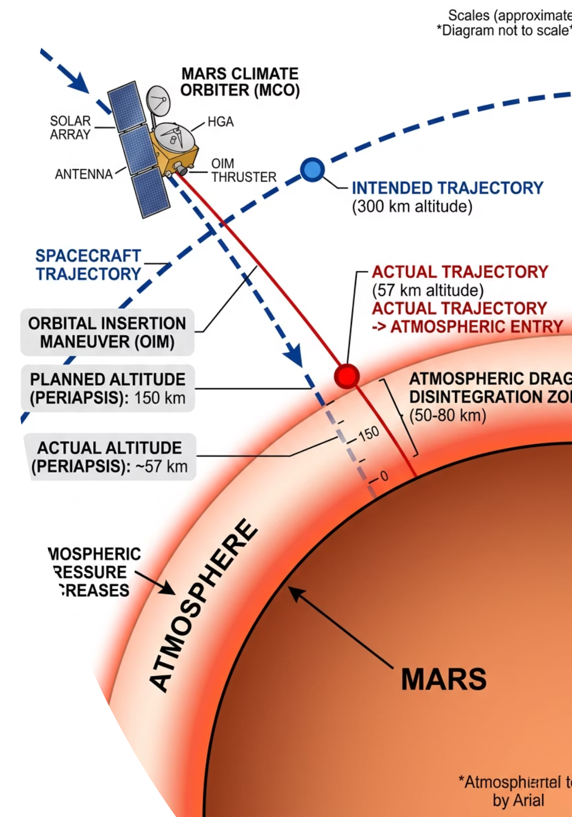

The Mars Climate Orbiter
In 1999, a multi-million dollar NASA mission to Mars failed catastrophically. The spacecraft burned up in the Martian atmosphere due to a single, fatal error: one engineering team used metric units whilst another used imperial units.
A number without a unit is physically meaningless. What makes a measurement truly meaningful in physics?
@thelucidstem.com

Slide 2
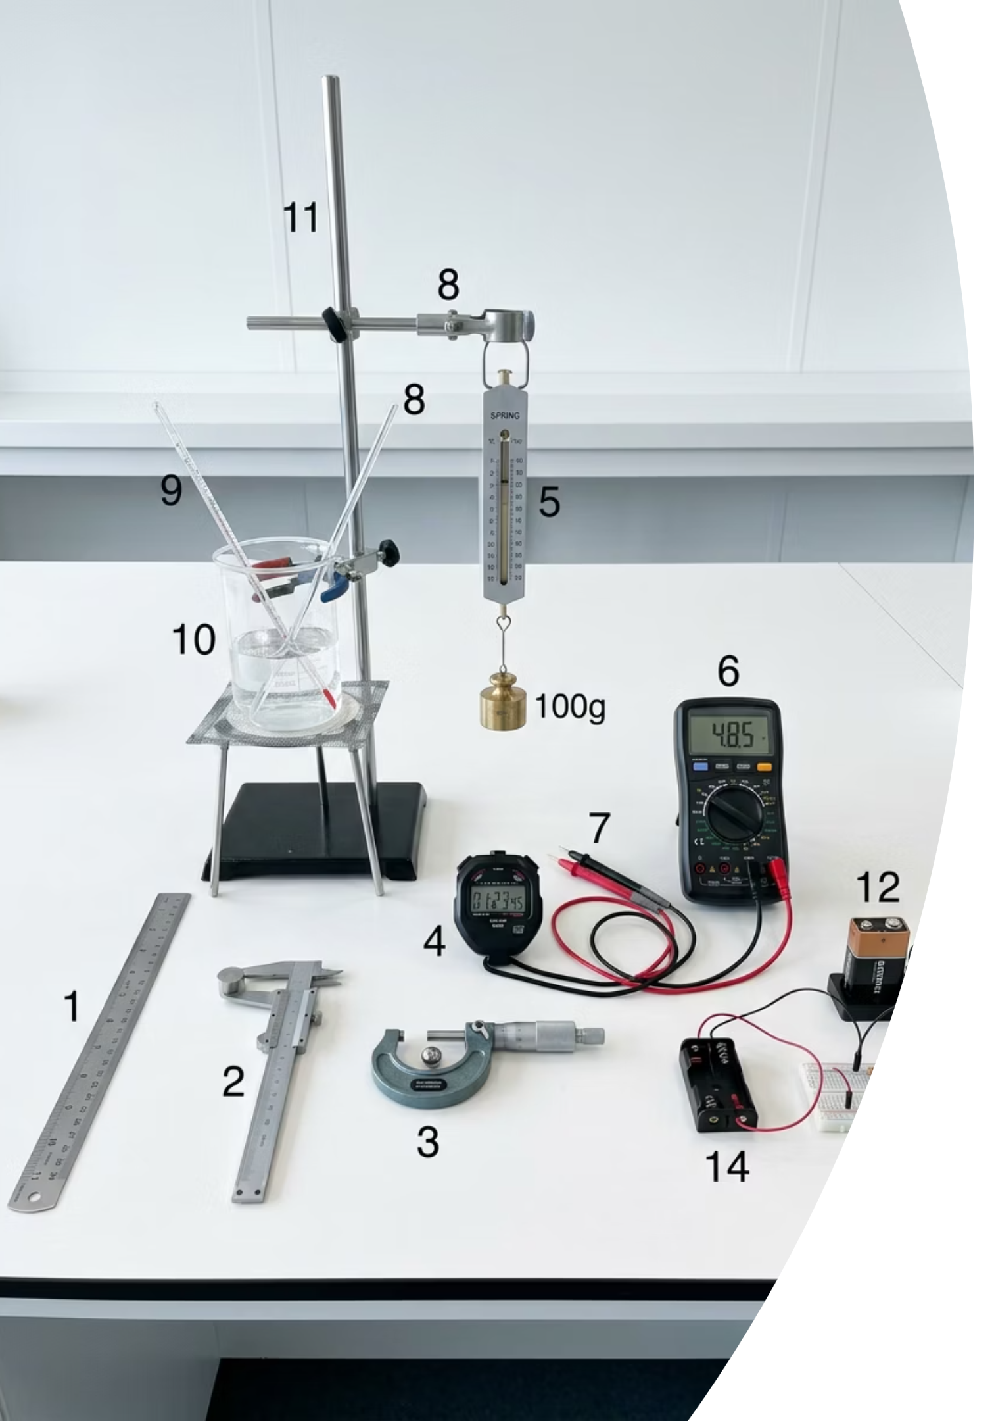
SI Units and Homogeneity
By the end of this AS Level lesson, you will be able to:
Recall SI Base Quantities
Name the six SI base quantities and their corresponding units.
Express Derived Units
Break any derived unit down into its SI base unit components.
Use SI Prefixes
Convert between pico and tera using powers of ten.
Test Homogeneity
Verify an equation by comparing base units on each side, and determine unknown constants.
@thelucidstem.com

Slide 3

The Six SI Base Quantities
Every measurement in physics is constructed from these six fundamental building blocks. All other units are derived from combinations of these.
Quantity
SI Unit
Symbol
Mass
kilogram
kg
Length
metre
m
Time
second
s
Electric Current
ampere
A
Thermodynamic Temperature
kelvin
K
Amount of Substance
mole
mol
These six quantities are independent of one another. No base quantity can be defined in terms of another.
@thelucidstem.com

Slide 4

Derived Units
Complex units are built from the SI base quantities using defining equations. The process is always the same: substitute base units into the equation and simplify.
Force (Newton)
Energy (Joule)
Pressure (Pascal)
From F = ma
Units: kg x m s-2
Base units: kg m s-2
From E = 1/2 mv2
Units: kg x (m s-1)2
Base units: kg m2 s-2
From p = F / A
Units: kg m s-2 / m2
Base units: kg m-1 s-2
Always substitute the base units of known quantities into the defining equation. Cancel and collect powers systematically.
@thelucidstem.com

Slide 5
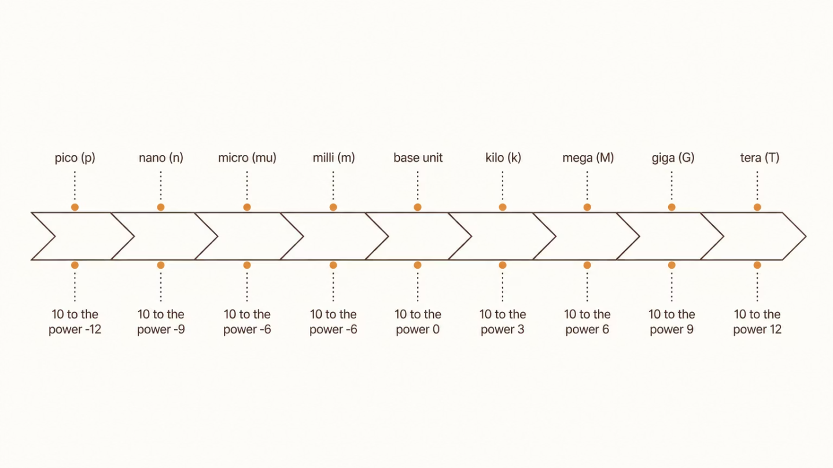
The SI Prefixes
These prefixes must be memorised. They represent exact powers of ten and allow us to express very large or very small quantities without cumbersome notation.
Large Prefixes
Small Prefixes
tera (T): 1012
giga (G): 109
mega (M): 106
kilo (k): 103
milli (m): 10-3
micro (µ): 10-6
nano (n): 10-9
pico (p): 10-12
@thelucidstem.com

Slide 6

Homogeneity of Physical Equations
An equation is homogeneous if every separate term has exactly the same base units. This is a powerful consistency check for any physical equation.
Simplify terms
Combine like terms and reduce expressions for clarity.
Replace quantities
Compare sides
Substitute known values into the equation to begin solving.
Evaluate both sides of the equation to find the solution.
Worked Example
The Balance Principle
Test v = u + at
LHS: m s-1
RHS: m s-1 + (m s-2)(s) = m s-1
Homogeneous. Equation is consistent.
Think of each side of an equation as a pan on a balance scale. For the equation to be physically valid, both pans must carry identical units. If they differ, the equation is certainly wrong.
@thelucidstem.com

Slide 7
The Examiner's Traps
Examiner reports consistently identify these errors. Eliminate them before your AS examination.
Trap 1: The Kilogram Prefix Error
Trap 2: Homogeneity Does Not Guarantee Correctness
Trap 3: Name vs. Base Unit Form
Students attempt to remove the "kilo" from kilogram to obtain a "pure" base unit. This is wrong. The kilogram is the SI base unit of mass exactly as written, despite carrying a prefix.
A homogeneous equation is not necessarily correct. Homogeneity cannot detect a missing dimensionless constant, such as the factor of 1/2 in E = 1/2 mv2.
"Newton" is the name of the unit. In examination answers, the base unit form kg m s-2 is required unless the question permits named derived units.
@thelucidstem.com

Slide 8



Cooperative Task: Quiz-Quiz-Trade
An active retrieval protocol to consolidate your understanding of SI units and prefixes. Follow the steps precisely.
Receive a Card
Quiz Your Partner
Trade and Move
Each card has a prompt on the front and the answer on the back.
Partner A quizzes Partner B. Coach them if they are stuck, then swap roles.
Trade cards, thank your partner, and find someone new. Keep moving until time is called.
The goal is not speed but accuracy. If you cannot recall an answer, work through the base units systematically before checking the card.
@thelucidstem.com

Slide 9
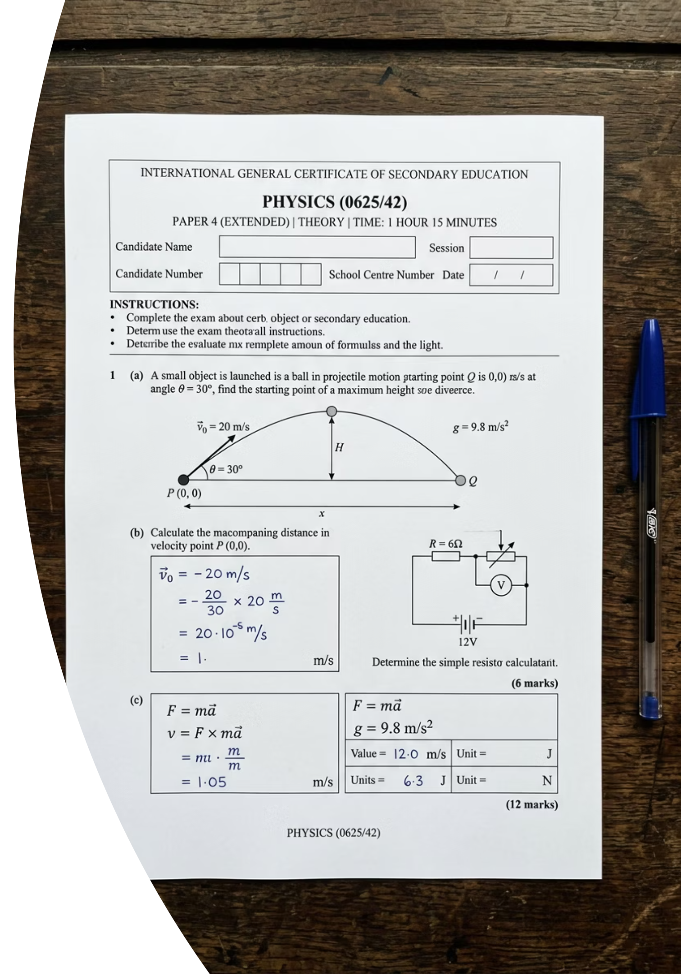

Prove It.
Complete these questions independently and in silence before you leave. Show all unit derivations in full.
Question 1
1
The volt is defined by the equation W = QV, where W is energy and Q is charge. Express the volt in SI base units.
Question 2
2
Is the equation P = Fv homogeneous? Justify your answer by showing the base units of both sides in full. State whether the equation is consistent.
Do not leave without submitting your exit ticket. Both derivations must be shown step by step.
@thelucidstem.com

