Slide 1
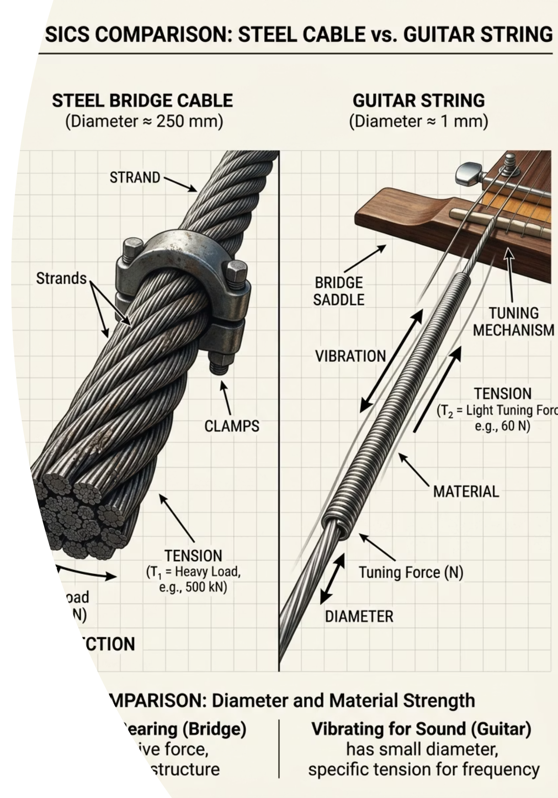
Stress, Strain and the Young Modulus
Cambridge International AS & A Level Physics 9702
A LEVEL PHYSICS
MATERIAL PROPERTIES

Slide 2
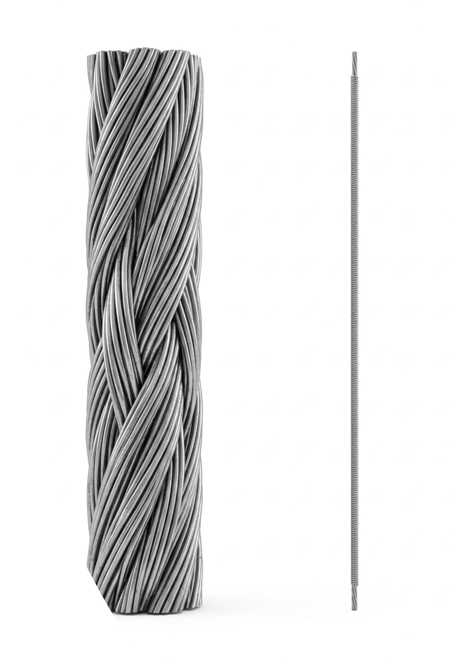

Stiffness versus Strength
Consider each statement carefully. Decide silently whether it is true or false before we begin.
Statement 1
A strong material is always a stiff material.
Statement 2
A thicker wire has a higher stiffness constant than a thin wire of the exact same metal.
Statement 3
Strain is measured in metres.
Keep your answers in mind. We will see exactly why most daily intuitions about materials are wrong in physics.
thelucidstem.com

Slide 3
Topic: Stress, Strain and the Young Modulus
By the end of this AS Level lesson, you will be able to:
01
02
03
Define stress and strain
Apply the Young modulus formula
Interpret a stress-strain graph
State tensile stress and tensile strain, and give the unit of each quantity.
Identify the limit of proportionality, elastic limit, and plastic region.
Define the Young modulus and use E = stress / strain in calculations.
04
05
Describe the core practical
Explain material independence
Outline the experiment to determine the Young modulus of a metal wire.
Articulate why E is a property of the material, not the sample dimensions.
thelucidstem.com

Slide 4
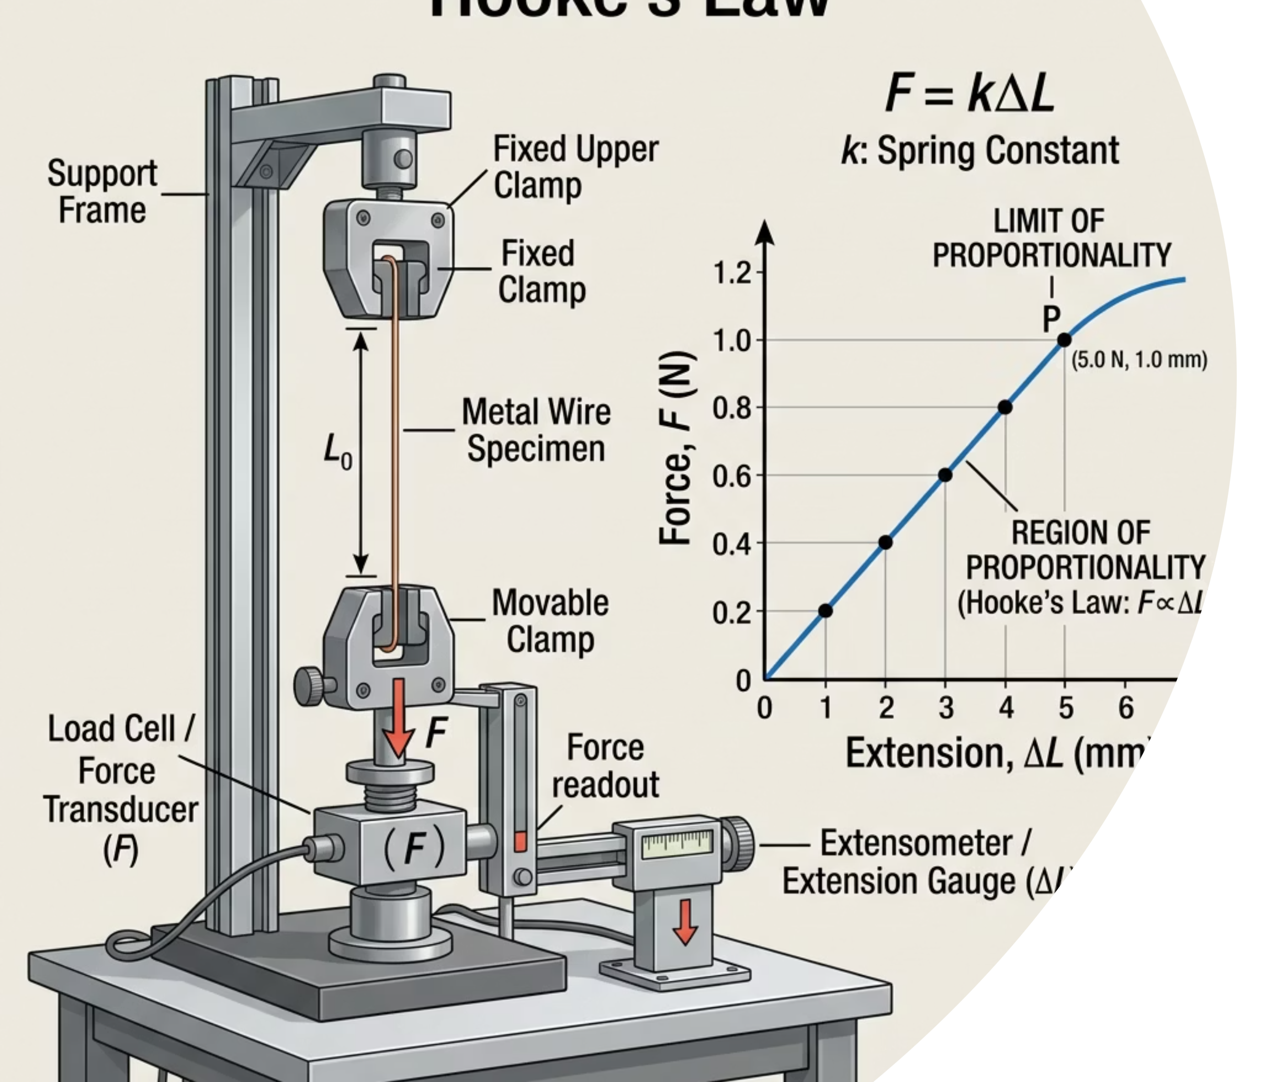
Hooke's Law and the Specimen
At IGCSE, Hooke's Law (F = kx) was applied to specific specimens. Force was plotted against extension, giving a straight line through the origin up to the limit of proportionality.
The Problem
This graph describes one specific specimen only. Cut the wire in half and the gradient doubles. Change the thickness and the graph changes entirely.
We need a method of characterising the material itself, independent of size or shape.
thelucidstem.com

Slide 5
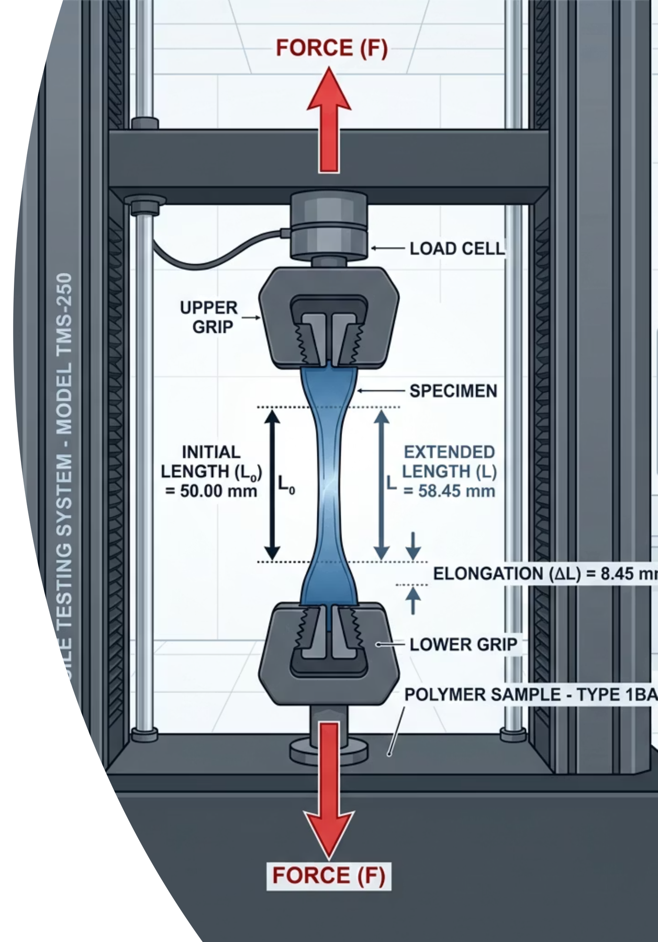
Stress and Strain
To compare materials fairly, we normalise force by area and extension by original length.
Tensile Stress (σ)
Force applied per unit cross-sectional area.
σ = F / A
Unit: Pascals (Pa) or N m^{-2}
Tensile Strain (ε)
Extension per unit original length.
ε = x / L
Unit: None. Strain is a dimensionless ratio of two lengths.
thelucidstem.com

Slide 6

The Young Modulus
The Young modulus (E) quantifies how stiff a material is, entirely independent of the shape or size of the sample.
Formula and Unit
Material Independence
A thin copper wire and a thick copper block share the identical Young modulus, because E is determined solely by the bonding between atoms in the material.
Only the specimen stiffness constant k changes with geometry. E does not.
Unit: Pascals (Pa), commonly expressed in Gigapascals (GPa).
Because stress has units of Pa and strain is dimensionless, E carries units of Pa.
thelucidstem.com

Slide 7

Examiner Report Warning: The following errors appear repeatedly in AS Level scripts. Each one costs marks directly.
The Stiffness Illusions
Trap 1 - Thickness and Young Modulus
Trap 2 - Strength versus Stiffness
Claiming a thicker wire has a higher Young modulus. Correction: E is a property of the material. Only the specimen stiffness constant k changes with thickness.
Confusing strength with stiffness. Correction: A high Young modulus means stiff (hard to stretch). Strength refers to the stress at breaking point.
Trap 3 - Units of Strain
Trap 4 - Diameter versus Radius
Assigning a unit to strain. Correction: Strain is a dimensionless ratio. It has no unit whatsoever.
Using diameter directly in the area formula. Correction: A = \pi r^2 = \pi d^2 / 4. Always halve the diameter first.
thelucidstem.com

Slide 8

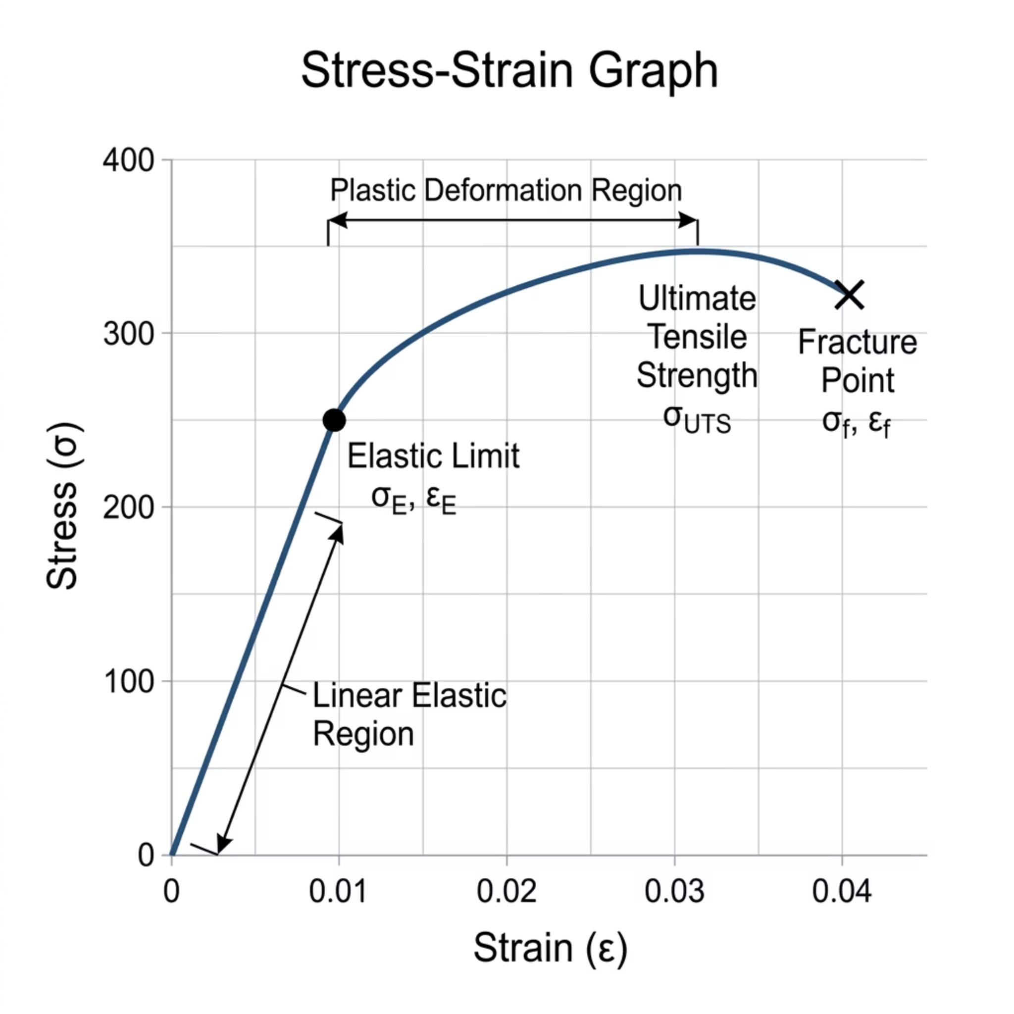
The Stress-Strain Graph
Plotting stress against strain eliminates the influence of specimen geometry and reveals the intrinsic behaviour of the material.
Key Features
Gradient
The gradient of the linear region equals the Young modulus E directly.
Elastic Limit
Beyond this point the wire will not return to its original length when unloaded.
Plastic Region
Permanent deformation occurs. The material flows rather than springs back.
thelucidstem.com

Slide 9
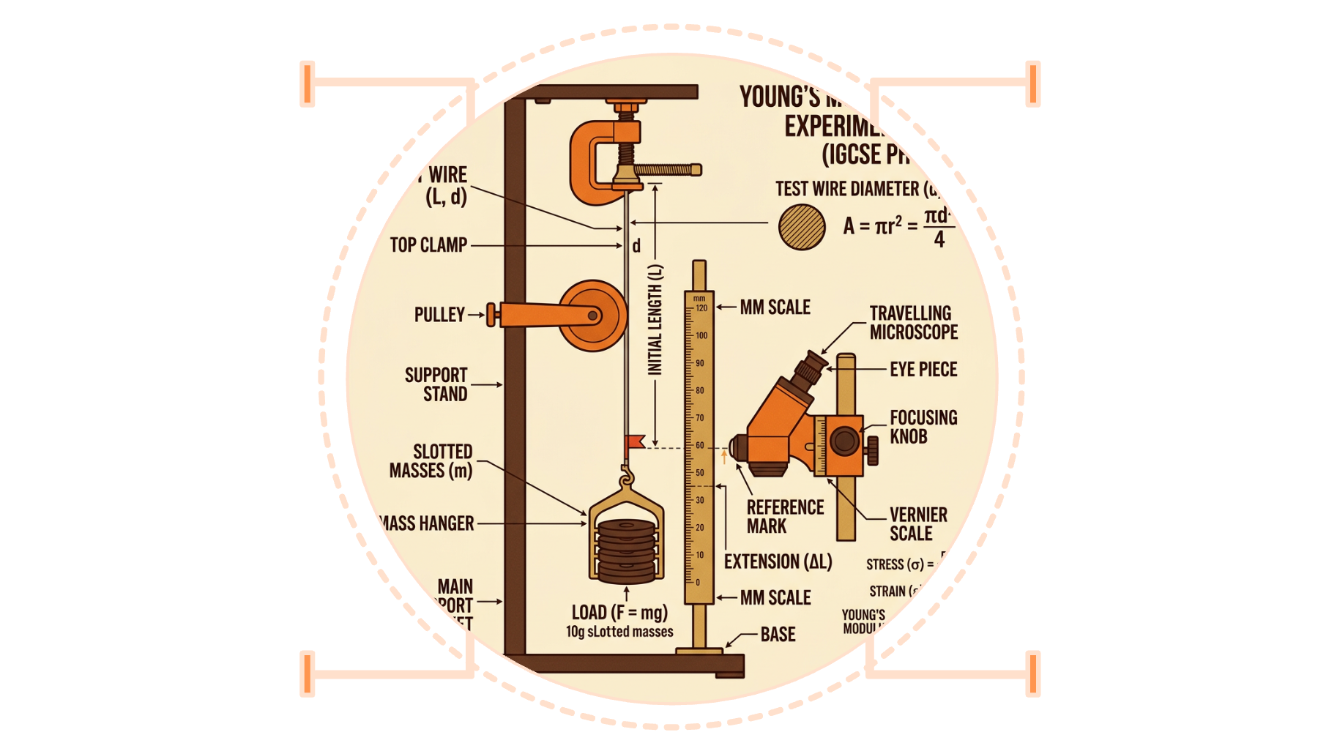
Measuring the Young Modulus
The standard AS Level core practical uses a long, thin metal wire loaded with slotted masses.
Key Measurements
Clamp
Wire
Holds wire to support
Long thin metal sample
Original length L measured with a metre rule
Diameter measured with a micrometer at several positions along the wire
Extension x recorded as masses are added incrementally
Principal Uncertainty
The diameter measurement dominates the uncertainty budget because area involves d squared. A 1% error in d becomes a 2% error in A, and therefore a 2% error in stress.
Pulley
Slotted masses
Changes direction of load
Apply known tensile force
thelucidstem.com

Slide 10


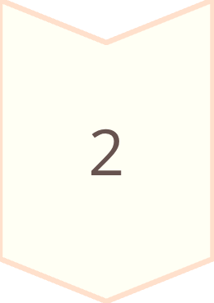
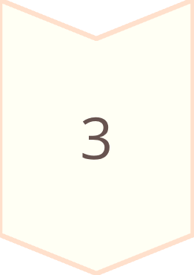
Cooperative Task: Numbered Heads Together
Number Off
Get into groups of four and assign each member a number: 1, 2, 3, or 4.
Heads Together
Discuss the problem until every member can explain both the answer and the full method independently.
One Voice
A number is called at random. That learner presents the answer alone, with no assistance from the group.
thelucidstem.com

Slide 11

ROUND 1
Calculate Tensile Stress
You have 2 minutes. Put your heads together before the number is called.
The Problem
Hint
A wire of cross-sectional area 2.0 x 10^{-7} m^2 supports a vertical load of 60 N.
Identify the correct formula from the definitions covered earlier. Substitute values with care, keeping powers of ten explicit in your working.
Calculate the tensile stress in the wire.
State the correct unit for your answer.
thelucidstem.com

Slide 12



ROUND 1 - ANSWER
Did Your Group Get It Right?
Formula
Substitution
Result
(equivalent to 300 MPa)
Correct unit required for full marks: Pascals (Pa) or N m^{-2}. Both are accepted.
thelucidstem.com

Slide 13
ROUND 2
Calculate Tensile Strain
You have 2 minutes. Check your units carefully before dividing.
The Problem
Hint
A wire has an original length of 1.50 m. Under load, it extends by 1.2 mm.
Strain is a ratio. Both quantities must be expressed in the same unit before dividing. A common error is to divide millimetres by metres directly.
Convert the extension into consistent SI units.
Calculate the tensile strain.
State the unit of your answer.
thelucidstem.com

Slide 14

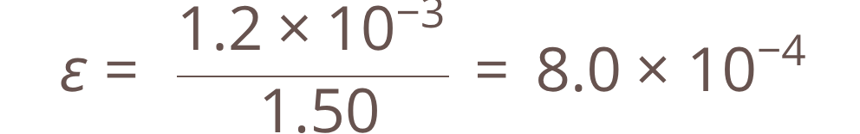
ROUND 2 - ANSWER
Did Your Group Get It Right?
Formula
Unit Conversion
Substitution
Strain has no unit. It is a dimensionless ratio. Writing "m/m" or any unit here loses the mark.
thelucidstem.com

Slide 15
ROUND 3
Calculate the Young Modulus
You have 4 minutes. This question requires three sequential calculations. Plan your method before computing.
The Problem
Method Outline
A metal wire has the following properties:
1
Calculate cross-sectional area from the diameter.
Length: 1.80 m
Diameter: 0.40 mm
Extension under load: 1.8 mm
Applied force: 25 N
2
Calculate stress using F and A.
Calculate the Young modulus of the metal. Show all steps clearly.
3
Calculate strain using x and L, then divide.
thelucidstem.com

Slide 16
ROUND 3 - ANSWER
Did Your Group Get It Right?
Step 1: Area
Step 2: Stress
Step 3: Strain
Young Modulus
This value is consistent with steel or iron. Recognising the order of magnitude (10^{11} Pa) is a useful check in the exam.
thelucidstem.com

Slide 17
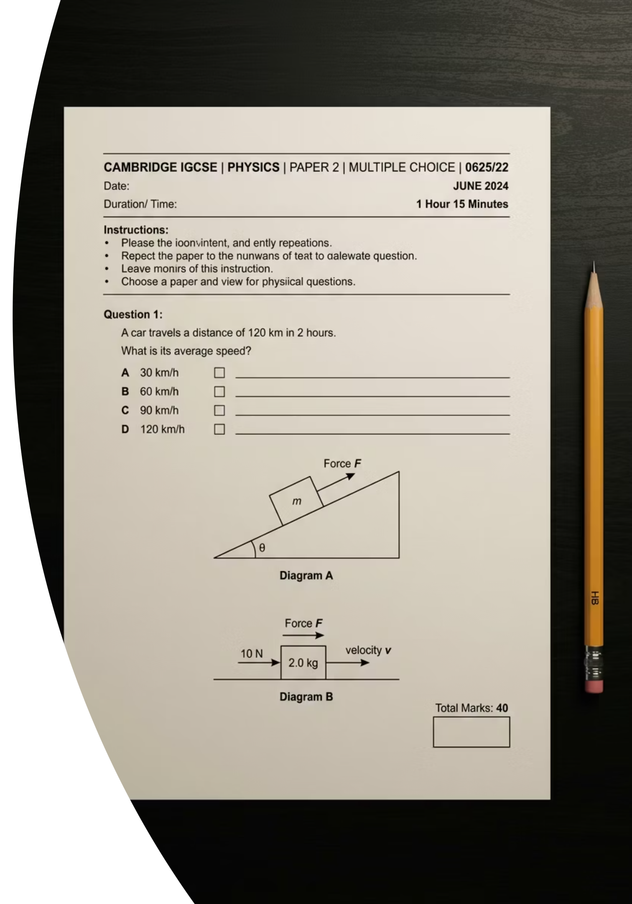
Prove It.
Complete this independently and in silence before you leave. This is your exit ticket.
Question 1 - Calculation
A wire of cross-sectional area 2.0 x 10^{-7} m^2 and original length 1.5 m extends by 0.90 mm under a load of 30 N.
Calculate the Young modulus of the wire. Show every step of your working and state the unit.
Question 2 - Explanation
In one precise sentence, explain why two wires made of the exact same metal but with different diameters have the identical Young modulus.
Your answer must refer to what the Young modulus actually represents at the level of the material.
thelucidstem.com

