Slide 1
CAMBRIDGE IGCSE PHYSICS 0625 · 1.2 · CORE
Apply and assess
One journey, read every way: speed, the two graphs, acceleration and free fall. The closing lesson of subtopic 1.2, then a short test.
TheLucidSTEM · Teachers’ Portal

Slide 2
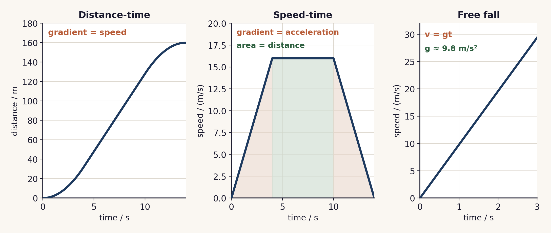
THE UNIT ANCHOR
One journey, read every way
02 / Apply and assess / 1.2 Core

Slide 3
RECALL · THE POSTER
Check the y-axis first
Distance-time graph: the gradient of the line is the speed.
Speed-time graph: the gradient is the acceleration, and the area under the line is the distance.
Free fall: a dropped object near the Earth speeds up at about 9.8 m/s².
03 / Apply and assess / 1.2 Core

Slide 4
THE TOOLKIT
Which tool for which question?
Distance-time graph
Speed-time graph
No graph given
gradient = speed
gradient = acceleration
area = distance
v = s / t
a = Δv / Δt
04 / Apply and assess / 1.2 Core

Slide 5
HOW WE’LL PRACTISE
Numbered Heads Together
1
2
3
4
Number off
Heads together
Random call
Confirm
Each group of four takes a number, 1 to 4.
Agree one answer that every member can give.
A number is called; that person answers for the group.
Check it against the poster, then the next round.
05 / Apply and assess / 1.2 Core

Slide 6
SIX ROUNDS
Across the unit
1 · Speed
2 · Distance-time
3 · Acceleration
90 m in 6 s: the average speed?
what does the gradient tell you?
4 to 16 m/s in 4 s: the acceleration?
4 · Area
5 · Deceleration
6 · Free fall
6 m/s for 10 s: the distance?
30 to 10 m/s in 5 s: the deceleration?
the value of g, and its units?
06 / Apply and assess / 1.2 Core

Slide 7
EXAMINER TRAPS
Traps to avoid
Mixing up the two graphs
An area on a distance-time graph
Read the y-axis first: distance-time gradient is speed; speed-time gradient is acceleration.
Only the area under a speed-time graph gives the distance.
Averaging the speeds
Treating g as a force or a speed
Average speed is total distance over total time, not the mean of speeds.
g is the free-fall acceleration, about 9.8 m/s².
07 / Apply and assess / 1.2 Core

Slide 8
ONE WORKED EXAMPLE
The journey, three answers
On the poster, a car speeds up from rest to 16 m/s in 4 s, holds 16 m/s for 6 s, then stops in 4 s.
Speed (steady section): read straight off the speed-time line: 16 m/s.
Acceleration (first 4 s): a = Δv ÷ Δt = 16 ÷ 4 = 4 m/s².
Distance (whole journey, from the area): ½×4×16 + 6×16 + ½×4×16 = 32 + 96 + 32 = 160 m.
08 / Apply and assess / 1.2 Core

Slide 9
PLENARY · THE SHORT TEST
Now the test
1. Sit the six-question short test on your own: speed, both graphs, acceleration, deceleration and free fall.
2. Mark it, then note which part of the poster each missed item belongs to.
Self-check: I can ...
use v = s/t and a = Δv/Δt · read a speed, an acceleration and a distance from the graphs · recall g ≈ 9.8 m/s²
09 / Apply and assess / 1.2 Core

Slide 10
check the axis, choose the tool
One journey, read every way: the distance-time gradient is the speed, the speed-time gradient is the acceleration, the area is the distance, and free fall is a steady 9.8 m/s².
TheLucidSTEM · created by the TheLucidSTEM team

