Slide 1
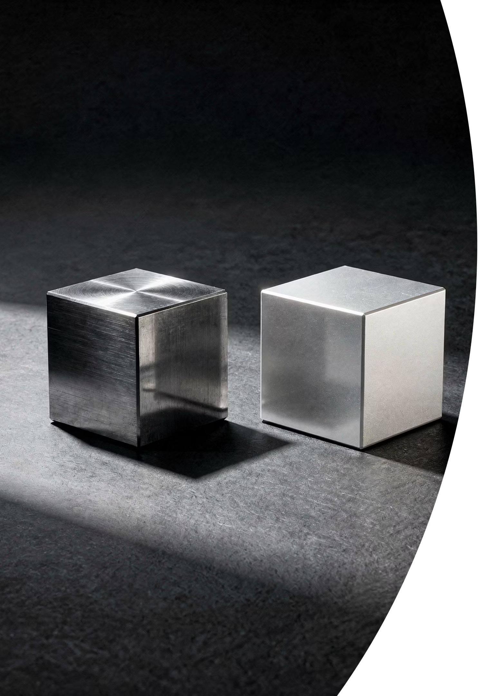
Density
Same Size, Different Mass
Cambridge IGCSE Physics 0625 | Core Level

Slide 2
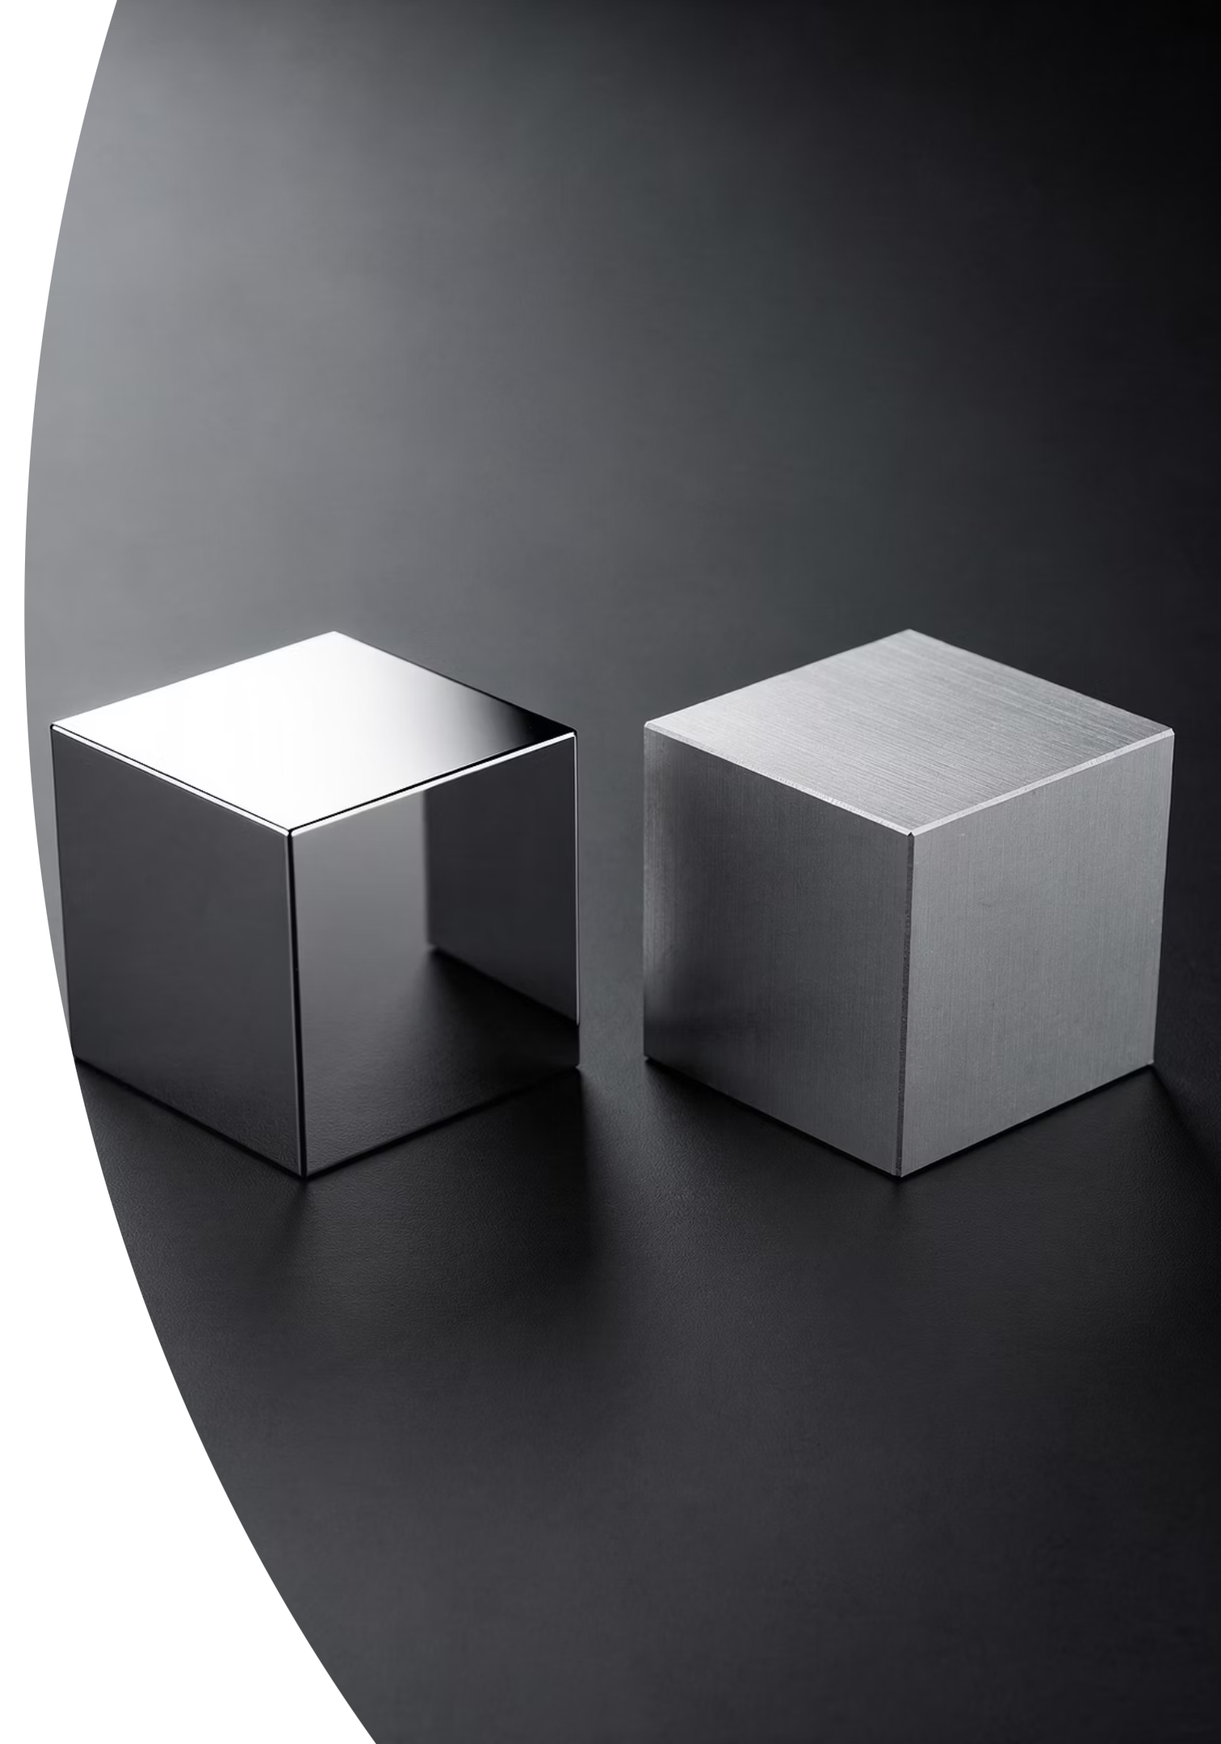

The Iron and The Aluminium
Look at the two cubes at the front of the room. Both cubes are exactly the same size -- equal volume. One is made of steel, the other of aluminium.
Think, Pair, Share: Predict which cube has the greater mass. Write on your whiteboard: "I think the ____ cube has more mass because ____."
@thelucidstem.com

Slide 3
LEARNING OBJECTIVES
Topic: Density
By the end of this lesson, you will be able to:
1
2
Define
Calculate
State density as mass per unit volume.
Recall and use rho = m / V, including rearranging to find mass or volume.
3
4
Units
Predict
Use g/cm3 and kg/m3 fluently in calculations.
Compare densities to predict whether an object floats or sinks in a liquid.
@thelucidstem.com

Slide 4
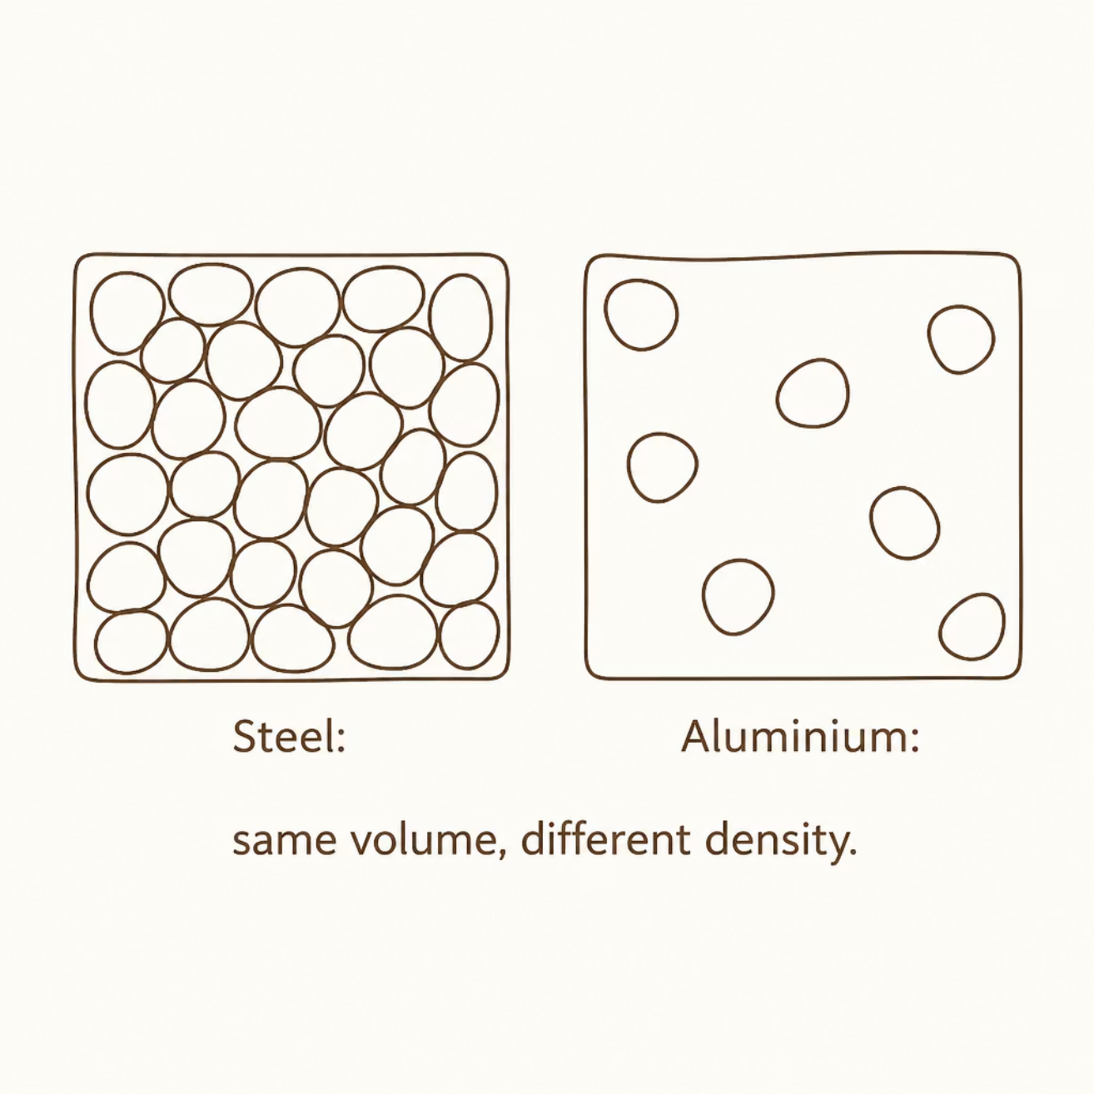
The Particle Model of Density
Why does the steel cube hold more mass in the exact same volume? Density is determined by two factors working together.
1. Particle Mass
2. Packing
Each steel particle is heavier than each aluminium particle.
Steel particles sit more closely packed together in the same space.
Result
More mass in the same space = Higher Density.
@thelucidstem.com

Slide 5
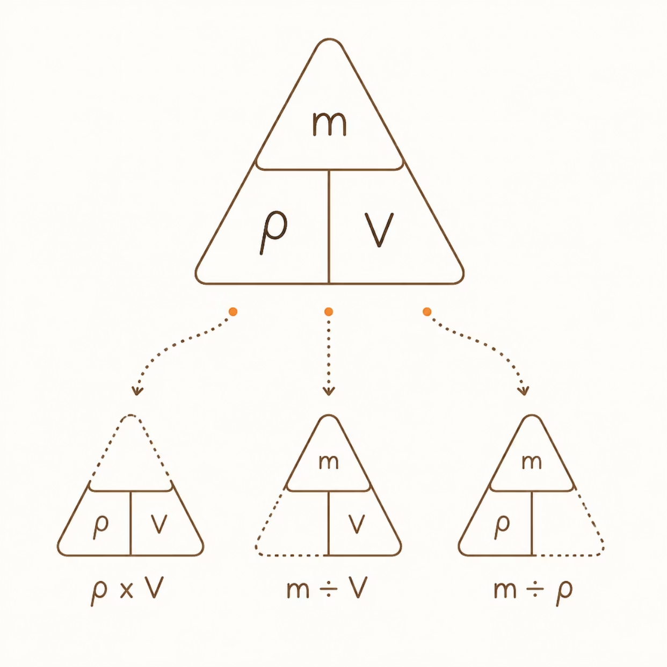

Calculating Density
Density is defined mathematically as mass per unit volume.
The Formula
rho = m / V (Density = Mass / Volume)
Units for the Exam
g/cm³
kg/m³
Grams per cubic centimetre
Kilograms per cubic metre
Key conversion: 1 g/cm3 = 1000 kg/m³
@thelucidstem.com

Slide 6
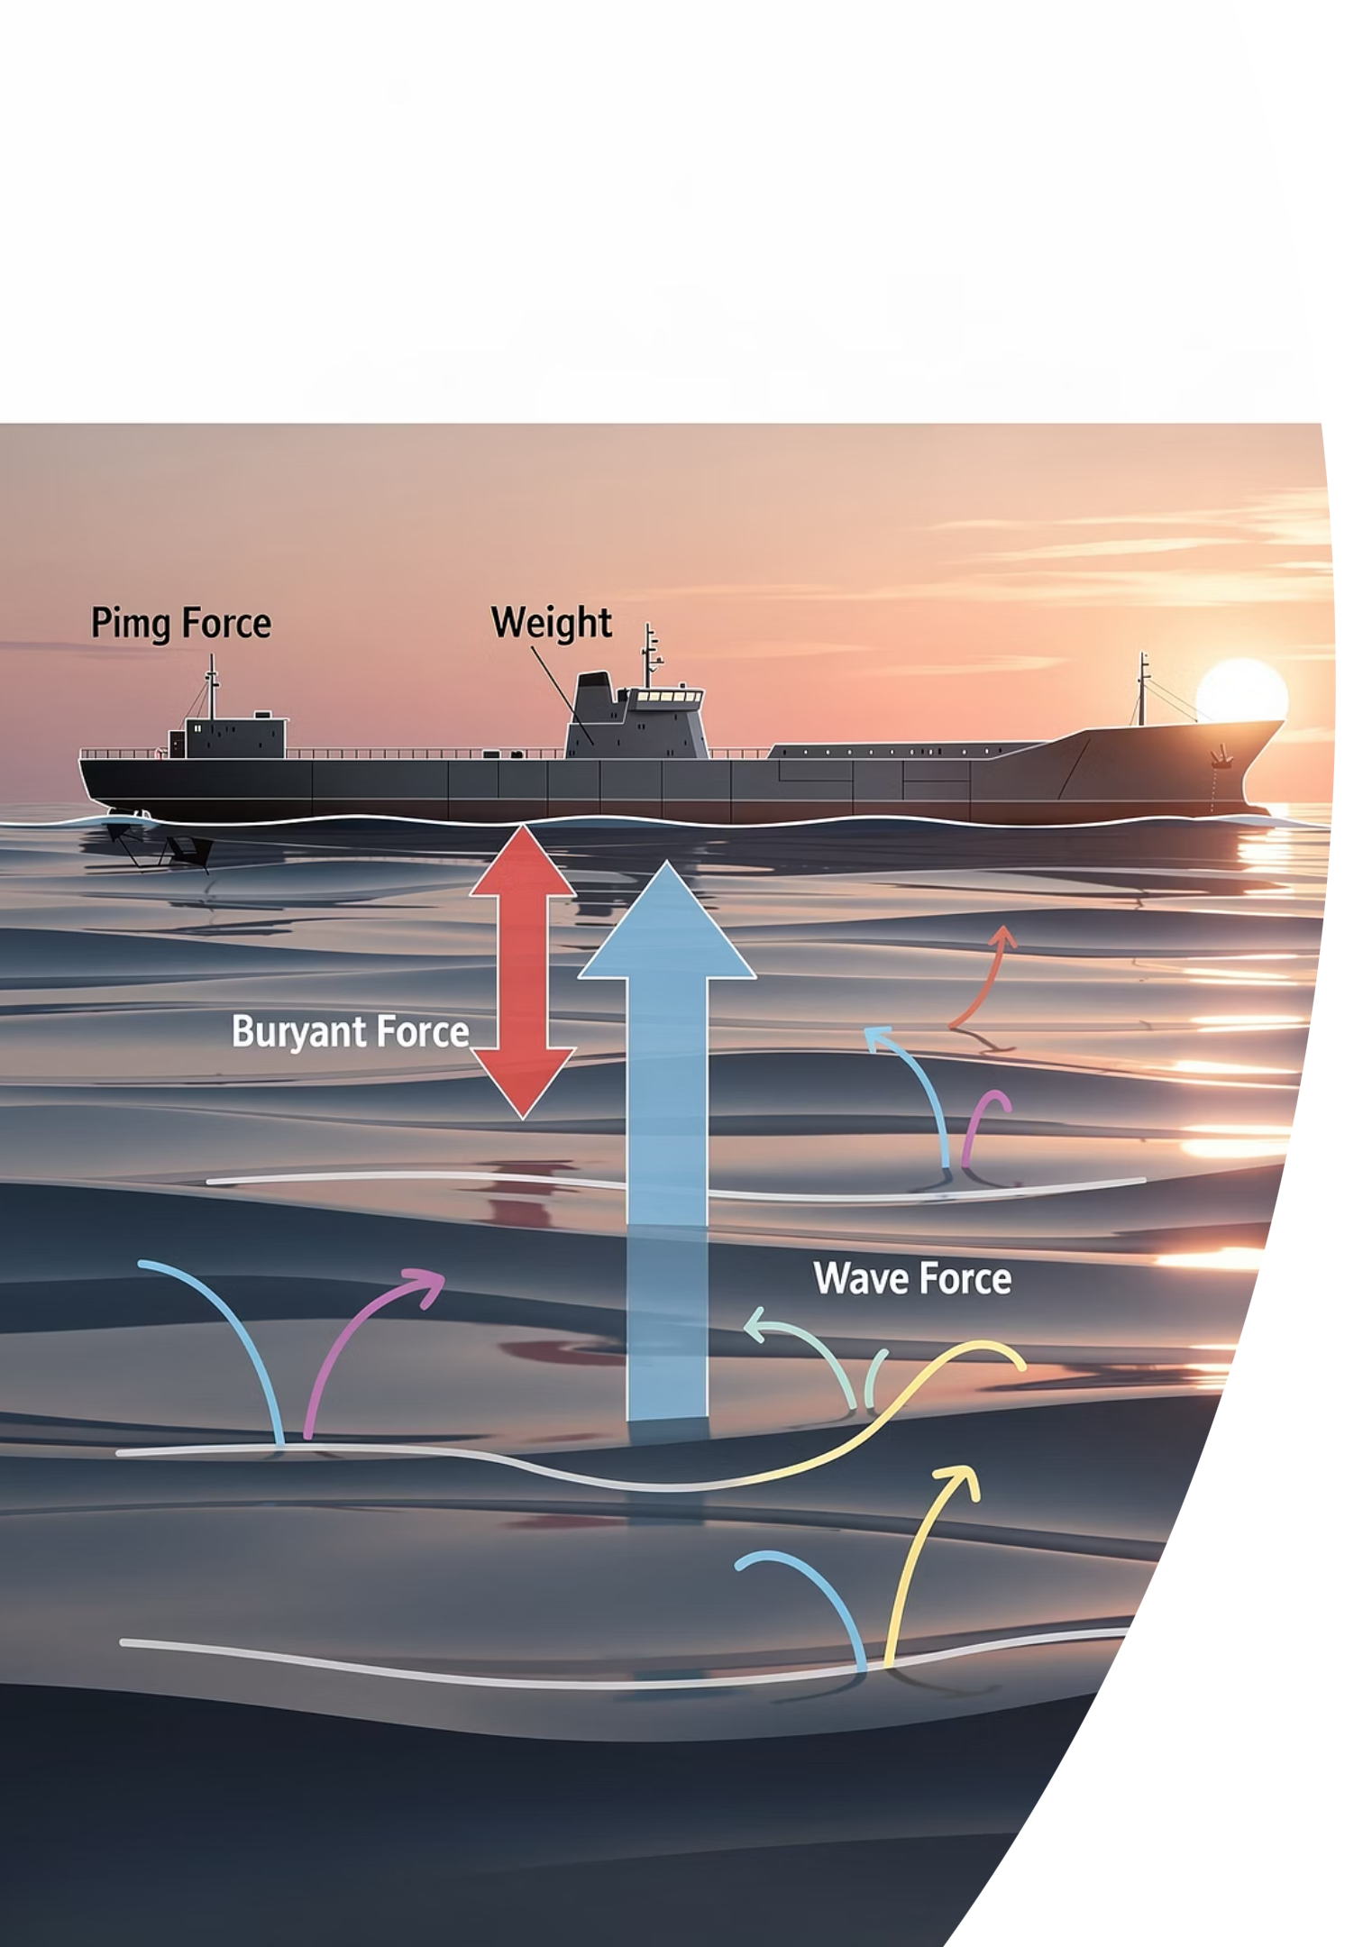
The "Heavy Means Sinks" Illusion
EXAMINER'S TRAP
Trap 1: Density vs Mass
Two objects can share the same mass but differ in density if their volumes differ.
Trap 2: Heavy Objects Always Sink
A steel ship is incredibly heavy, yet it floats. Floating depends on density compared to the liquid, not mass alone.
Trap 3: Rearranging the Formula
Always check: mass = density x volume. Not the other way round.
@thelucidstem.com

Slide 7

Cooperative Task: Rally Coach
Get into pairs and decide who is Partner A and who is Partner B.
The Solver
Works the problem out loud, writes every step, and states the unit.
The Coach
Watches, checks each line, gives a tick or a hint -- but NEVER gives the answer.
Swap Roles
After each round, you MUST swap roles.
@thelucidstem.com

Slide 8

ROUND 1
Find Density
Partner A is solving. Partner B is coaching. You have 60 seconds.
Question
A block has a mass of 240 g and a volume of 30 cm³. Find its density.
Solvers: write the formula first, show all working, and include the unit in your final answer.
@thelucidstem.com

Slide 9
ROUND 1 ANSWER
Coaches, did your partner get it right?
Formula
Working
Answer
rho = m / V
rho = 240 / 30
8.0 g/cm³
@thelucidstem.com

Slide 10

ROUND 2
Find Mass
SWAP ROLES! Partner B is now solving. Partner A is now coaching.
You have 60 seconds.
Question
Lead has a density of 11.3 g/cm³. Find the mass of a 5 cm³ piece of lead.
Solvers: which rearrangement do you need? Write it down before you calculate.
@thelucidstem.com

Slide 11
ROUND 2 ANSWER
Coaches, did your partner get it right?
Formula
Working
Answer
m = rho x V
m = 11.3 x 5
56.5 g
@thelucidstem.com

Slide 12
ROUND 3
Find Volume
SWAP ROLES! Partner A is now solving. Partner B is now coaching.
You have 60 seconds.
Question
An object has a mass of 60 g and a density of 2.4 g/cm³. Find its volume.
Solvers: rearrange the formula first. V = m / rho
@thelucidstem.com

Slide 13
ROUND 3 ANSWER
Coaches, did your partner get it right?
Formula
Working
Answer
V = m / rho
V = 60 / 2.4
25 cm³
@thelucidstem.com

Slide 14
ROUND 4 -- STRETCH
The Stretch: Comparison
SWAP ROLES! Partner B is now solving. Partner A is now coaching.
You have 60 seconds.
Question
Oil has a density of 0.92 g/cm³. Water has a density of 1.0 g/cm³. They do not mix. Which liquid floats on top, and exactly why?
This question requires a full sentence explanation, not just a number. Think density comparison.
@thelucidstem.com

Slide 15
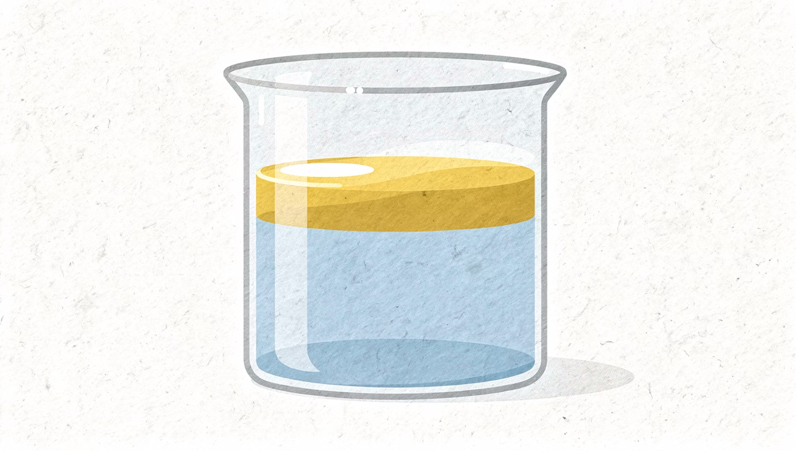
ROUND 4 ANSWER
Coaches, did your partner get it right?
Answer
Oil floats on top.
Reasoning
Oil is less dense than water (0.92 < 1.0 g/cm³). The less dense liquid always rises above the more dense liquid.
Key Principle
Floating depends on relative density -- not on mass or weight alone.
@thelucidstem.com

Slide 16

Prove It.
EXIT TICKET
Silence in the room. Complete both questions independently before you leave.
1
2
Question 1: Calculate
Question 2: Predict and Explain
A block has a mass of 150 g and a volume of 50 cm³. Calculate its density. Show all working and include the unit.
Will a block with a density of 0.7 g/cm³ float or sink in water (density 1.0 g/cm³)? Explain your reasoning in one sentence.
@thelucidstem.com

