Slide 1
CAMBRIDGE IGCSE PHYSICS 0625 · 1.2 · EXTENDED
Gradient and area
On a speed-time graph the gradient is the acceleration, and the area under the line is the distance.
TheLucidSTEM · Teachers’ Portal

Slide 2
HOOK · MATCH IT
What do the gradient and area tell us?
Open Distance from a Speed-Time Graph (Unit 1): shape an area to match a true distance.
Open Acceleration from a Velocity-Time Line for the gradient side.
Predict: which reading gives the acceleration, and which gives the distance?
02 / Gradient and area / 1.2 Extended

Slide 3
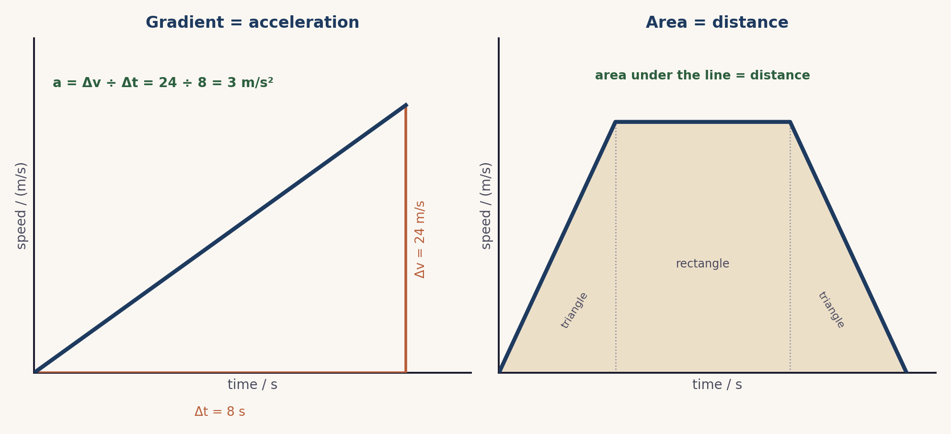
THE CORE MODEL
Two readings from one line
Gradient = acceleration (a = Δv ÷ Δt). Area = distance.
03 / Gradient and area / 1.2 Extended

Slide 4
FIRST READING
Gradient = acceleration
Use a large triangle that spans most of the line.
a = Δv ÷ Δt, in m/s². Example: 24 ÷ 8 = 3 m/s².
A line sloping down has a negative gradient: a deceleration.
04 / Gradient and area / 1.2 Extended

Slide 5
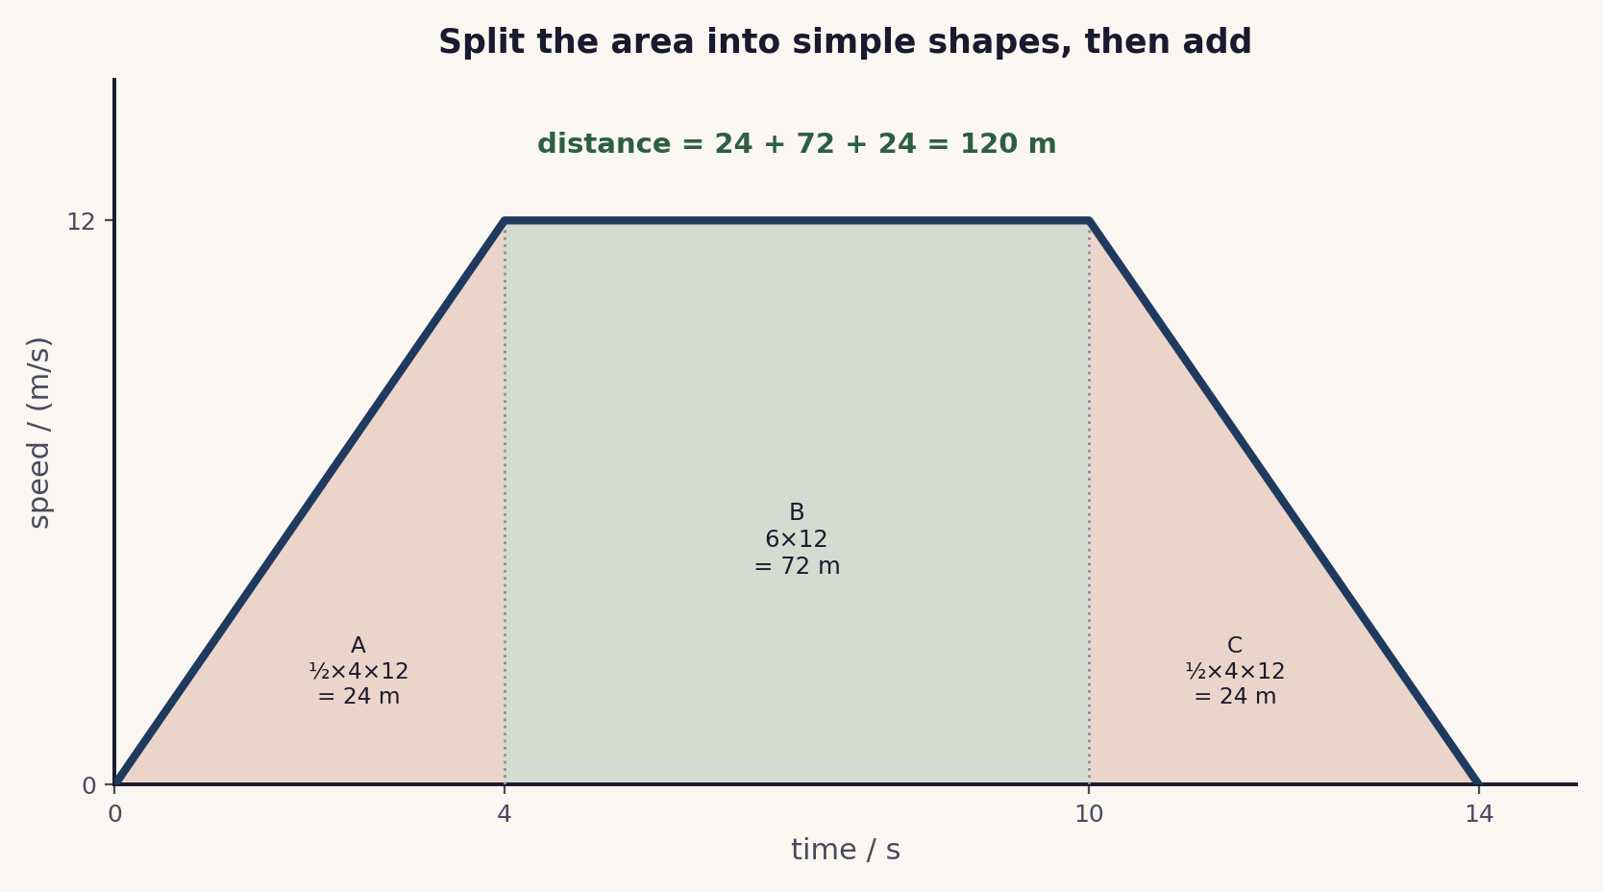
SECOND READING
Area = distance
Split the area into simple shapes.
Find each: triangles (½ × base × height) and the rectangle.
Add them: 24 + 72 + 24 = 120 m.
05 / Gradient and area / 1.2 Extended

Slide 6
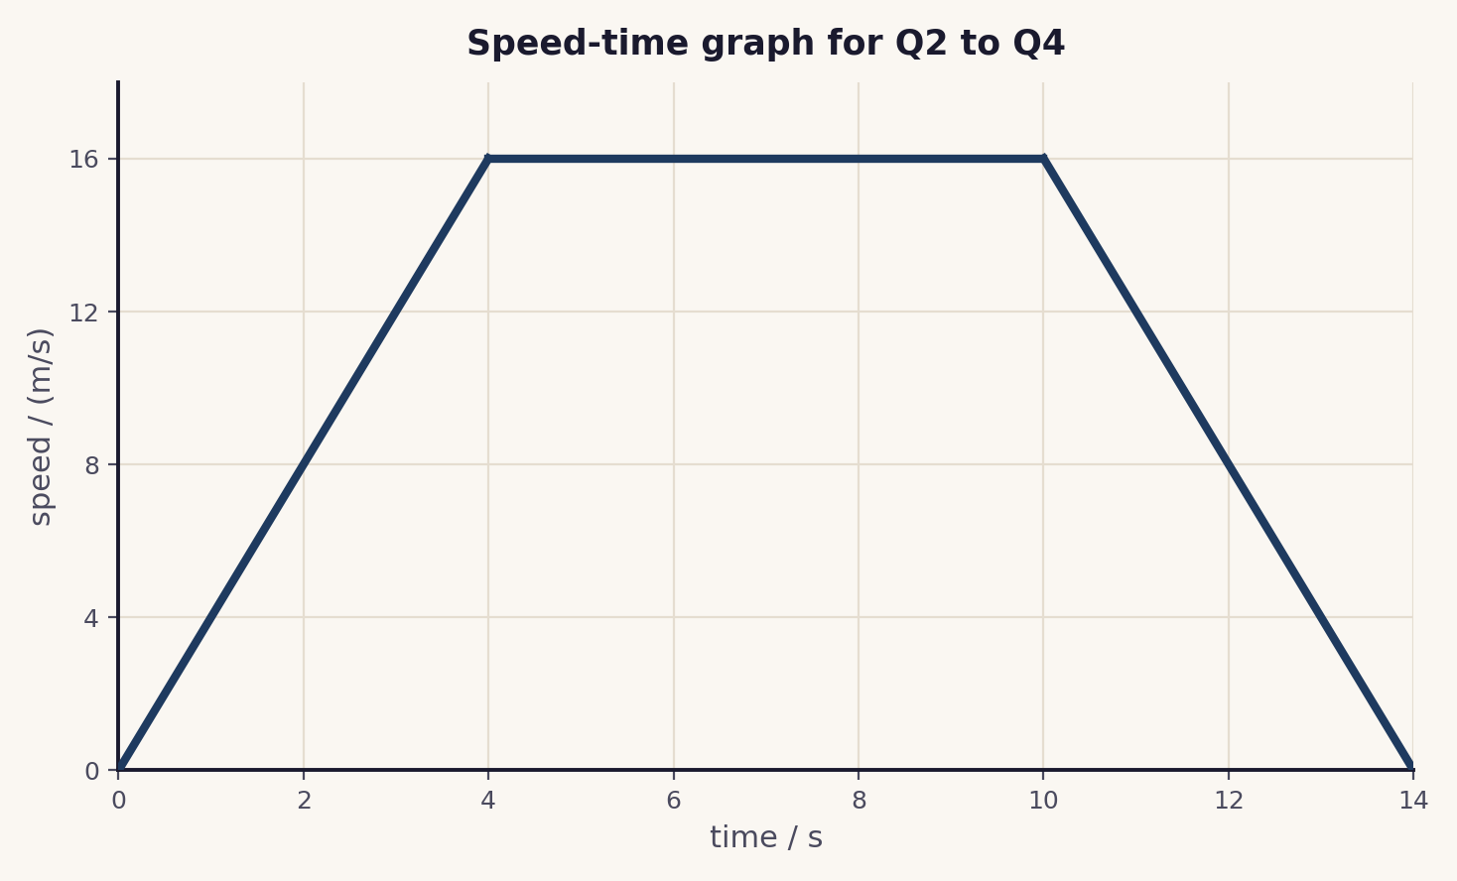
PUT IT TOGETHER
One graph, three answers
Acceleration (0 to 4 s): 16 ÷ 4 = 4 m/s².
Distance: 32 + 96 + 32 = 160 m.
Deceleration (10 to 14 s): 16 ÷ 4 = 4 m/s².
06 / Gradient and area / 1.2 Extended

Slide 7
COOPERATIVE PRACTICE
Pairs Check, then a Gallery Walk
1 Solve and coach
One partner solves aloud; the other coaches and checks.
2 Swap
Change roles for the next problem.
3 Check as four
After two problems, the two pairs compare answers.
4 Gallery Walk
Display one solution; walk the room; leave a star and a question.
Problem set, gallery task, sentence stems, teacher script and answer key: see the activity in this bundle.
07 / Gradient and area / 1.2 Extended

Slide 8
EXAMINER TRAPS
Four traps to avoid
Gradient from two close points
Use a large triangle and give the unit m/s².
Area read as the speed
The area is the distance, not the speed.
Not splitting the area
Split into a triangle and a rectangle, then add.
Forgetting deceleration is negative
A downward slope is a negative gradient.
08 / Gradient and area / 1.2 Extended

Slide 9
PLENARY · EXIT TICKET
Show what you know
A car speeds up from rest to 20 m/s in 5 s, holds 20 m/s for 10 s, then stops in 4 s.
1. Find the acceleration in the first 5 s.
2. Find the total distance travelled, using the area.
Self-check: I can ...
find acceleration from a gradient · find distance from an area · handle a deceleration
09 / Gradient and area / 1.2 Extended

Slide 10
two readings, one line
On a speed-time graph the gradient is the acceleration and the area is the distance. Use a large triangle, and split the area.
TheLucidSTEM · created by the TheLucidSTEM team

