Slide 1

Acceleration of Free Fall, g
Cambridge IGCSE Physics 0625 | Core Level
THELUCIDSTEM.COM

Slide 2

The Hammer and the Feather
Observe the simulation on the board. A heavy hammer and a light feather are dropped at the exact same moment.
With Air Resistance
In a Vacuum
What do you predict will happen?
Now remove all the air. What changes?
The Real Question
What truly decides how fast something falls?
THELUCIDSTEM.COM

Slide 3
Lesson Objectives
Acceleration of Free Fall, g
By the end of this lesson, you will be able to:
01
02
State the value of g
Define free fall
The acceleration of free fall near Earth is approximately 9.8 m/s² (often taken as 10 m/s²).
Describe free fall as motion under gravity alone, with no air resistance.
03
04
Explain equal acceleration
Interpret and use the graph
All masses fall with the exact same acceleration when air resistance is absent.
Recognise the speed-time graph as a straight line with gradient equal to g, and use v = g t.
THELUCIDSTEM.COM

Slide 4
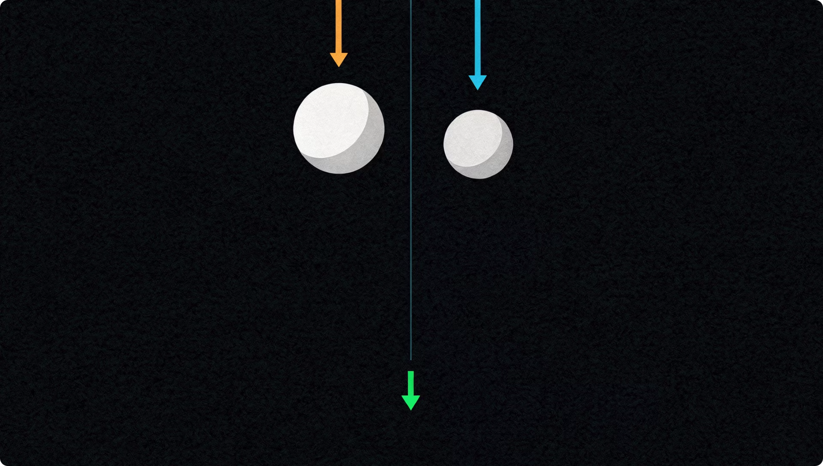

Motion Under Gravity Alone
Free fall is motion under gravity alone, with no air resistance.
Because there is no air resistance, every mass falls with the same acceleration, regardless of size or weight.
A hammer and a feather dropped in a vacuum land at exactly the same time.
The acceleration of free fall near Earth: g = 9.8 m/s²
THELUCIDSTEM.COM

Slide 5
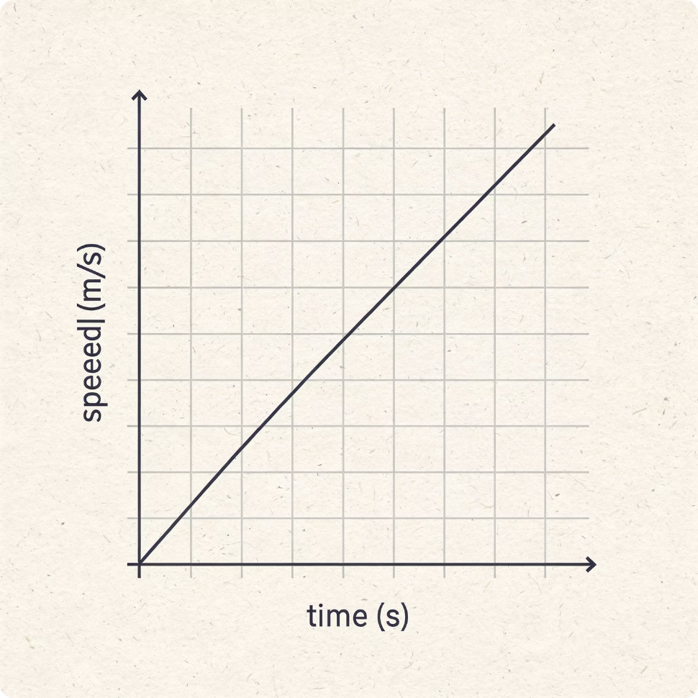
Because g is constant, the speed-time graph of a freely falling object is a perfectly straight line through
the origin.
The Gradient
The Equation
The steepness of the line equals exactly 9.8 m/s², the value of g.
To find speed after time t: v = g t
THELUCIDSTEM.COM

Slide 6
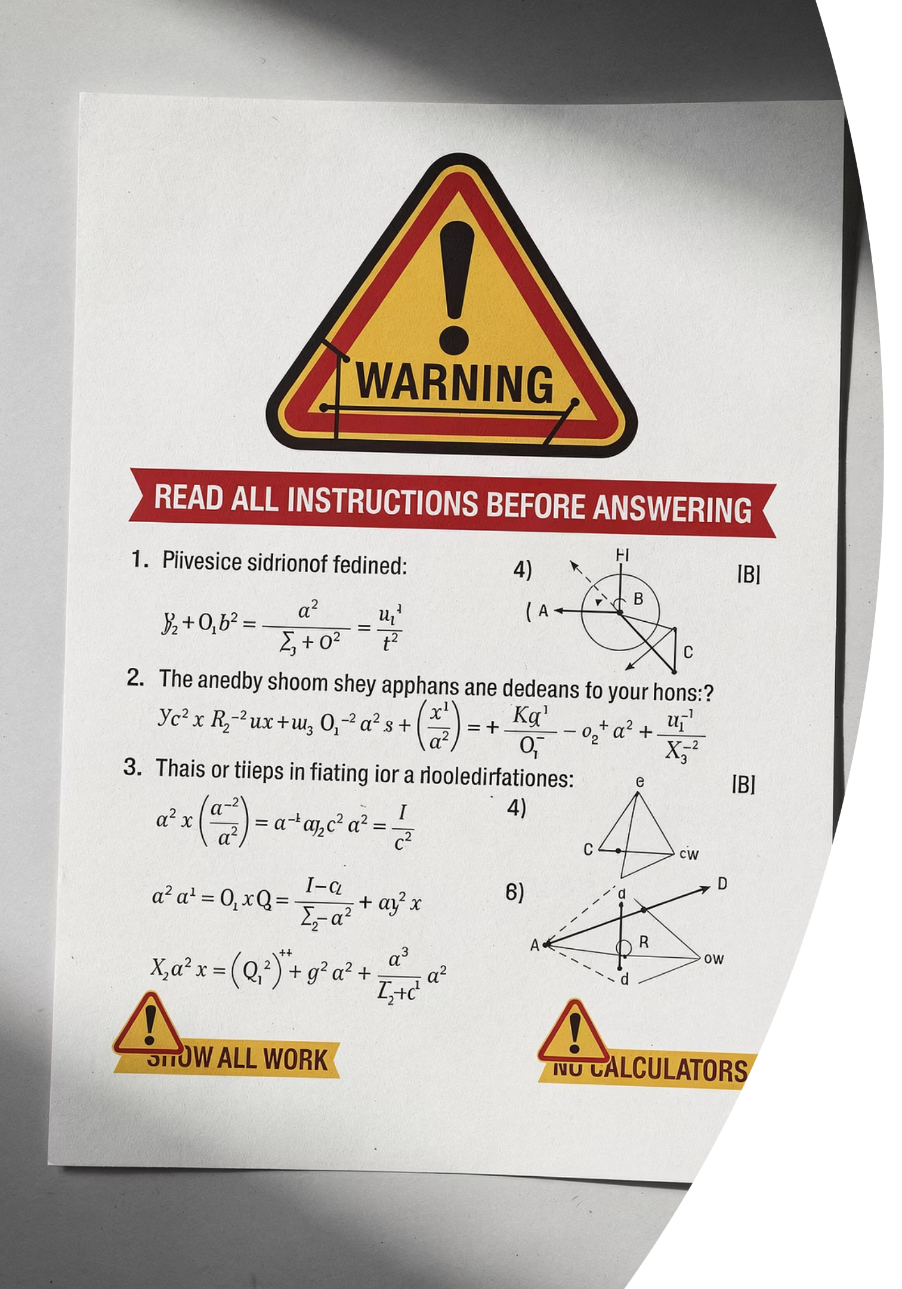
The Examiner's Trap
Examiner Report Warning: Avoid these three fatal errors in your assessments.
Trap 1: Heavier objects fall faster
Mass does not change the acceleration of free fall. With no air resistance, all masses fall with the same g.
Trap 2: Gravity makes the feather slow
The feather falls slowly because of air resistance, not because g is different for lighter objects.
Trap 3: Writing the unit as m/s
g is an acceleration. The correct unit is m/s², never m/s.
THELUCIDSTEM.COM

Slide 7

Cooperative Task: Numbered Heads Together
01
Form Your Teams
Get into groups of four and number yourselves 1 to 4.
02
Read the Question
A free-fall question will appear on the board.
03
Discuss Together
Put your heads together. Every member must be able to explain the answer fully.
04
Random Recall
A number will be called at random. That person answers for the entire team.
THELUCIDSTEM.COM

Slide 8

Q1
Round 1: Definition
Put your heads together. You have 30 seconds.
What is the strict physics definition of "free fall"?
What is the approximate value and correct unit of the acceleration of free fall (g) near Earth?
THELUCIDSTEM.COM

Slide 9

Round 1
Answer: Definition
Did your team get it right?
Free Fall Defined
Value of g
Free fall is motion under gravity alone, with no air resistance.
The acceleration of free fall is approximately 9.8 m/s².
THELUCIDSTEM.COM

Slide 10

Q2
Round 2: The Vacuum
Put your heads together. You have 45 seconds.
A heavy bowling ball and a light tennis ball are dropped from the exact same height inside a vacuum chamber.
Which one hits the ground first, and why?
THELUCIDSTEM.COM

Slide 11

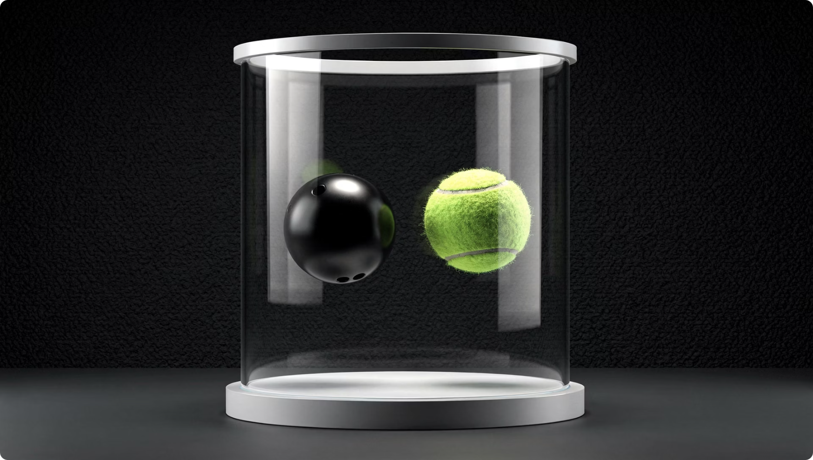
Round 2
Answer: The Vacuum
Did your team get it right?
They land at the same time
Both hit the ground at the exact same moment.
The Reason
In a vacuum there is no air resistance, so all masses fall with the same acceleration, g. Mass does not affect free fall.
THELUCIDSTEM.COM

Slide 12
Q3
Round 3: The Graph
Put your heads together. You have 45 seconds. Have your mini-whiteboards ready.
Draw the speed-time graph for an object in free fall.
What specifically does the gradient (slope) of this line represent?
THELUCIDSTEM.COM

Slide 13

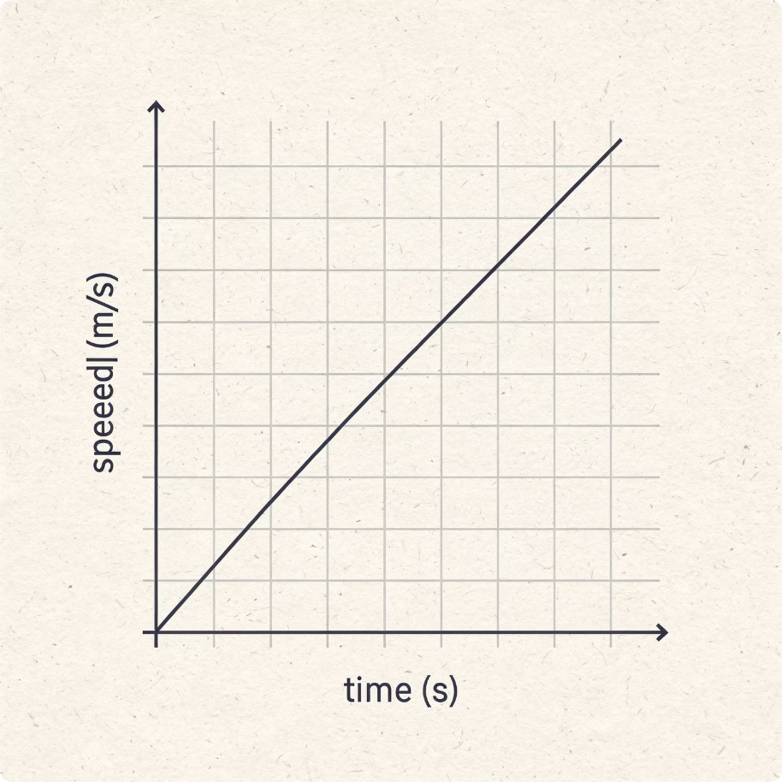
Round 3
Answer: The Graph
Did your team get it right?
Shape of the Graph
The Gradient
A straight, diagonal line starting from zero, showing constant acceleration.
The gradient represents g, the acceleration of free fall (9.8 m/s²).
THELUCIDSTEM.COM

Slide 14
Q4
Round 4: Calculation
Put your heads together. You have 60 seconds.
A stone is dropped from a high cliff. Assuming there is no air resistance, calculate the speed of the stone after it has been falling for 3 seconds.
Use g = 9.8 m/s²
THELUCIDSTEM.COM

Slide 15
Round 4
Answer: Calculation
Did your team get it right?
01
02
03
Identify the Equation
Substitute the Values
Final Answer
v = g t
v = 9.8 × 3
v = 29.4 m/s
THELUCIDSTEM.COM

Slide 16
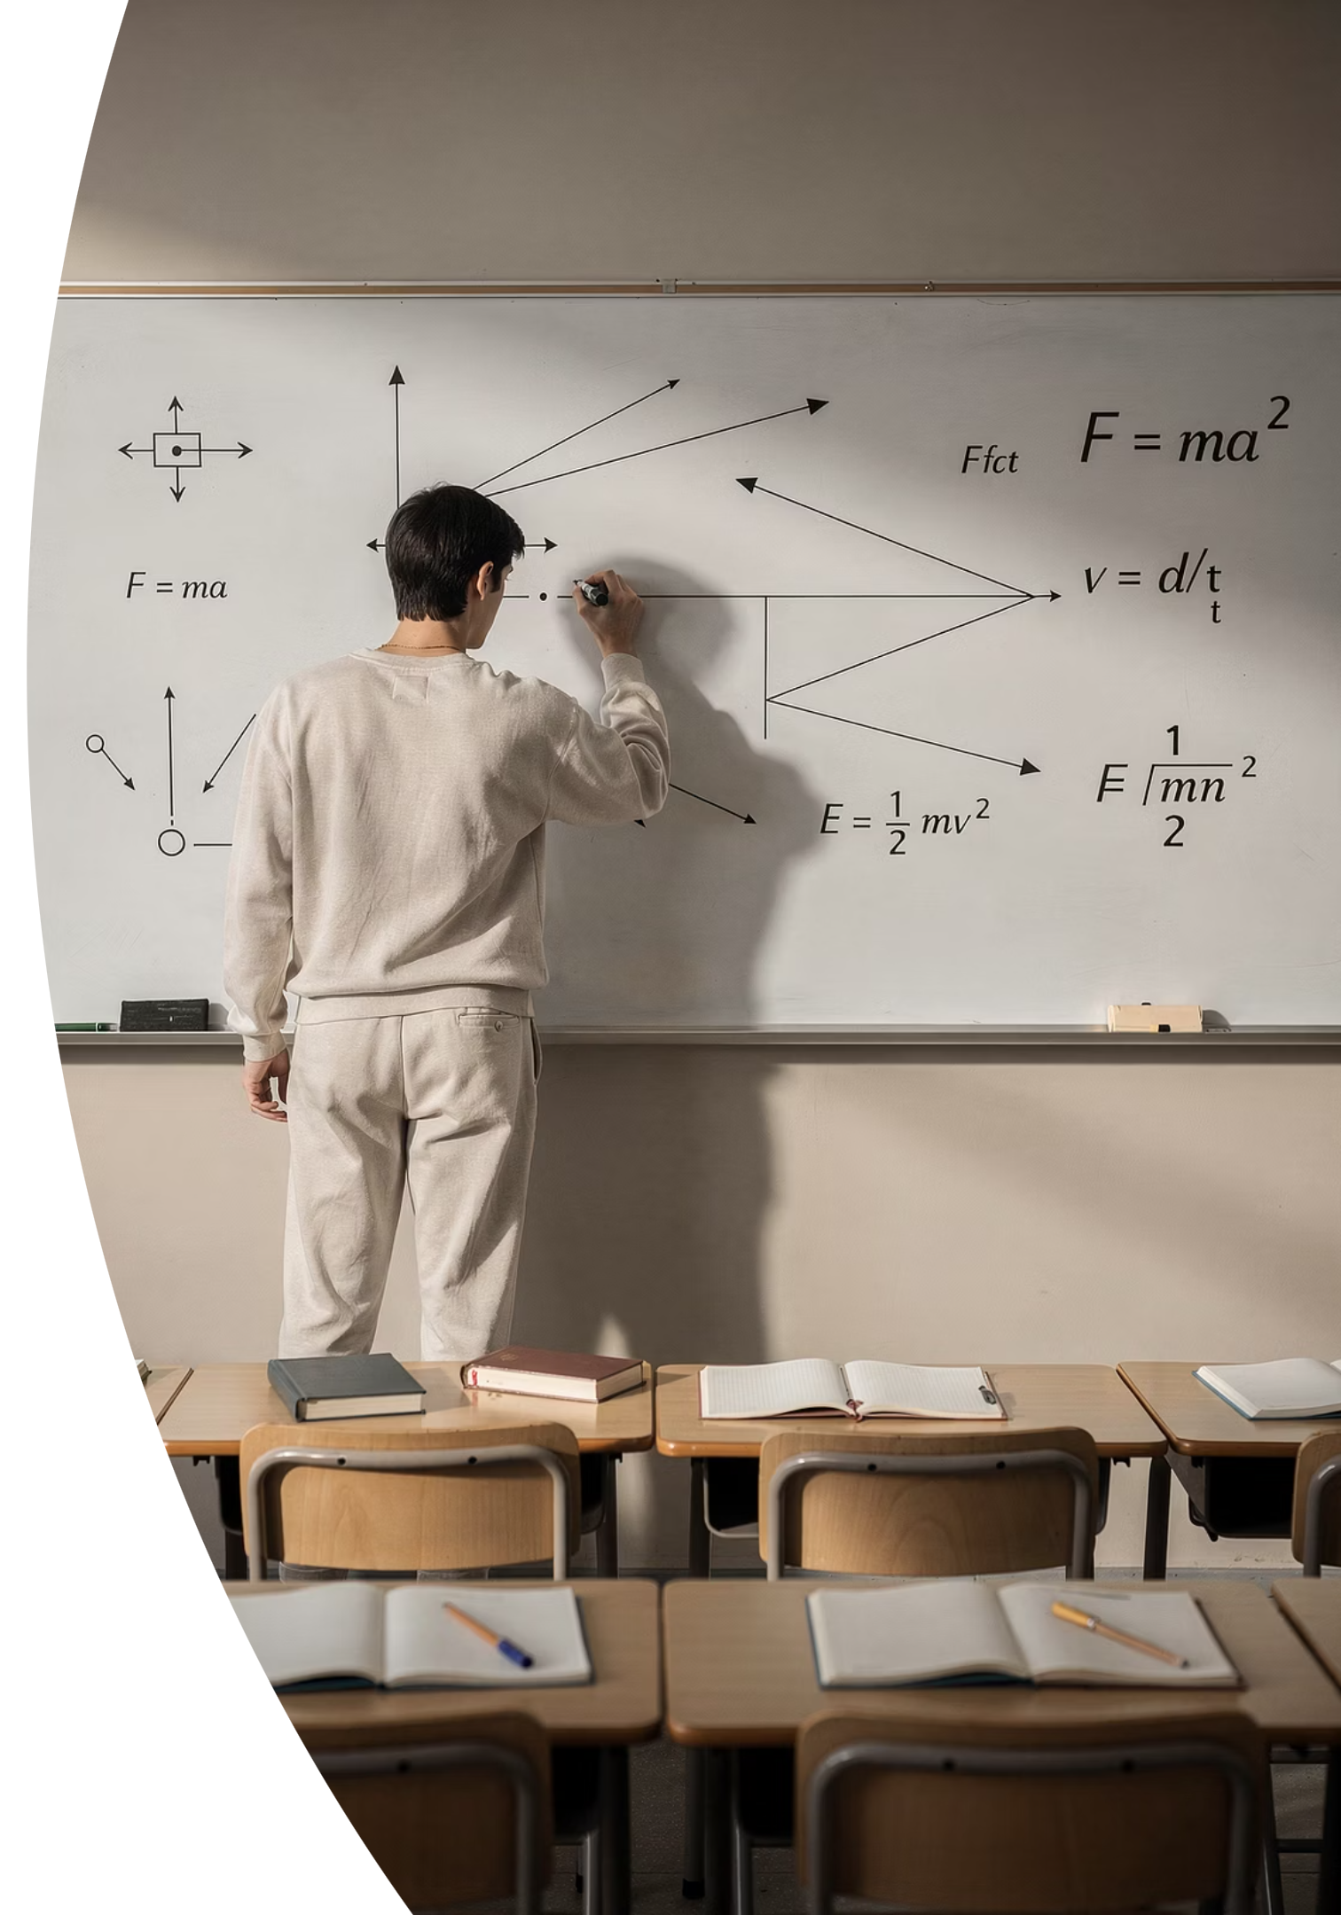
Prove It.
Silence in the room. Answer the following independently on your mini-whiteboards.
1
2
State g
Explain
Give the value of the acceleration of free fall on Earth, including the correct unit.
In one sentence, explain why mass does not affect the acceleration of free fall.
3
Calculate
Find the speed of an object after 2 seconds of free fall. Use v = g t.
THELUCIDSTEM.COM

