Slide 1
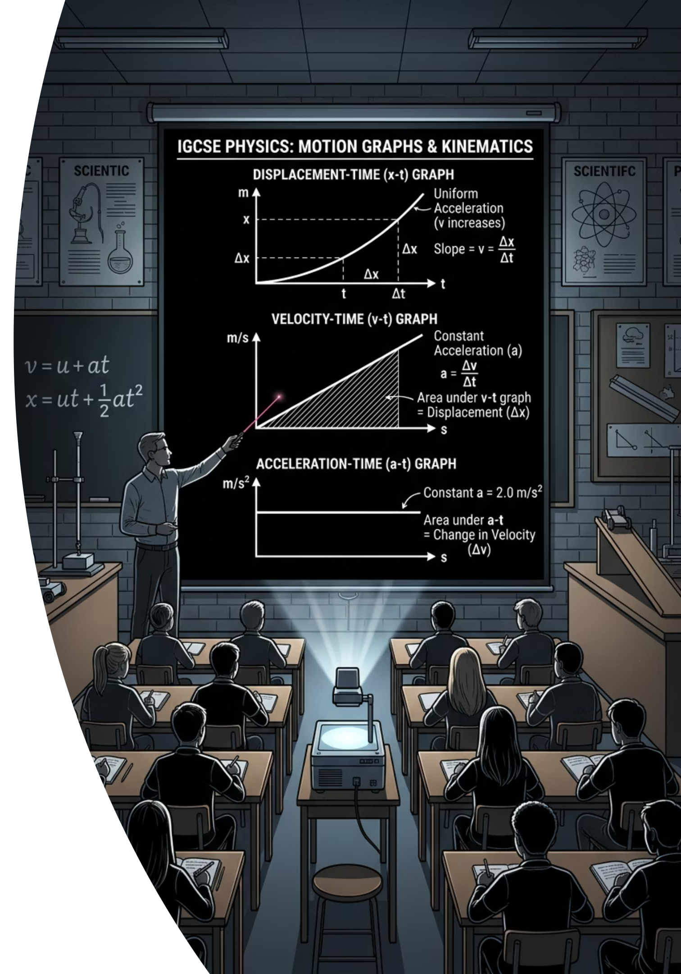
Motion, End to End
Cambridge IGCSE Physics 0625 · Applying and Assessing Motion
@thelucidstem.com

Slide 2
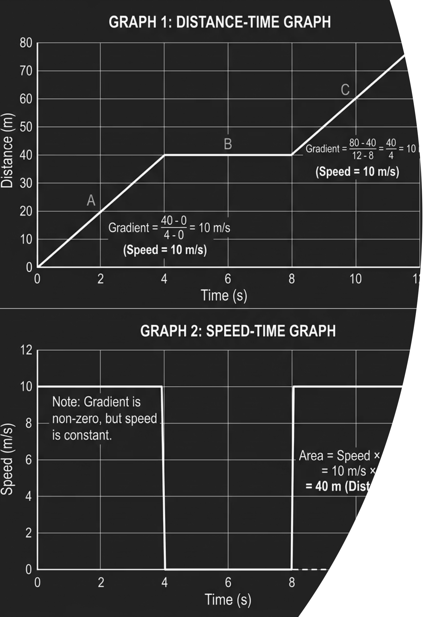
One Journey, Read Every Way
Look at the twin-graph poster on the board. The exact same journey can be described in multiple ways, each revealing something different about the motion.
Distance-Time Graph
Speed-Time Graph
The gradient of the line gives the speed of the object at that moment.
The gradient gives the acceleration. The area under the line gives the distance travelled.
Free Fall
Any object dropped near Earth accelerates at 9.8 m/s² downwards, ignoring air resistance.
Today, we pull all three ideas together into a single coherent picture of motion.
@thelucidstem.com

Slide 3
Topic: Applying and Assessing Motion
By the end of this lesson, you will be able to:
01
02
03
Average Speed
Distance-Time Graphs
Speed-Time Graphs
Recall and apply the equation speed = distance / time using consistent SI units throughout.
Extract speed from the gradient of a distance-time graph with confidence and precision.
Read both acceleration (gradient) and distance (area) from a speed-time graph.
04
05
Acceleration and Deceleration
Tool Selection
Calculate acceleration correctly, treating deceleration as a negative value.
Choose the correct method, a formula or a graph reading, to solve any motion problem efficiently.
@thelucidstem.com

Slide 4


⚠ Examiner Report Warning: These are the most common errors seen in IGCSE Physics scripts. Study them carefully before your test.
The Axes and Area Illusions
Avoid these fatal errors in your test today. Each trap below has cost students marks repeatedly, according to published Cambridge examiner reports.
Trap 1: Mixing Up the Two Graphs
Trap 2: Finding Area Under a Distance-Time Graph
Trap 3: Dropping Units
A numerical answer without units scores zero for that part. Speed must be in m/s. Acceleration must be in m/s². Write units on every final answer, always.
A straight diagonal line looks identical on both graph types, but it means entirely different things. Always read the y-axis label first. Speed on a distance-time graph is not the same as acceleration on a speed-time graph.
That area has no physical meaning. Only the area under a speed-time graph gives distance. Do not apply the area method to the wrong graph type.
@thelucidstem.com

Slide 5
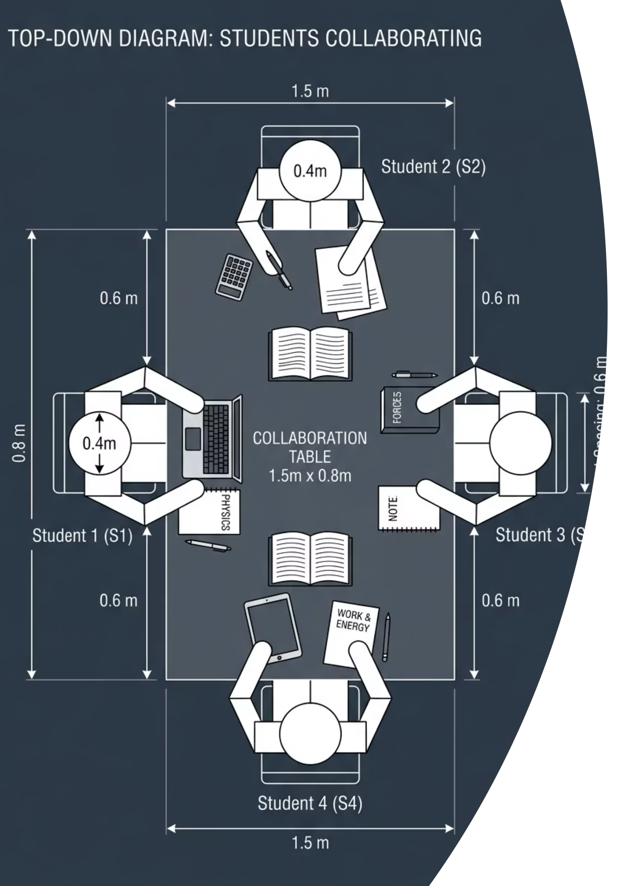

Cooperative Task: Numbered Heads Together
This activity uses the Numbered Heads Together protocol to ensure every member of your group is accountable for the shared answer.
Heads Together
Number Off
Everyone Knows
Random Call
When your number is called, you represent your entire group. Make certain that everyone, not just the strongest student, can explain the full working out before you agree on a final answer.
@thelucidstem.com

Slide 6

ROUND 1
Round 1: Speed
Put your heads together. You have 60 seconds.
The Problem
Hint: Which Formula?
A car travels 90 m in 6 s.
What is its average speed?
Show your formula, your substitution, and your final answer with units.
You need the average speed equation. Recall it from memory before you substitute any numbers.
speed = distance / time
@thelucidstem.com

Slide 7

ROUND 1 ANSWER
Round 1: Answer
Did your group get it right? Check every step of the working below.
Formula
Substitution
Final Answer
speed = distance / time
speed = 90 / 6
15 m/s
✓ Correct! Remember: units are mandatory. An answer of "15" without "m/s" would not receive full marks.
@thelucidstem.com

Slide 8
ROUND 2
Round 2: Distance-Time Graph
Put your heads together. You have 60 seconds.
The Problem
Think Carefully
On a distance-time graph, what does the gradient of the line tell you?
Give the precise physical quantity and its unit.
Gradient = rise / run on any graph. What are the axes of a distance-time graph? What quantity does that ratio represent?
@thelucidstem.com

Slide 9
ROUND 2 ANSWER
Round 2: Answer
Did your group get it right? This is a foundational fact that must be committed to memory.
The gradient of a distance-time graph is the speed of the object.
Gradient = change in distance / change in time = m / s = m/s
✓ Correct! A steeper gradient means greater speed. A horizontal line means the object is stationary. A curved line means the speed is changing.
@thelucidstem.com

Slide 10
ROUND 3
Round 3: Acceleration
Put your heads together. You have 60 seconds.
The Problem
Hint: Which Formula?
A bus speeds up from 4 m/s to 16 m/s in 4 s.
What is its acceleration? Include the correct unit.
acceleration = change in velocity / time taken
Remember: change in velocity = final velocity minus initial velocity.
@thelucidstem.com

Slide 11
ROUND 3 ANSWER
Round 3: Answer
Did your group get it right? Check every step of the working below.
Formula
Substitution
Final Answer
a = (v - u) / t
a = (16 - 4) / 4 = 12 / 4
3 m/s²
✓ Correct! The unit m/s² means the velocity increases by 3 metres per second for every second of travel.
@thelucidstem.com

Slide 12
ROUND 4
Round 4: Speed-Time Area
Put your heads together. You have 60 seconds.
The Problem
Hint: Shape of Area
A runner holds a steady speed of 6 m/s for 10 s.
Use the area under the speed-time graph to find the total distance travelled.
A constant speed on a speed-time graph produces a rectangle.
Area of a rectangle = base x height.
@thelucidstem.com

Slide 13
ROUND 4 ANSWER
Round 4: Answer
Did your group get it right? Check every step of the working below.
Method
Substitution
Final Answer
distance = area = base x height
distance = 10 x 6
60 m
✓ Correct! The rectangular area (base = time = 10 s, height = speed = 6 m/s) gives distance in metres. Always include the unit.
@thelucidstem.com

Slide 14
ROUND 5
Round 5: Deceleration
Put your heads together. You have 60 seconds.
The Problem
Key Point: Sign Convention
A train slows from 30 m/s to 10 m/s in 5 s.
What is its deceleration? Show the sign of your answer and explain what it means.
Deceleration means the velocity is decreasing. The change in velocity will be negative, so the acceleration value will be negative.
@thelucidstem.com

Slide 15
ROUND 5 ANSWER
Round 5: Answer
Did your group get it right? Pay close attention to the sign in the working.
Formula
Substitution
Final Answer
a = (v - u) / t
a = (10 - 30) / 5 = -20 / 5 = -4
Deceleration = 4 m/s²
✓ Correct! The negative sign confirms the object is slowing down. The magnitude of the deceleration is 4 m/s². In an exam, stating "deceleration of 4 m/s²" is acceptable.
@thelucidstem.com

Slide 16
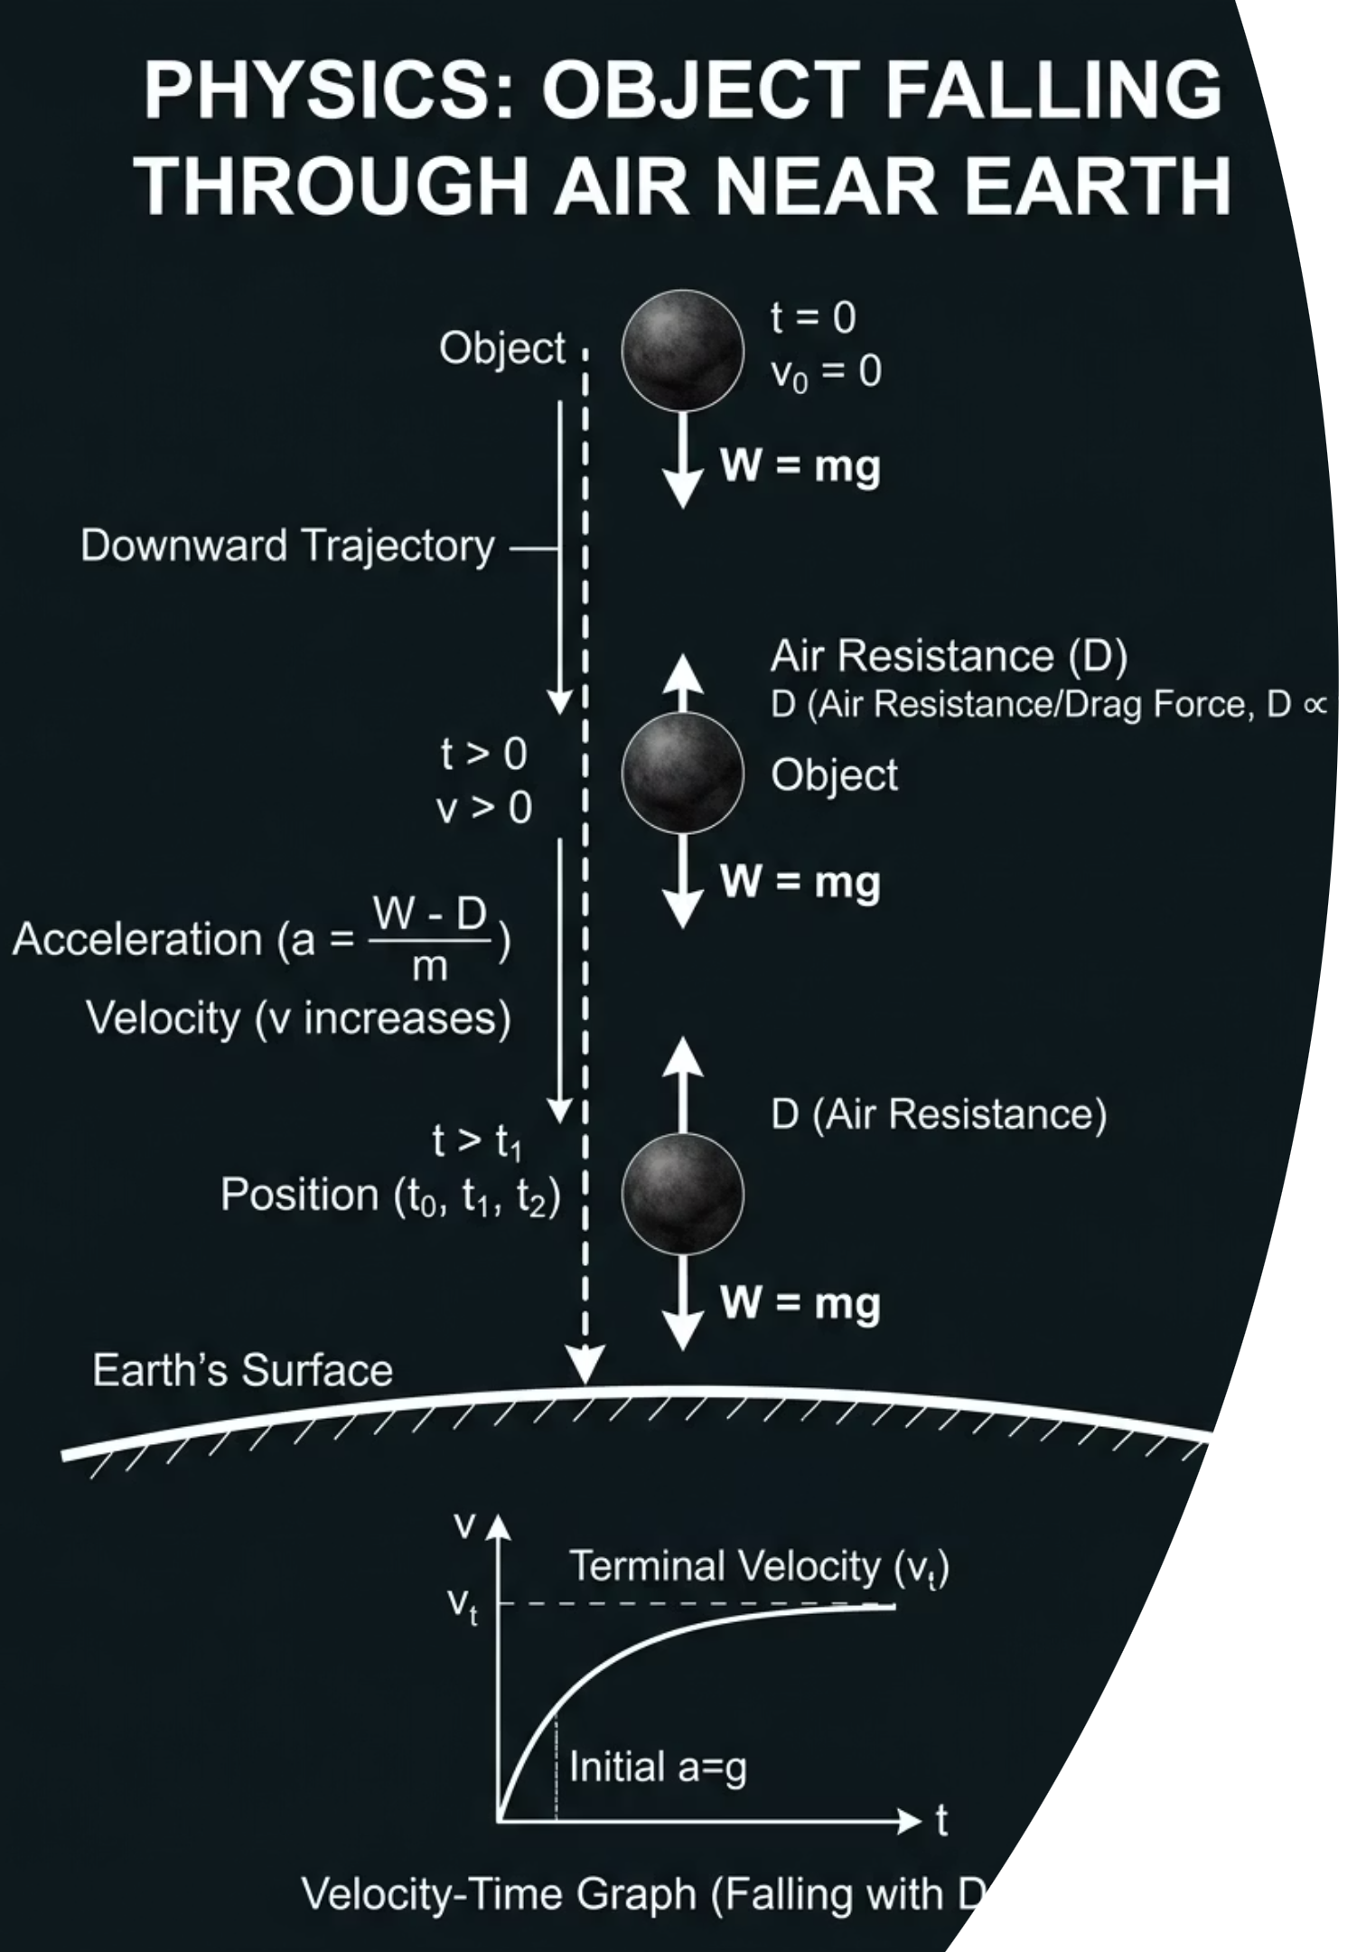
ROUND 6
Round 6: Free Fall
Put your heads together. You have 60 seconds.
The Problem
Context
What is the approximate acceleration of free fall near the surface of the Earth?
Give both the numerical value and the correct unit.
This is a constant value for all objects near Earth's surface, regardless of their mass, when air resistance is ignored.
@thelucidstem.com

Slide 17
ROUND 6 ANSWER
Round 6: Answer
Did your group get it right? This value must be recalled precisely in the examination.
9.8
m/s² downwards
The standard value for the acceleration of free fall near Earth's surface. Cambridge also accepts 10 m/s² as an approximation.
✓ Correct! Both 9.8 m/s² and 10 m/s² are accepted by Cambridge. Always include the unit m/s² in your answer. The direction is always downward toward the Earth.
@thelucidstem.com

Slide 18
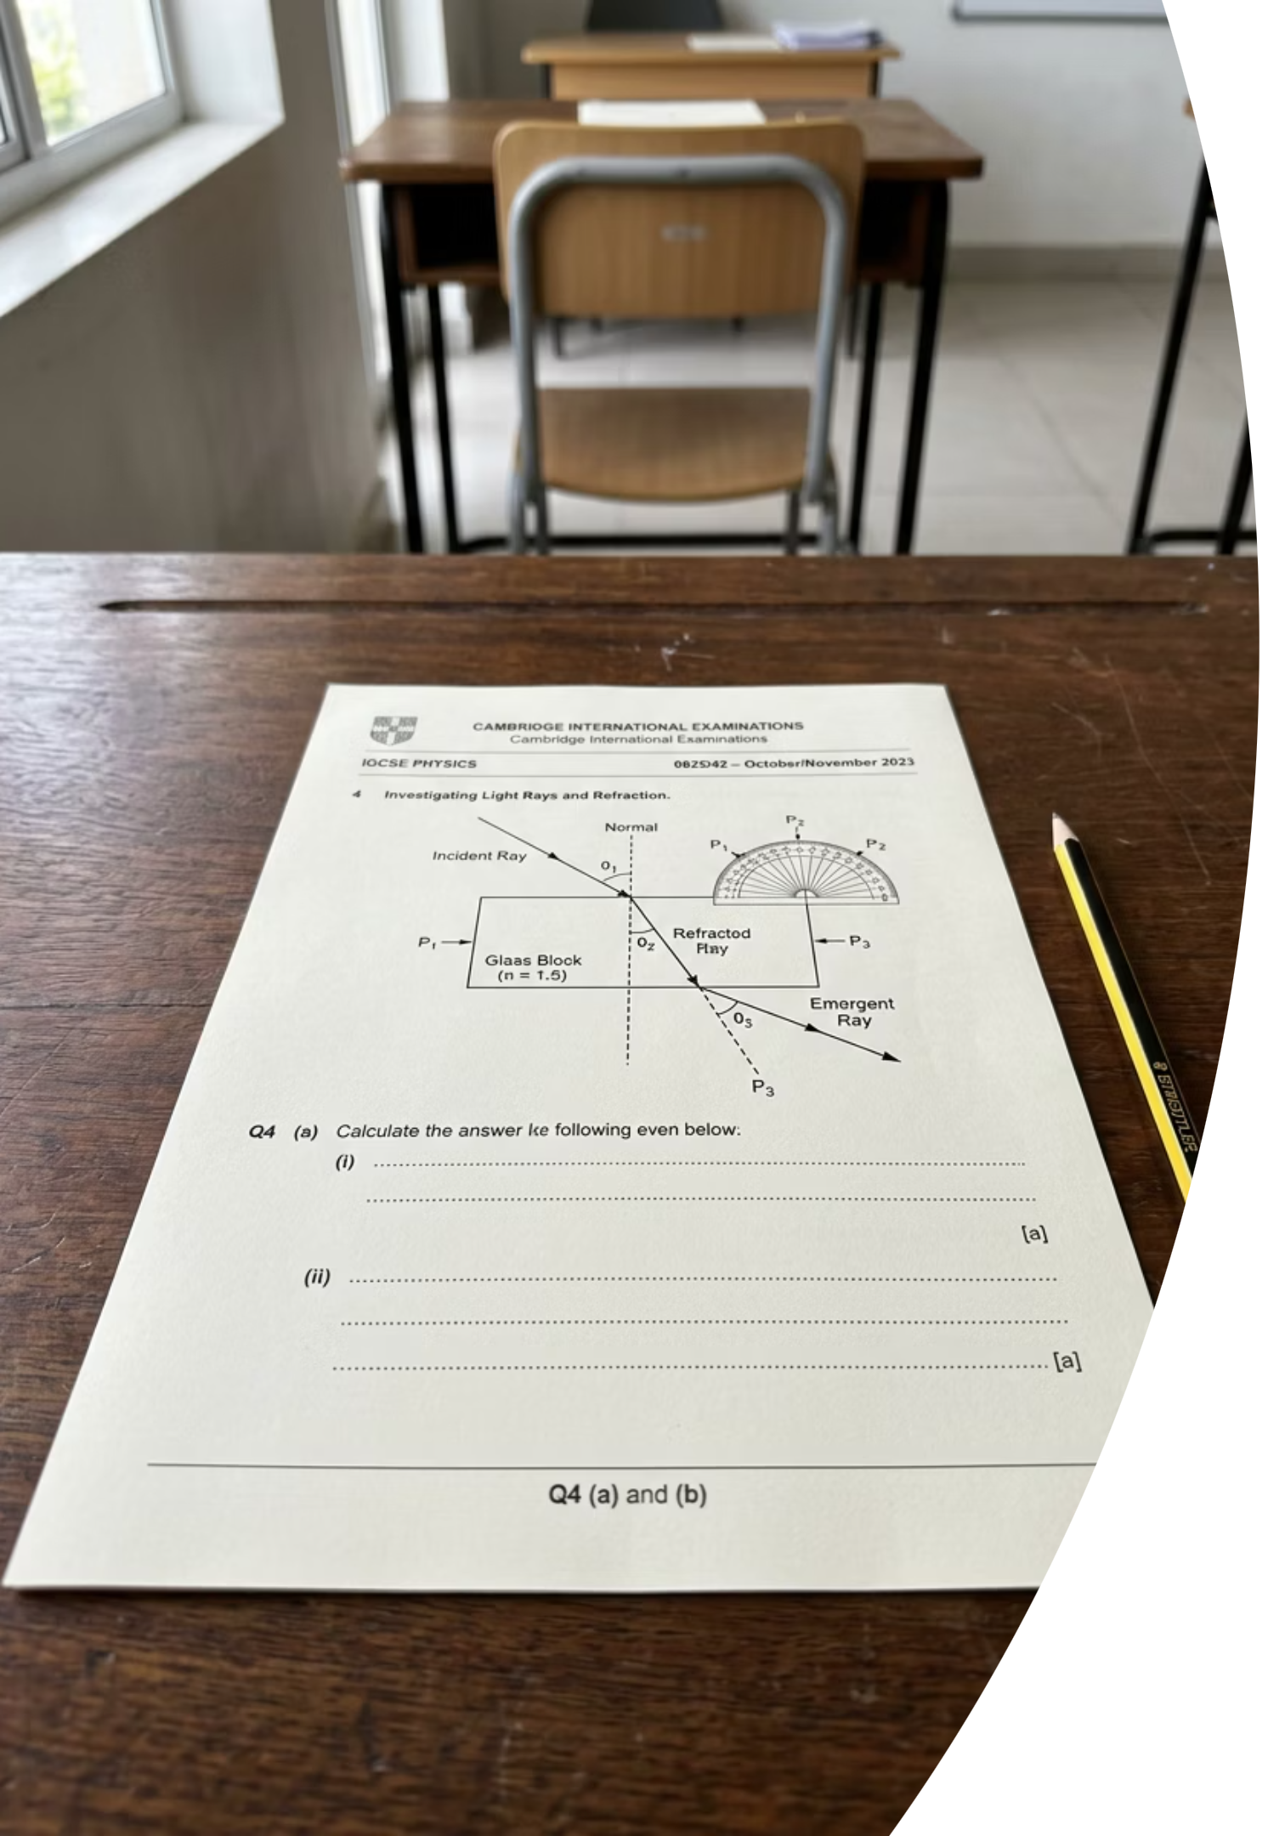

Apply and Assess: The Test
Silence in the room. Clear your desks. This is an independent assessment.
Instructions
Topics Covered
Complete the 15-mark test independently and in silence.
Write the formula, the substitution, and the final answer for every calculation question.
Write the unit for every final answer.
Average speed calculations
Distance-time graph gradients
Speed-time graph: gradient and area
Acceleration and deceleration
Free fall near Earth
Good luck.
@thelucidstem.com

