Slide 1
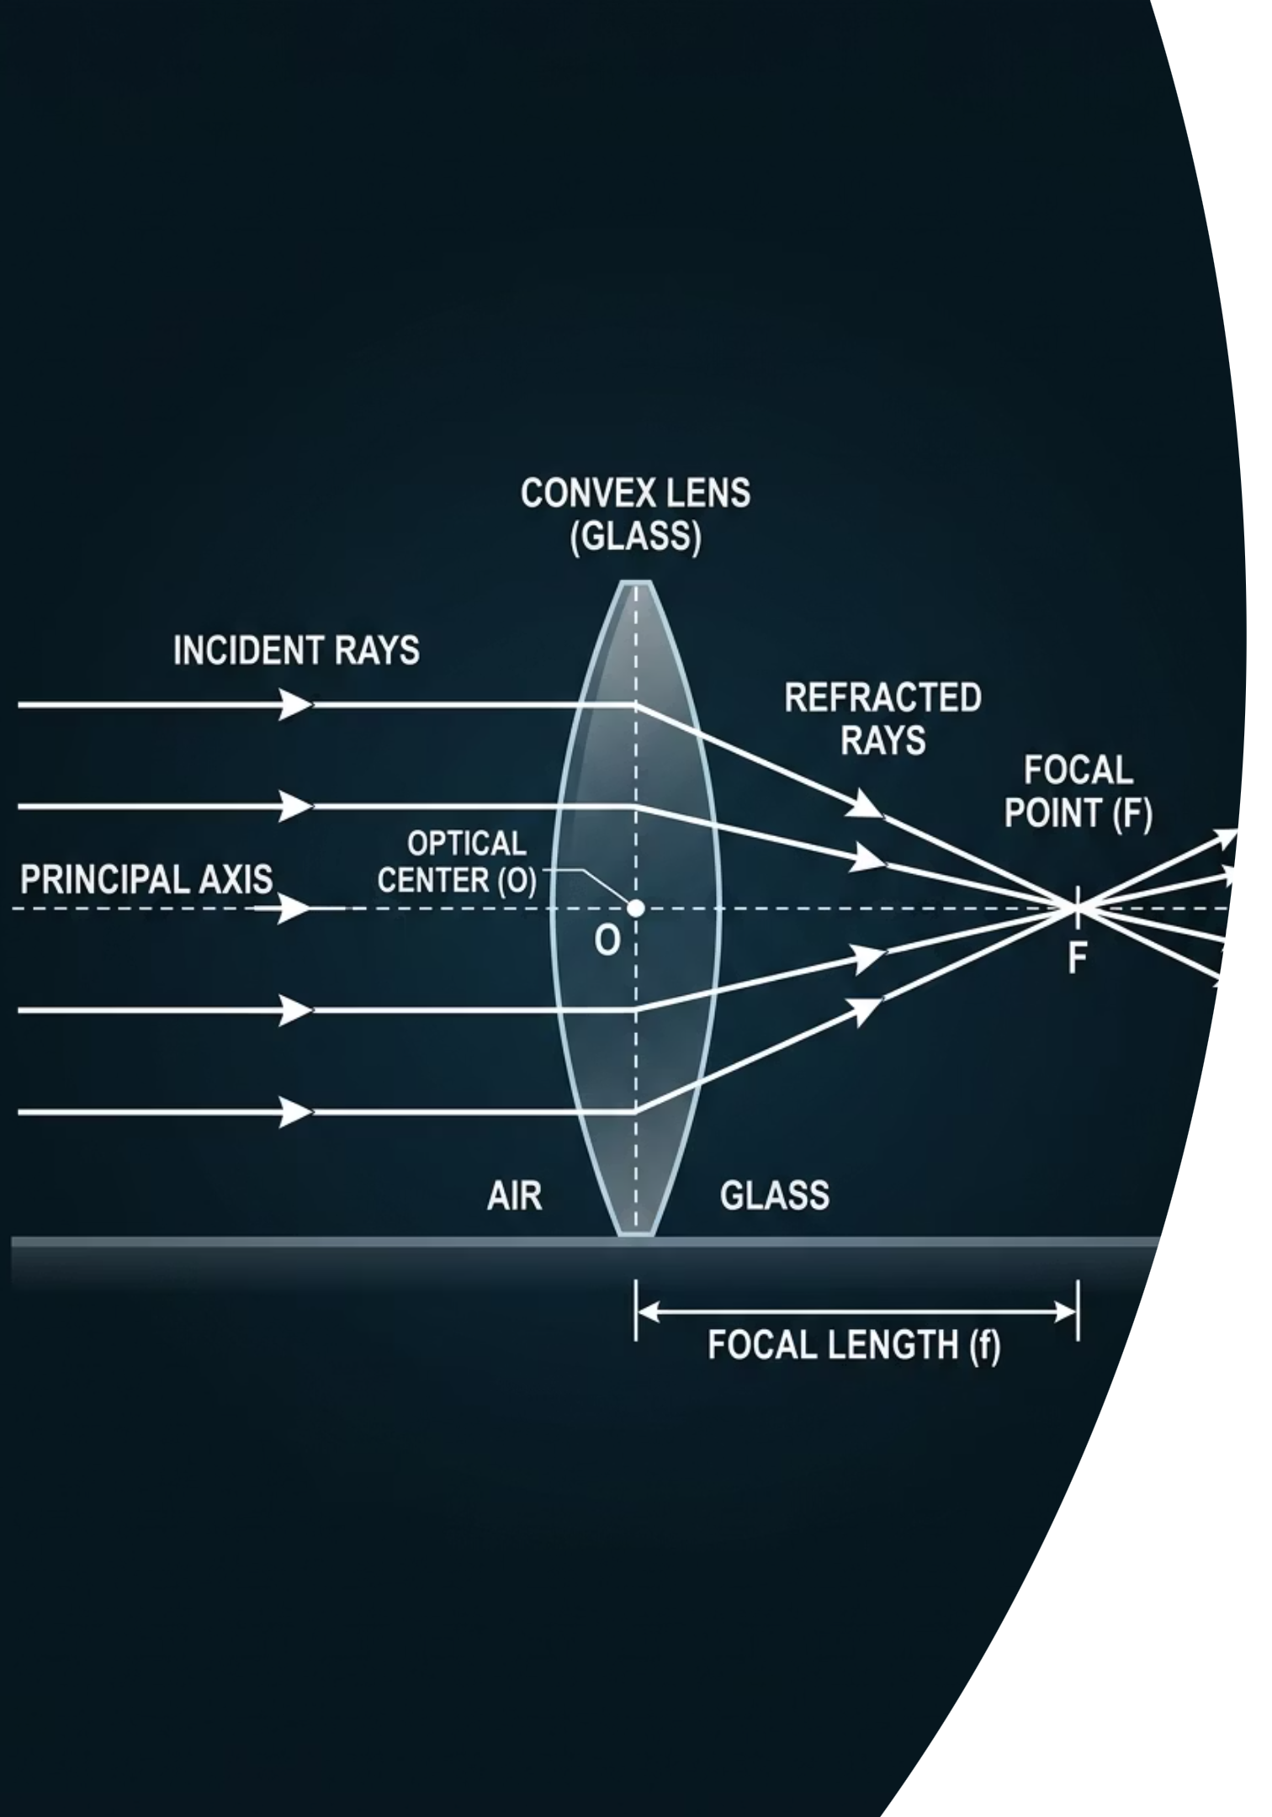
Converging Lenses
Cambridge IGCSE Physics 0625 · Extended Level
@thelucidstem.com

Slide 2
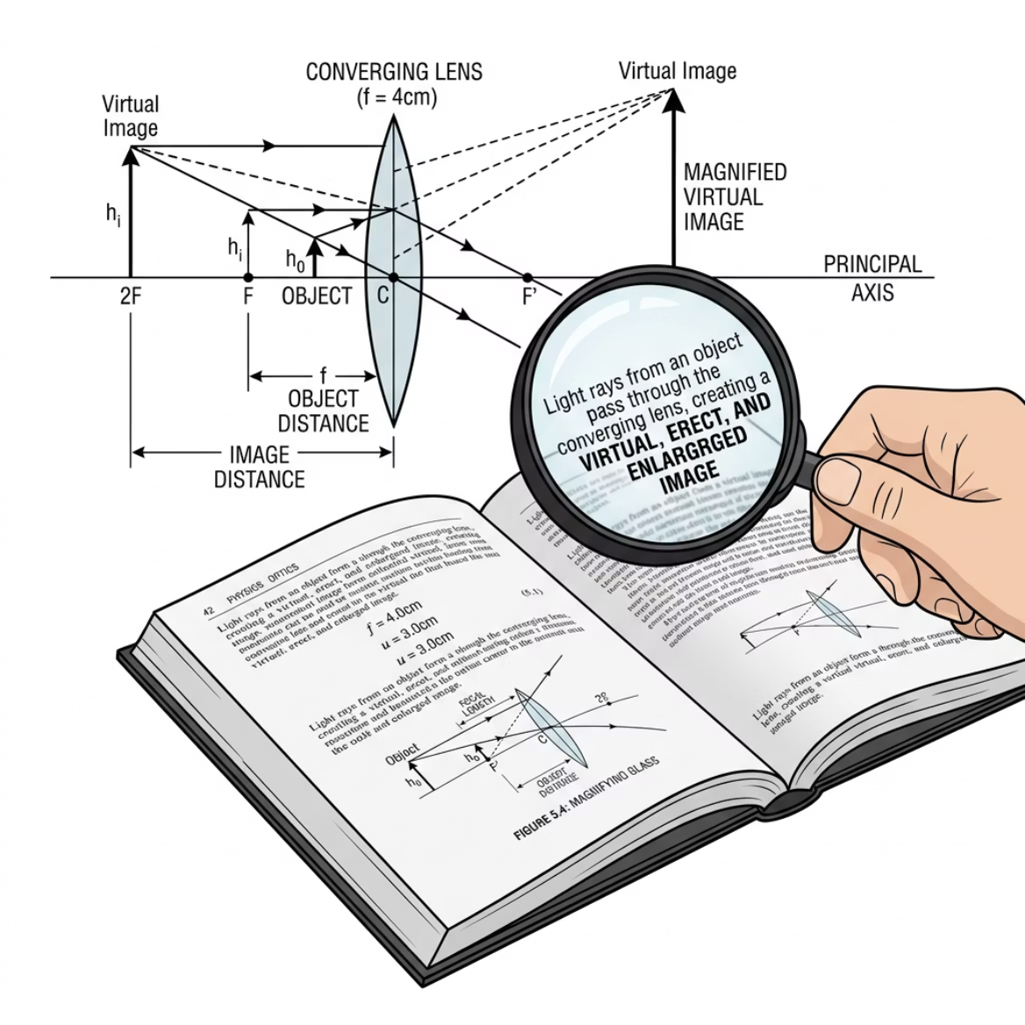
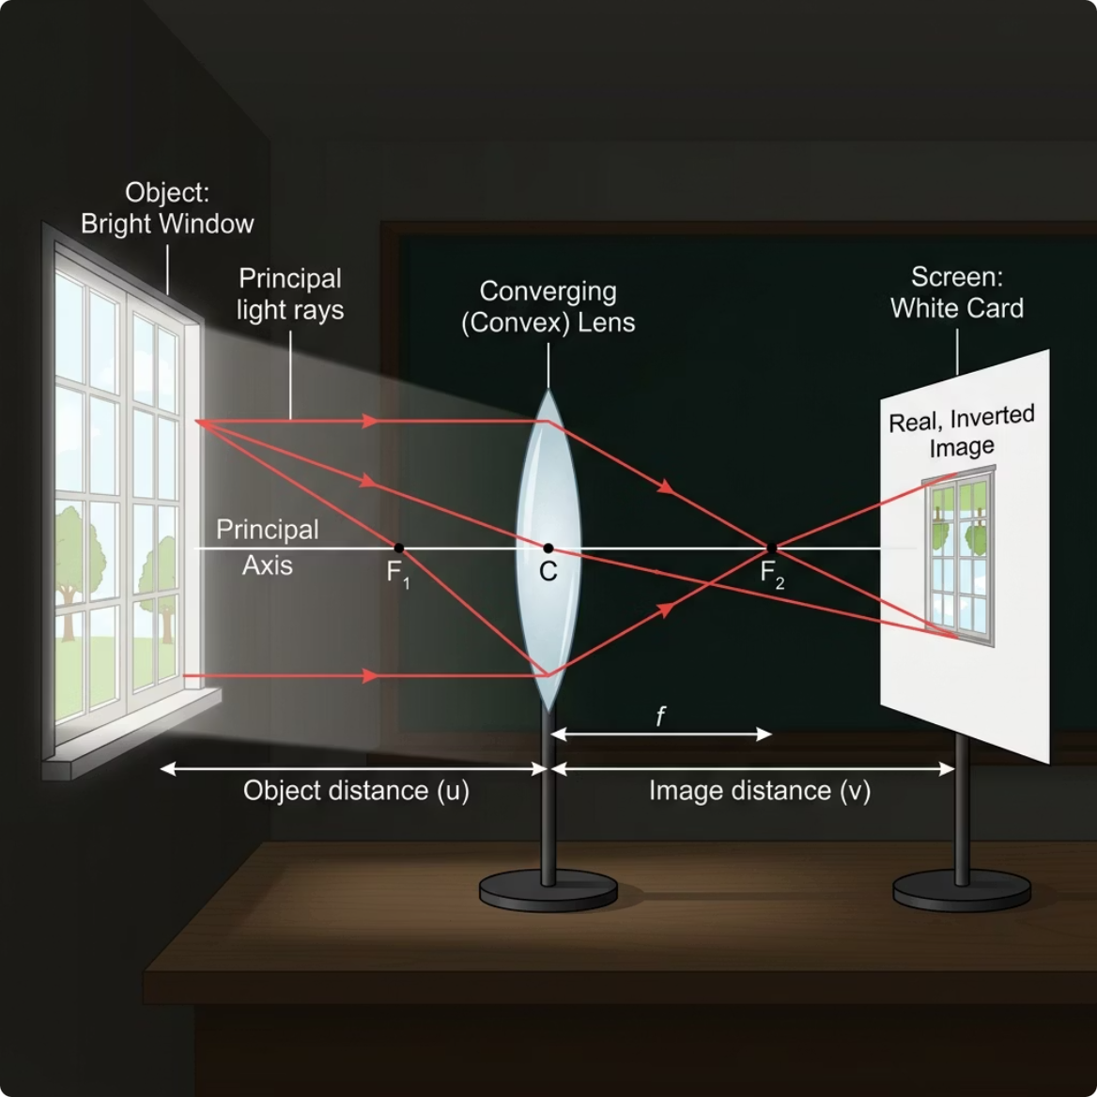

Held Close: Magnifying Glass
Held Far: Projector
When held close to a page, the lens produces an image that is upright and enlarged, acting as a magnifying glass.
When held far from a bright window, the same lens projects a small, inverted image onto a piece of paper.
The Two Faces of a Lens
Think, Pair, Share: How can the exact same piece of glass produce two completely different types of image?
@thelucidstem.com

Slide 3
Topic: Converging Lenses
By the end of this Extended lesson, you will be able to:
01
02
03
Describe Refraction
Mark Key Features
Construct Ray Diagrams
Explain how a thin converging lens bends parallel light rays to a single point of focus.
Identify and label the principal focus (F) and focal length (f) on a lens diagram.
Draw accurate ray diagrams using the three standard construction rays.
04
05
Classify Images
Explain the Magnifying Glass
Describe any image as real or virtual, upright or inverted, and enlarged or diminished.
Account for how a single converging lens produces a virtual, upright, enlarged image.
@thelucidstem.com

Slide 4
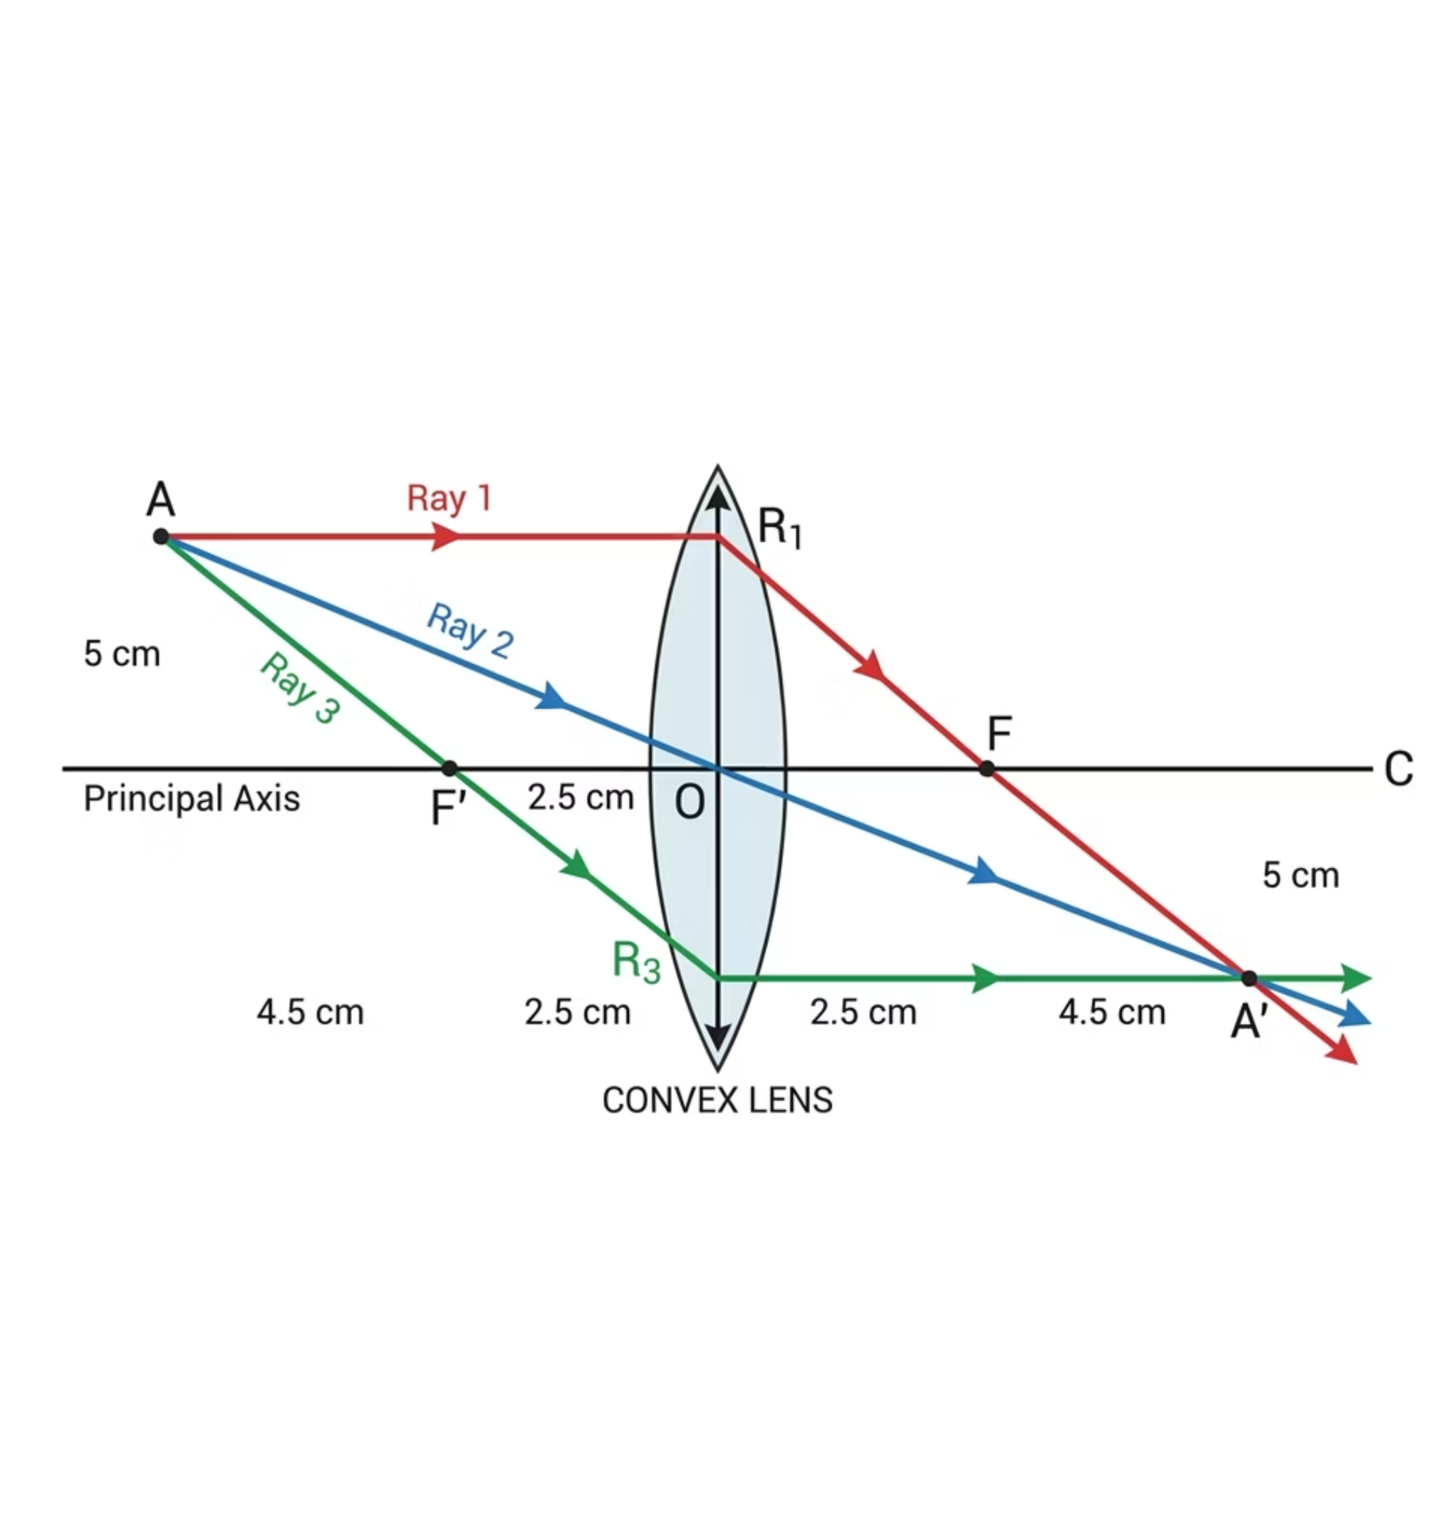
The Three Golden Rays
Every ray diagram in this topic is built from exactly three predictable rays. Where any two of them cross, the top of the image is located.
Ray 1: Parallel Ray
1
Travels parallel to the principal axis, then bends through the principal focus (F) on the far side of the lens.
Ray 2: Centre Ray
2
Passes straight through the optical centre of the lens without bending or changing direction.
Ray 3: Focus Ray
3
Passes through the near principal focus (F) first, then emerges parallel to the principal axis on the far side.
@thelucidstem.com

Slide 5

The Ray Illusions
EXAMINER REPORT WARNING
Avoid these fatal errors in your ray diagrams. Each one costs marks in the examination.
Trap 1: Bending Rays Twice
Trap 2: Freehand Lines
Trap 3: Only One Focus Marked
In the thin lens convention, each ray is bent only once, exactly at the vertical construction line passing through the optical centre. Never show a gradual curve through the glass.
No ruler and no direction arrows means zero marks. Every ray must be drawn with a ruler and carry a clear arrowhead showing the direction of travel.
A converging lens always has two principal foci, one on each side, at exactly the same distance from the optical centre. Mark both clearly as F on your diagram.
These three errors are among the most commonly cited mistakes in Cambridge Examiner Reports. Practise until they become automatic.
@thelucidstem.com

Slide 6
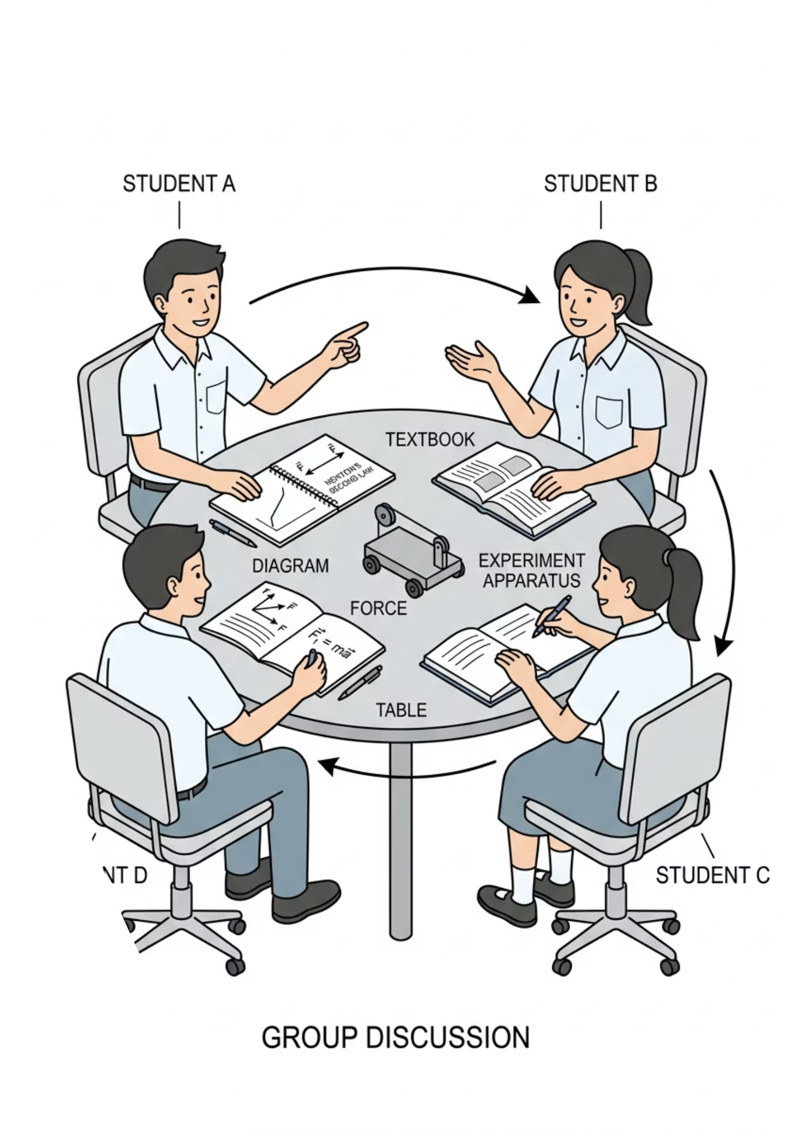

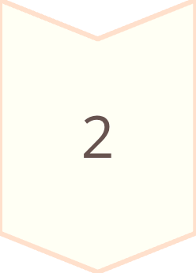
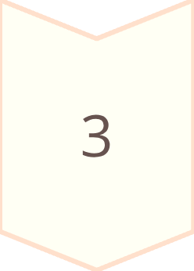

Cooperative Task: Jigsaw
This activity uses a structured cooperative learning protocol. Every expert is essential; the group cannot complete the picture without each contribution.
1. Assign
Each student is assigned one object position case to become expert in.
2. Expert Groups
Meet with others who have the same case. Master the ray diagram and the full image description together.
3. Teach Back
Return to your home group of four. Each expert teaches their case; the rest record the results.
Because every home group needs all four experts, nobody can skip their turn. Your contribution is non-negotiable.
@thelucidstem.com

Slide 7
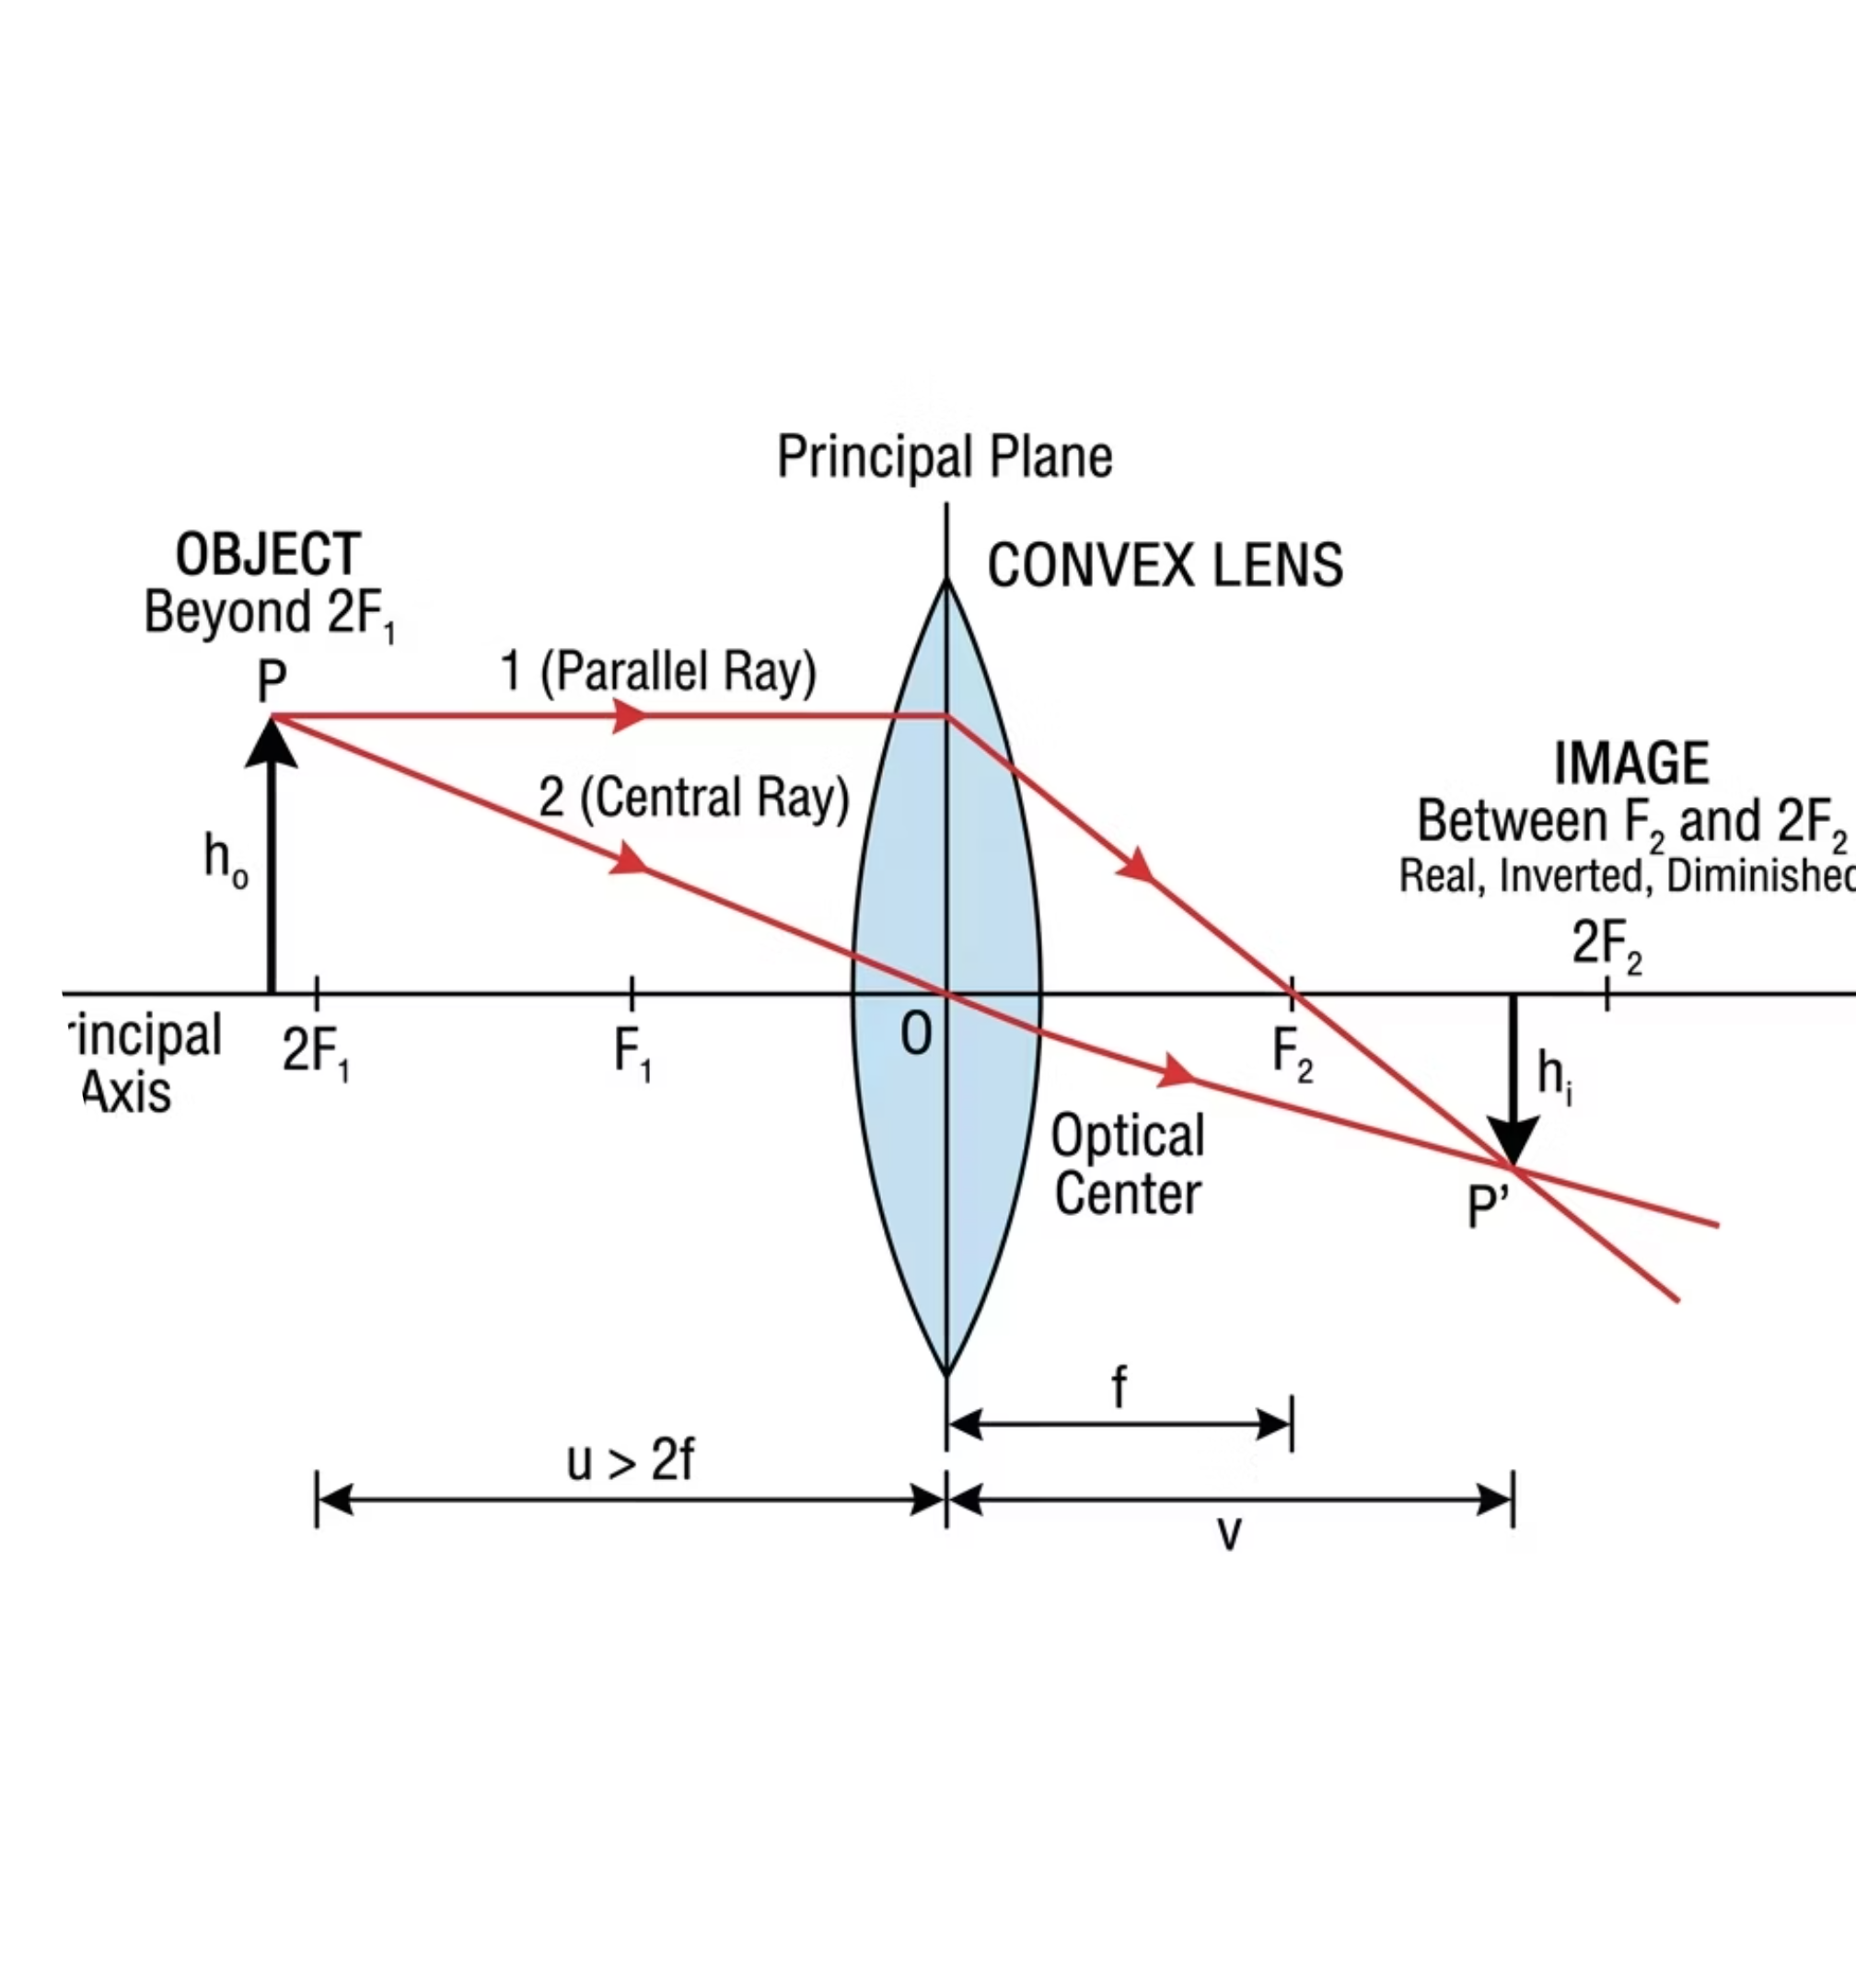
EXPERT CASE 1
Object Beyond 2F
How to Draw It
Place the object beyond the 2F mark on the left. Draw Ray 1 (parallel, then through far F) and Ray 2 (straight through the optical centre). Mark where they cross on the right side of the lens.
Image Description
Real
Inverted
Diminished
The image forms between F and 2F on the far side of the lens. This is the principle behind a camera.
@thelucidstem.com

Slide 8
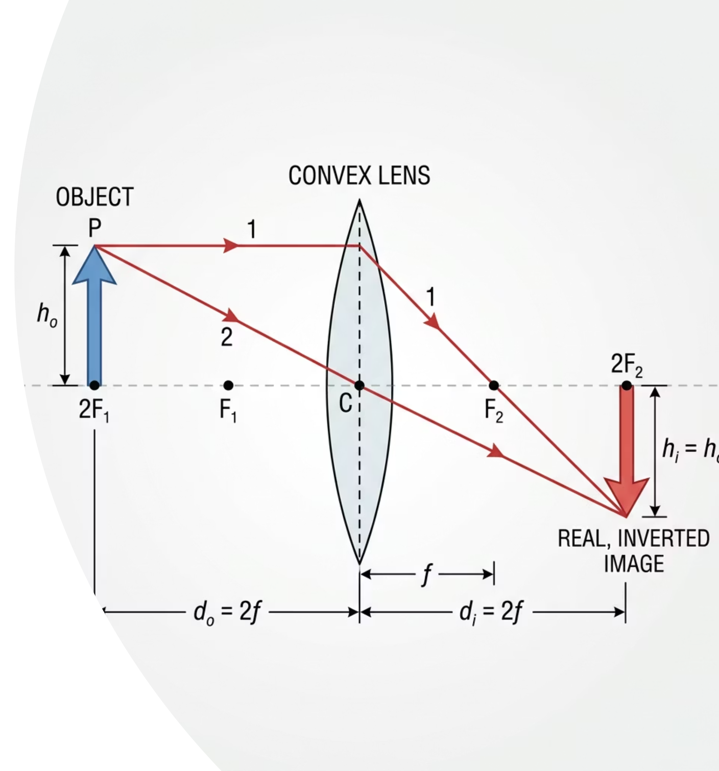
EXPERT CASE 2
Object Exactly At 2F
How to Draw It
Place the object precisely on the 2F mark to the left of the lens. Draw Ray 1 and Ray 2. The crossing point falls exactly on the 2F mark on the right side, the same distance from the lens as the object.
Image Description
Real
Inverted
Same Size
This is the only case that produces an image of exactly the same height as the object. Note it as a special, symmetrical case.
@thelucidstem.com

Slide 9

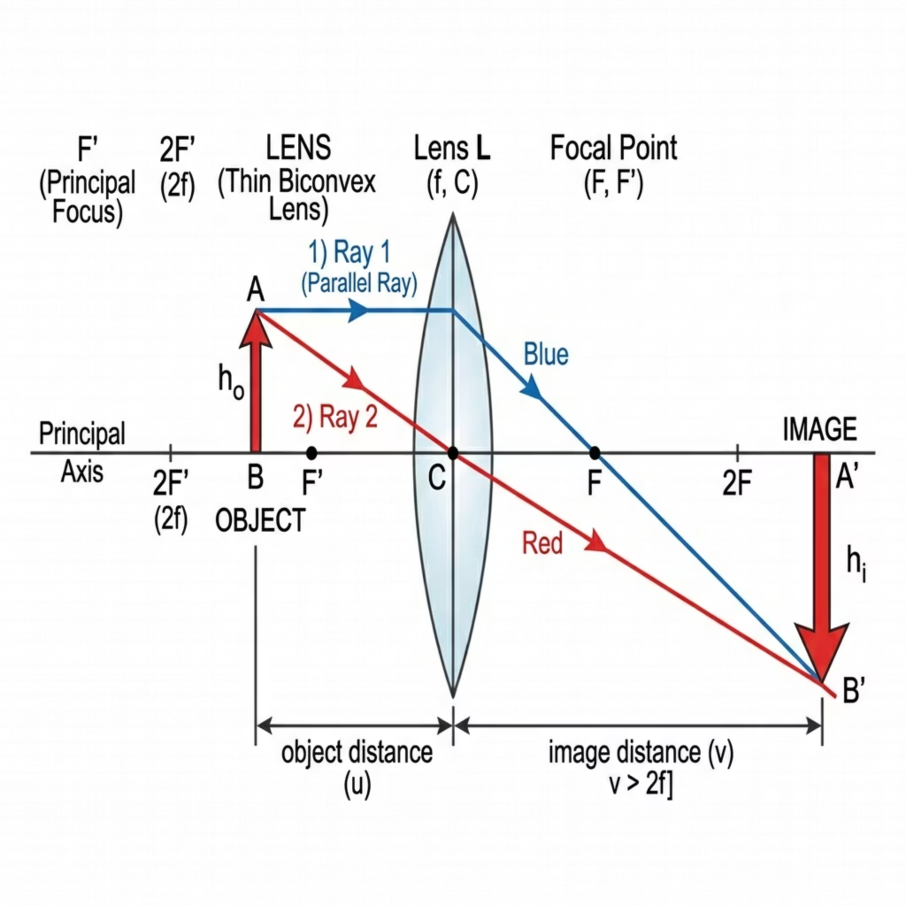
EXPERT CASE 3
Object Between F and 2F
How to Draw It
Place the object between the F and 2F marks on the left. Draw Ray 1 and Ray 2. Notice that the rays cross much further to the right, well beyond the 2F mark. The image is far from the lens.
Image Description
Real
Inverted
Enlarged
The image forms beyond 2F on the far side. This is the principle behind a projector or slide enlarger.
@thelucidstem.com

Slide 10
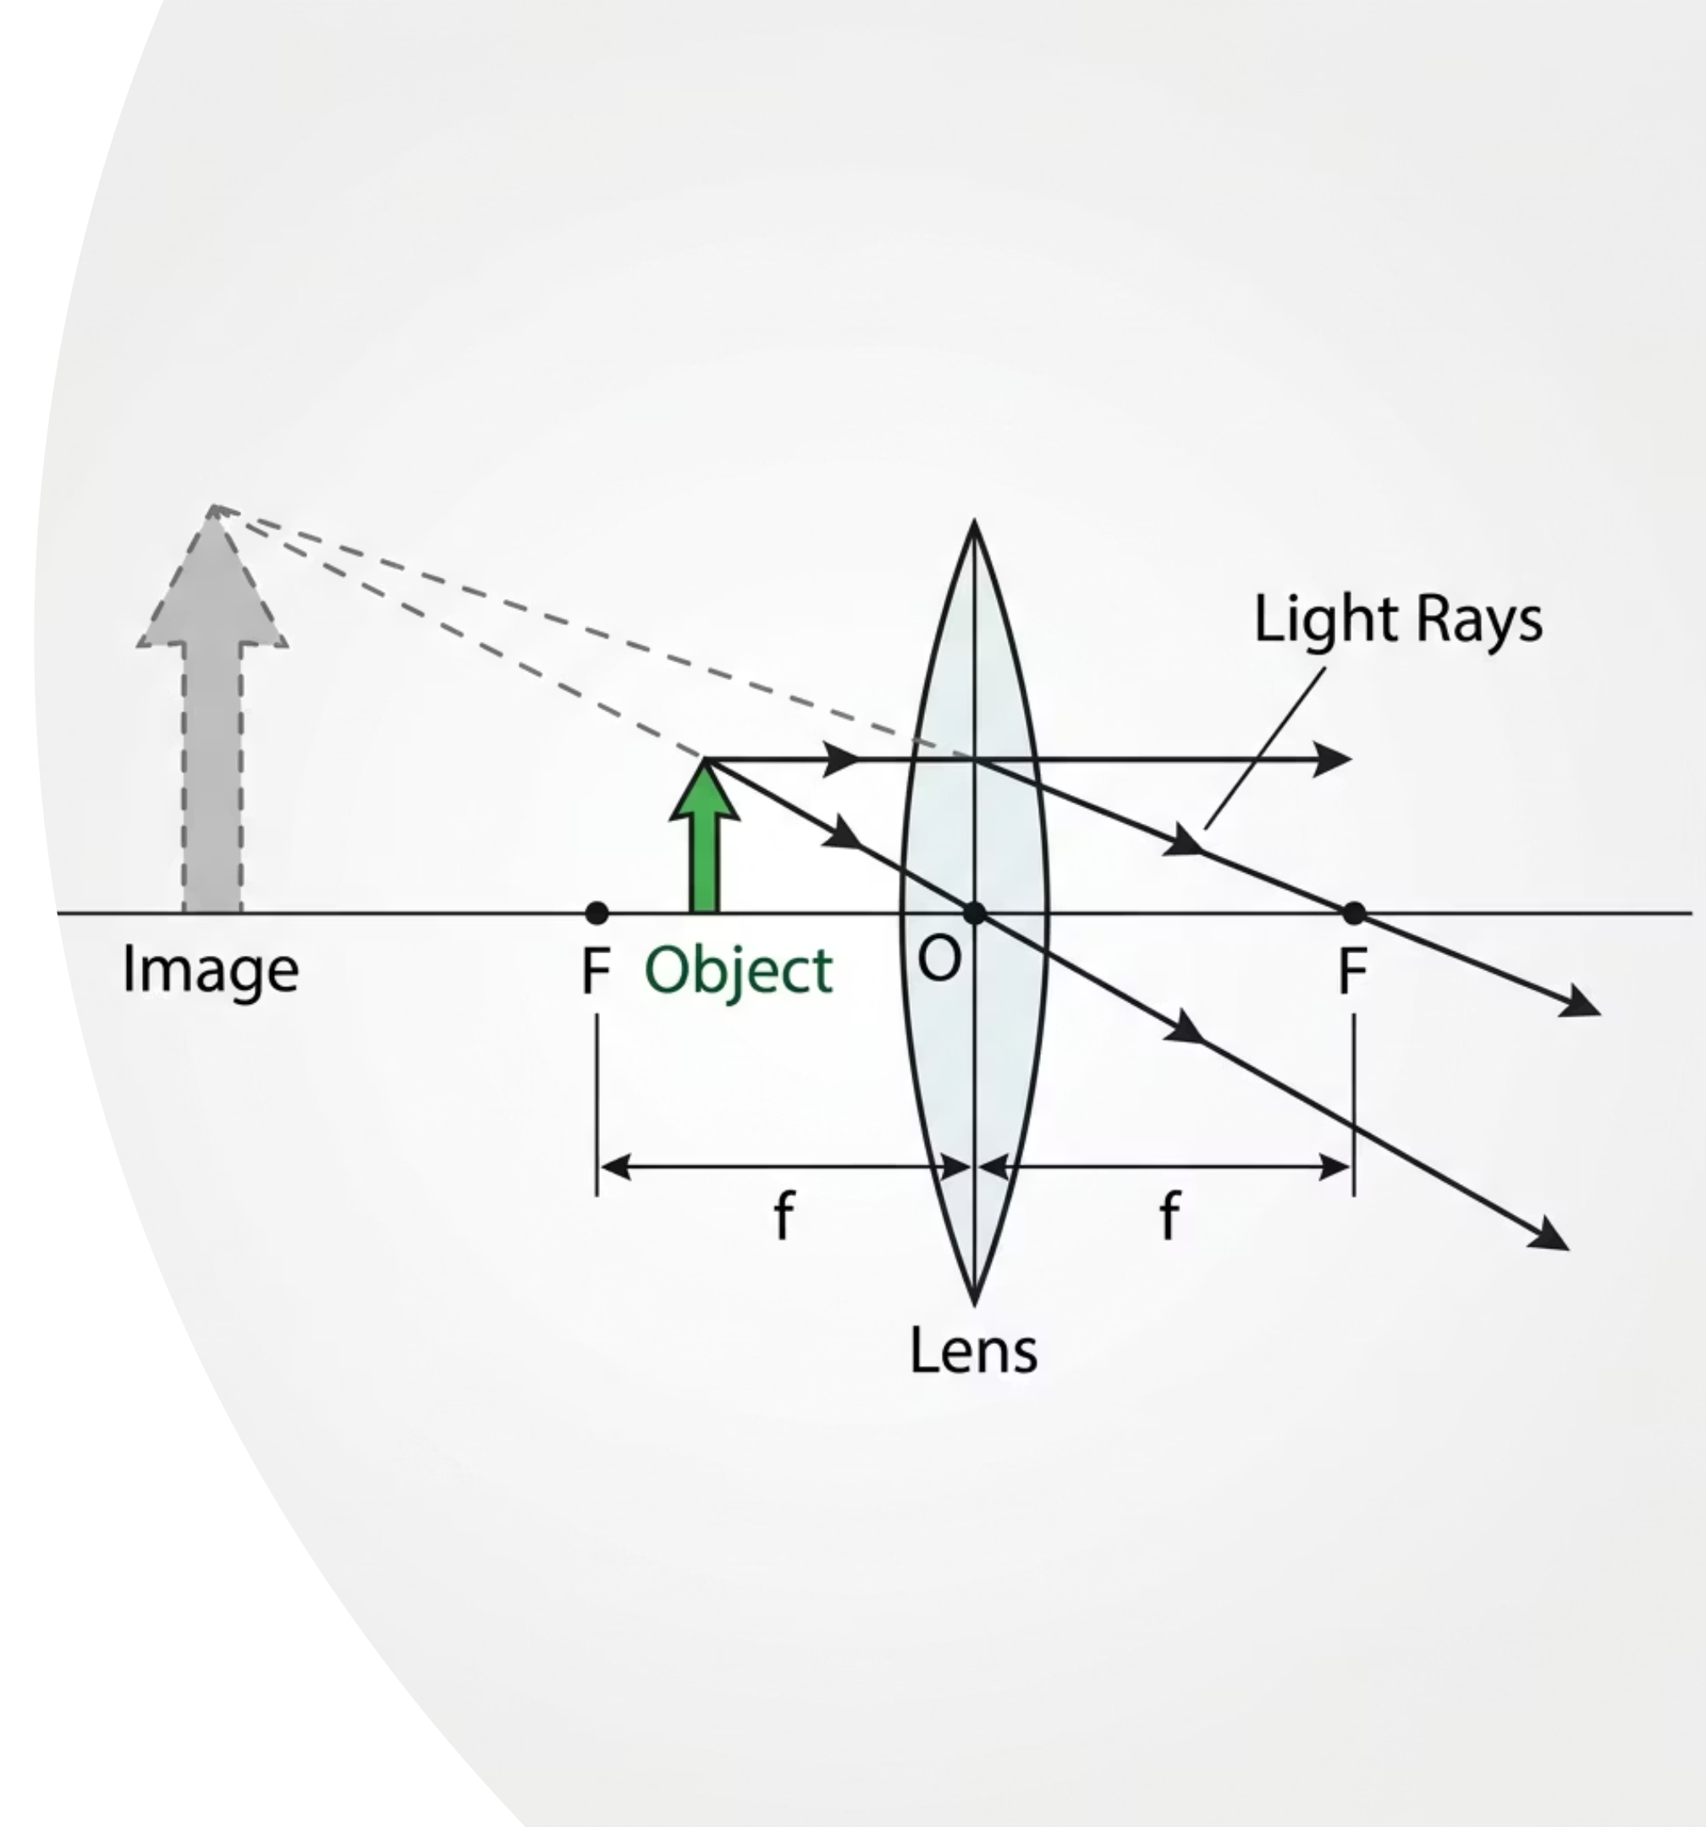
EXPERT CASE 4 · EXTENDED
Object Inside F: The Magnifying Glass
The Key Difference
When the object is inside F, the refracted rays on the right side diverge. They never cross, so no real image forms. You must trace the rays backwards as dashed lines until they meet on the same side as the object.
Image Description
Virtual
Upright
Enlarged
This is the magnifying glass. The image cannot be projected onto a screen; it exists only where the diverging rays appear to originate from.
@thelucidstem.com

Slide 11

Assemble the Big Picture
Check your home group table. Confirm you have recorded all four expert cases before proceeding to the summary below.
Object Position
Real / Virtual
Upright / Inverted
Size
Image Location
Beyond 2F
Real
Inverted
Diminished
Between F and 2F
At 2F
Real
Inverted
Same size
At 2F (far side)
Between F and 2F
Real
Inverted
Enlarged
Beyond 2F
Inside F
Virtual
Upright
Enlarged
Same side as object
Pattern to remember: as the object moves closer to the lens, the image grows larger and moves further away. Cross F and the image switches from real to virtual.
@thelucidstem.com

Slide 12
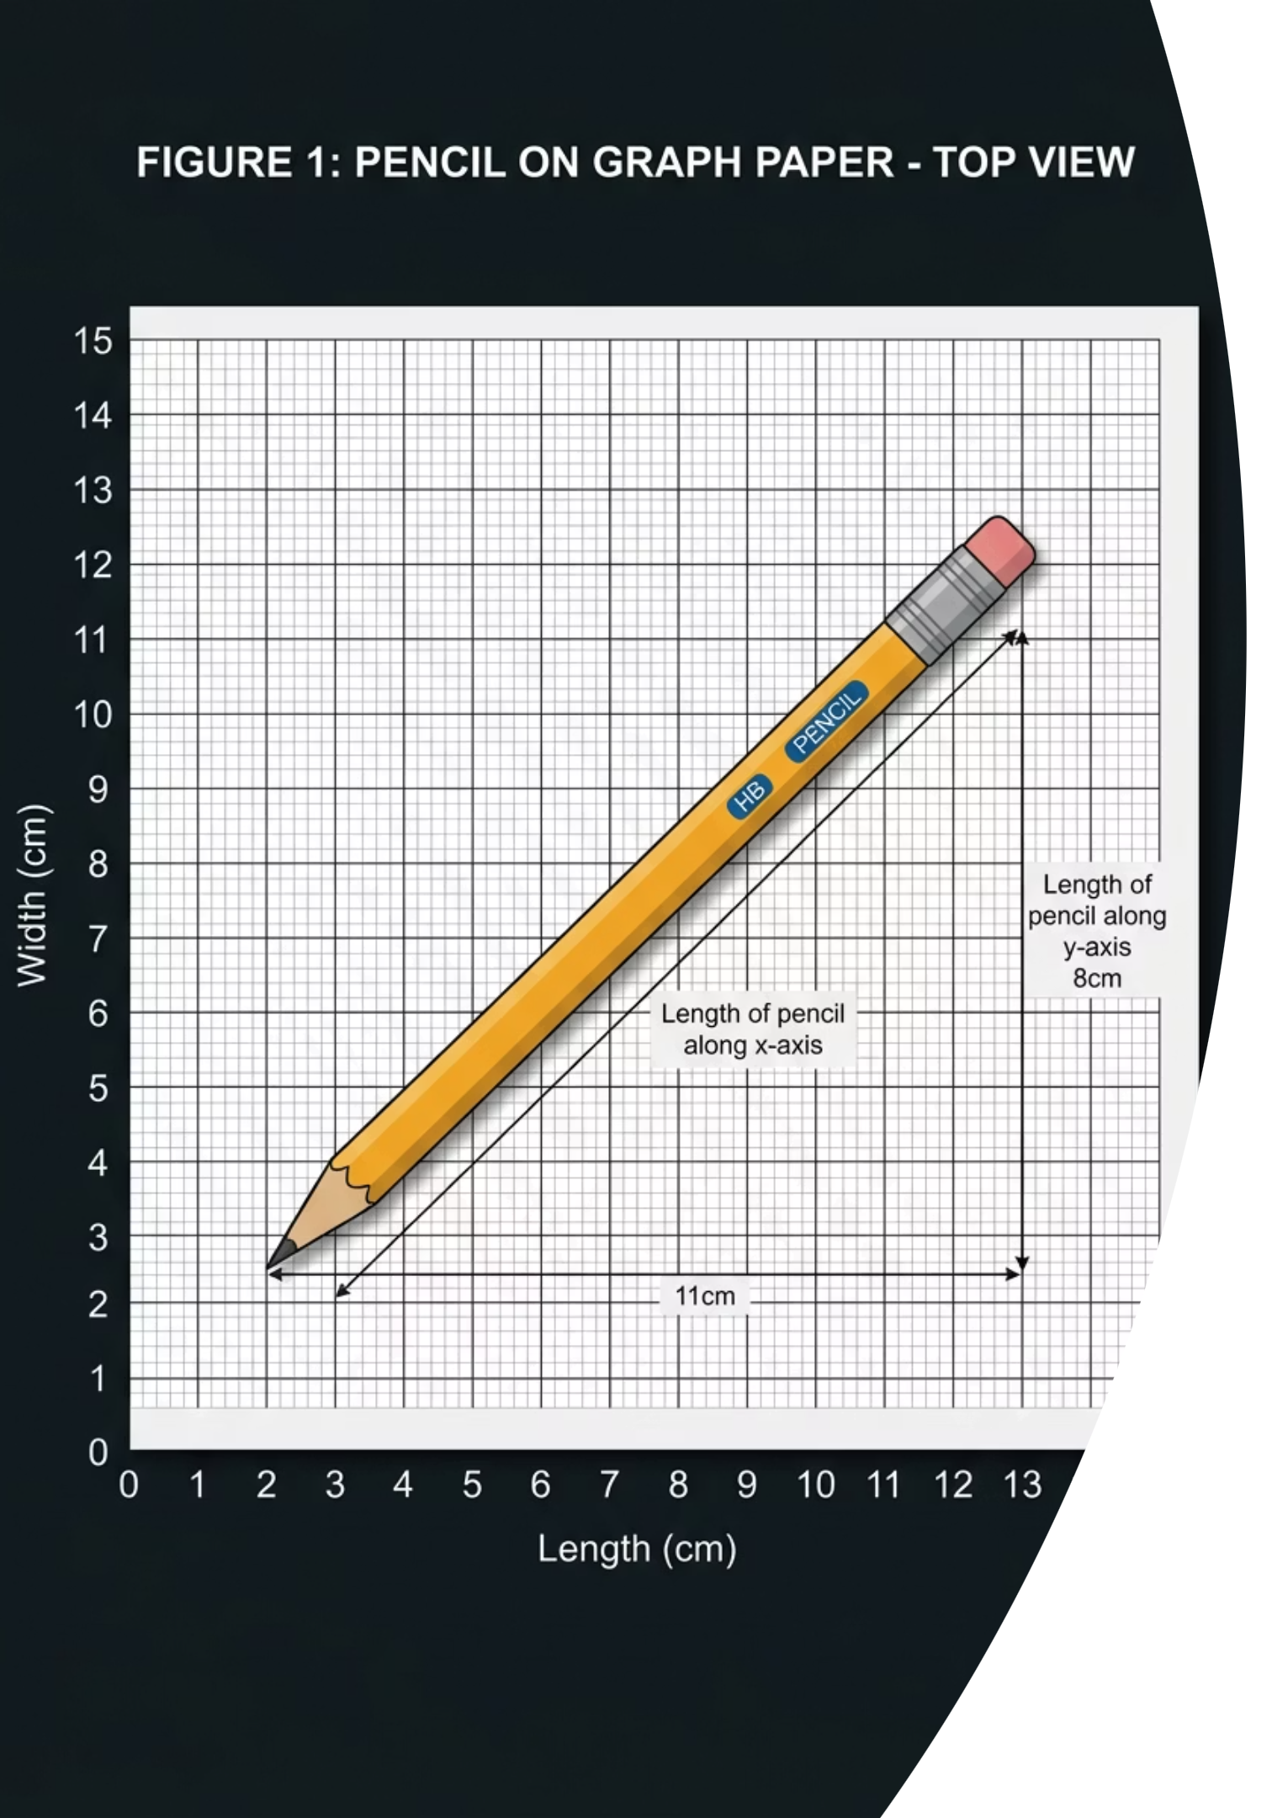
Prove It.
Silence in the room. Complete each task independently before you leave. No notes, no group discussion.
1
2
Construct the Ray Diagram
State the Image Nature
Using your ruler, draw a complete and accurate ray diagram for an object placed beyond 2F. Include both principal foci, all construction rays with arrows, and the final image arrow.
Write the full three-part description of the image: state whether it is real or virtual, upright or inverted, and enlarged or diminished.
3
One-Sentence Condition
In exactly one sentence, state the precise condition under which a converging lens produces a virtual image rather than a real one.
@thelucidstem.com

