Slide 1
Topic: Distance-Time Graphs
By the end of this lesson, you will be able to:
01
02
Read the Shape
Gradient = Speed
State what a horizontal, sloped, and curved section of a distance-time graph shows about an object's motion.
Recognise that the steepness (gradient) of a distance-time graph directly represents the speed of the object.
03
04
Calculate Speed
Sketch & Distinguish
Calculate speed from a distance-time graph by drawing a large gradient triangle and applying Speed = Distance / Time.
Sketch a distance-time graph for a described journey and tell it apart from a speed-time graph by reading the axes.
@thelucidstem.com

Slide 2
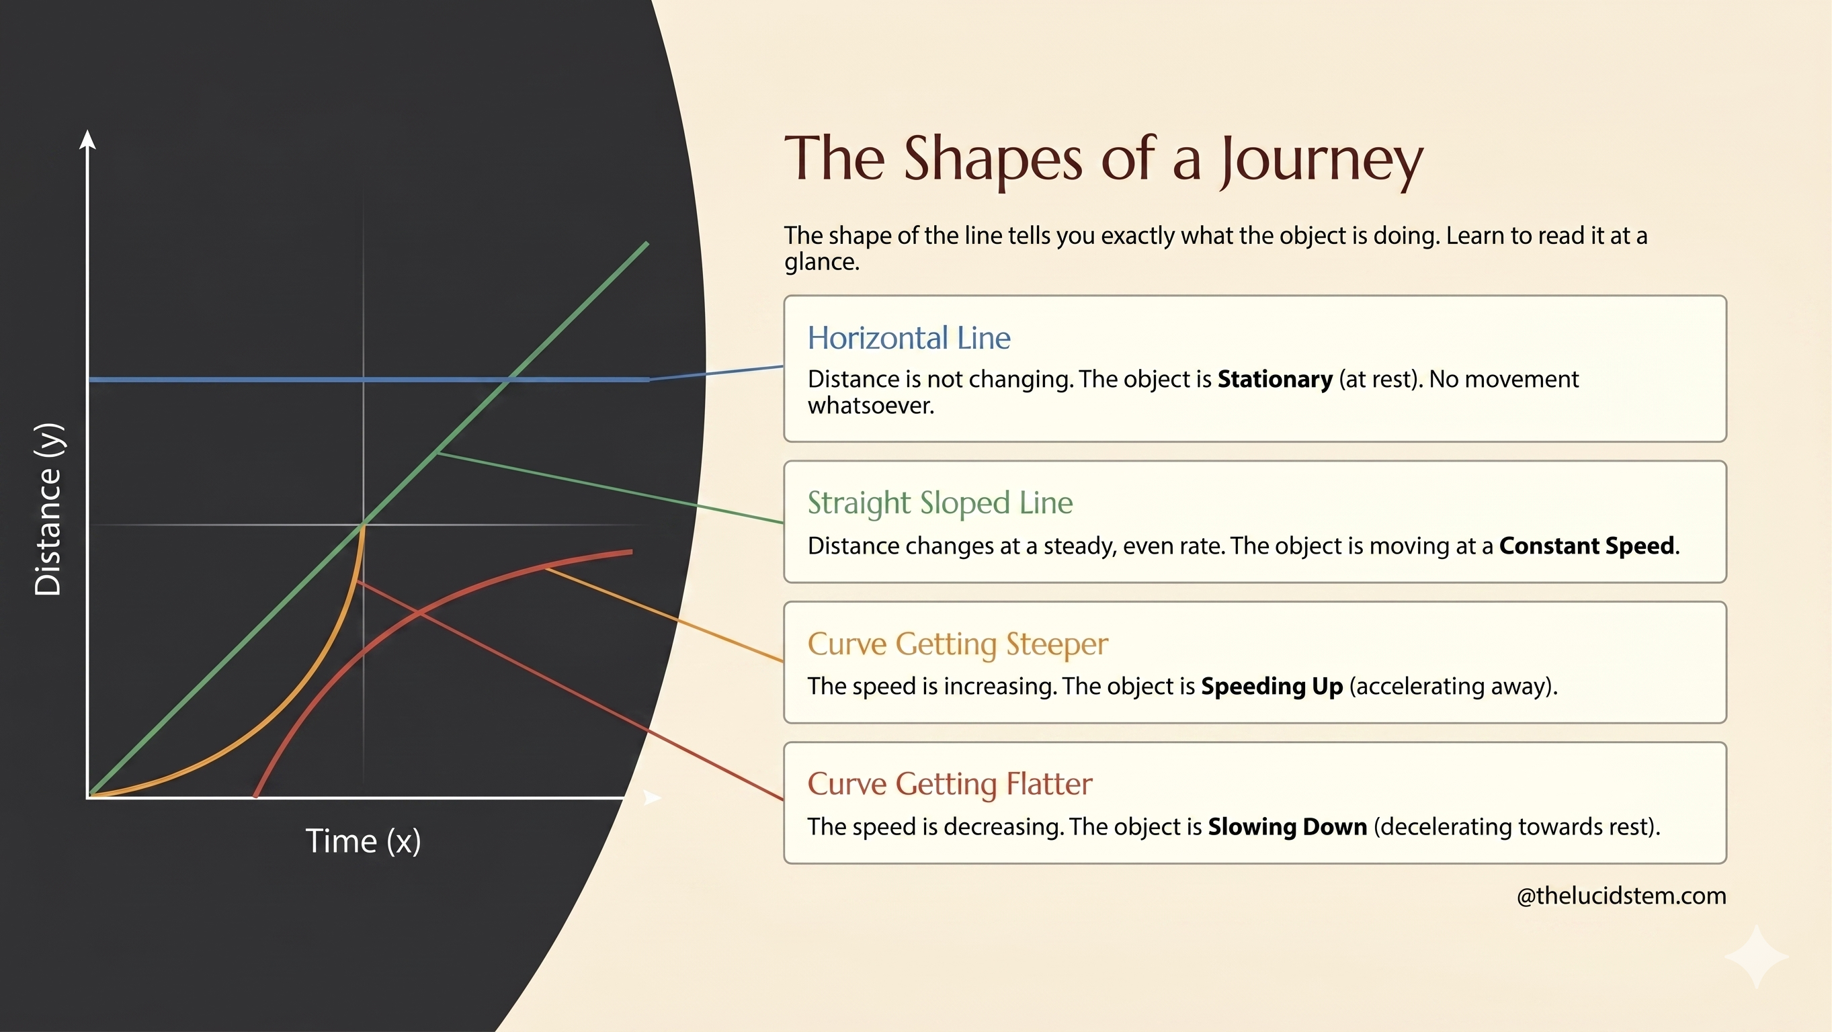

Slide 3
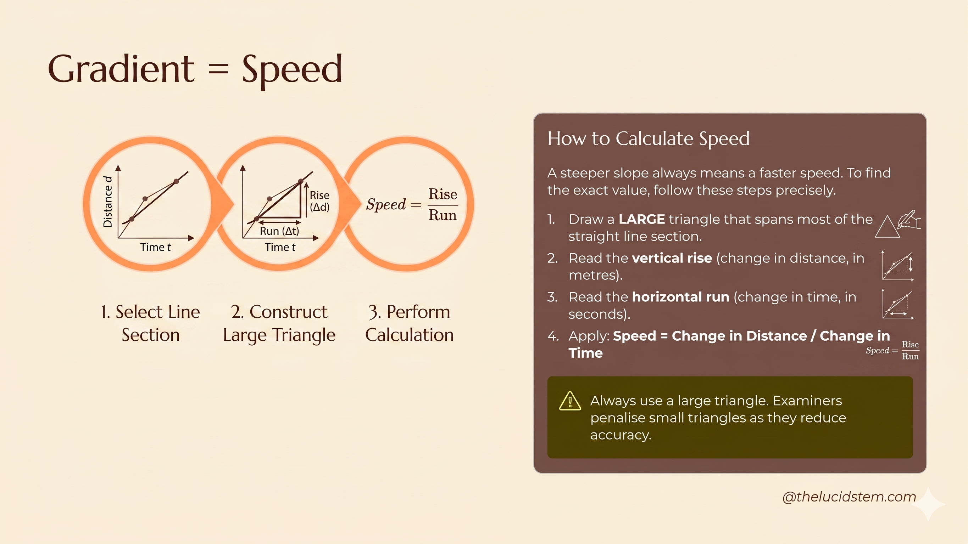

Slide 4
The Axes Illusion
EXAMINER'S TRAP
These are the most common mistakes seen in Cambridge IGCSE exam scripts. Read them carefully and commit the corrections to memory.
Trap 1: Horizontal = Constant Speed?
Trap 2: Steeper = Further Travelled?
Trap 3: Using a Tiny Triangle
Wrong. Examiners specifically deduct marks for tiny gradient triangles. Your triangle must span at least half of the straight-line section to gain full marks.
Wrong. On a distance-time graph, a horizontal line means the object is stationary. The distance is not changing at all. Always check the y-axis label first.
Wrong. A steeper line means a faster speed, not a greater distance. Read the y-axis value to determine how far the object has actually travelled.
@thelucidstem.com

Slide 5




Cooperative Task: Think-Pair-Share
You will match 6 described journeys to 6 distance-time graphs on your sheet. Follow the protocol precisely.
Think (4 mins)
Work alone in silence. Match each journey to a graph and write one word justifying each choice (e.g., "steeper", "horizontal").
Pair (6 mins)
Compare your answers with your partner. Discuss any differences using: "I matched Journey X to Graph Y because..." Reach agreement.
Share (4 mins)
Random call will be used. Be ready to justify your team's match clearly and confidently in front of the class.
@thelucidstem.com

Slide 6
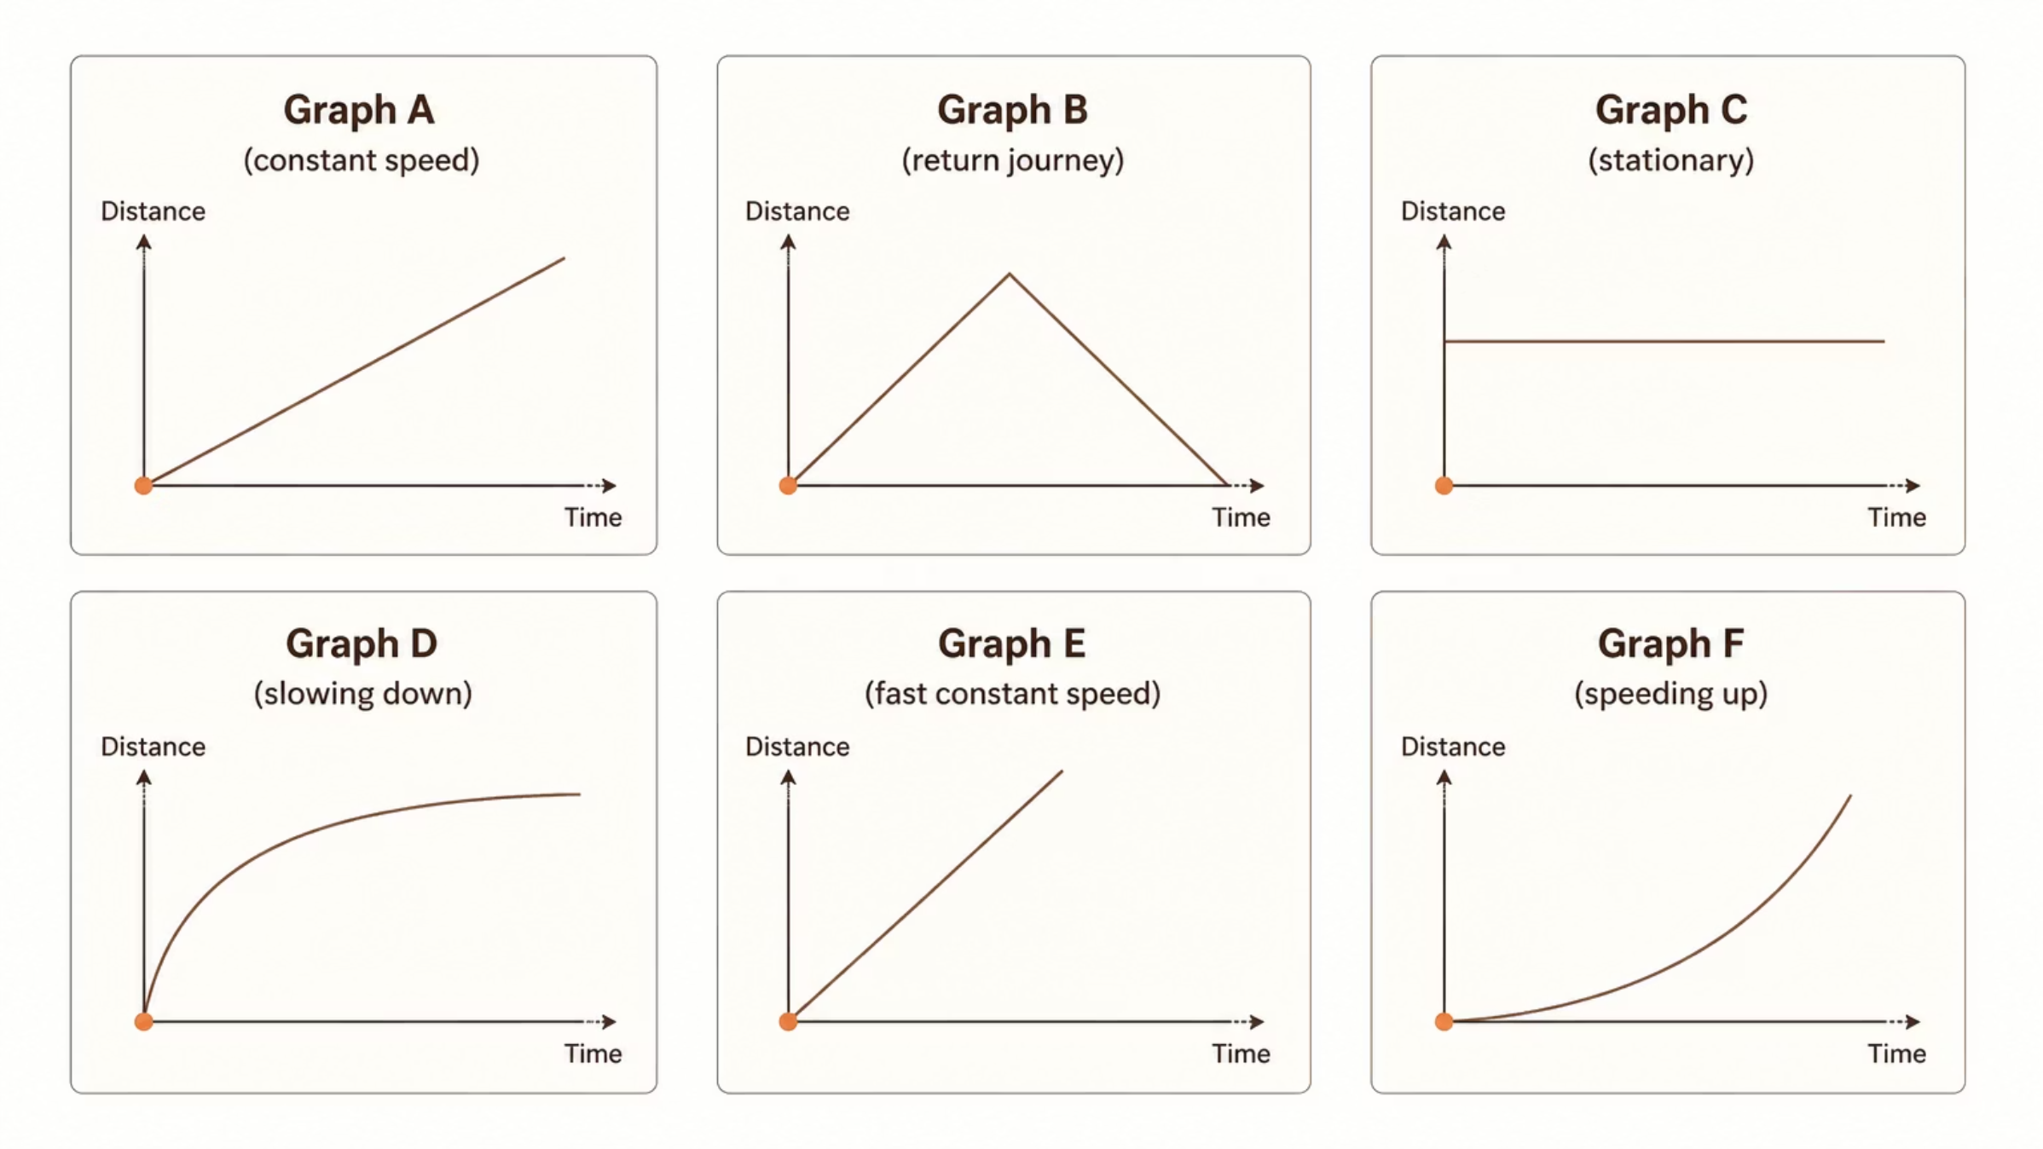
The Six Shapes
Here are the six distance-time graphs you are matching to the journey descriptions. Study each shape carefully before committing to your answers.
Each shape corresponds to a unique type of motion. Your task is to identify which journey matches which graph, and to explain your reasoning using precise physics vocabulary.
@thelucidstem.com

Slide 7


Round 1: Stationary and Steady
Random call is active. Be ready to justify your match!
1
Journey 1
A car is parked outside a house and does not move for several minutes. Which graph matches this situation?
2
Journey 2
A person walks away from home at a steady, unchanging pace. They do not slow down or speed up. Which graph matches?
Think carefully about what each graph shape represents before answering. Use precise language in your justification.
@thelucidstem.com

Slide 8

Round 1: Answers
Journey 1 → Graph C
Journey 2 → Graph A
A horizontal line means the distance from the start is not changing at all. The object is therefore stationary. A parked car perfectly matches this flat, unchanging line.
A straight sloped line means the distance increases by the same amount each second. This represents a constant speed. A person walking steadily away from home fits this exactly.
Key rule: A horizontal line on a distance-time graph ALWAYS means stationary. Not slow. Not constant speed. Stationary.
@thelucidstem.com

Slide 9
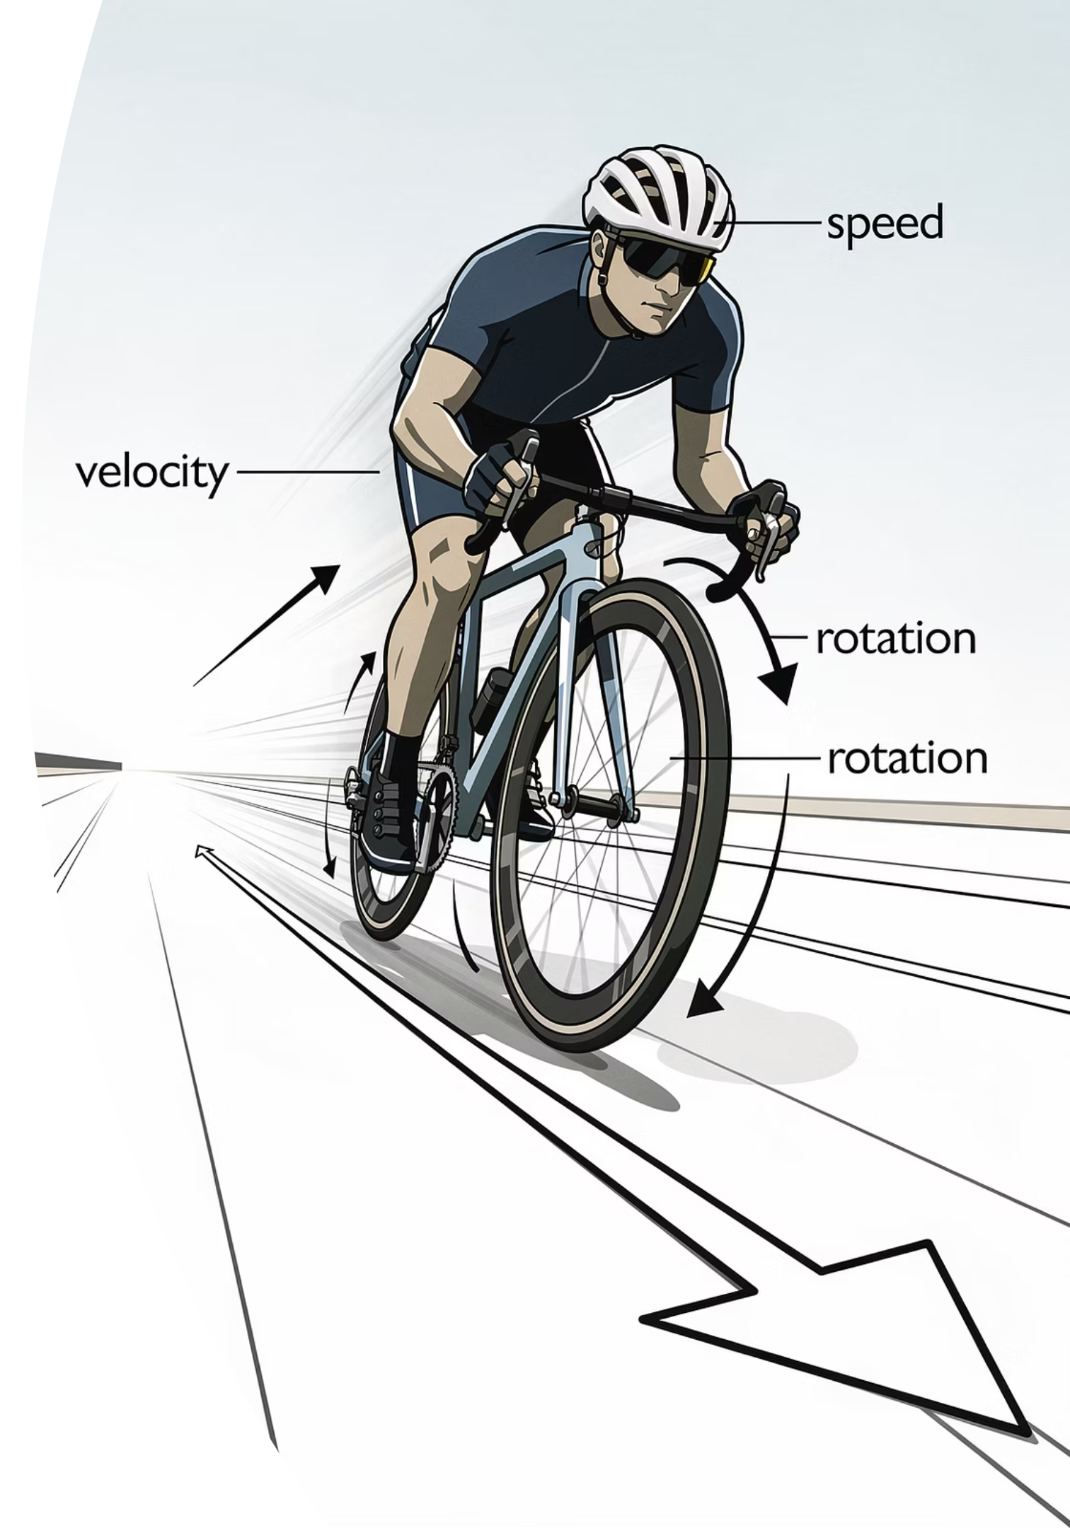

Round 2: Faster and Faster
Random call is active. Be ready to justify your match!
1
Journey 3
A cyclist rides away from the start at a steady pace. They are travelling noticeably faster than the walker in Journey 2, but their speed remains constant throughout.
2
Journey 4
A train pulls out of a station. It begins very slowly, then gradually picks up speed, moving faster and faster as it accelerates away from the platform.
@thelucidstem.com

Slide 10

Round 2: Answers
Journey 3 → Graph E
Journey 4 → Graph F
Graph E is a straight line, confirming constant speed. It is steeper than Graph A, which tells us the speed is greater. A steeper gradient on a distance-time graph always means a faster speed.
Graph F shows a curve that gets progressively steeper. This means the speed is increasing over time. The train is accelerating away from the station, exactly as described.
Compare Graphs A and E: both are straight lines (constant speed), but Graph E has a steeper gradient, meaning a higher speed. This is a favourite comparison question in Cambridge exams.
@thelucidstem.com

Slide 11
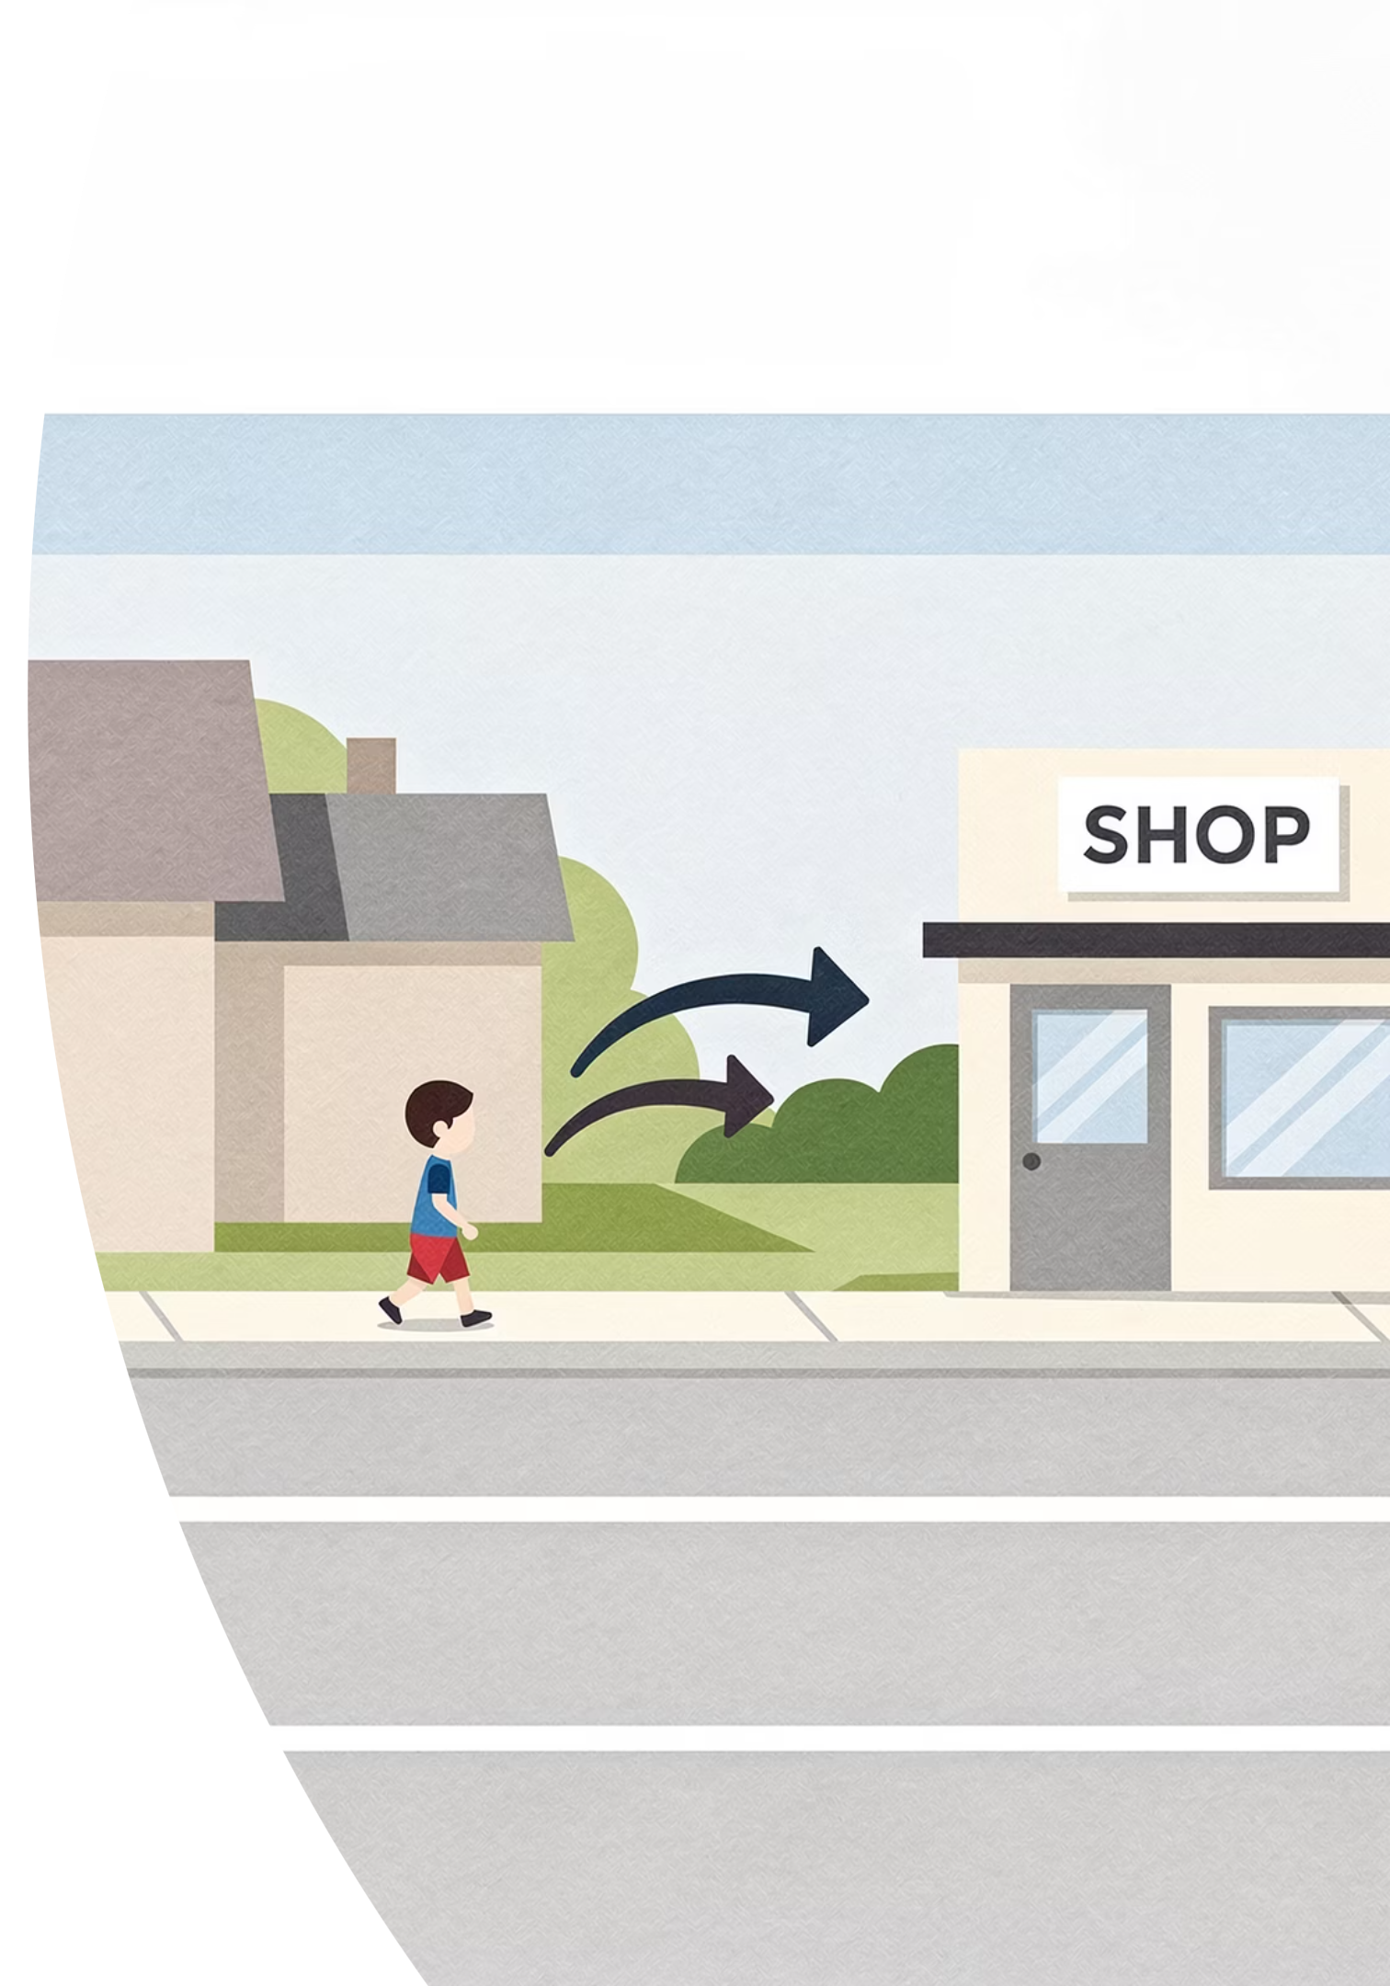

Round 3: Slowing and Returning
Random call is active. Be ready to justify your match!
1
Journey 5
A runner sets off at a good pace but gradually slows down over time, eventually coming to a complete stop. Their speed decreases steadily until they are at rest.
2
Journey 6
A child walks to a local shop at a steady pace, then immediately turns around and walks straight back home at the same steady pace. Their distance from home ends at zero.
@thelucidstem.com

Slide 12
Round 3: Answers
Journey 5 → Graph D
Journey 6 → Graph B
Graph D shows a curve that gradually flattens out. As the curve becomes less steep, the speed is decreasing. The runner is decelerating until the flat horizontal end confirms they have stopped completely.
Graph B shows the distance rising then falling back to zero. The distance from home increases as the child walks to the shop, then decreases back to zero as they return. Note: distance from start (not total distance) falls here.
All six graphs matched. Well done! Now apply this knowledge independently in the exit ticket.
@thelucidstem.com

Slide 13
Prove It.
EXIT TICKET
INDEPENDENT WORK
Silence in the room. Complete both tasks independently on your mini-whiteboards. You have four minutes.
1
2
Sketch the Graph
State the Meaning
A person walks steadily to a bus stop. They wait there for a few minutes. Then they travel on the bus at a faster steady speed. Sketch a single distance-time graph for this complete journey, labelling each section clearly.
In one precise sentence, state exactly what a horizontal line represents on a distance-time graph. Do not confuse this with what it would mean on a speed-time graph.
Expected sketch: a gentle slope upward (walking), a flat horizontal section (waiting), then a steeper slope upward (bus). Three clearly labelled sections.
@thelucidstem.com

