Slide 1
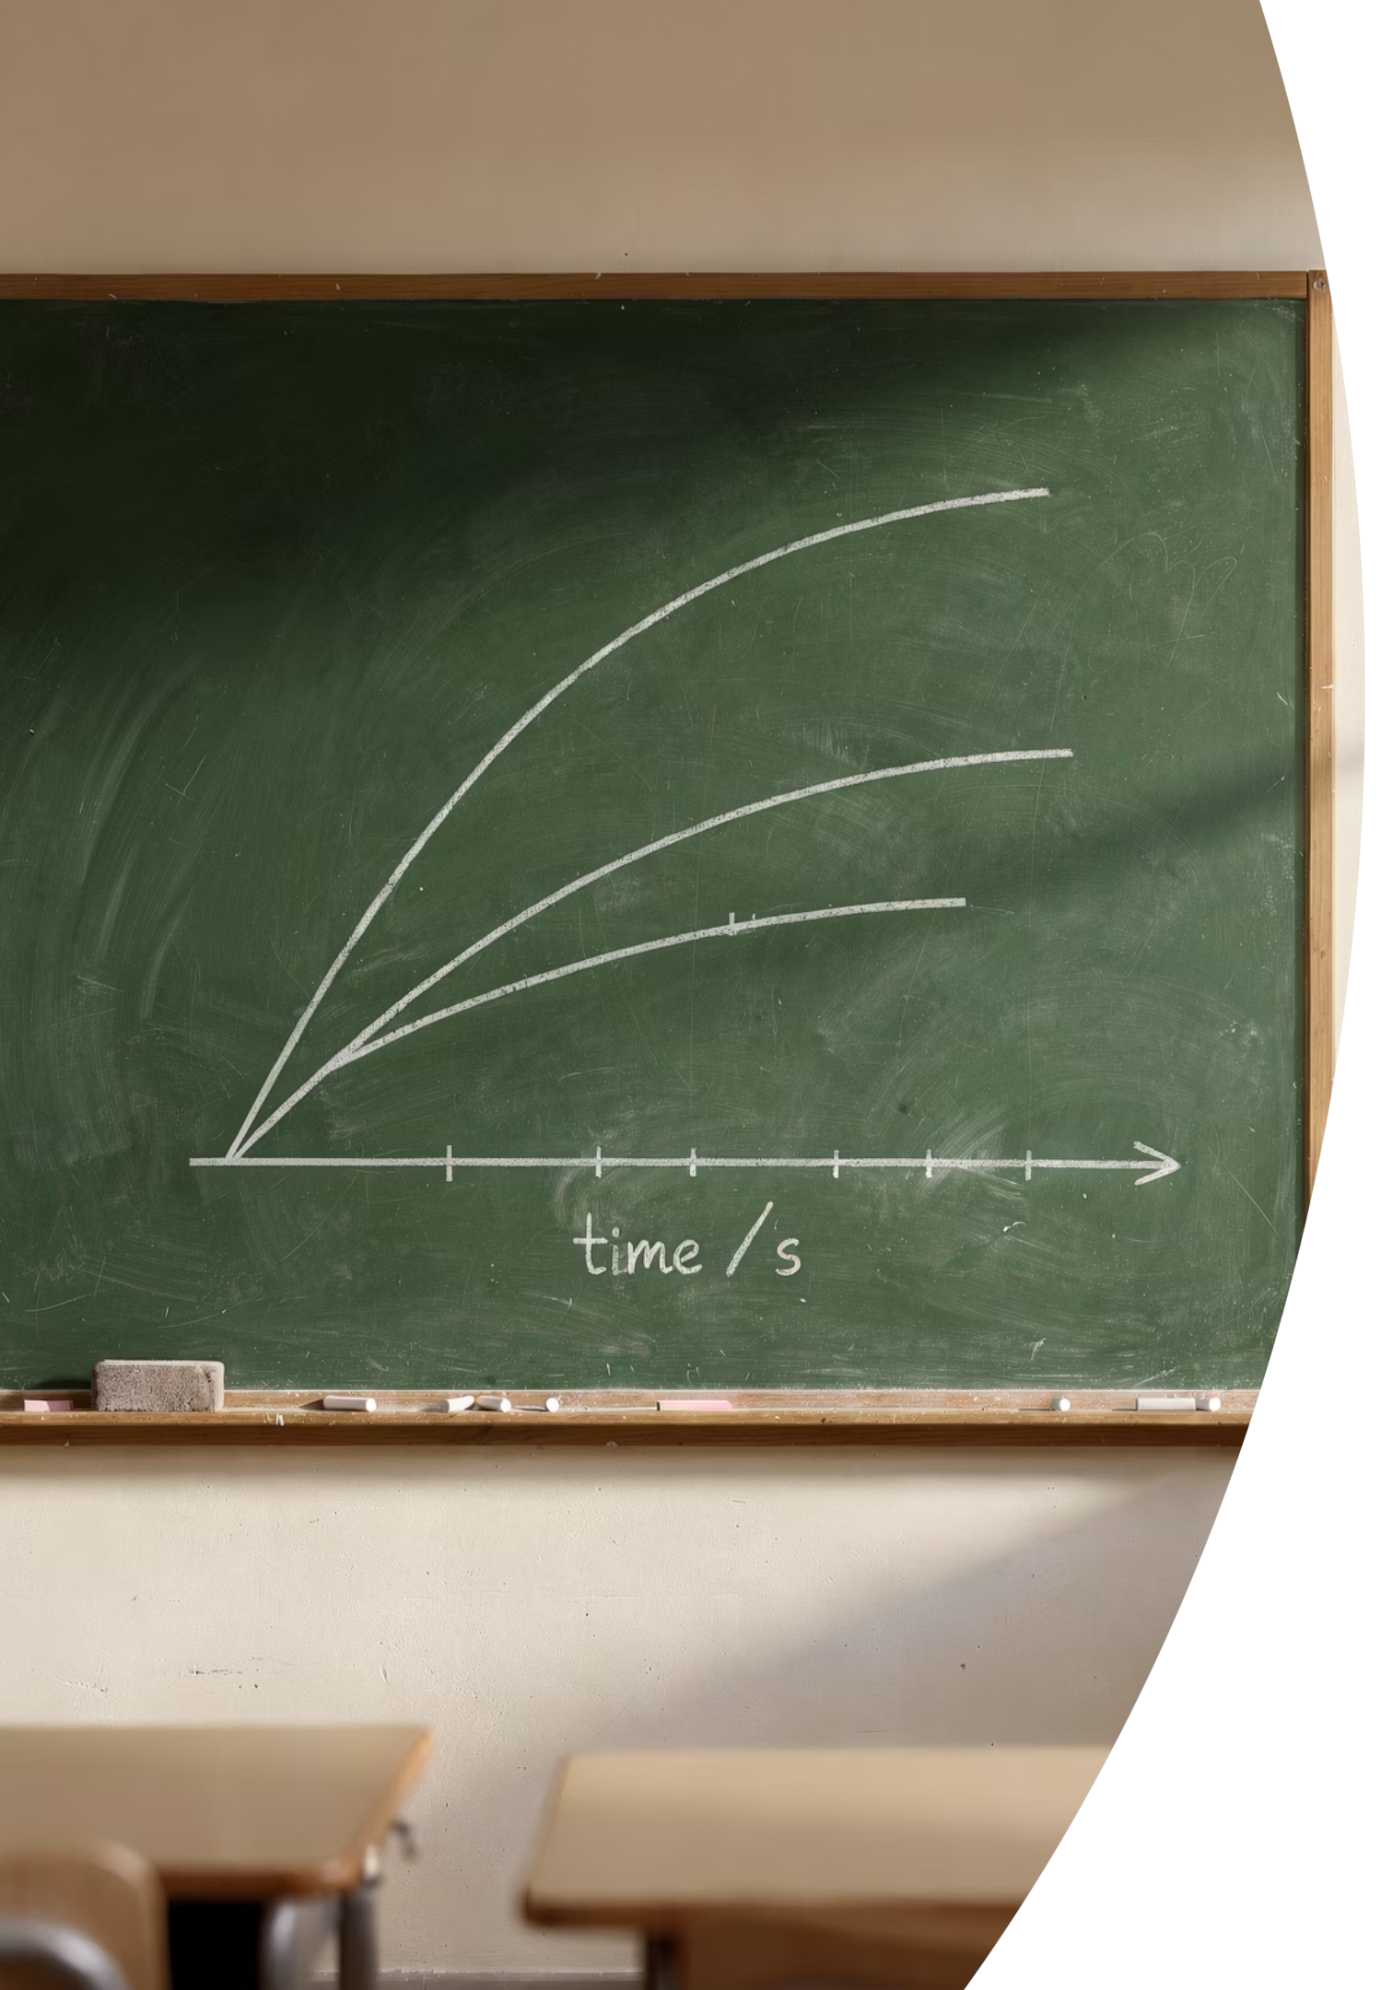
Gradient and Area
EXTENDED LEVEL
By the end of this lesson, you will be able to:
01
Find acceleration
Calculate acceleration from the gradient of a speed-time graph
02
Handle deceleration
Treat deceleration as a negative acceleration
03
Find distance
Determine distance travelled from the area under the line
04
Solve complex graphs
Split areas into triangles and rectangles for multi-step problems

Slide 2
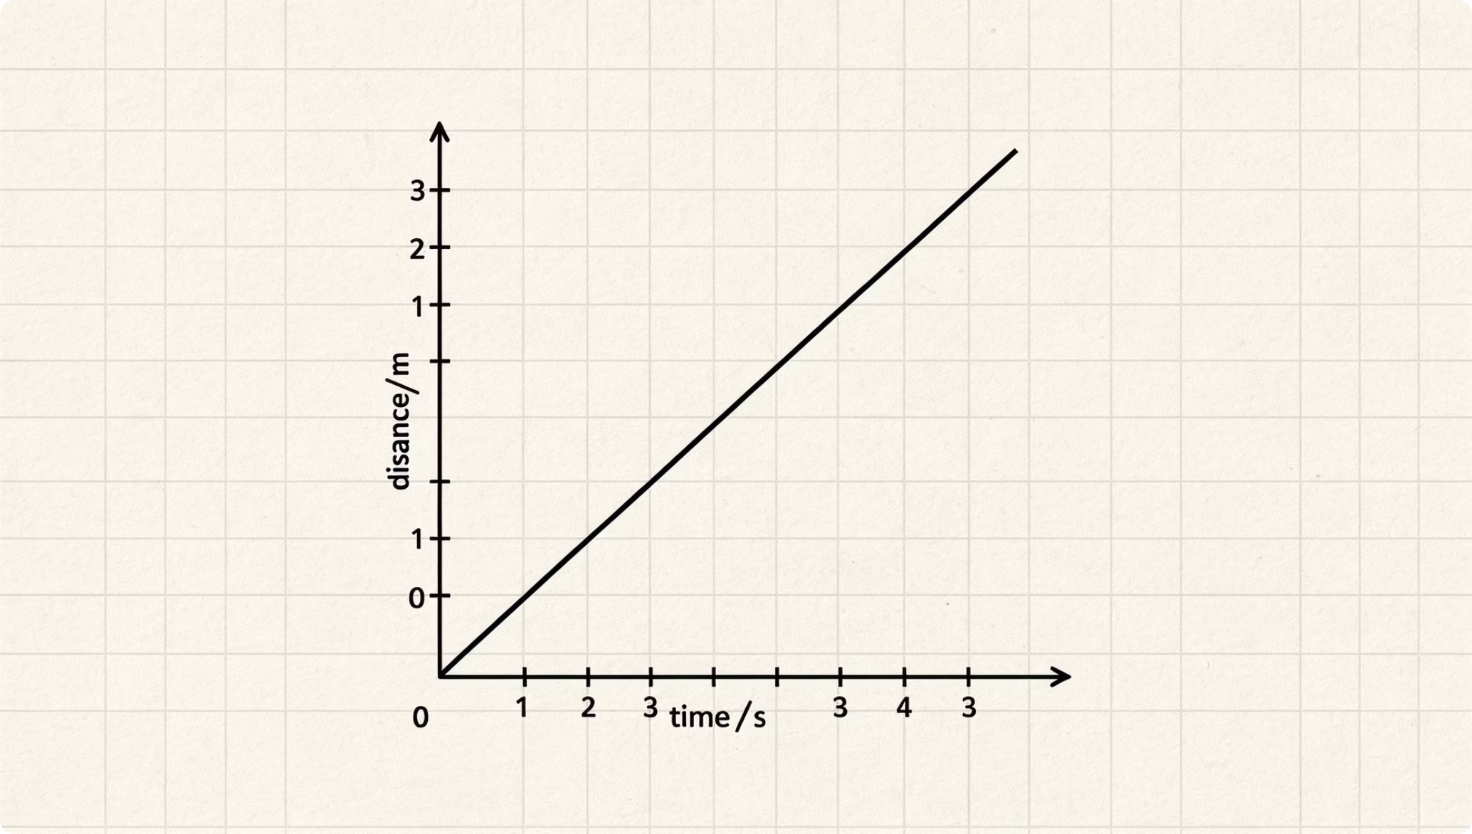
Two Readings, One Line
A speed-time graph holds two hidden pieces of information for Extended candidates:
How steep is it?
Gradient = Acceleration
The slope of the line tells you how quickly speed is changing.
How much space is underneath?
Area = Distance Travelled
The shaded region between the line and the time axis gives total distance.

Slide 3
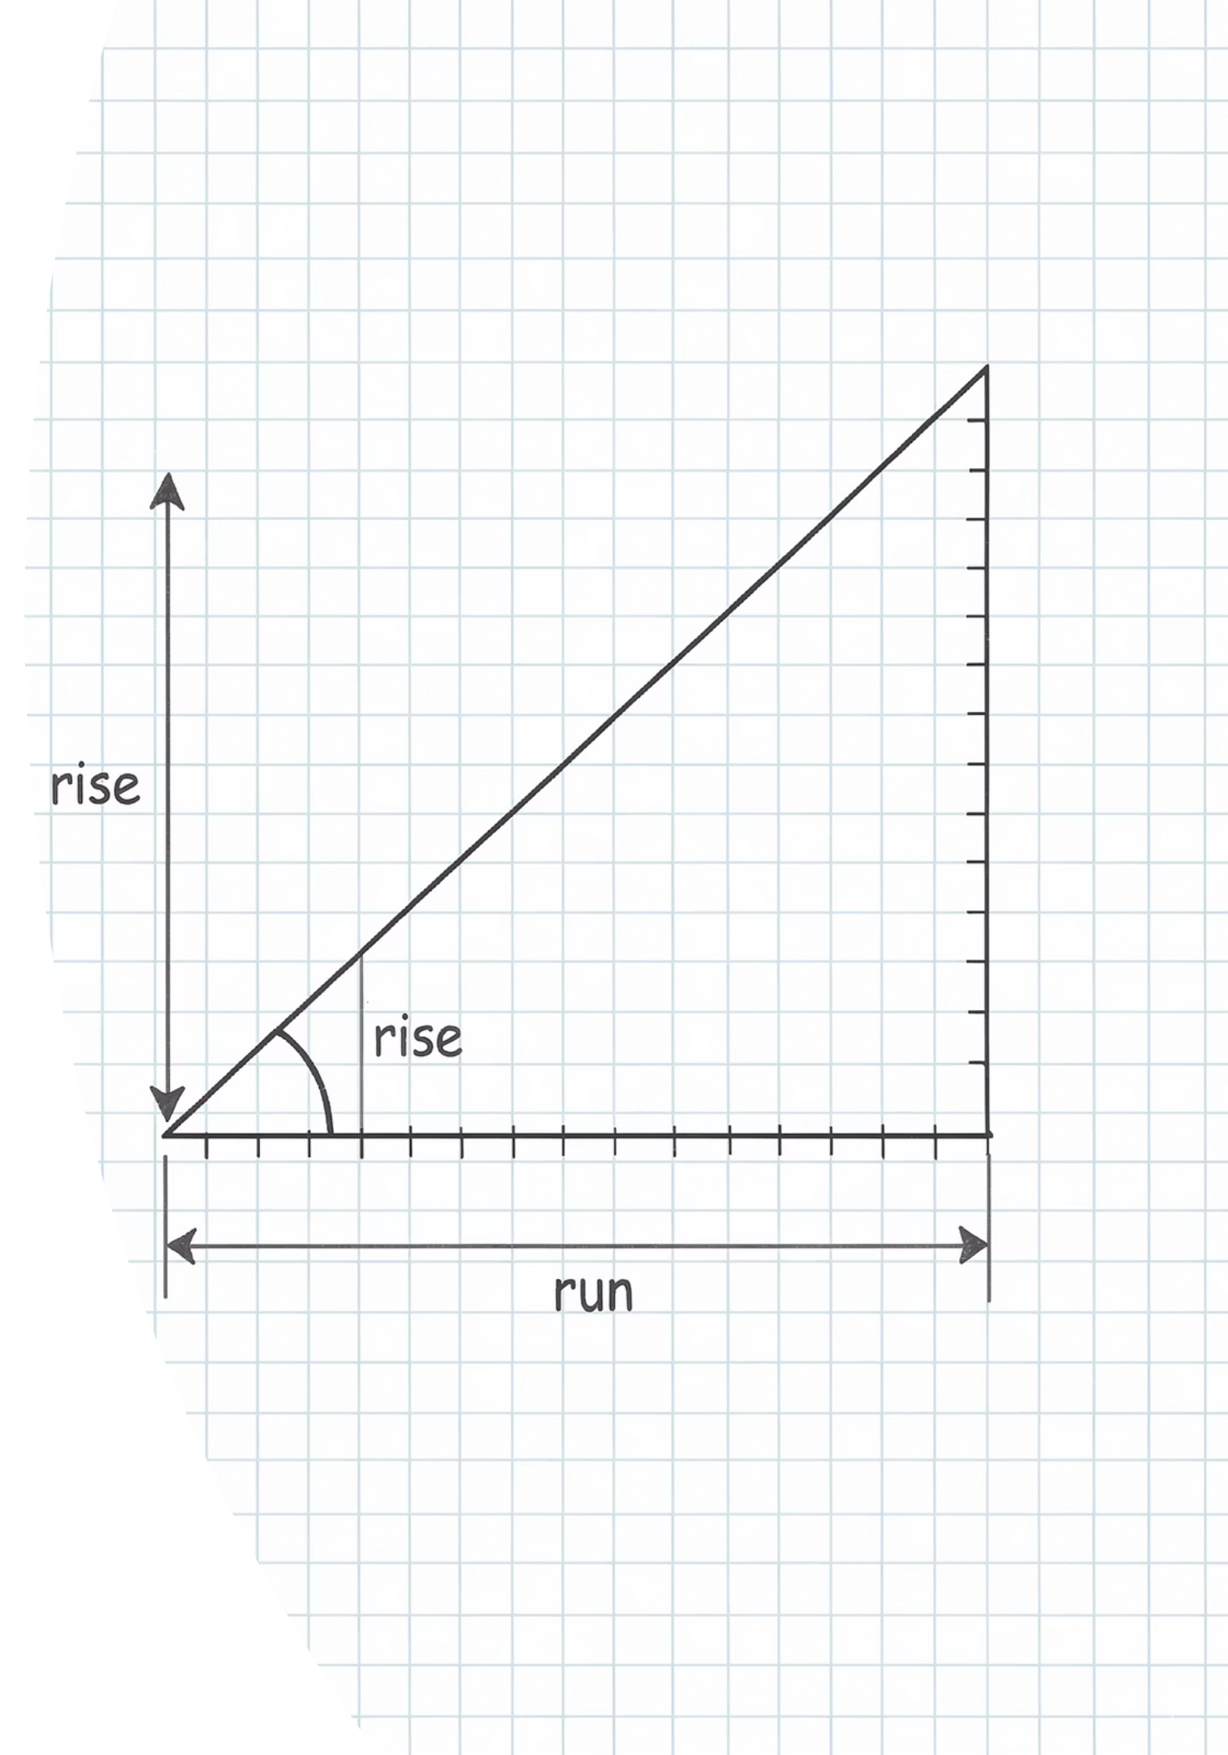


Gradient = Acceleration
The gradient of a speed-time graph gives the acceleration directly:
The Formula
a = \Delta v / \Delta t Always draw a large triangle spanning most of the line. Never pick two points close together.
Negative Gradient = Deceleration
A line sloping downward has a negative gradient. Report it as a deceleration, e.g. -3 \text{ m/s}^2.

Slide 4
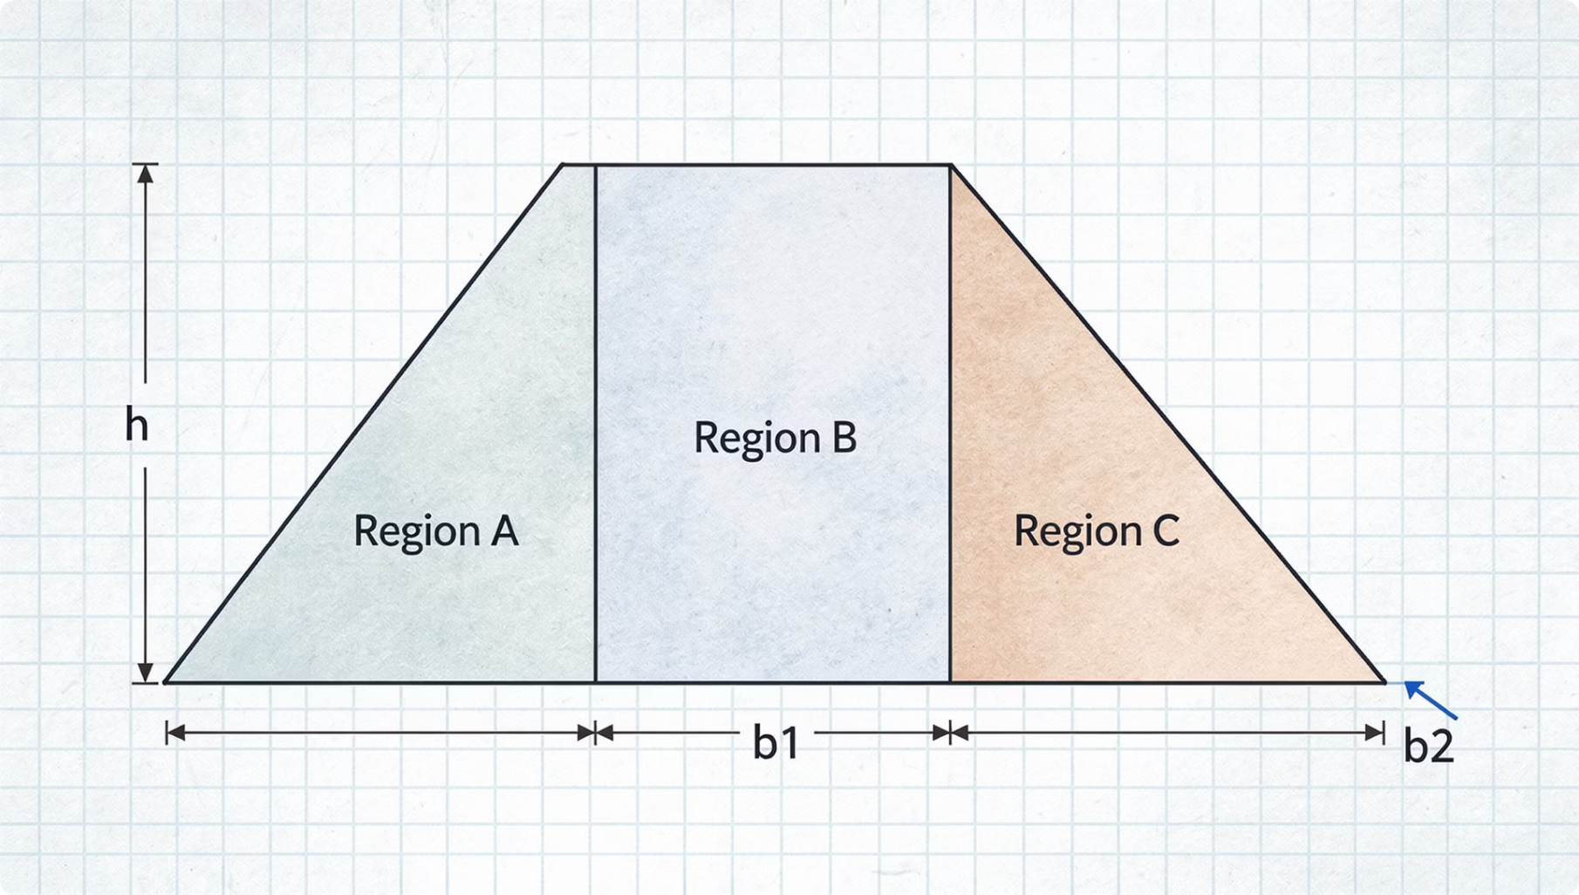

Area = Distance Travelled
The total distance is the total area enclosed between the line and the time axis. Always split complex shapes into simple ones:
Rectangle
\text{Area} = \text{base} \times \text{height}
Triangle
\text{Area} = \tfrac{1}{2} \times \text{base} \times \text{height}
Never guess the area. Always identify and split the shape before calculating.

Slide 5



The Graph Illusions
EXAMINER'S TRAPS
Trap 1: Using v = s/t on an accelerating object
Trap 2: Mixing up graph types
Gradient on a distance-time graph = Speed.
Gradient on a speed-time graph = Acceleration.
These are not interchangeable.
This formula only works when speed is constant. If speed is changing, you must use the area under the graph to find distance.
Read the axes carefully before every calculation. One misread can cost all the marks.

Slide 6
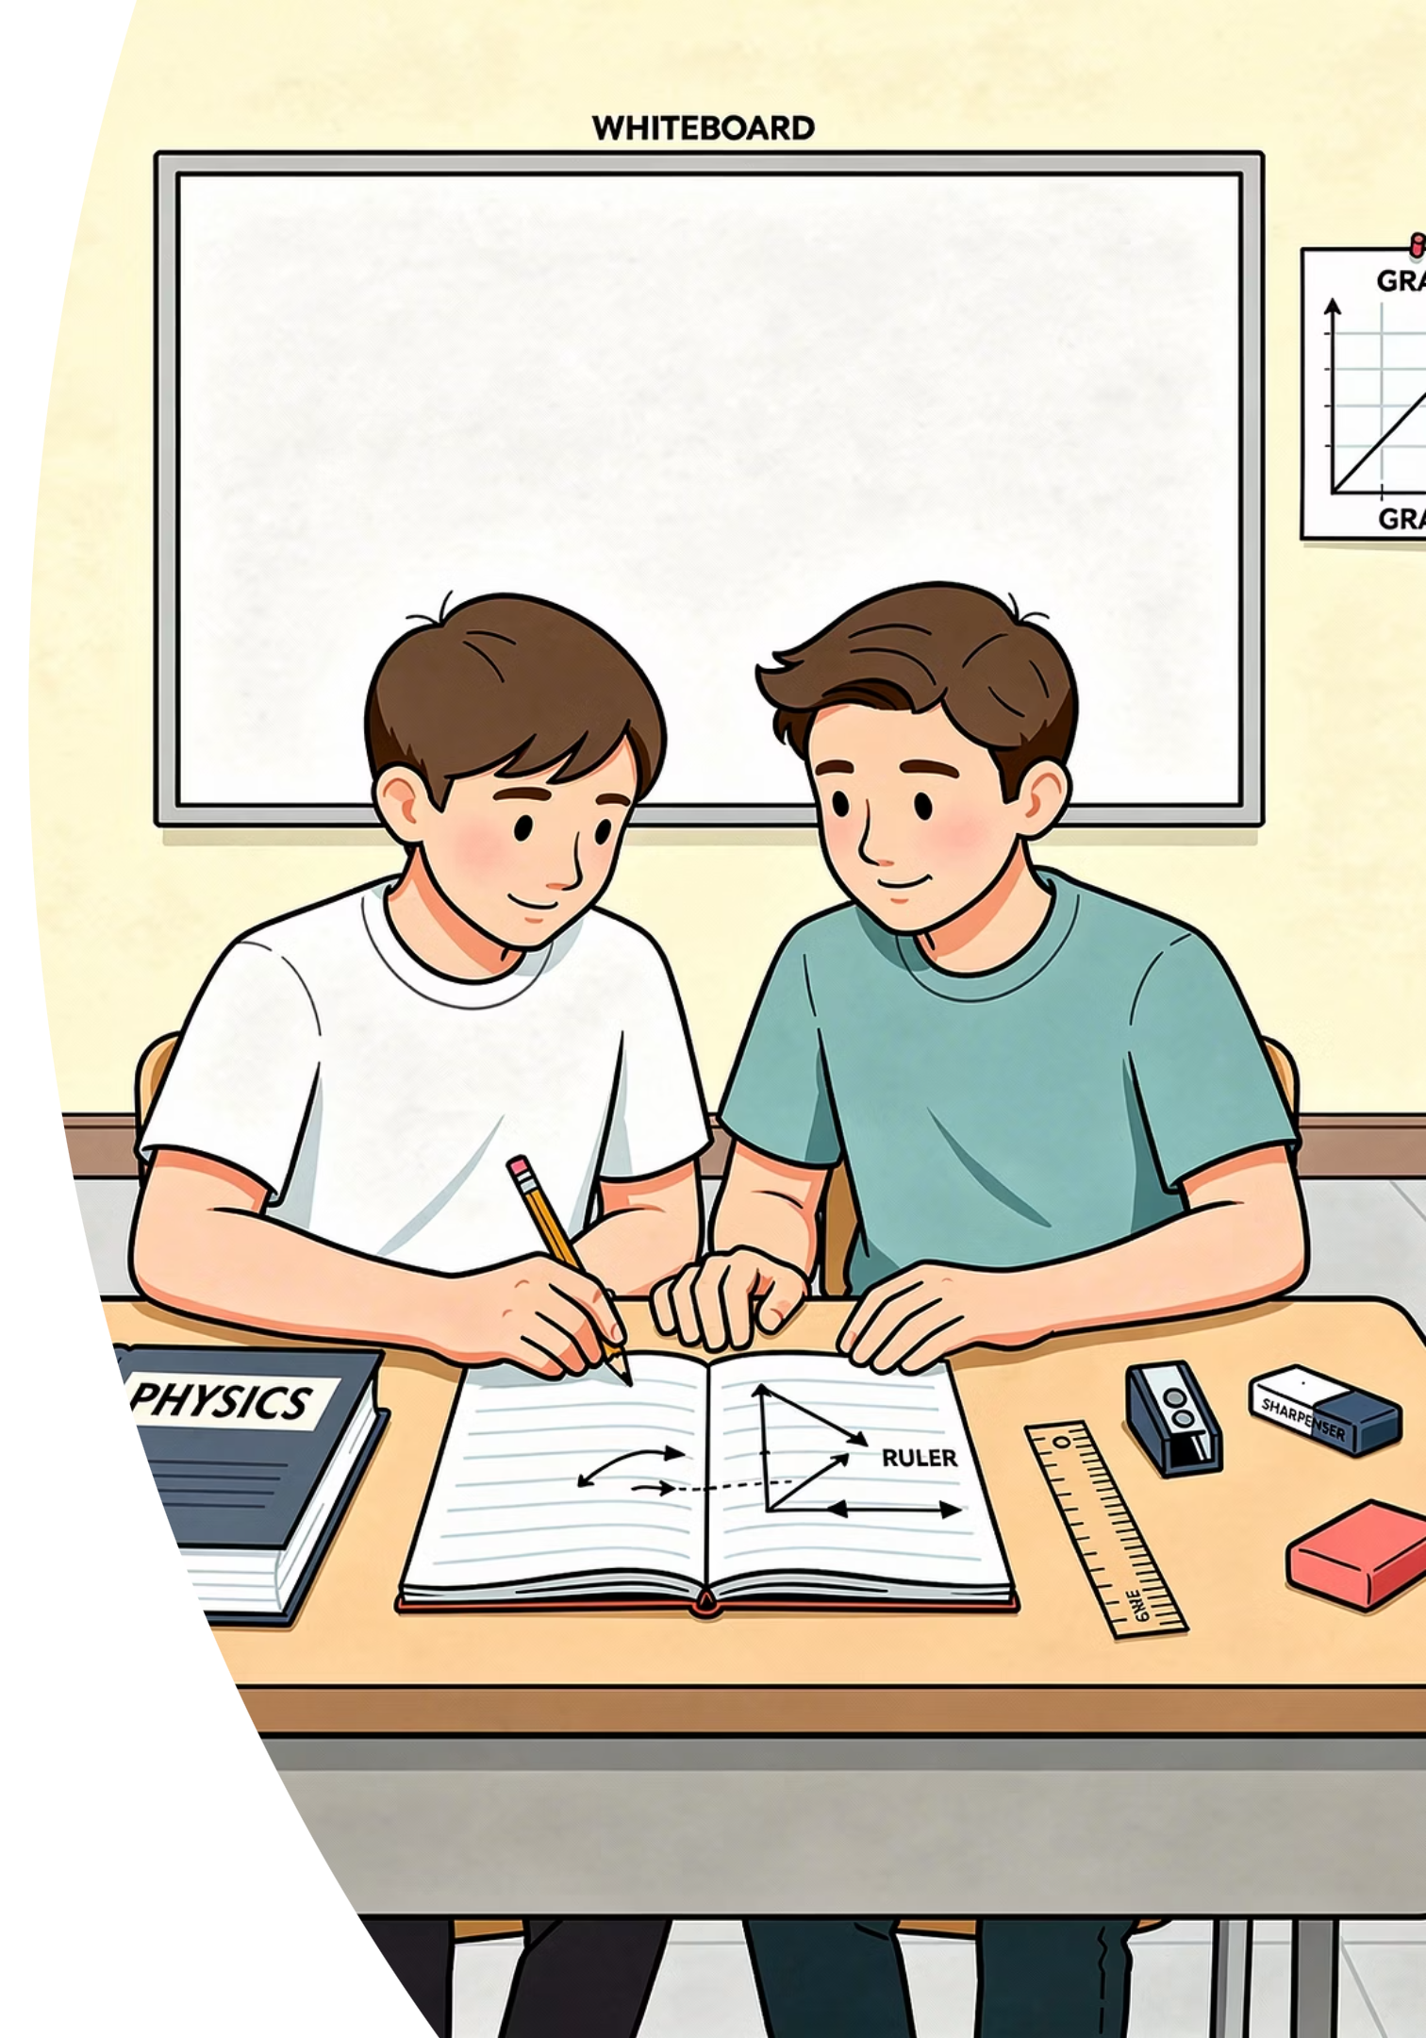

Pairs Check Protocol
The Doer
The Coach
Holds the pencil. Works the problem aloud, draws the large triangle or splits the area, and states units in the final answer.
Watches and checks each step. Asks prompts like "How will you split that area?" but never gives the answer directly.
Swap Roles
Switch after every question. After Question 2, compare answers as a group of four before moving on.

Slide 7

Round 1: Acceleration
GRADIENT TASK
Partner A (Doer)
Partner B (Doer)
A cyclist speeds up from rest to 12 m/s in 6 s.
Find the acceleration.
Draw a large triangle on your sketch graph. Show \Delta v and \Delta t clearly.
A car slows from 30 m/s to 18 m/s in 4 s.
Find the deceleration.
Decide whether the gradient is positive or negative. State the sign in your answer.
Coach: remind your partner to include units in their final answer.

Slide 8


Round 1: Coach's Key
ANSWERS
1
2
Partner A
Partner B
a = \Delta v / \Delta t = 12 / 6
2 m/s2
a = (18 - 30) / 4 = -12 / 4 = -3 \text{ m/s}^2
Deceleration = 3 m/s2
A negative value for acceleration means the object is slowing down. Always report the magnitude when asked for "deceleration".

Slide 9
Round 2: Distance Travelled
SWAP ROLES!
Partner A (Doer)
Partner B (Doer)
A runner moves at a constant 8 m/s for 15 s.
Find the distance travelled.
Identify the shape and calculate its area.
A car accelerates from rest to 20 m/s in 5 s, then travels at a constant 20 m/s for 10 s.
Find the total distance.
Split the area into two shapes before calculating.

Slide 10


Round 2: Coach's Key
ANSWERS
1
2
Partner A
Partner B
Rectangle: 8 \times 15
Distance = 120 m
Triangle: \tfrac{1}{2} \times 5 \times 20 = 50 \text{ m}
Rectangle: 10 \times 20 = 200 \text{ m}
Total = 250 m
Always show each shape separately with its own calculation. Method marks are available even if the final total is wrong.

Slide 11


Prove It.
EXIT TICKET -- INDEPENDENT WORK
Silence. Complete all three parts on your own.
A speed-time graph shows a train accelerating from rest to 30 m/s in 10 seconds.
1
Calculate the acceleration of the train.
2
Calculate the distance travelled during these 10 seconds.
3
Challenge: What would the graph look like if the acceleration were non-uniform?

