Slide 1
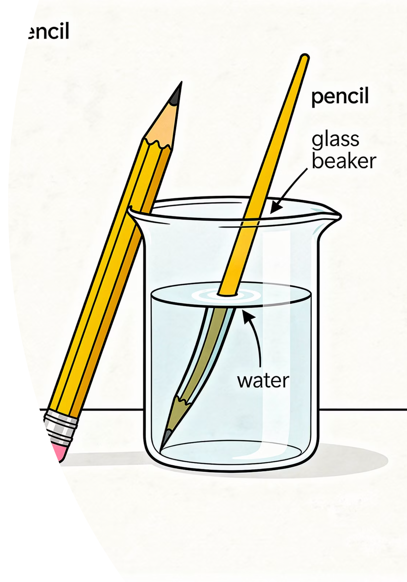

Exactly How Much?
Look at the pencil and the beaker of water at the front of the room.
Rule #1 of Physics: A measurement is meaningless without two things: a number and a unit.
thelucidstem.com

Slide 2
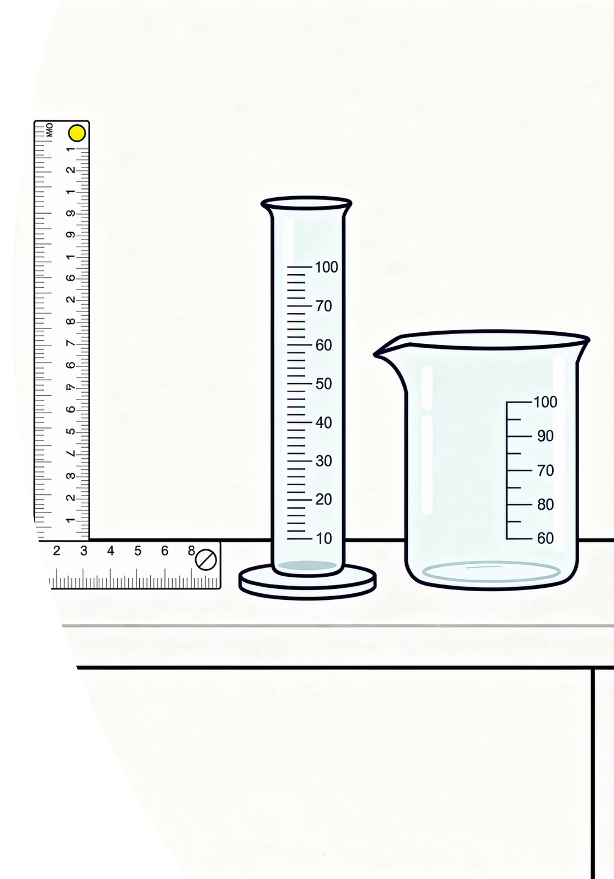
Measuring Length and Volume
By the end of this lesson, you will be able to:
01
Choose the Right Instrument
Select a rule, measuring cylinder, or displacement can for the task.
02
Read Scales Correctly
Read at eye level, square to the scale, to the smallest division.
03
Master the Meniscus
Read the bottom of the curved water surface in any cylinder.
04
Record Fully
Every value must carry its unit: mm, cm, m, or cm3.
thelucidstem.com

Slide 3
The Lab Bench Basics
Accuracy comes from reading the smallest division carefully, not from the size of the instrument.
The Rule
The Measuring Cylinder
The Displacement Can
Read at eye level, perfectly square to the scale. Any angle introduces parallax error.
Water curves inside a tube. Always read the flat bottom of the meniscus, not the edges.
For irregular solids: the volume of the solid equals the volume of water displaced.
thelucidstem.com

Slide 4

The Parallax and Unit Illusions
Examiner Report Warning: These four errors cost students marks every year.
Trap 1: Parallax Error
Trap 2: Top of the Meniscus
Reading from an angle shifts the apparent scale position. Always read square to the scale, at eye level.
The curved edges of water sit above the true level. Read the lowest point of the curve.
Trap 3: Naked Numbers
Trap 4: Floating Solids
Writing "42" earns zero marks. You must write "42 cm3". Value = Number + Unit.
The solid must be fully submerged with no trapped air for displacement to work.
thelucidstem.com

Slide 5
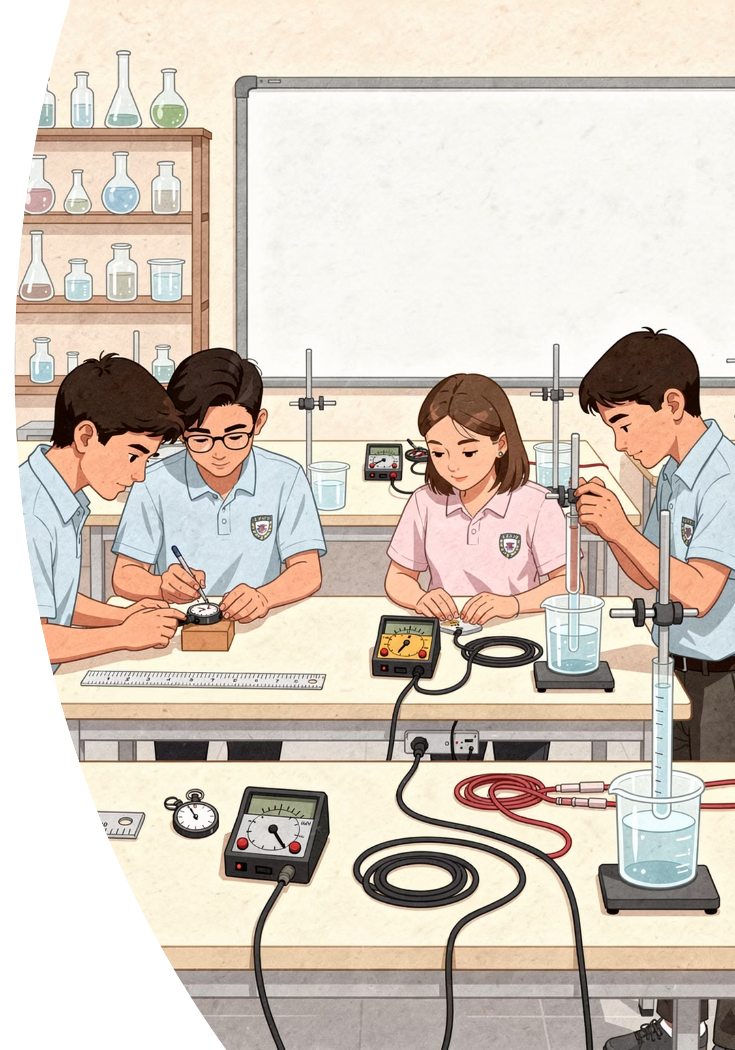

Cooperative Task: The Measurement Carousel
The Protocol
The Golden Rule: Record the unit every single time, without exception. Random students will be called to report readings to the class.
Work in pairs and rotate through three lab stations on a signal.
Bring your record sheet to every station.
You have exactly 6 minutes per station.
Both partners must agree on the reading before recording.
thelucidstem.com

Slide 6
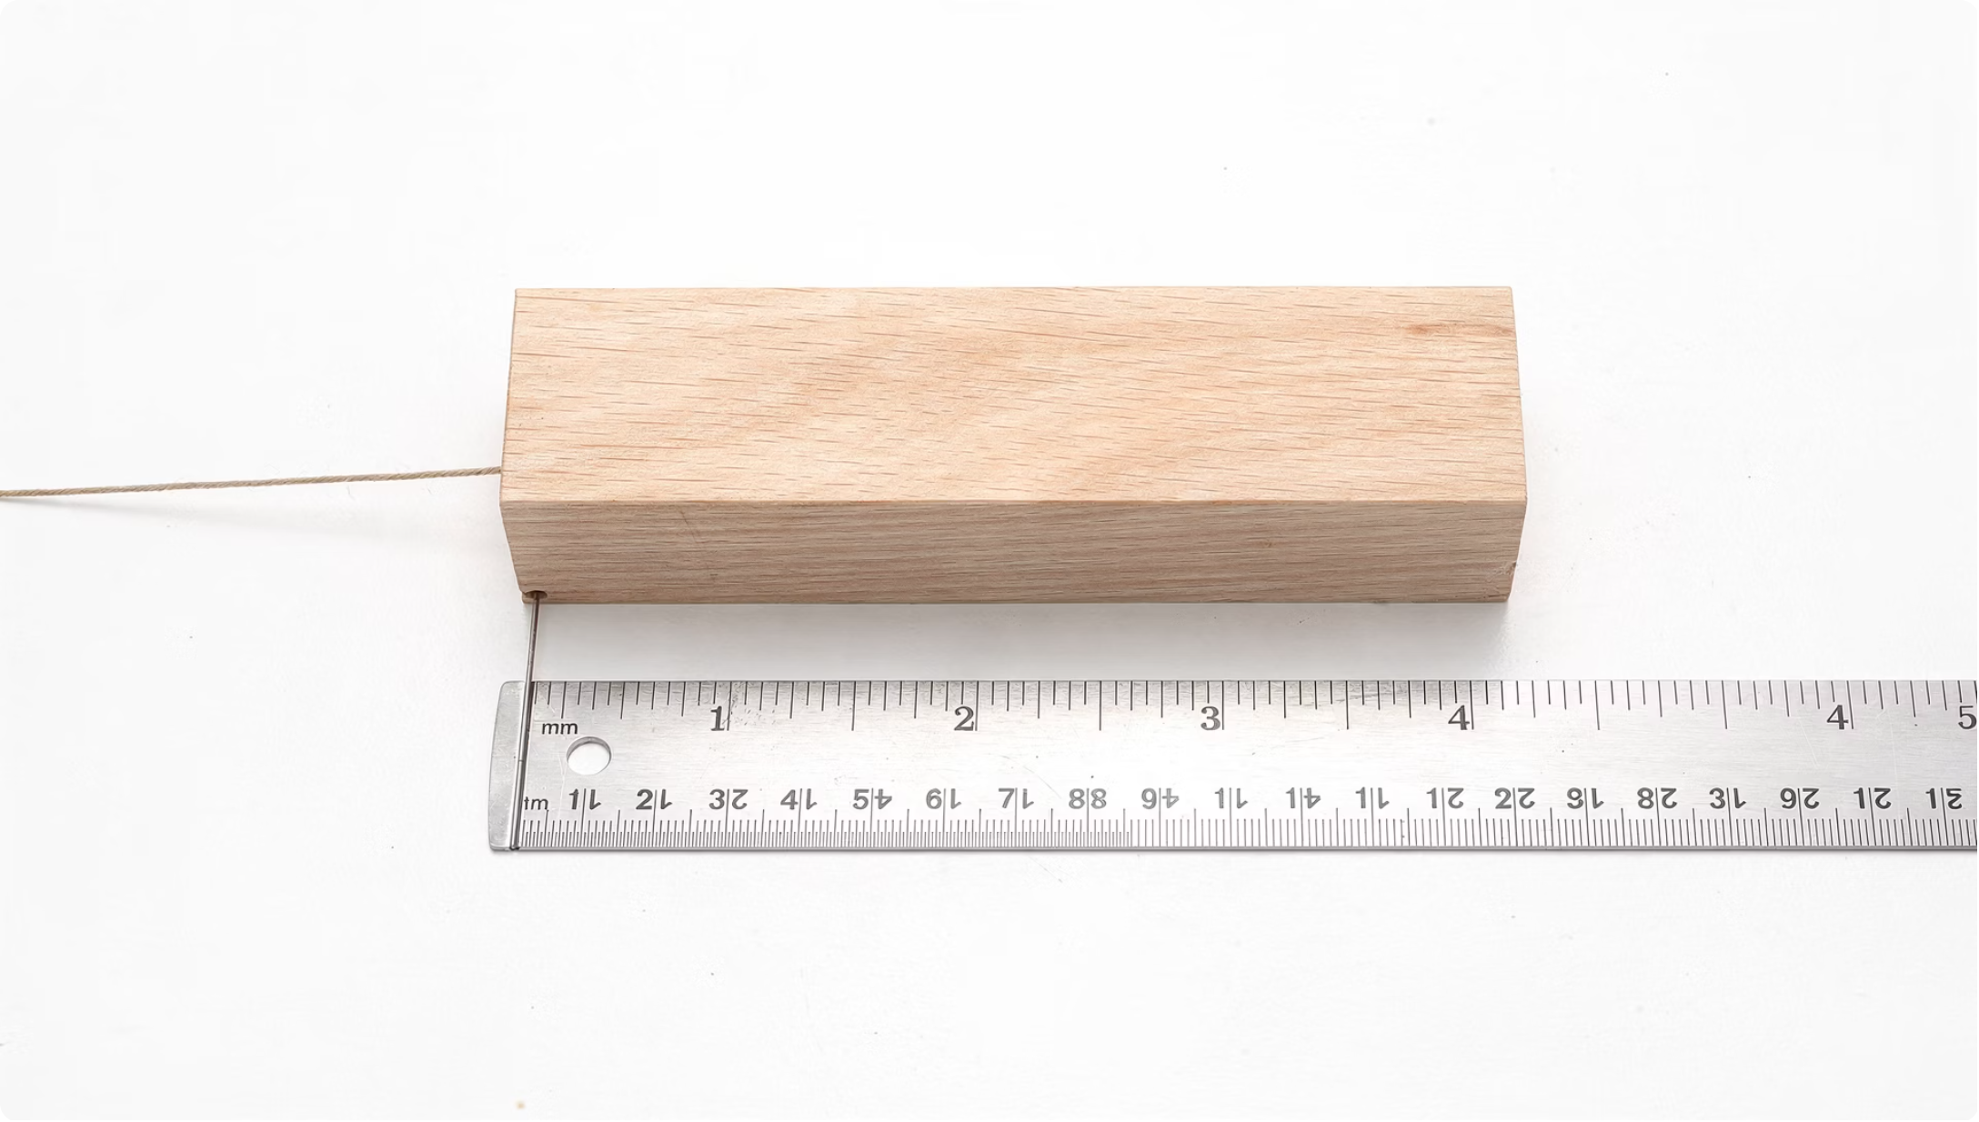

STATION 1
Length
Measure the straight length of the regular block using the rule directly.
For the curved edge, lay a piece of string along the curve, then measure the string against the rule.
Check: Are you reading square to the scale, to the nearest millimetre? Record in mm or cm.
thelucidstem.com

Slide 7
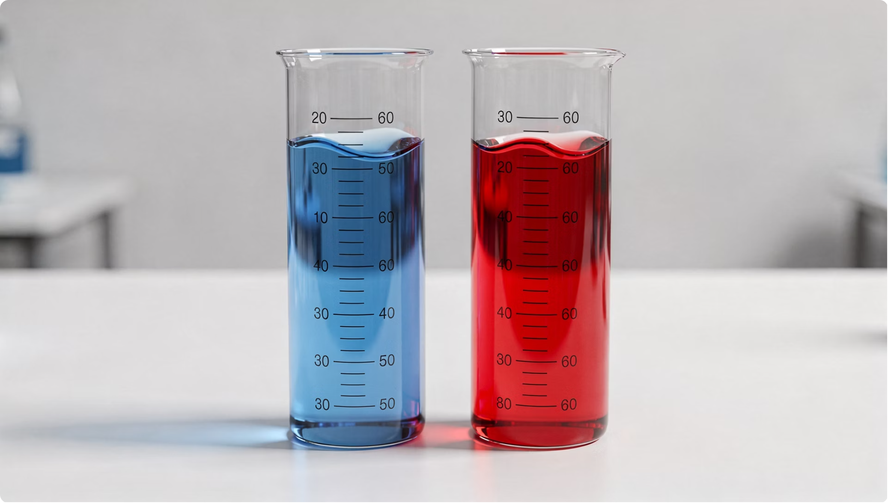

STATION 2
Liquid Volume
Measure the volume of Liquid A and Liquid B in the measuring cylinders provided.
Check: Is your eye perfectly level with the liquid surface? Are you reading the true bottom of the meniscus, not the curved edges?
Record both values in cm3, to the smallest division on the scale.
thelucidstem.com

Slide 8
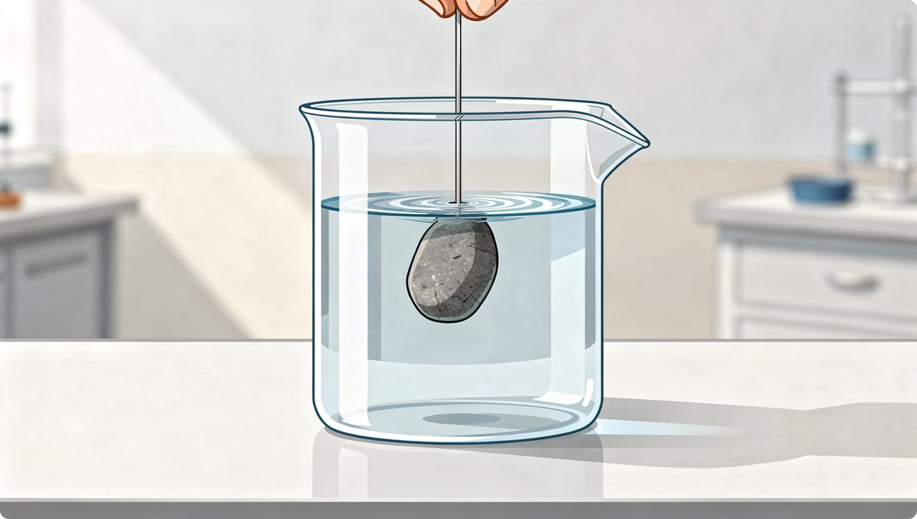

STATION 3
Solid Displacement
Read and record the initial water level in the measuring cylinder.
Lower the stone in gently: fully submerged, no splashing, no trapped air.
Read and record the final water level.
Calculate: Volume of stone = Final Reading - Initial Reading.
Record your answer in cm3 with both readings shown.
thelucidstem.com

Slide 9
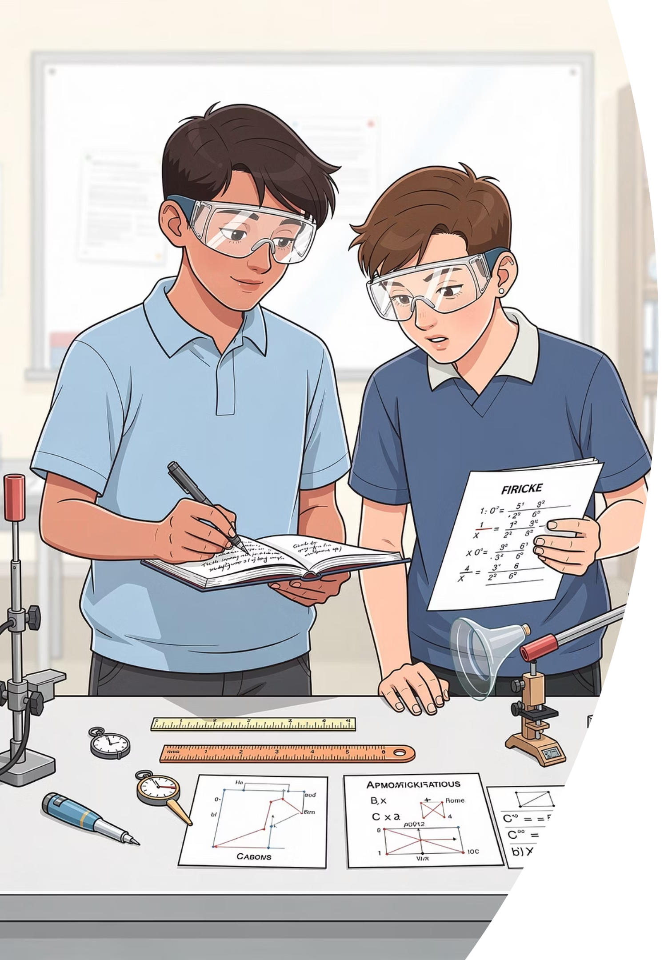
Compare and Reconcile
Swap your record sheet with another pair and examine the differences.
Where do your readings differ?
Identify every measurement where pairs recorded different values.
Why did they differ?
Did someone misread the smallest division? Was there a parallax error? Did someone read the top of the meniscus instead of the bottom?
thelucidstem.com

Slide 10
Prove It.
Silence in the room. Complete this independently before you leave.
Your Exit Task
Number
Unit
Three images will be projected: a ruler, a measuring cylinder, and a displacement reading.
Read all three scales and write the exact values on your mini-whiteboard.
Every answer must include the correct unit.
Read to the smallest division on the scale.
mm, cm, m, or cm3. No unit = no marks.
thelucidstem.com

