Slide 1
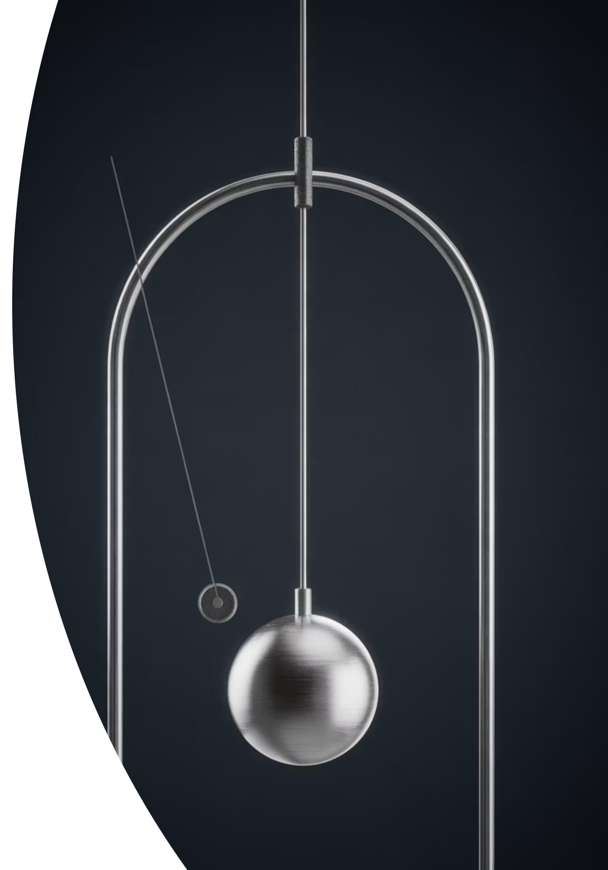
Measuring Time
Measure Many, Then Divide
Cambridge IGCSE Physics 0625
thelucidstem.com

Slide 2
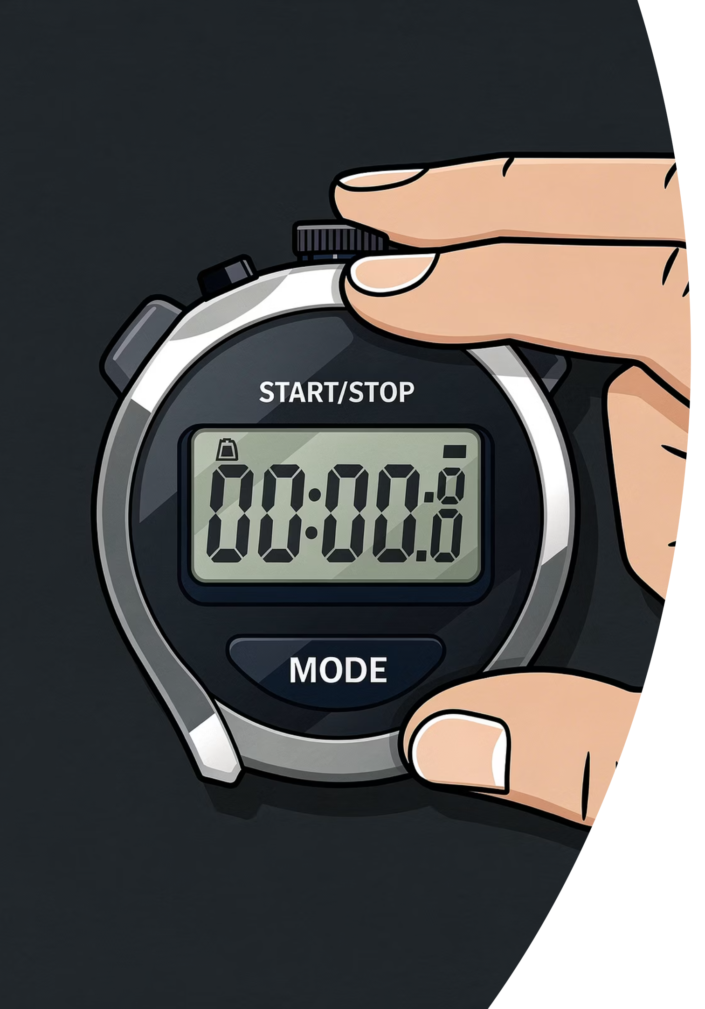

The Impossible Timing
Look at the pendulum at the front of the room. Your teacher is about to time exactly one single swing using a stopwatch.
The Problem
Why is a single-swing reading completely unreliable? Consider what happens the moment you press start and stop.
Think, Pair, Share
Discuss with your partner: how does human reaction time affect short measurements? How could you obtain a more accurate value?
thelucidstem.com

Slide 3
Topic: Measuring Time and Accuracy
By the end of this lesson, you will be able to:
01
02
03
Use a Digital Timer
Reduce Random Error
Find the Period
Measure a time interval correctly using a digital stopwatch.
Measure multiples of a quantity and divide to minimise the effect of reaction time.
Determine the period of a pendulum by timing many complete swings and dividing by the number of swings.
04
05
Find Sheet Thickness
Explain the Reasoning
Measure a stack of paper and divide by the number of sheets to find the thickness of one sheet.
Articulate clearly why timing many swings is more accurate than timing one.
thelucidstem.com

Slide 4

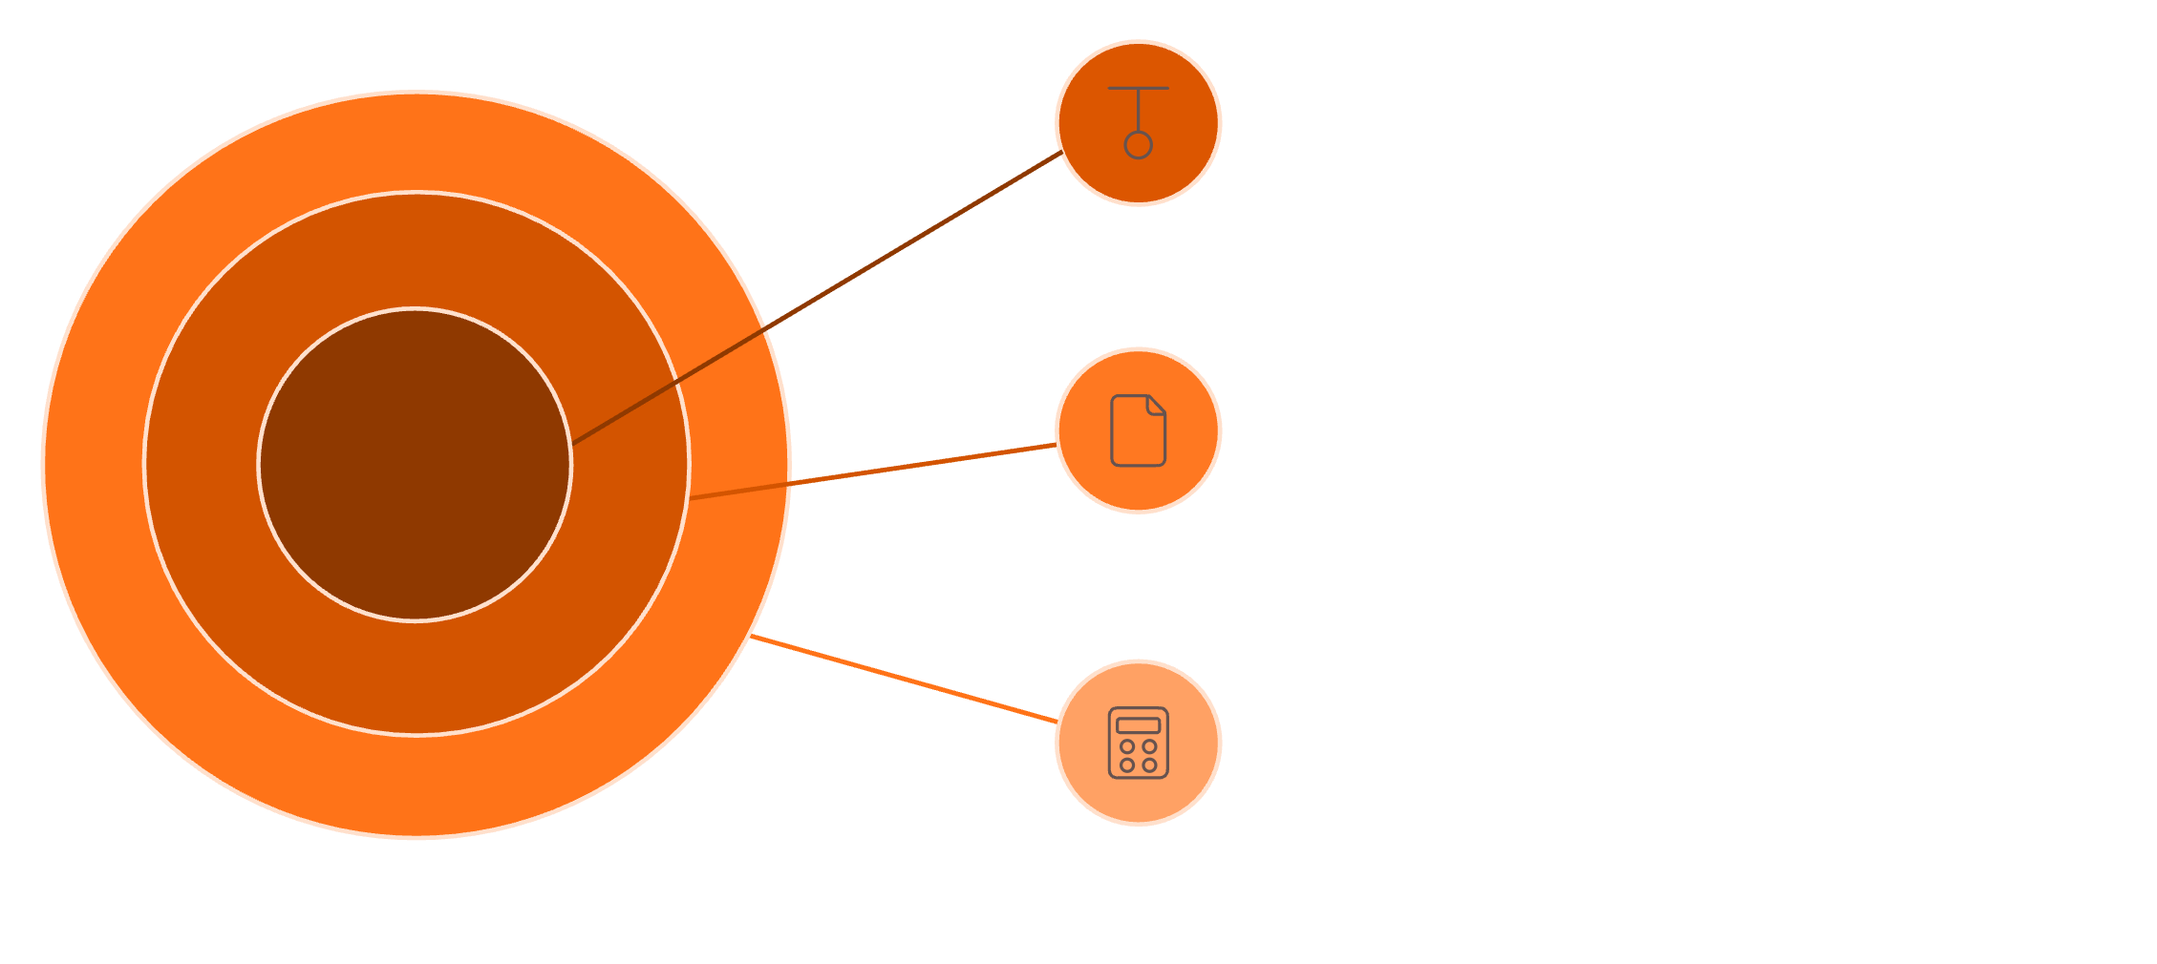
Measure Many, Then Divide
We cannot eliminate human reaction time. But we can make it almost irrelevant.
The Problem
The Solution
Your reaction time is a significant fraction of a single, short measurement. For a pendulum swing of 1.4 s, a reaction time of 0.2 s is an error of over 14%.
Measure a large multiple, such as 20 swings or 500 sheets. Divide the total by the number of repetitions. The reaction time error is now spread across all 20 swings, reducing the percentage error to under 1%.
Buying a stopwatch with more decimal places does not fix human reaction time.
Reduce Error
Increase counts to minimize reaction-time impact
Pendulum Averaging
Time 20 swings, then divide by 20
Stack Measurement
Measure 500 sheets, then divide by 500
thelucidstem.com

Slide 5
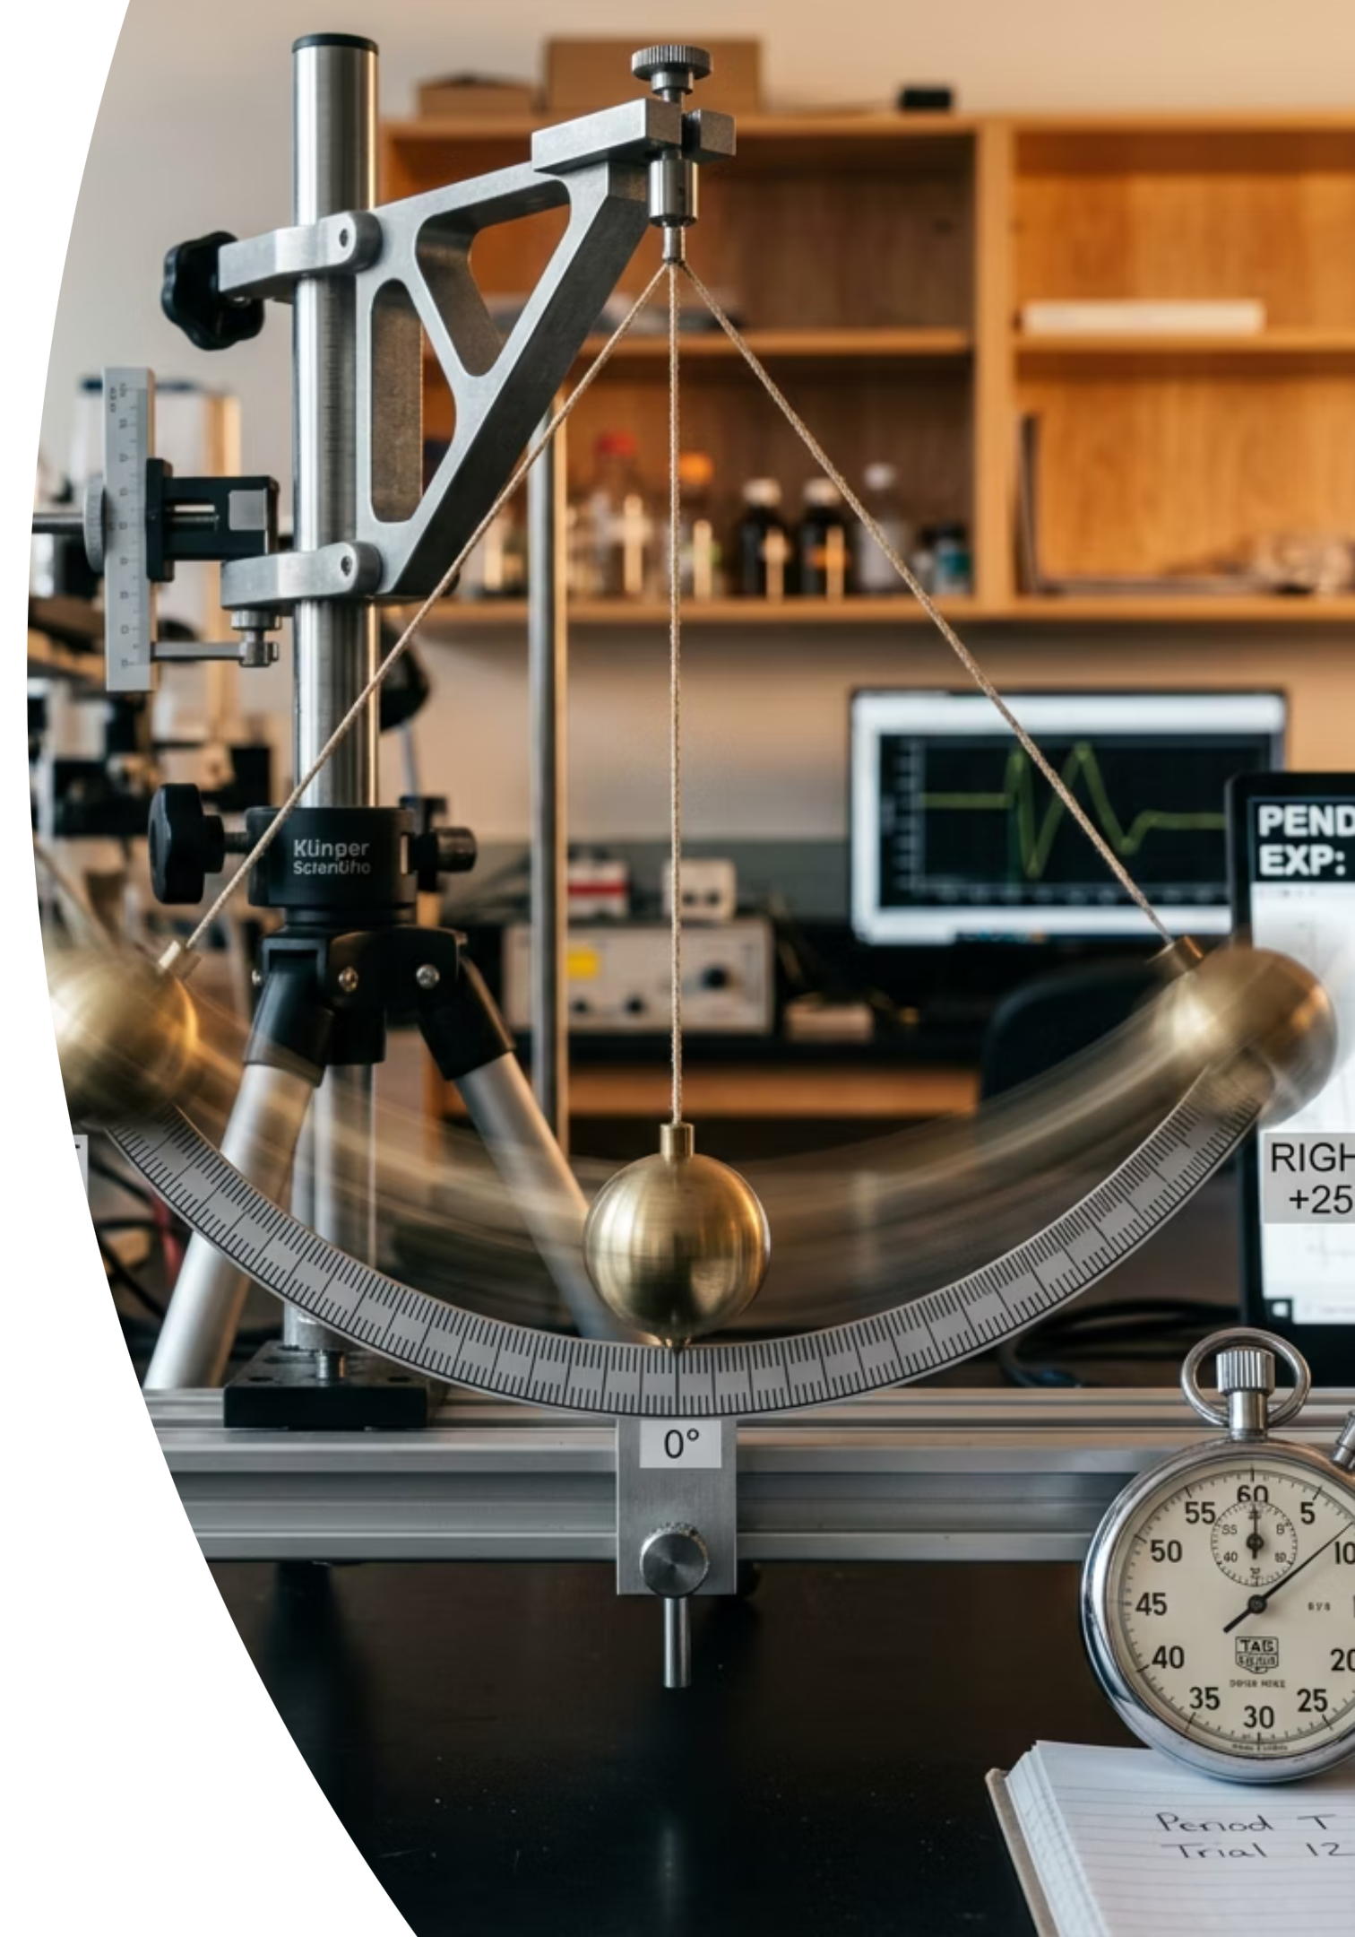


Rules of the Swing
To measure the period of a pendulum accurately, three strict laboratory rules must be followed every time.
1
2
Start at the Centre
Count From Zero
Always start and stop the timer as the bob passes the centre resting point. The bob moves fastest here, making the moment easiest to judge precisely. Never measure from the extreme edges of the swing.
As you start the stopwatch, say "Zero". The next pass through the centre in the same direction is "One". Starting from "One" causes an off-by-one error in your count.
3
One Complete Swing
A complete oscillation means the bob travels out and returns to the exact same point, moving in the same direction. This is one full period.
thelucidstem.com

Slide 6

Examiner Report Warning: These are the most common practical exam mistakes.
The Random Error Illusion
Examiners consistently report these three errors in practical assessments. Learn to avoid them now.
Trap 1: Timing One Swing
Trap 2: Counting From One
Trap 3: Forgetting to Divide
The Mistake: Recording the time for a single swing as the period.
The Correction: Always time at least 10 or 20 complete swings to reduce the percentage error due to reaction time.
The Mistake: Beginning the count at "One" when the stopwatch is started.
The Correction: The moment you press start is always "Zero". The first completed swing is "One".
The Mistake: Reporting the total time for 20 swings as the period.
The Correction: Period = Total Time divided by Number of Swings.
thelucidstem.com

Slide 7
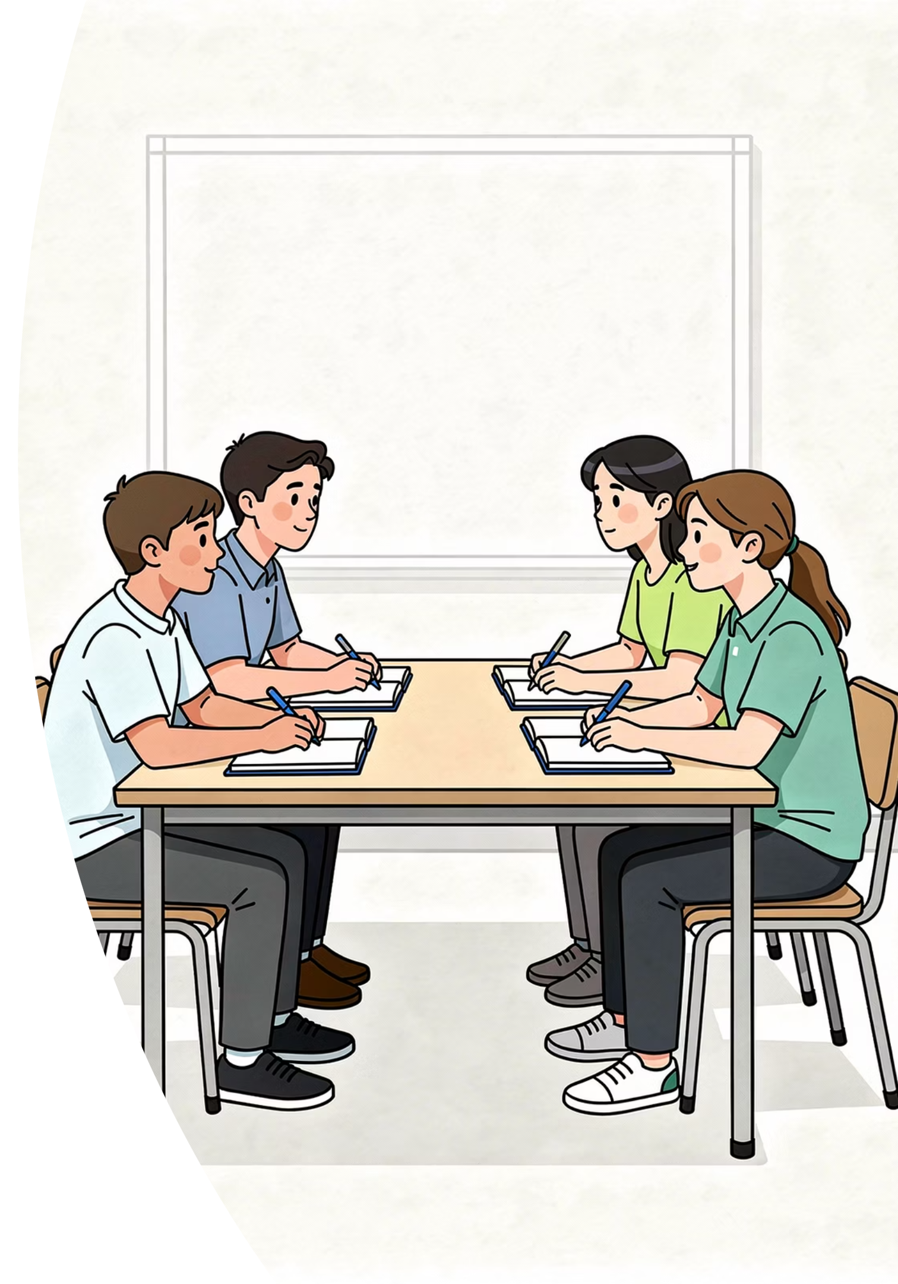



Cooperative Task: Numbered Heads Together
An active learning protocol to ensure every student can explain the method.
Form Teams
Get into teams of four. Number yourselves 1 to 4.
Heads Together
Discuss the challenge. Agree on the exact method and calculation. Every member must understand it fully.
Random Call
A random number is called. That student stands and explains the method for their team.
thelucidstem.com

Slide 8
Challenge A: The Single Sheet
ROUND 1
2:00
The Goal
Find the exact thickness of one single sheet of printer paper. A ruler and a stack of paper are available.
Heads Together
Discuss
Your timer starts now. Discuss with your team and agree on one method.
What is your exact method?
What is the exact calculation you will perform at the end?
What quantity do you need to measure, and what do you divide by?
thelucidstem.com

Slide 9
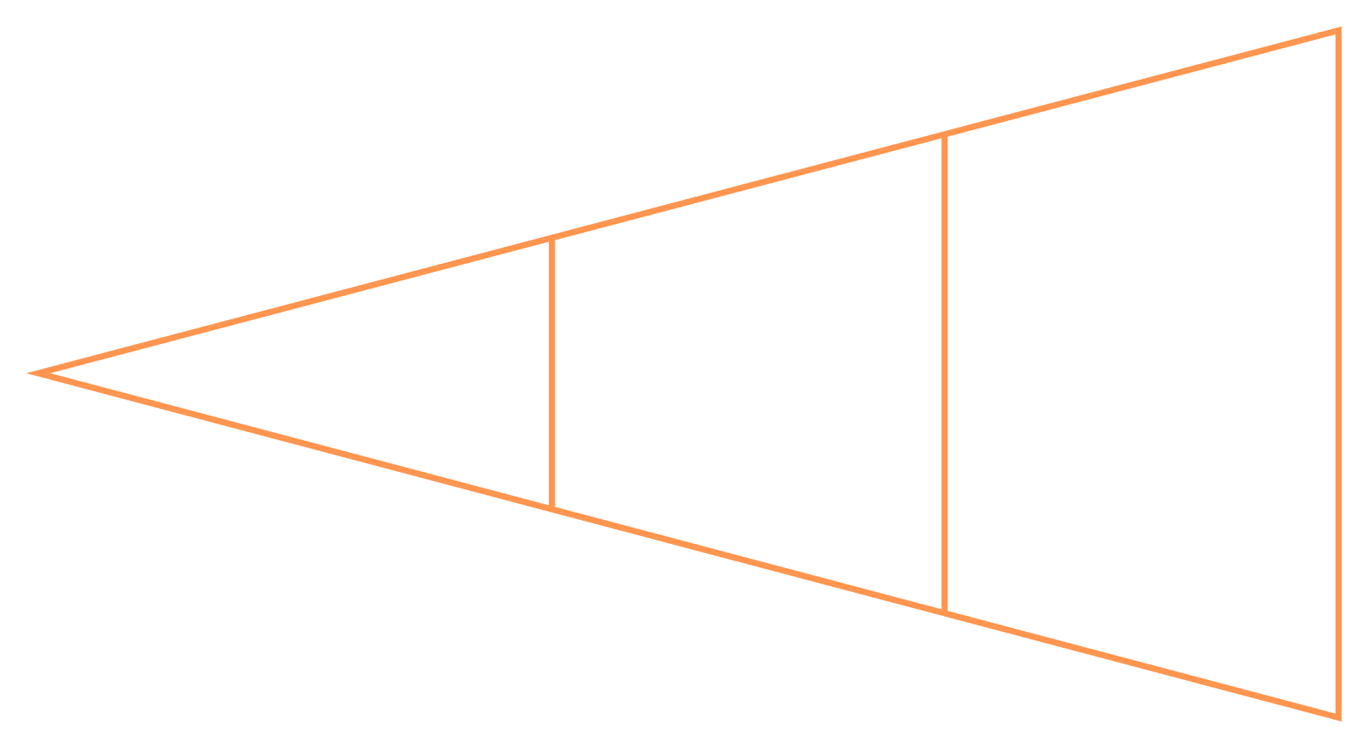

Answer A: The Stack Method
ROUND 1 ANSWER
Method
Take a stack of 500 sheets of printer paper. Place a ruler vertically alongside the stack and measure the total height of the entire stack in millimetres.
Calculation
Measure Stack
Compute Thickness
Record Height
Thickness of one sheet = Total height of stack (mm) divided by 500
For example: if 500 sheets measure 50 mm, then one sheet is 50 / 500 = 0.1 mm thick.
thelucidstem.com

Slide 10
Challenge B: The Dripping Tap
ROUND 2
2:00
The Goal
Find the exact time it takes for one single drip to fall from a slow, steady tap.
Heads Together
Discuss
Your timer starts now. Apply the same principle you used in Challenge A.
What is your exact method?
What is the exact calculation you will use at the end?
How many drips will you count, and why?
thelucidstem.com

Slide 11
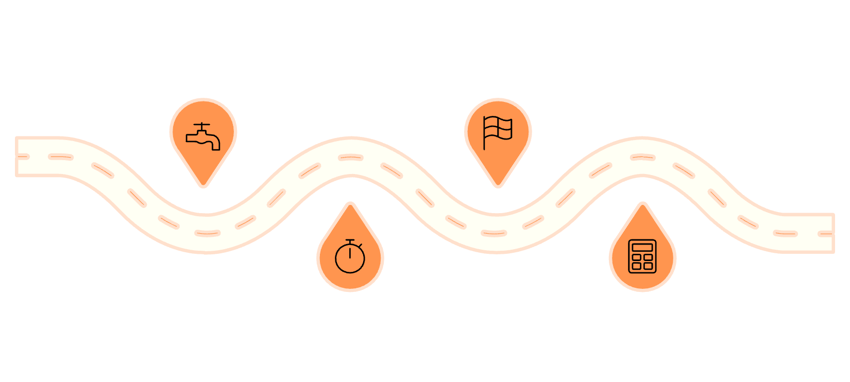
Answer B: The Multiple Drip Method
ROUND 2 ANSWER
Method
Setup
Stop
Place beaker under tap; stopwatch ready
Stop watch at drip 50
Position the stopwatch beside a slow, steady dripping tap. As a drip falls, press start and call it "Zero". Count each subsequent drip: 1, 2, 3... Stop the watch on drip 50.
Calculation
Time per drip = Total time on stopwatch (s) divided by 50
Start
Calculate
Press start at drip 0 (Zero)
Time per drip = total time ÷ 50
For example: if 50 drips take 35.0 s, then one drip takes 35.0 / 50 = 0.70 s.
thelucidstem.com

Slide 12


Prove It.
Complete these questions independently and in silence before you leave.
1
2
Period Calculation
Explain the Method
A student times 20 complete swings of a pendulum. The total time recorded is 28.4 seconds.
Calculate the period of the pendulum. Show your working clearly and include the correct unit.
In exactly one sentence, explain why timing 20 swings is more accurate than timing a single swing.
You must use the phrase "reaction time" in your answer.
thelucidstem.com

