Slide 1
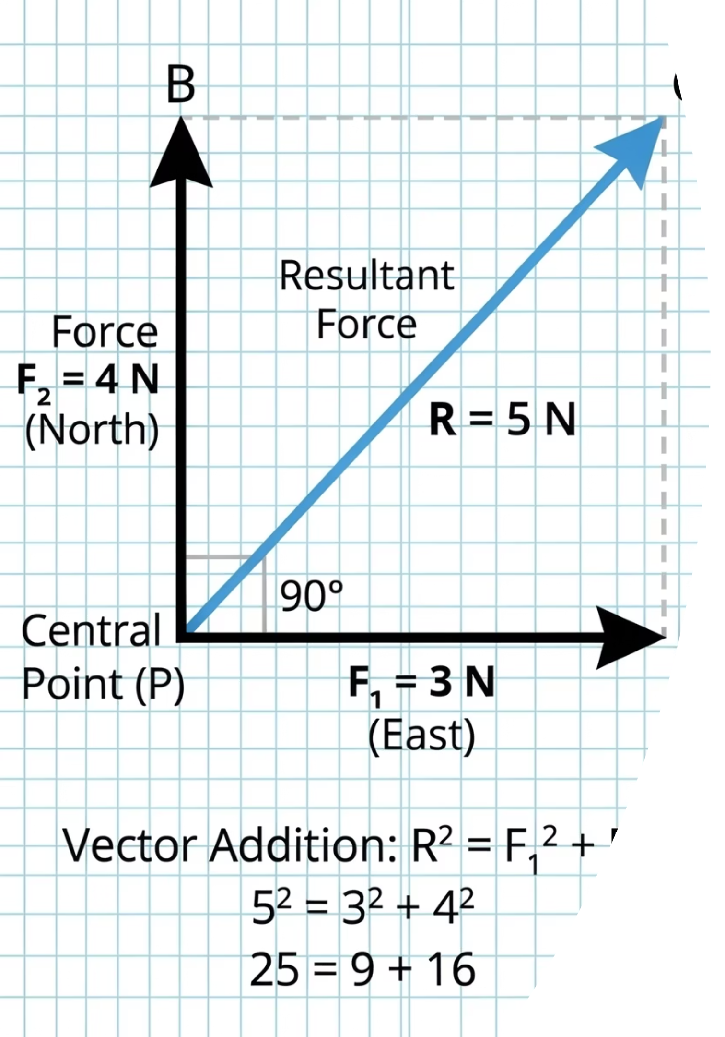

The 3 and 4 Paradox
Look at these two forces acting on a single object. A force of 3 N pulls due East. A force of 4 N pulls due North. What is the single combined force acting on this object?
Did you guess 7 N? The actual answer is 5 N. This lesson explains exactly why, and how to calculate it every time.
@thelucidstem.com

Slide 2
IGCSE Extended Physics
Topic: Resultant of Two Perpendicular Vectors
By the end of this lesson, you will be able to:
01
02
Combine
Draw
Add two perpendicular vectors to find their resultant using correct method.
Construct a resultant by scale drawing, joining vectors tip to tail.
03
04
Calculate
State
Find magnitude using Pythagoras and direction using the tangent ratio.
Express a resultant correctly with both a magnitude and a direction.
@thelucidstem.com

Slide 3
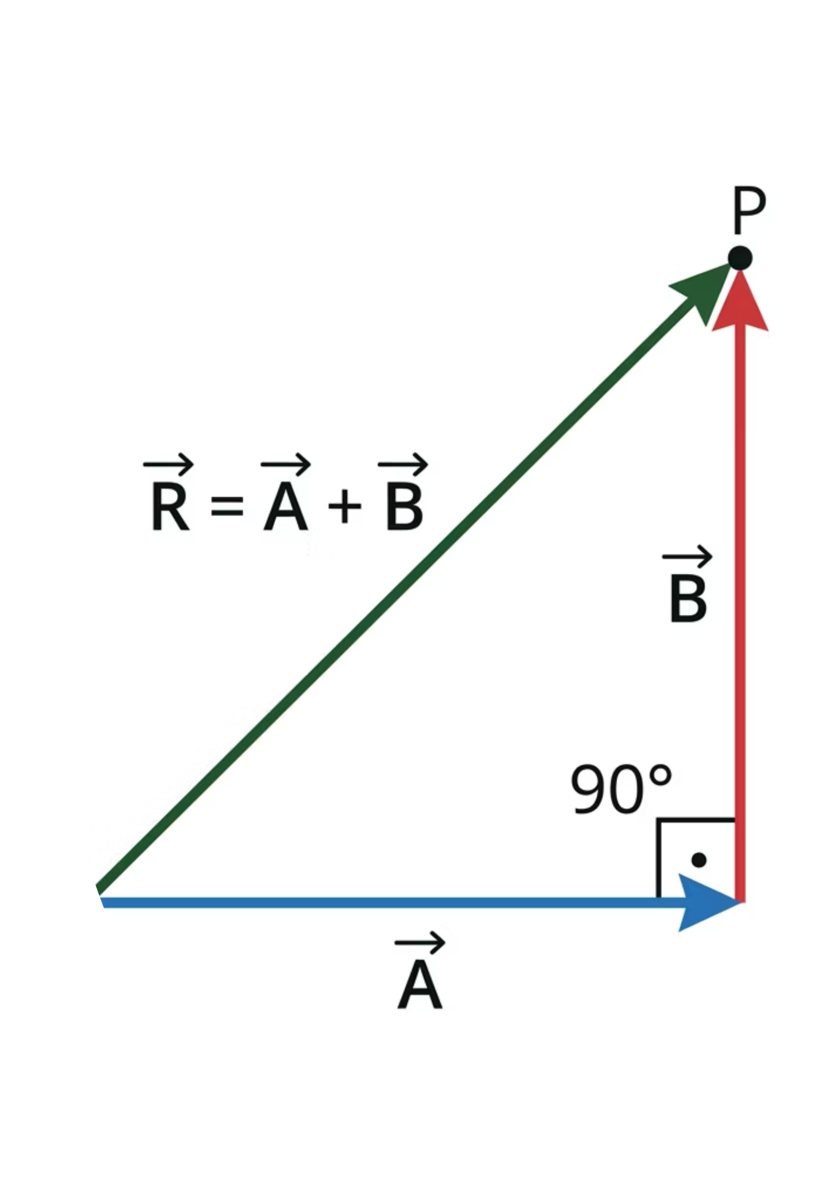
The Vector Triangle
To combine two perpendicular vectors, we draw them tip to tail. The resultant is the closing line of the right-angled triangle formed.
The resultant always runs from the tail of the first vector to the tip of the last vector. Crucially, this diagonal line represents the single force that has the same effect as both original forces combined.
@thelucidstem.com

Slide 4
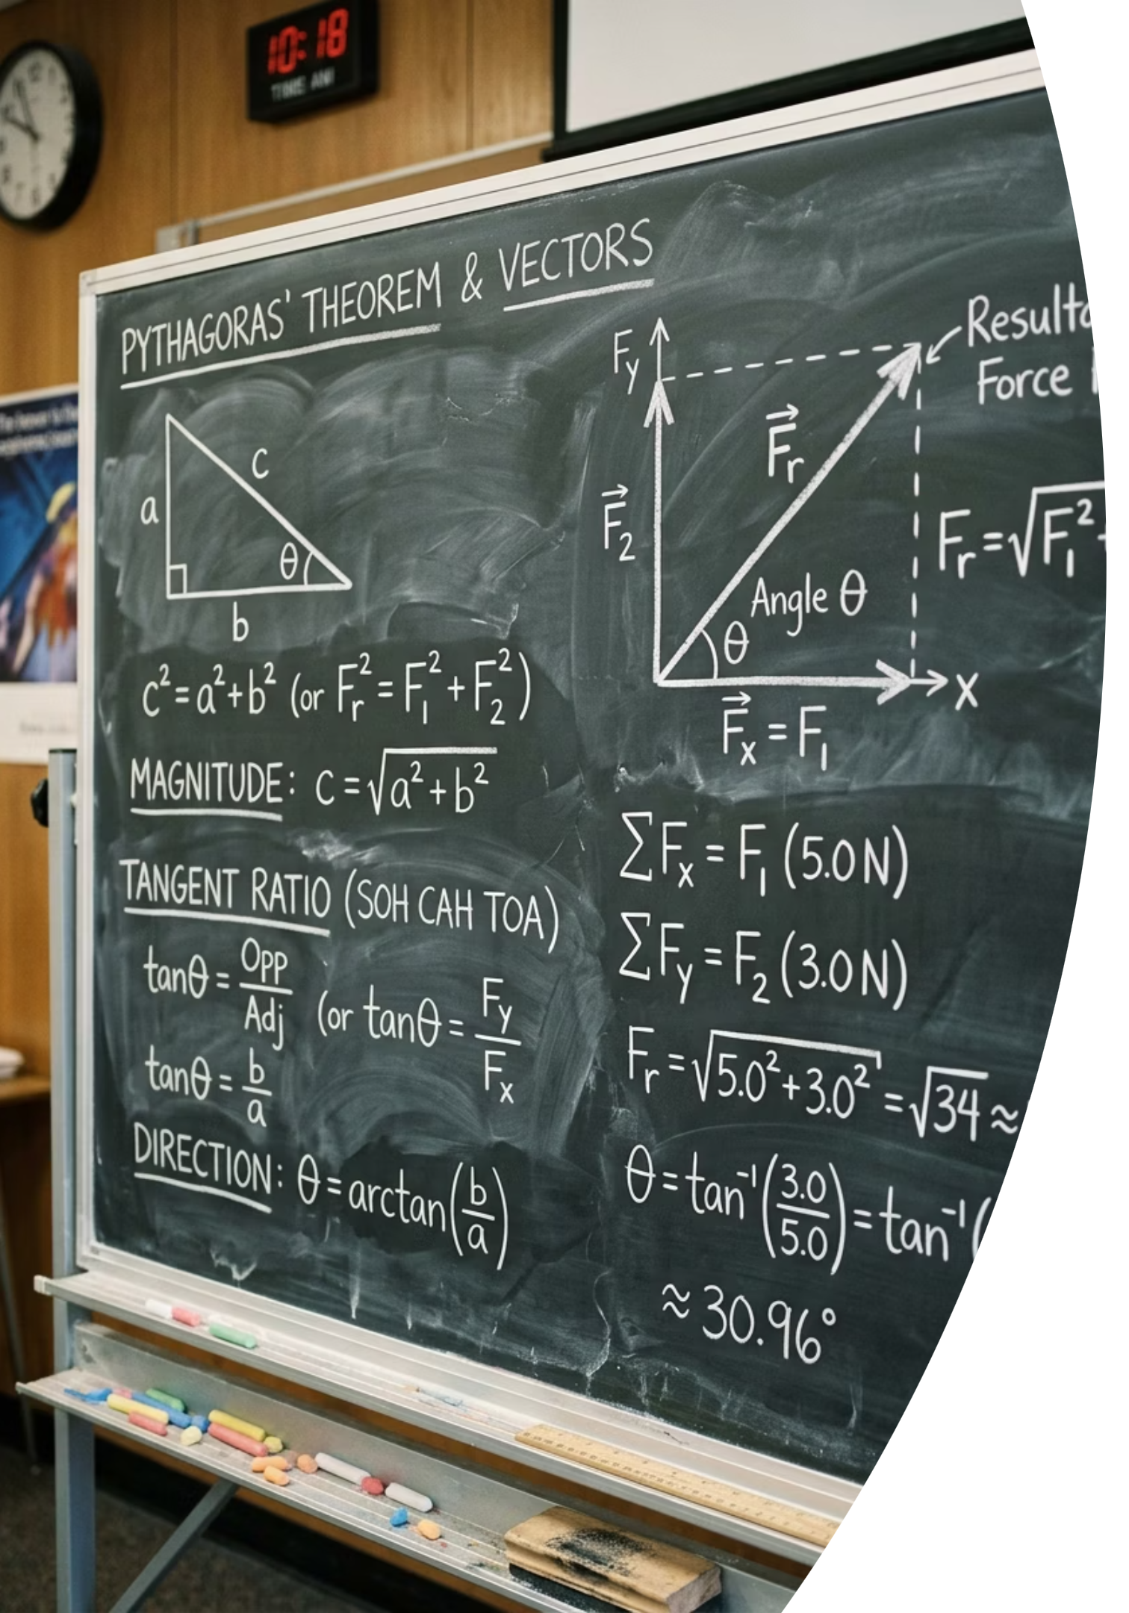


Pythagoras and Tangent
We can calculate the exact resultant without a scale drawing. Two formulas are required:
Magnitude
Direction
Use Pythagoras' theorem to find the size of the resultant:
Use the tangent ratio to find the angle:
For 3 N and 4 N: R = 5 N
For 3 N and 4 N: theta = 53 degrees
@thelucidstem.com

Slide 5


EXAMINER'S TRAP
The Magnitude Illusion
Examiner Report Warning: These are the most common fatal errors at Extended level. Avoid every one of them.
Trap 1: Adding Magnitudes Directly
Trap 2: Stating Only the Magnitude
Trap 3: Misidentifying Tangent Sides
3 + 4 = 7 N Perpendicular vectors cannot be added arithmetically. You must apply Pythagoras' theorem to find the true resultant magnitude.
A resultant is a vector quantity. Magnitude alone is incomplete. You must always state both the size and the direction as an angle.
Always mark your chosen angle first on the diagram. Then carefully identify which side is opposite and which is adjacent before substituting into tan(theta).
@thelucidstem.com

Slide 6


Cooperative Task: Rally Coach
Work in pairs with one pencil between you. Follow the protocol below precisely.
Partner A: Solver
Work through the problem out loud. Calculate the magnitude using Pythagoras, then the direction using the tangent ratio. Narrate every step clearly.
Partner B: Coach
Watch and listen without touching the pencil. Praise correct steps. Catch and correct any errors before your partner moves on. Do not simply give answers.
Swap roles for every new problem. Both partners must experience both roles.
@thelucidstem.com

Slide 7

ROUND 1
Calculate the Resultant
Partner A solves. Partner B coaches. You have 3 minutes. Show all working clearly.
Given
Find
Two perpendicular forces acting on a single object:
The resultant magnitude in Newtons.
The angle measured from the 6 N force.
Force 1: 6 N
Force 2: 8 N
Draw the vector triangle first. Label all sides before applying any formula.
@thelucidstem.com

Slide 8
ROUND 1: COACH'S KEY
Did Your Pair Get It Right?
Step-by-Step Working
Final Answer
Magnitude:
The resultant force is:
10 N at 53°
Direction:
Both magnitude and direction must be stated for full marks. A number alone is insufficient for a vector quantity.
@thelucidstem.com

Slide 9
ROUND 2
Calculate the Resultant
SWAP ROLES. Partner B solves. Partner A coaches. You have 3 minutes. Show all working clearly.
Given
Find
Two perpendicular forces acting on a single object:
The resultant magnitude in Newtons.
The angle measured from the 5 N force.
Force 1: 5 N
Force 2: 12 N
Note: 5, 12, 13 is a Pythagorean triple. Do you recognise the pattern?
@thelucidstem.com

Slide 10
ROUND 2: COACH'S KEY
Did Your Pair Get It Right?
Step-by-Step Working
Final Answer
Magnitude:
The resultant force is:
13 N at 67°
Direction:
The triple 5, 12, 13 is a classic Pythagorean triple. Recognising these can save valuable time in examinations.
@thelucidstem.com

Slide 11


Prove It.
Silence in the room. Complete both questions independently before you leave. Show all working.
1
2
Exit Question 1
Exit Question 2
Two perpendicular forces of 8 N and 15 N act on an object.
In one precise sentence, explain why a 3 N force and a 4 N force acting at right angles do not combine to produce a resultant of 7 N.
Calculate the exact resultant magnitude.
Calculate the resultant direction as an angle from the 8 N force.
Hint for Q1: 8, 15, 17 is a Pythagorean triple.
@thelucidstem.com

