Slide 1

The Round Trip Trap
A car drives out along a straight road, then returns to exactly the same starting point. Watch what happens to each quantity as it completes the round trip.
Distance
Keeps climbing the entire journey. Never falls back.
Average Speed
Increases throughout. Always positive.
Displacement
Returns to zero at journey end.
Average Velocity
Also falls back to zero at the finish.
Think: Which of these quantities require a direction to be fully defined, and which do not?
thelucidstem.com

Slide 2
IGCSE PHYSICS
Topic: Scalars and Vectors
By the end of this Extended lesson, you will be able to:
01
02
03
Define Scalar
Define Vector
Classify Quantities
Describe a scalar as a quantity possessing magnitude only, with no directional component.
Describe a vector as a quantity possessing both magnitude and a specified direction.
Sort common physical quantities correctly into scalar and vector categories.
04
05
Contrast Key Pairs
Represent Vectors
Explain the distinction between distance and displacement, and between speed and velocity.
Draw a vector quantity as a scaled arrow showing both magnitude and direction.
thelucidstem.com

Slide 3
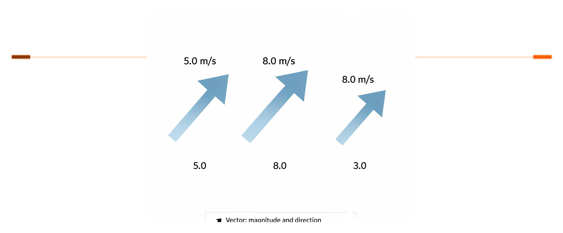
The Arrow Board
In physics, every measurement belongs to one of two fundamental categories. Understanding this distinction is the foundation of all mechanics.
Vector
Scalar
A number with a unit and a direction. Represented as an arrow: the length encodes magnitude; the arrowhead encodes direction.
A number with a unit only. No directional information is needed or given. The value stands alone.
5 m to the right
12 N downwards
30 m/s north
5 kg
10 seconds
340 J
VECTOR
SCALAR
Arrows showing magnitude and direction
Numbers with units, no direction
thelucidstem.com

Slide 4
Pairs That Trip You Up
These three pairs are frequently confused in examinations. Study each contrast carefully.
Distance (Scalar) vs Displacement (Vector)
Speed (Scalar) vs Velocity (Vector)
Mass (Scalar) vs Weight (Vector)
Distance is the total path length travelled, regardless of direction. Displacement is the straight-line separation from start to finish, stated with a direction. A runner completing one full lap has a large distance but zero displacement.
Speed tells you how fast an object is moving. Velocity tells you how fast and in which direction. A car travelling at 60 km/h has a speed; 60 km/h due north is a velocity.
Mass is the amount of matter in an object, measured in kilograms. Weight is the gravitational force acting on that mass, measured in newtons, and always acts downwards towards the centre of the Earth.
thelucidstem.com

Slide 5

Examiner Report Warning: These errors appear repeatedly in student scripts and cost marks every year.
The Direction Illusion
Three specific mistakes account for the majority of lost marks on scalar and vector questions. Eliminate them now.
Trap 1: Missing Direction
Trap 2: Negative Magnitude
Trap 3: Speed as a Vector
Writing a vector answer without stating its direction is incomplete and will lose marks. Always append the direction: write 5 N to the right, never just 5 N.
The magnitude of a vector is its size and is always positive. A negative sign indicates direction along a chosen axis. Never state that a magnitude is negative.
Speed is a scalar quantity. Velocity is the corresponding vector. Calling speed a vector, or confusing the two terms, is a direct error in classification.
thelucidstem.com

Slide 6
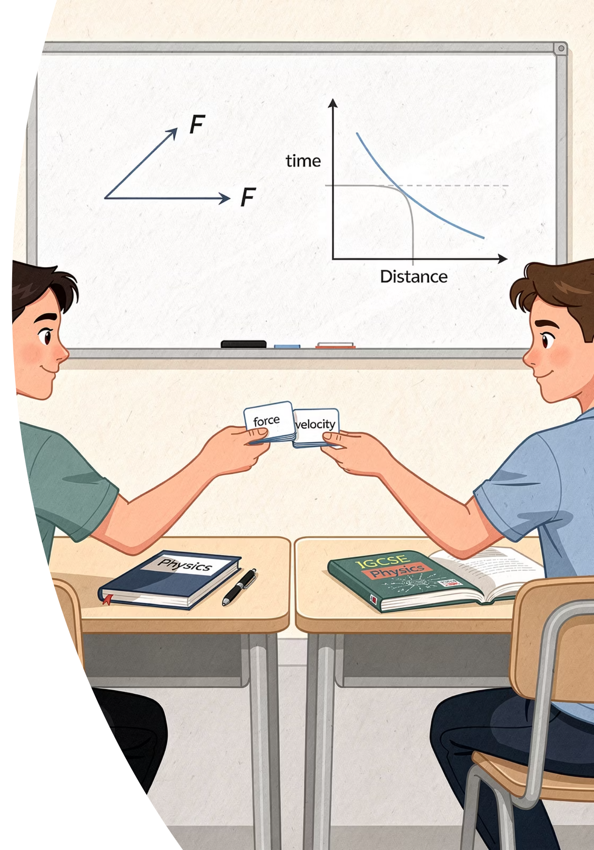




Cooperative Task: Quiz-Quiz-Trade
An active peer-learning protocol to consolidate your classification skills across the whole class.
Receive
Each student is given one quantity card. Read your card and decide whether it is scalar or vector.
Quiz
Find a partner. Ask them: "Is this a scalar or vector, and why?" Listen carefully to their reasoning.
Coach
If your partner is unsure, offer a targeted hint. Do not give the answer directly; guide their thinking.
Trade
Swap cards and move to a new partner. Repeat until the teacher signals time.
thelucidstem.com

Slide 7

The Sorting Mat
Return to your groups of four. You have eight quantity cards and a sorting mat divided into two columns. Place every card on the correct side, then prepare to justify your choices.
Side 1: Scalar
Side 2: Vector
Magnitude only. No direction needed or given.
Magnitude and direction. Both components are essential.
Mass
Time
Distance
Speed
Weight
Velocity
Displacement
Force
A random group number will be called. That group must justify aloud why each card was placed on its side. Every member should be prepared to speak.
thelucidstem.com

Slide 8

Prove It.
Exit Ticket
Silence in the room. Complete both questions independently before you leave. This is your personal record of understanding from today's lesson.
1
2
Classify These Quantities
Speed vs Velocity
State whether each of the following is a scalar or a vector, giving a reason for each: Force, Time, Acceleration, Energy.
Write exactly one sentence explaining why velocity is a vector quantity but speed is a scalar quantity.
There are no notes, no partners, and no discussion. This is your individual evidence of what you have learnt today.
thelucidstem.com

