Slide 1
CAMBRIDGE IGCSE · PHYSICS
Speed and Velocity
By the end of this lesson, you will be able to:
How fast, and which way?
Define speed and use average speed = distance ÷ time (v = s / t).
1
2
Define velocity as speed in a given direction.
3
Rearrange v = s / t to find s, v, or t with correct units.
4
Convert between km/h and m/s.
@thelucidstem.com
Notes:
Set the scene: today we pin down the difference between speed and velocity, and master the v = s/t triangle plus unit conversions. Read the four objectives aloud - these are exactly what the exam tests.

Slide 2
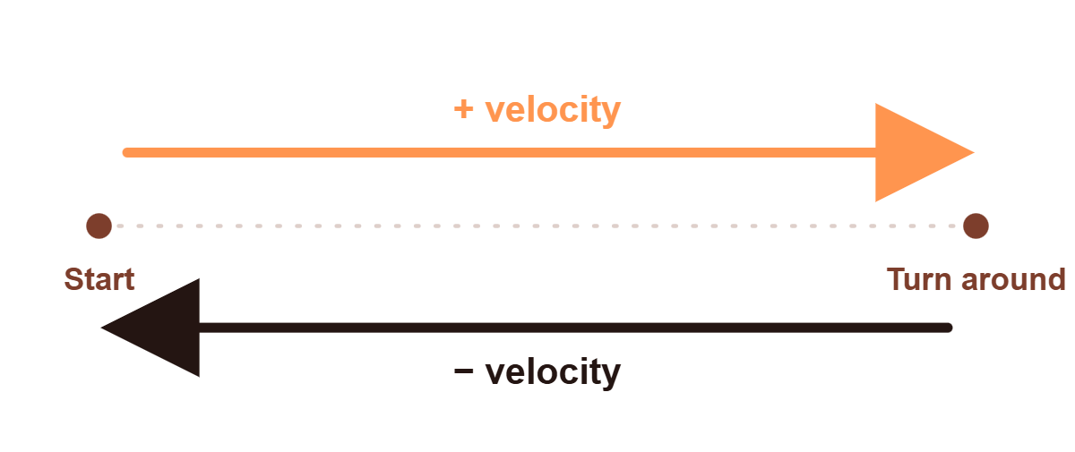
DO NOW
The Round Trip Trap
A car drives out, turns around, and drives back. Watch what each quantity does:
↑
Distance keeps going up.
↑
Average speed keeps going up.
⇅
Velocity drops to zero and reverses!
QUESTION
How is velocity different from speed?
@thelucidstem.com
Notes:
Play the round-trip simulation. The key reveal: distance and average speed only ever climb, but velocity flips sign on the way back and reads zero over the whole trip. Pose the question and let them discuss for 30 seconds.

Slide 3
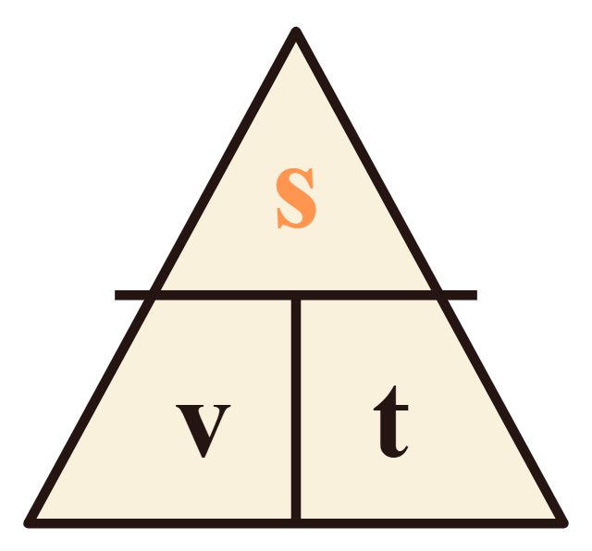
CORE CONCEPT
The Equation Triangle
Speed
How fast. e.g. 8 m/s
Velocity
How fast + which way. e.g. 8 m/s due East
Formula
v = s / t
@thelucidstem.com
Notes:
Speed is a scalar - magnitude only. Velocity is a vector - magnitude AND direction. Teach the triangle: cover the quantity you want and the layout tells you the operation. Cover s → v × t; cover v → s over t; cover t → s over v.

Slide 4
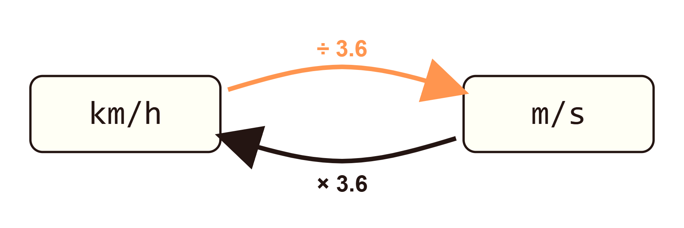
KEY SKILL · CONVERSIONS
The 3.6 Rule
Cambridge exams love to test your unit conversions, so make them automatic.
Tip
The m/s number should always be the smaller number.
@thelucidstem.com
Notes:
Conversions are guaranteed marks if you remember one number: 3.6. Going to the smaller unit (m/s) you divide; going to the bigger number (km/h) you multiply. The sanity check - m/s is always the smaller figure - catches the direction error.

Slide 5

EXAMINER REPORT
The Fatal Errors
Examiner report warnings
Trap 1
Giving a velocity without a direction. If they ask for velocity, “8 m/s” loses a mark - “8 m/s North” gets the mark.
Trap 2
Averaging two speeds. Average speed is always total distance ÷ total time.
@thelucidstem.com
Notes:
These two errors appear in examiner reports every series. Trap 1: velocity with no direction loses the mark every time. Trap 2: you cannot average two speeds - average speed is total distance over total time. Drill this hard.

Slide 6
COOPERATIVE TASK
Rally Coach Protocol
The Solver
The Coach
Holds the pencil.
Watches every step.
→
Works the problem
out loud.
→
Checks each step.
→
Writes the formula, then substitutes.
→
Gives prompts,
“What unit goes there?”
→
Calculates and
adds the unit.
→
Never gives the answer.
SWAP ROLES AFTER EVERY QUESTION
@thelucidstem.com
Notes:
Explain the protocol clearly before handing out problems. The Solver does all the talking and writing. The Coach checks every line and prompts but never reveals the answer. Roles swap after each question so everyone solves and everyone coaches.

Slide 7
PRACTICE · ROUND 1
Finding Speed
A
PARTNER A · SOLVER
B
PARTNER B · SOLVER
A car travels 150 m in 6 s.
A train travels 800 m in 40 s.
Find the speed.
Find the speed.
@thelucidstem.com
Notes:
Round 1 - both partners find a speed. Partner A solves first while B coaches. Remind them: formula, substitute, calculate, unit. Give about two minutes.

Slide 8

ANSWER KEY · ROUND 1
Coach's Key
PARTNER A
PARTNER B
v =
150
=
25 m/s
v =
800
=
20 m/s
6
40
@thelucidstem.com
Notes:
Coaches confirm. Check the working shows the formula, the substitution, and the unit m/s - not just the final number. A bare 25 with no unit would drop a mark in the exam.

Slide 9
PRACTICE · ROUND 2
↻ SWAP ROLES
Rearranging
B
PARTNER B · SOLVER
A
PARTNER A · SOLVER
A runner moves at 4 m/s for 30 s.
A cyclist rides at 8 m/s and covers 200 m.
Find the distance.
Find the time.
@thelucidstem.com
Notes:
Swap roles - the coach now solves. This round rearranges the triangle: cover s to get v × t, cover t to get s over v. Watch that units come through correctly.

Slide 10
ANSWER KEY · ROUND 2
Coach's Key
PARTNER B
PARTNER A
s = 4 × 30 = 120 m
t =
200
=
25 s
8
@thelucidstem.com
Notes:
Confirm the rearrangement. s = v × t gives metres; t = s ÷ v gives seconds. Praise correct units before moving on.

Slide 11
PRACTICE · ROUND 3
↻ SWAP ROLES
The 3.6 Rule
A
PARTNER A · SOLVER
B
PARTNER B · SOLVER
Change 90 km/h into m/s.
Change 36 km/h into m/s.
Convert the units.
Convert the units.
@thelucidstem.com
Notes:
Swap once more. Pure conversion practice - divide by 3.6 to reach m/s. Sanity check: the answer must be smaller than the km/h figure.

Slide 12
ANSWER KEY · ROUND 3
Coach's Key
PARTNER A
PARTNER B
90 ÷ 3.6 =
25 m/s
36 ÷ 3.6 =
10 m/s
@thelucidstem.com
Notes:
Both answers are smaller than the starting km/h figure - that is the sanity check working. 90 over 3.6 is 25; 36 over 3.6 is 10.

Slide 13
1
Calculate the speed of a bird flying 400 m in 20 s.
EXIT TICKET
Prove It.
2
Convert 72 km/h into m/s.
Silence in the room. Mini-whiteboards, on your own.
3
In one sentence: why does velocity always require a direction?
@thelucidstem.com
Notes:
Independent, silent work on mini-whiteboards. No partner help. Collect a quick visual scan of the room: speed of the bird (20 m/s), 72 km/h converts to 20 m/s, and the one-sentence reason velocity needs a direction. This is your formative check.

