Slide 1
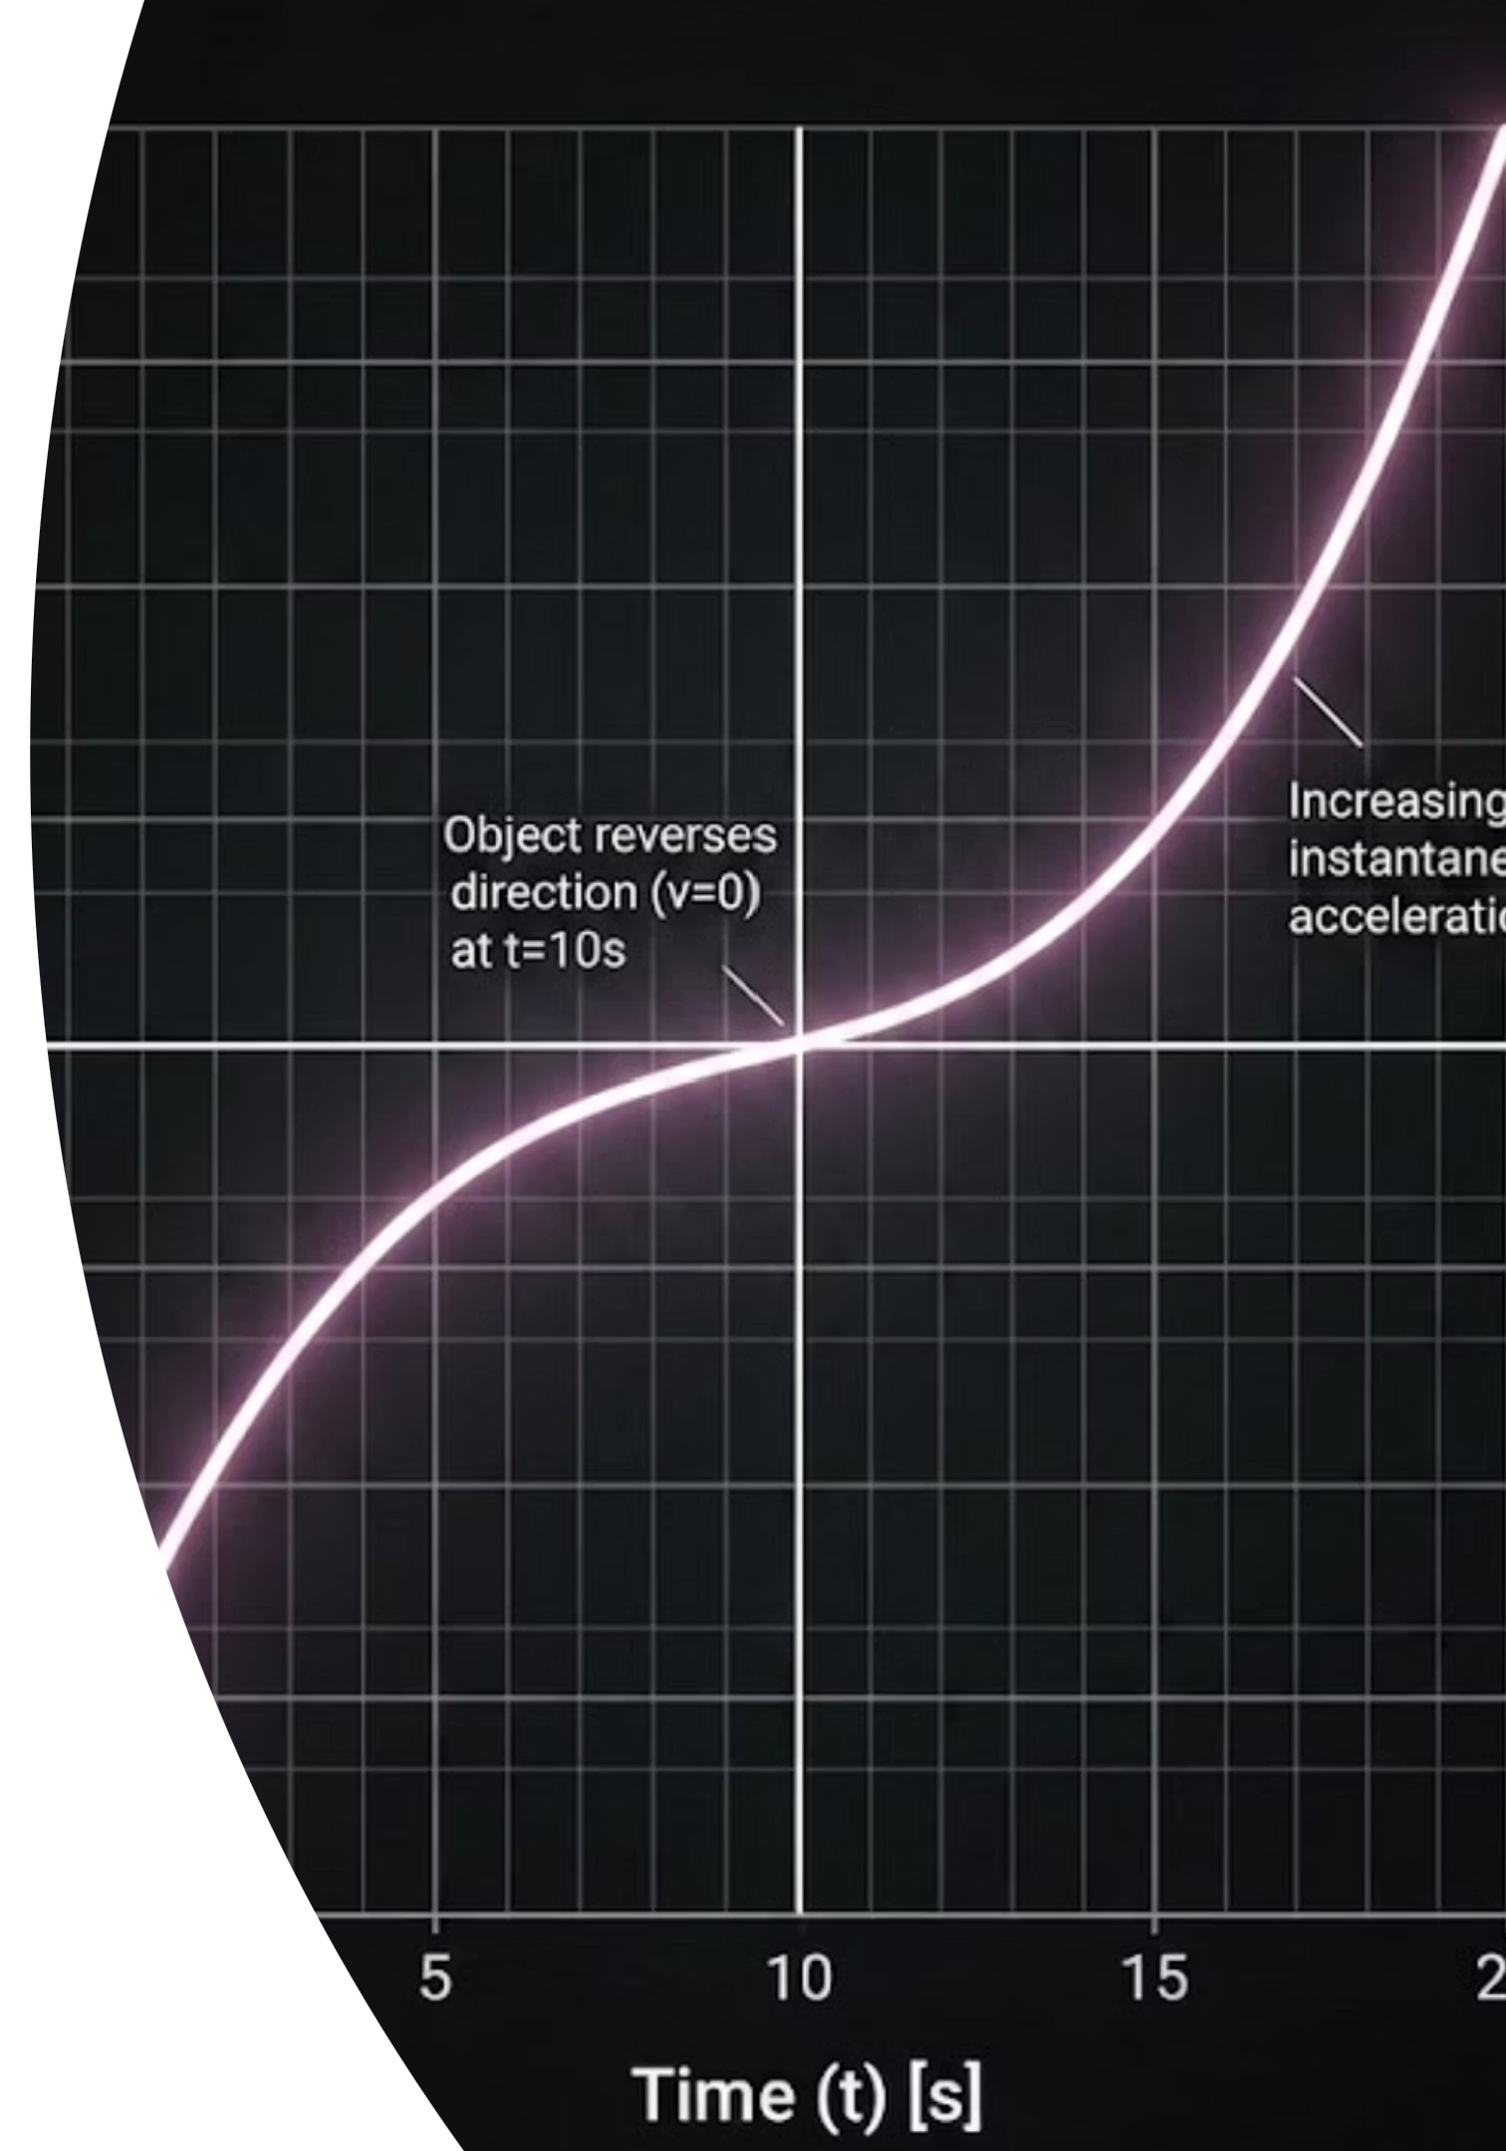
Speed-Time Graphs and Acceleration
Look at the speed-time graph on the board. When the line is flat, what is happening to the speed? When the line slopes upward, what is happening? The core question: What exactly does the steepness of a speed-time line tell us about an object's motion?
CAMBRIDGE IGCSE PHYSICS 0625
CORE AND EXTENDED

Slide 2
Topic: Speed-Time Graphs
Learning Objectives
By the end of this lesson, you will be able to:
1
2
Read the Graph
Define Acceleration
State whether an object is at rest, at constant speed, accelerating, or decelerating from a speed-time graph.
Define acceleration as the change in velocity per unit time using a = Δv ÷ Δt, and state the unit as m/s².
3
4
Gradient (Extended)
Area (Extended)
Determine the acceleration of an object directly from the gradient of a speed-time graph.
Determine the total distance travelled from the area under a speed-time graph.

Slide 3
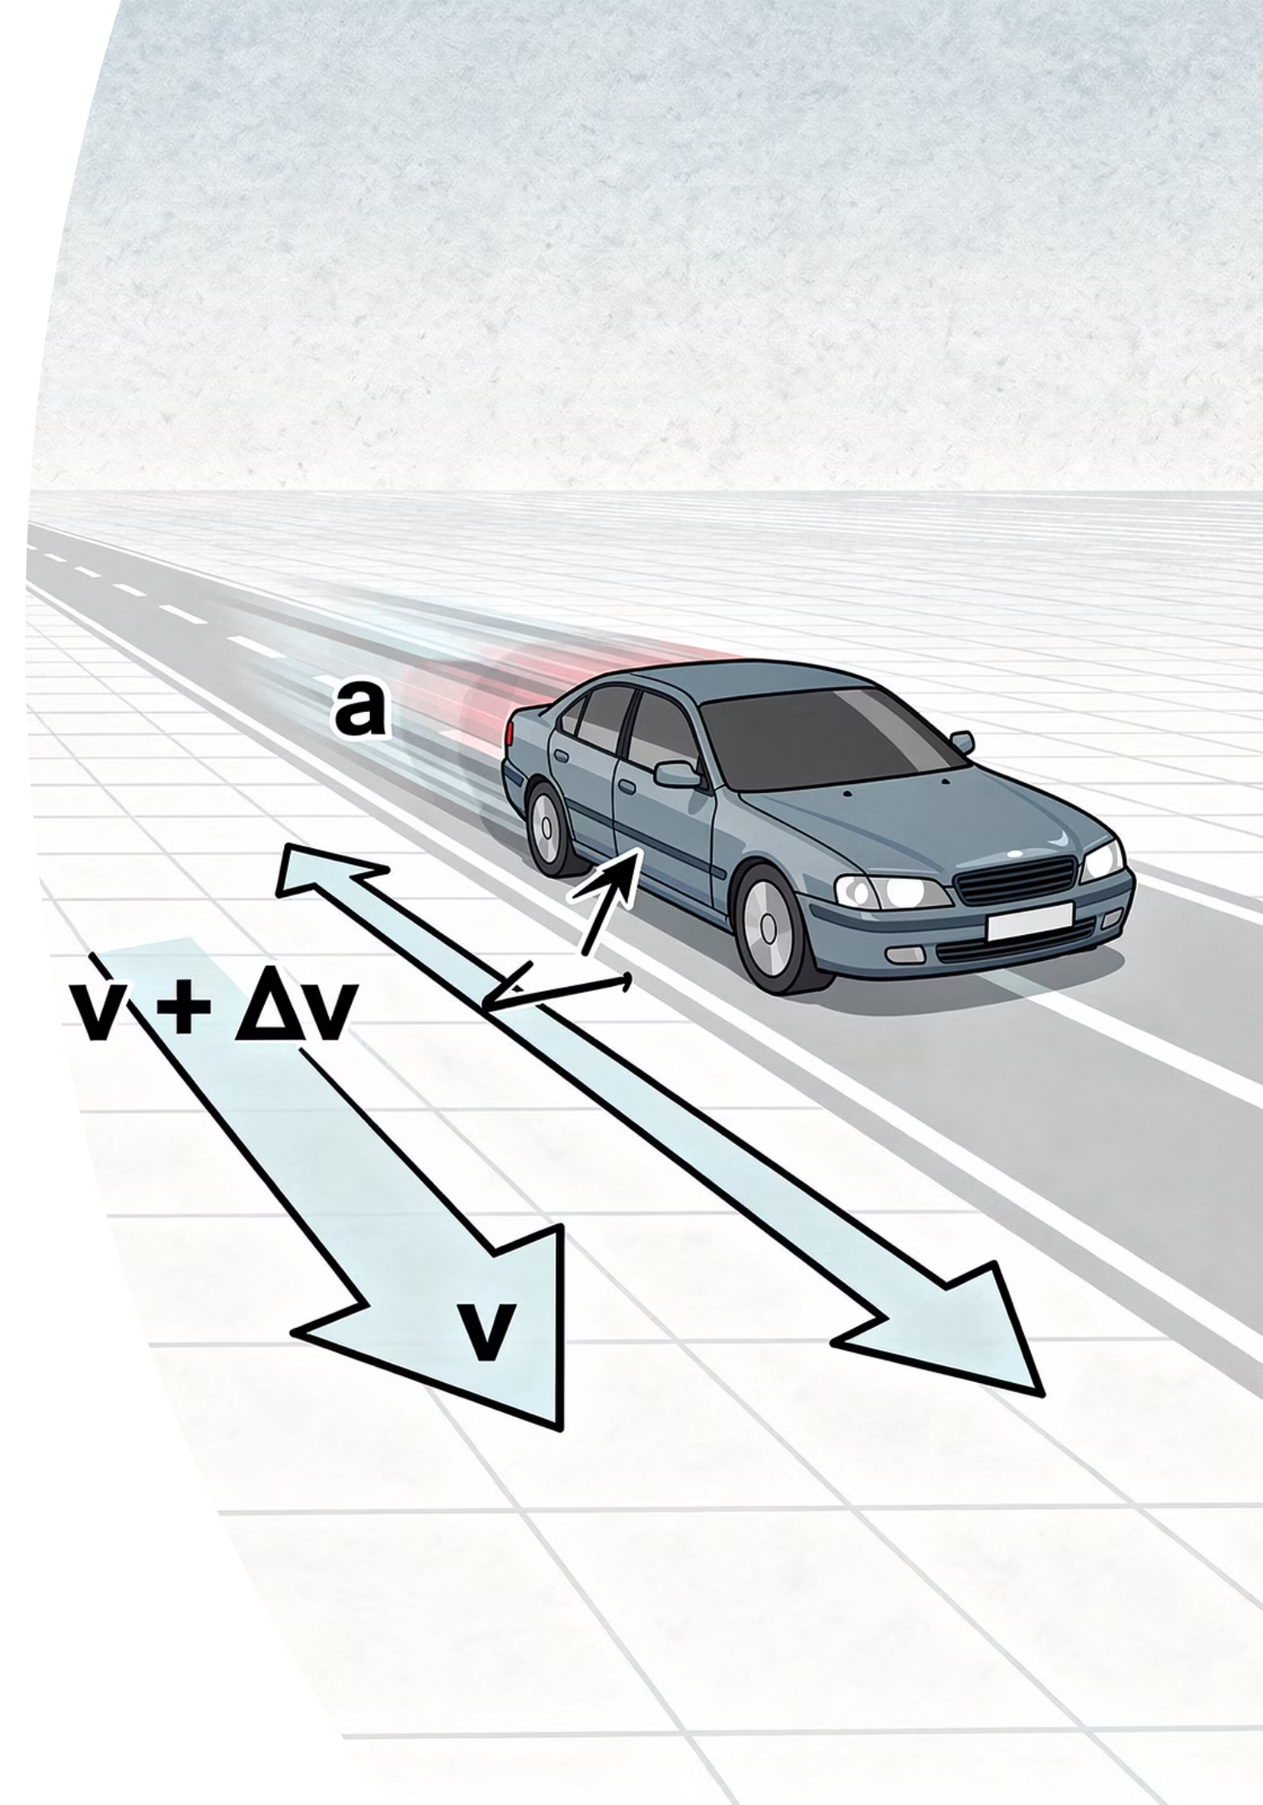
When Speed Changes
Acceleration measures how quickly velocity changes over time. The steeper the line on a speed-time graph, the greater the acceleration.
The Formula
Worked Example
a = Δv / Δt
A car accelerates from 0 to 20 m/s in 8 seconds.
a = 20 ÷ 8 = 2.5 m/s²
On a speed-time graph, the gradient (slope) of the line equals the acceleration. A steeper slope means a larger acceleration.
Where Δv is the change in velocity (m/s) and Δt is the time taken (s). The result is always in m/s².

Slide 4

The Twin-Graph Illusion
Examiner Report Warning: Do not mix up Distance-Time and Speed-Time graphs. Always read the y-axis label first before drawing any conclusions.
Trap 1: Horizontal Line = Stationary?
Trap 2: Writing the Unit as m/s
Trap 3: Downward Slope = Moving Backwards?
Horizontal line means the object is stationary. On a speed-time graph, a horizontal line means constant speed. Stationary would be a horizontal line sitting on the x-axis at zero.
Acceleration is measured in m/s. Acceleration is a change in speed each second. The unit must always be m/s². Writing m/s loses the mark every time.
A downward slope means the object reverses direction. It simply means the object is decelerating (slowing down). Negative velocity would require a separate context.

Slide 5




Cooperative Task: Jigsaw
This activity builds expertise through collaboration. Every person in the room becomes responsible for one part of the content and then teaches it to others.
Step 1: Number Off
In your Home Groups of 4, number yourselves 1 to 4.
Step 2: Expert Groups
All 1s meet together, all 2s together, and so on. Master your specific graph feature.
Step 3: Teach Back
Return to your Home Group. You are the only expert on your feature. Teach it so everyone can complete their recording sheet.

Slide 6

Phase 1: Become the Expert
Move to your Expert Group stations now. You have 5 minutes.
Expert 1
Expert 2
Constant Speed
What does the line look like? What does it mean? Give a real-world example.
Acceleration
What does the line look like? How is it calculated? Give a real-world example.
Expert 3
Expert 4 (Extended)
Deceleration
What does the line look like? What does it mean? Give a real-world example.
Area Under the Line
What does the area represent? How do you calculate it for a complex journey?
Agree on what the line looks like, what it means, and a clear example. Prepare to teach your Home Group in Phase 2.

Slide 7

Phase 2: Teach Your Home Group
Return to your Home Groups now. You have 6 minutes in total.
1
90 Seconds Each
Each expert teaches their feature to the rest of the group. Keep it clear and concise.
2
Fill In Your Recording Sheets
Everyone completes their recording sheet as each expert teaches. Do not leave any section blank.
3
Be Ready
Random call will be used to check whether your group has successfully learned all four features. Any member may be asked.

Slide 8

Check: Feature 1
Q1
Two Questions for Your Group
What does Constant Speed look like on a speed-time graph?
Give a real-world example of an object travelling at constant speed.
Random call...
Think carefully before answering. Do not confuse this with what a constant speed looks like on a distance-time graph.

Slide 9
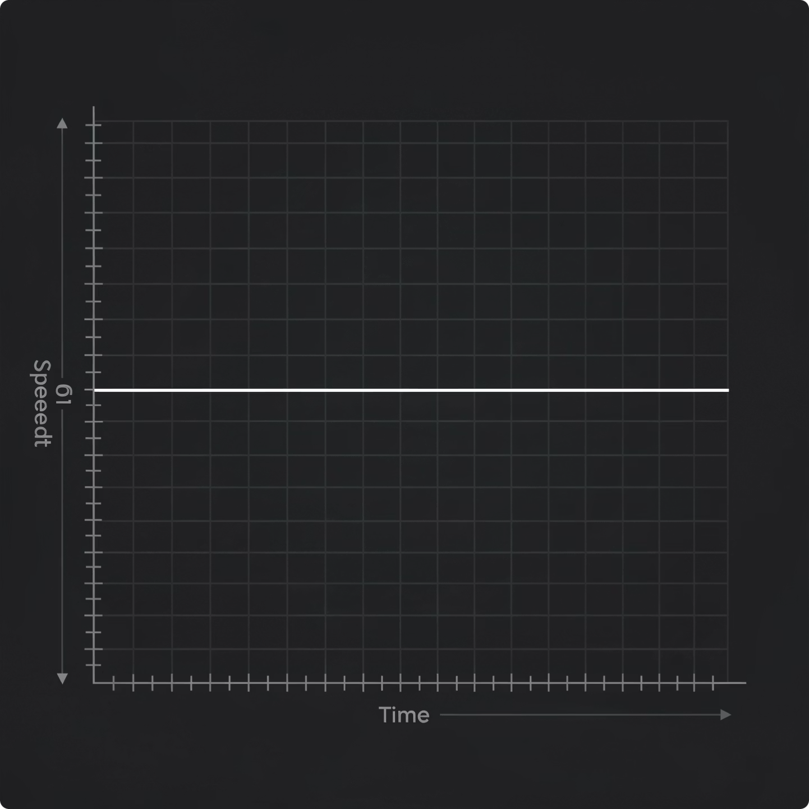
Answer: Constant Speed
Did your Expert 1 teach it correctly?
Looks Like
A horizontal straight line positioned above the time axis (above zero on the y-axis).
Means
The speed of the object is not changing. There is no acceleration and no deceleration.
Example
A car holding exactly 20 m/s on a motorway with cruise control engaged.

Slide 10
Check: Feature 2
Q2
Two Questions for Your Group
What does Acceleration look like on a speed-time graph?
What is the formula used to calculate it, and what is the correct unit?
Random call...
Make sure you can state both the formula and the unit precisely. Both are required for full marks in an exam question.

Slide 11
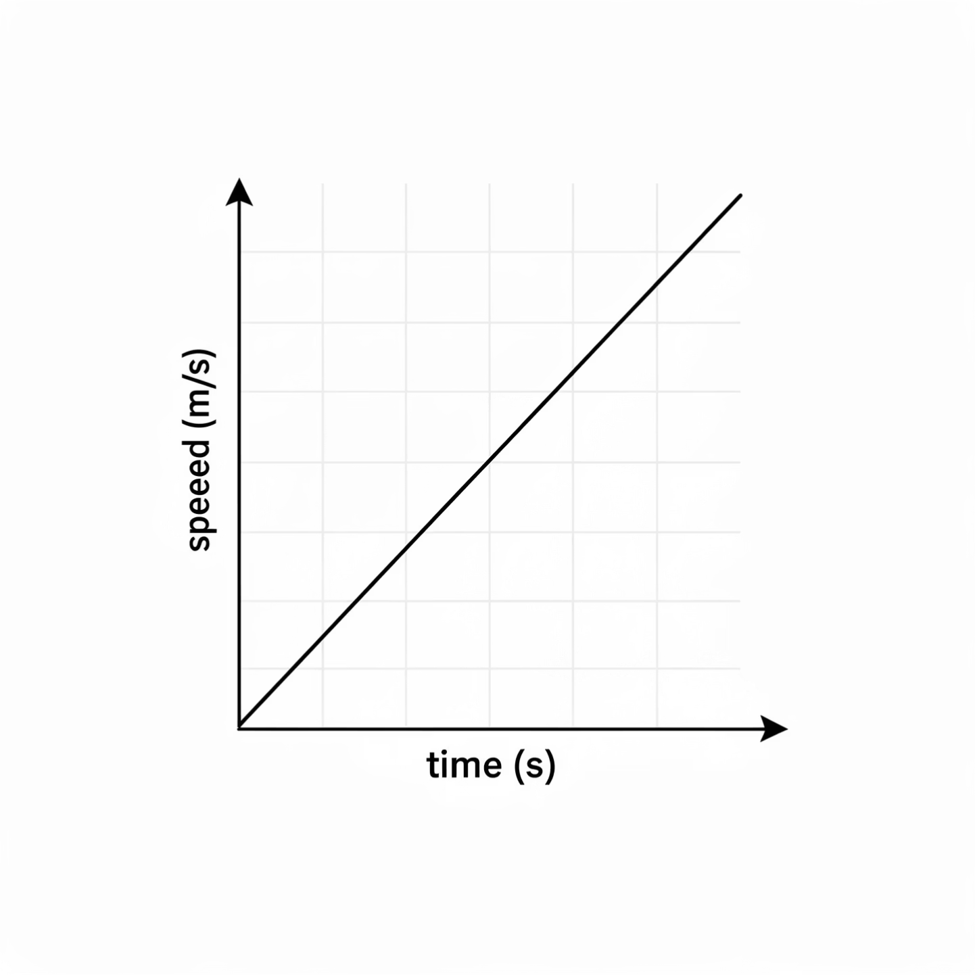
Answer: Acceleration
Did your Expert 2 teach it correctly?
Looks Like
A line sloping upwards from left to right. The steeper the slope, the greater the acceleration.
Means
The object is speeding up. Its velocity is increasing over time.
Formula
a = Δv ÷ Δt, measured in m/s². The gradient of the line equals the acceleration.

Slide 12
Check: Feature 3
Q3
Two Questions for Your Group
What does Deceleration look like on a speed-time graph?
Does a downward slope mean the object is moving backwards? Explain your reasoning.
Random call...
This is one of the most commonly lost marks in IGCSE exams. Make sure your group has the correct answer.

Slide 13
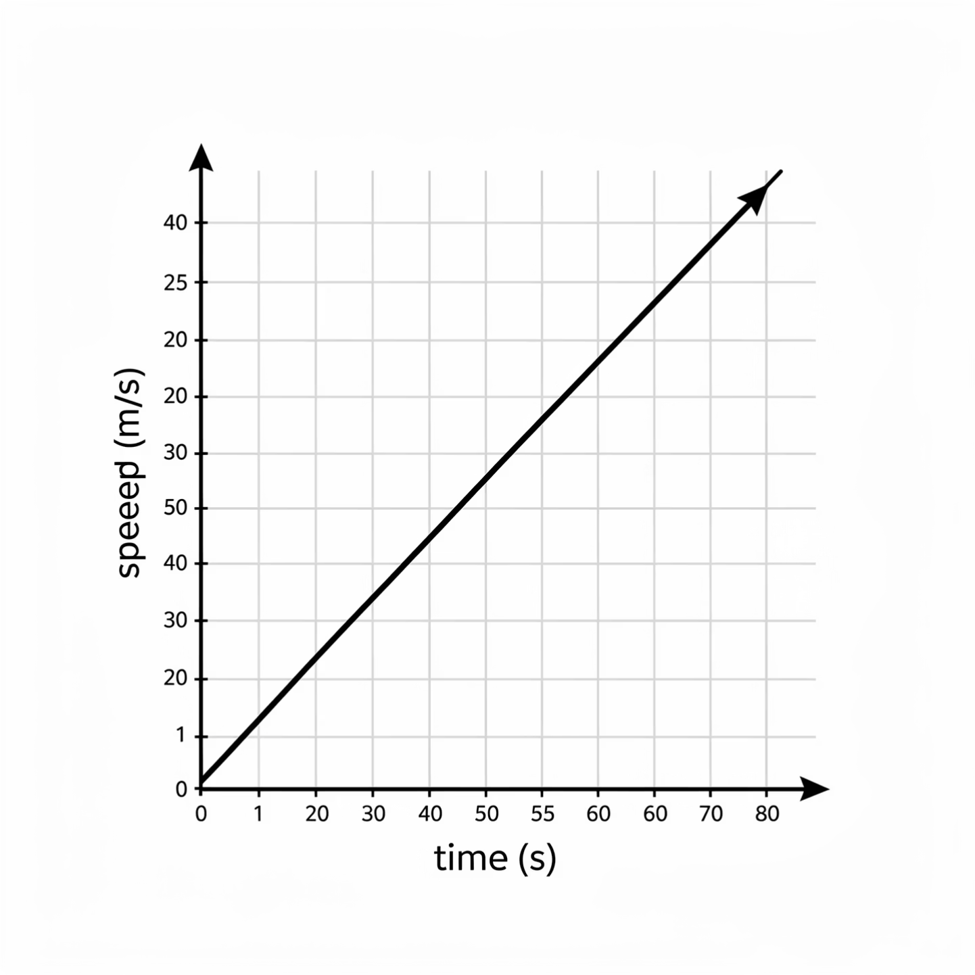
Answer: Deceleration
Did your Expert 3 teach it correctly?
Looks Like
A line sloping downwards from left to right, heading towards the time axis.
Means
The object's speed is decreasing. It is slowing down. It does not mean the object is moving backwards.
Extended Note
Deceleration can be expressed as a negative acceleration. The gradient of the line will give a negative value for a.

Slide 14
Check: Feature 4
EXTENDED ONLY
Q4
Two Questions for Your Group
What does the area under the line represent on a speed-time graph?
How do you calculate it for a complex journey with changing speeds?
Random call...
Think about the shapes you can identify between the line and the time axis. How would you find the area of each one?

Slide 15
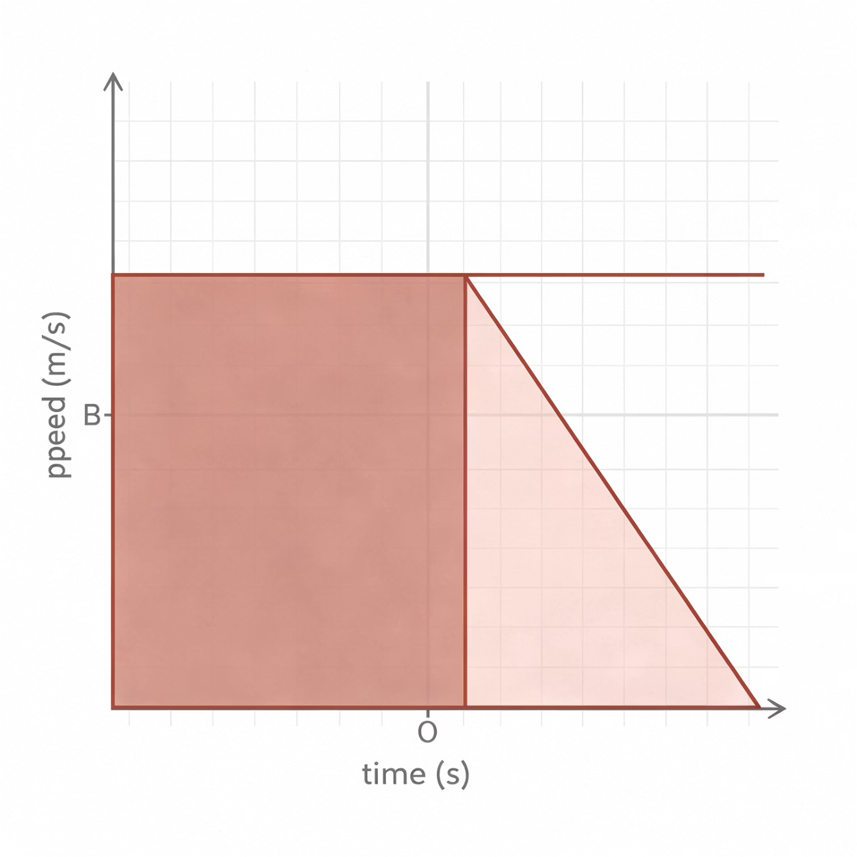
Answer: Area = Distance
EXTENDED ONLY
Did your Expert 4 teach it correctly?
Represents
The area between the line and the time axis equals the total distance travelled by the object.
How to Calculate
Split the region under the line into simple shapes: triangles and rectangles. Calculate the area of each shape separately, then add them all together.
Key Formulae
Rectangle: base x height. Triangle: 0.5 x base x height. A trapezium can be split into one of each.

Slide 16

Prove It.
Formative Assessment: Exit Ticket
Silence in the room. Complete all three questions independently on your mini-whiteboards. No discussion until everyone has finished.
1
2
3
Sketch the Journey
Calculate the Acceleration
Interpret the Graph
Draw a speed-time graph for a car that accelerates from rest, travels at constant speed, and then brakes to a complete stop. Label each section.
An object accelerates from 0 to 15 m/s in 3 seconds. Calculate the acceleration. Include the correct unit in your answer.
What does a horizontal line mean on a speed-time graph? Write your answer in a full sentence.

