Slide 1
CAMBRIDGE IGCSE PHYSICS 0625 · 1.1 · CORE
Measuring length and volume: read it right
Choose the right instrument, read its scale square to the eye, and record a number with its unit.
TheLucidSTEM · Teachers’ Portal

Slide 2
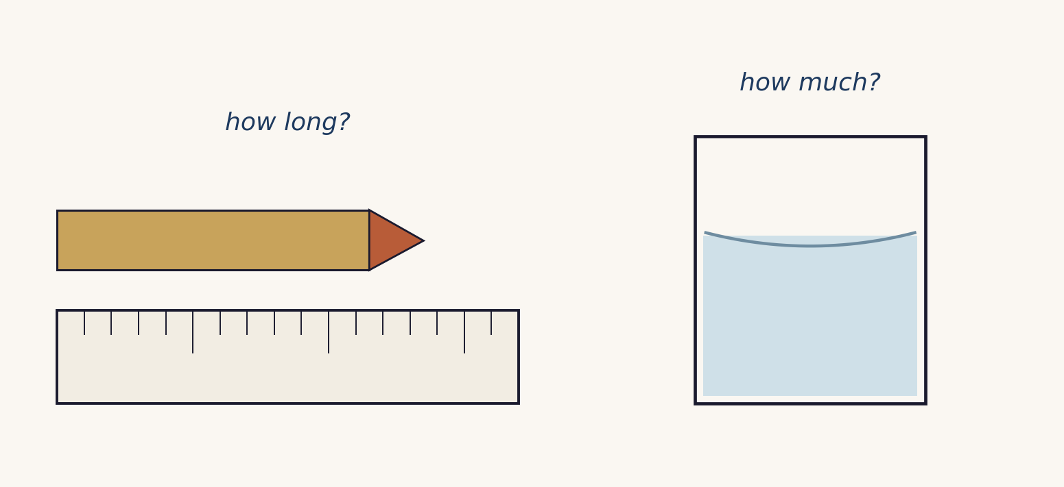
HOOK · THINK, PAIR, SHARE
Exactly how long, exactly how much?
Look at the pencil on the rule and the water in the beaker.
Write one answer for each, then compare with a partner.
A measurement is a number and a unit, and it depends on how you read the scale.
02 / Measurement / 1.1

Slide 3
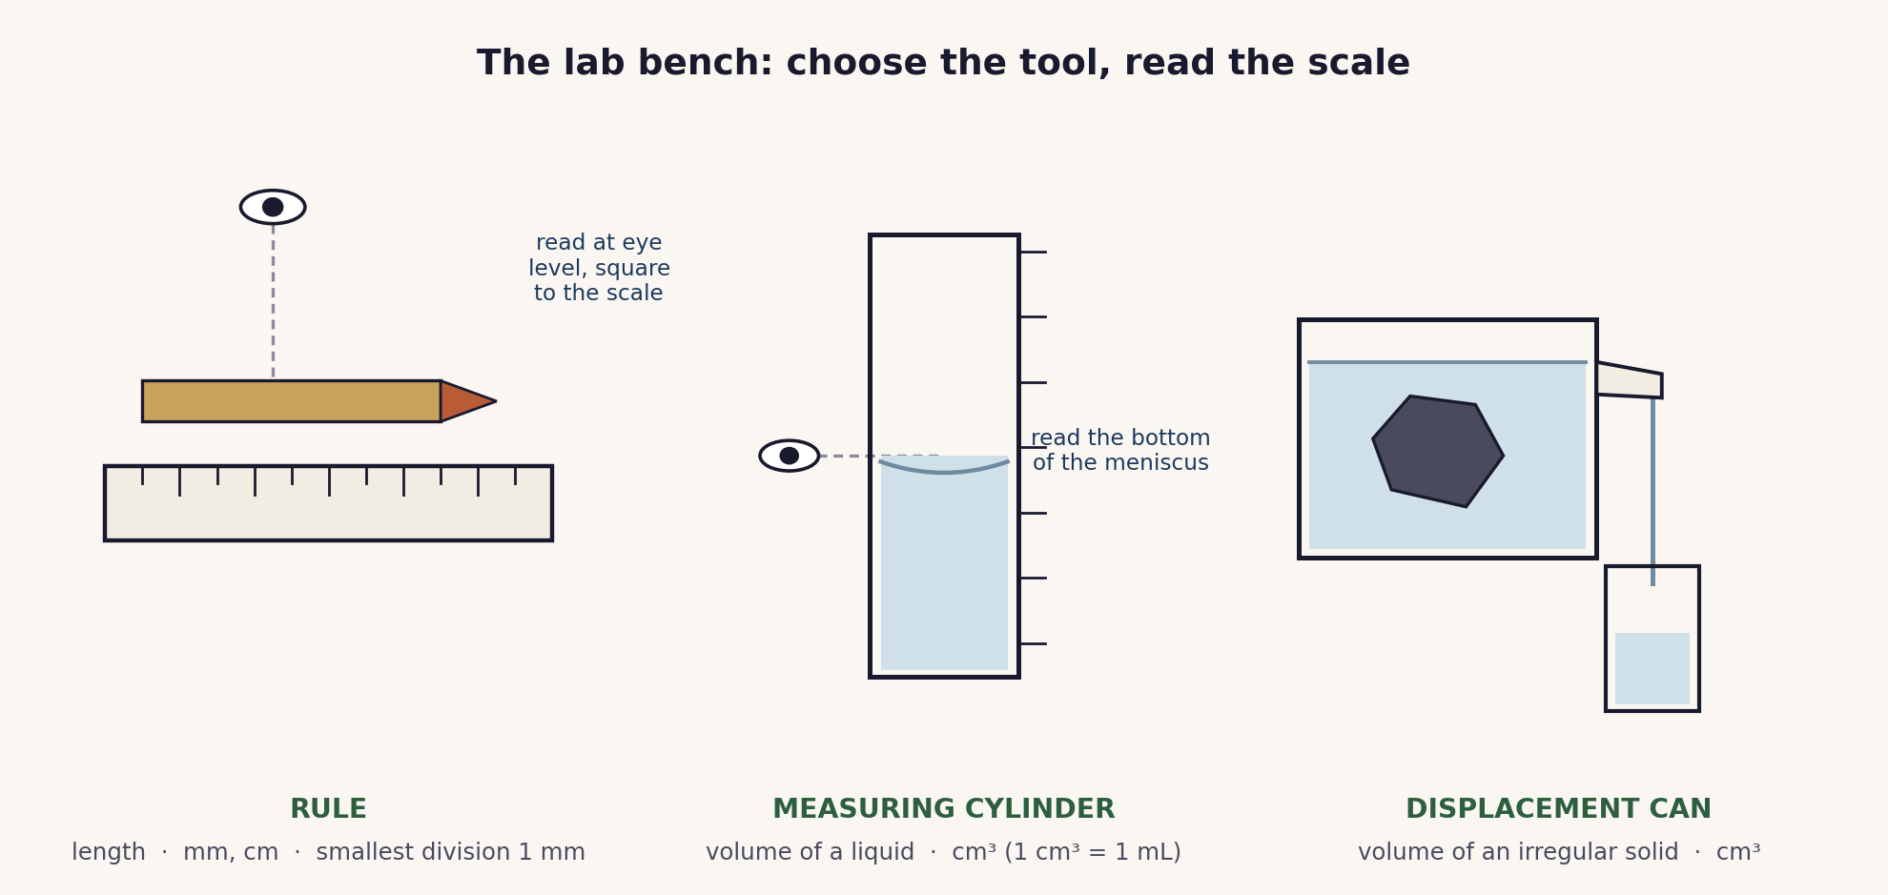
THE CORE MODEL
The lab bench: choose the tool, read the scale
Every reading is a number with its unit. Accuracy comes from the smallest division and reading square to the scale, not from the size of the instrument.
03 / Measurement / 1.1

Slide 4
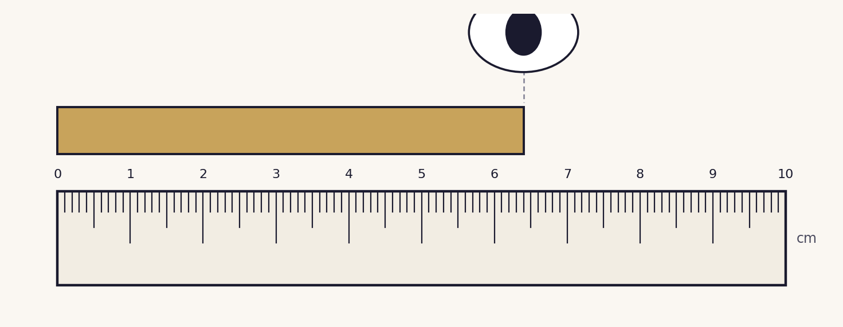
READING A RULE
Read at eye level, to the nearest mm
Line the object up with the zero mark.
Look straight down, square to the scale, to avoid parallax.
Read to the nearest millimetre, then write value = number + unit.
04 / Measurement / 1.1

Slide 5
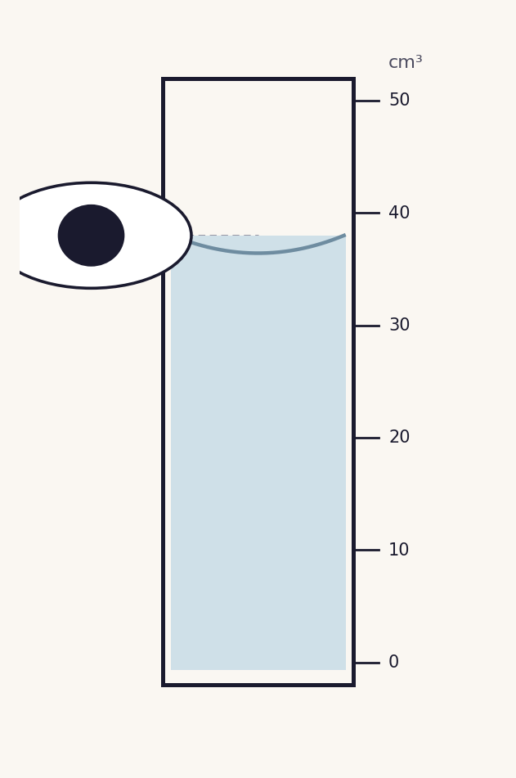
READING A MEASURING CYLINDER
Read the bottom of the meniscus
The liquid surface curves up at the edges: this is the meniscus.
Put your eye level with the liquid and read the bottom of the curve.
Volume is measured in cm³. 1 cm³ = 1 mL.
05 / Measurement / 1.1

Slide 6
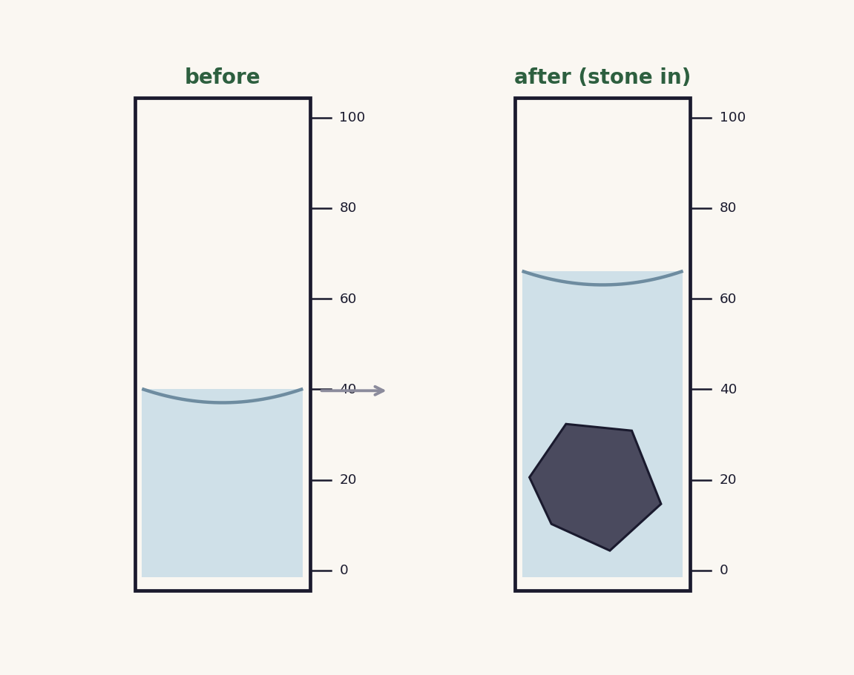
VOLUME OF AN IRREGULAR SOLID
Find the volume by displacement
Lower the solid gently into a measuring cylinder of water.
Volume of the solid = final reading minus first reading.
Here: 66 − 40 = 26 cm³.
Keep it fully submerged, with no trapped air.
06 / Measurement / 1.1

Slide 7
UNITS AND PREFIXES
Keep the units straight
Length
10 mm = 1 cm
100 cm = 1 m
1000 m = 1 km
Volume
1 cm³ = 1 mL
1000 cm³ = 1 dm³ = 1 litre
so 250 cm³ = 0.25 dm³
Every measurement is a number and a unit. A number on its own is not an answer.
07 / Measurement / 1.1

Slide 8
COOPERATIVE PRACTICE
Measurement carousel
Station 1
Length: a block, and a curved edge with string. Read square, to the nearest mm.
Station 2
Volume of a liquid: read the bottom of the meniscus, in cm³.
Station 3
Volume of a stone: by displacement. Volume = final minus first reading.
Rotate on the signal. Record every value with its unit on the carousel sheet.
Compare with another pair, then any of you may be called to report a reading.
08 / Measurement / 1.1

Slide 9
EXAMINER TRAPS
Four traps to avoid
Parallax
Read square to the scale, at eye level, to the nearest division.
Size is not accuracy
A mm rule beats a cm rule. Accuracy is the smallest division, not length.
The meniscus
Read the bottom of the curve, eye level with the liquid.
No bare numbers
Every value is a number and a unit. Write both, every time.
09 / Measurement / 1.1

Slide 10
PLENARY · EXIT TICKET
Show what you know
1. Read the rule and the measuring cylinder on the board. State each value with its unit.
2. How do you read a measuring cylinder correctly, and why at eye level?
Self-check: I can ...
choose the right instrument · read a scale square to the eye · record a number with its unit
10 / Measurement / 1.1

Slide 11
value = number + unit
Accuracy comes from the smallest division, not the size of the instrument.
TheLucidSTEM · created by the TheLucidSTEM team

