Slide 1
CAMBRIDGE IGCSE PHYSICS 0625 · 1.1 · CORE
Measuring time: measure many, then divide
Reduce error by measuring many and dividing, from the period of a pendulum to the thickness of one sheet of paper.
TheLucidSTEM · Teachers’ Portal

Slide 2
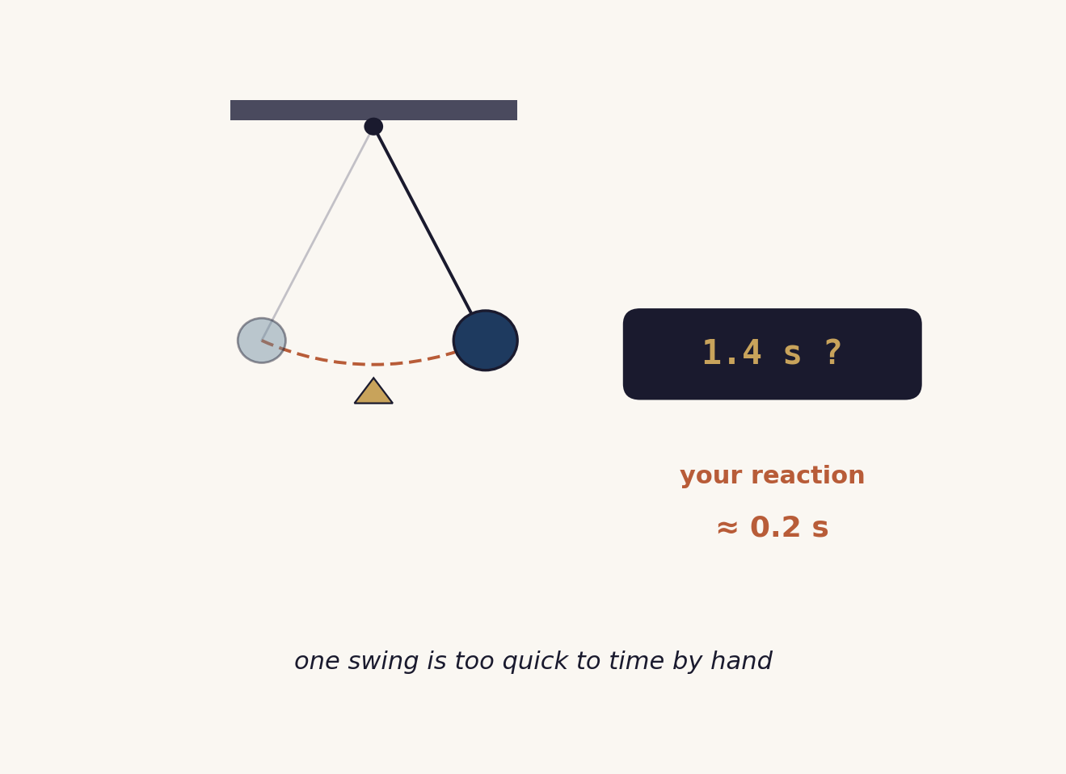
HOOK · THINK, PAIR, SHARE
Time one swing?
Watch the teacher try to time a single swing with a stopwatch.
One swing lasts only about a second, but your reaction adds about 0.2 s each time you start or stop.
In pairs: how could we get a far better value?
02 / Measuring time / 1.1

Slide 3
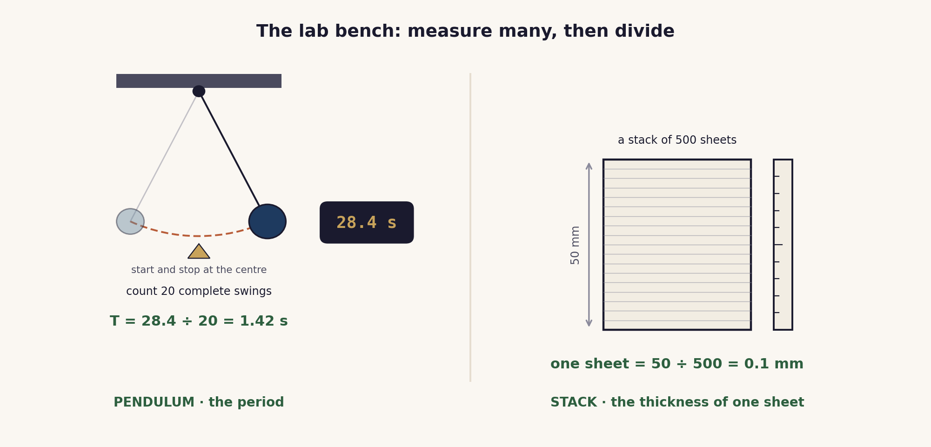
THE CORE MODEL
Measure many, then divide
The reaction-time error sits on the whole timing, so dividing the total by the number of swings shares it out and shrinks it.
03 / Measuring time / 1.1

Slide 4
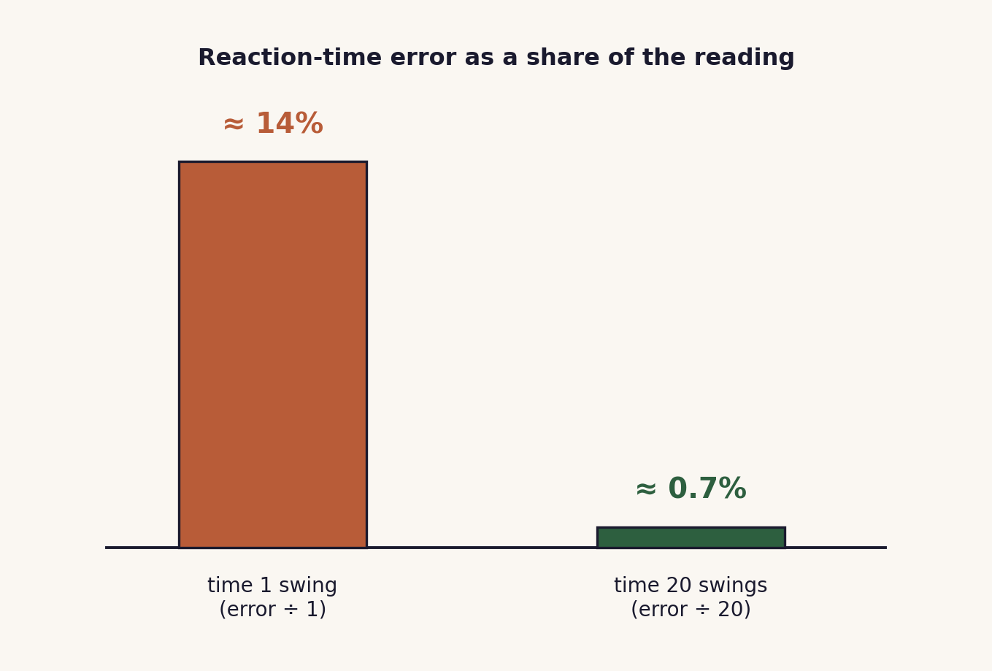
WHY IT WORKS
Divide the count, divide the error
The error happens once on starting and once on stopping.
That error is about the same whether you time 1 swing or 20.
Dividing the total by 20 divides the error by 20 too.
04 / Measuring time / 1.1

Slide 5
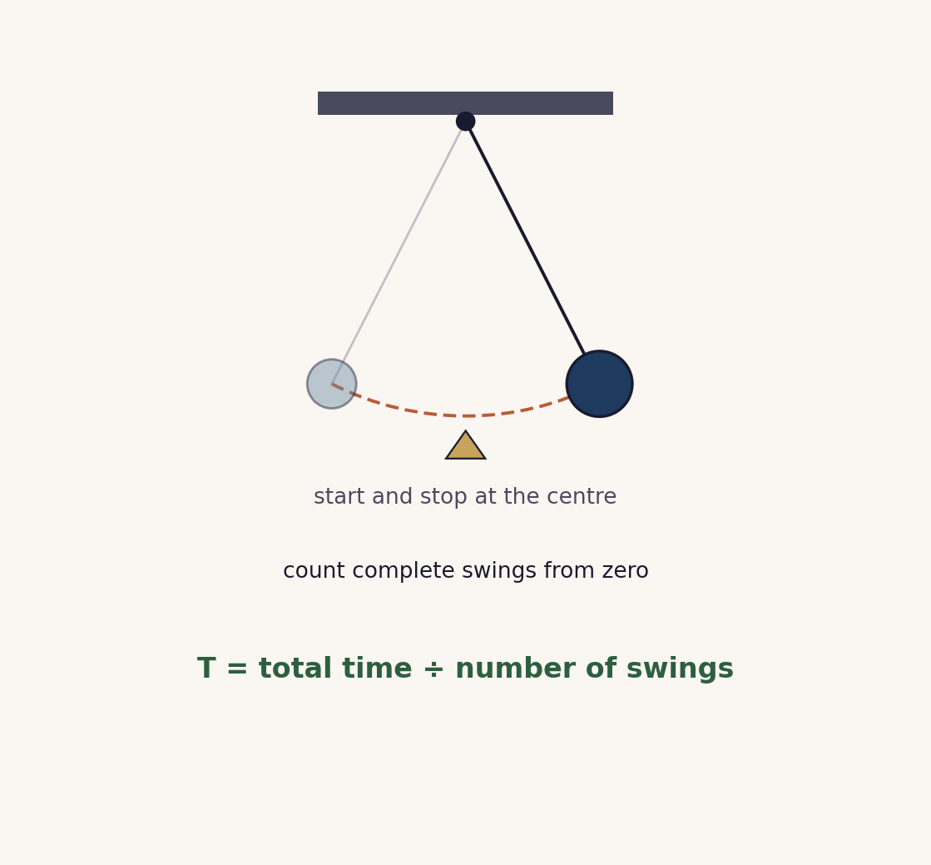
TIMING A PENDULUM WELL
Count, then divide
Start the stopwatch as the bob passes the centre, where it moves fastest.
Count complete swings from zero, not from one.
Time 20 swings, then divide: T = total ÷ 20.
Repeat and compare to reduce the random error.
05 / Measuring time / 1.1

Slide 6
COOPERATIVE PRACTICE
Numbered Heads Together
1 Number off
Each of the four in a group takes a number.
2 Think alone
How would you measure this small quantity, and what is the calculation?
3 Heads together
Agree one method and one calculation. Everyone must be able to explain it.
4 Random call
A number is called. That learner speaks for the group.
Challenges: the thickness of one sheet · the time for one drip · the diameter of one bead.
06 / Measuring time / 1.1

Slide 7
WORKED EXAMPLE
From a count to one value
Pendulum period
20 swings take 29.0 s
T = 29.0 ÷ 20
T = 1.45 s
Thickness of one sheet
250 sheets are 25 mm tall
one sheet = 25 ÷ 250
= 0.10 mm
Same rule both times: total ÷ count, with the unit kept on the answer.
07 / Measuring time / 1.1

Slide 8
EXAMINER TRAPS
Four traps to avoid
Timing a single event
Reaction time dominates one short reading. Time many and divide.
Counting from one
Count complete swings from zero. One swing is there and back.
Stopping at the end of the swing
Start and stop at the centre, where the bob moves fastest.
Forgetting to divide
Period = total ÷ number of swings. Keep the unit on the answer.
08 / Measuring time / 1.1

Slide 9
PLENARY · EXIT TICKET
Show what you know
1. A pendulum takes 30.0 s for 20 complete swings. Find the period.
2. Explain in one sentence why timing 20 swings is better than timing one.
Self-check: I can ...
measure a time interval · use measure many, then divide · say why it is more accurate
09 / Measuring time / 1.1

Slide 10
measure many, then divide
The same start-and-stop error, shared across the whole count, becomes small.
TheLucidSTEM · created by the TheLucidSTEM team

