Slide 1
CAMBRIDGE IGCSE PHYSICS 0625 · 1.1 · EXTENDED
Resultant vectors: 3 and 4 make 5, not 7
Combine two perpendicular vectors into a single resultant, by scale drawing and by calculation, with a magnitude and a direction.
TheLucidSTEM · Teachers’ Portal

Slide 2
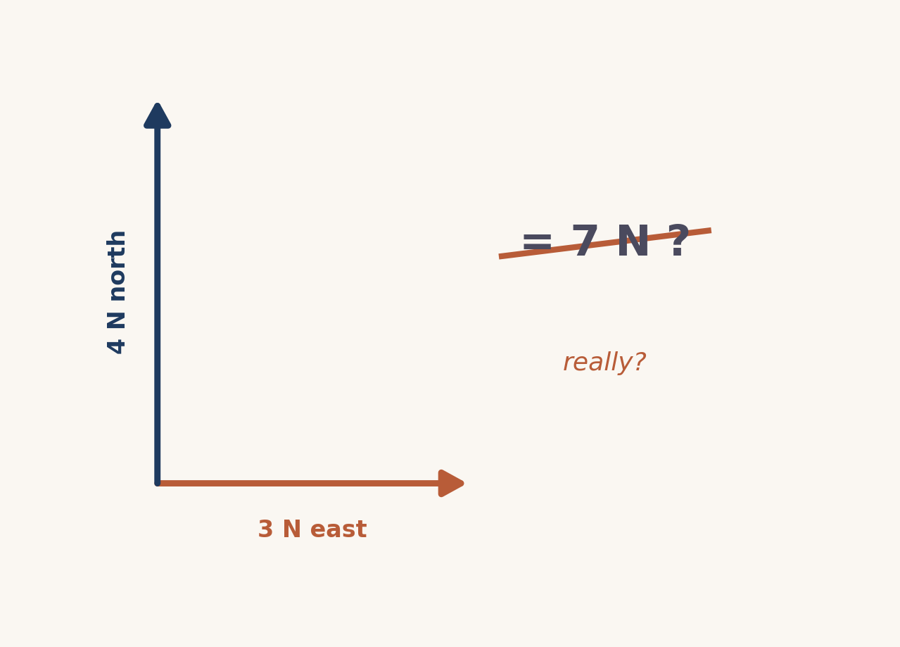
HOOK · THINK, PAIR, SHARE
3 N east, 4 N north. One force?
Two forces pull on the same point at right angles.
What single force would have the same effect?
Write your prediction, then compare with a partner.
02 / Resultant vectors / 1.1 S

Slide 3
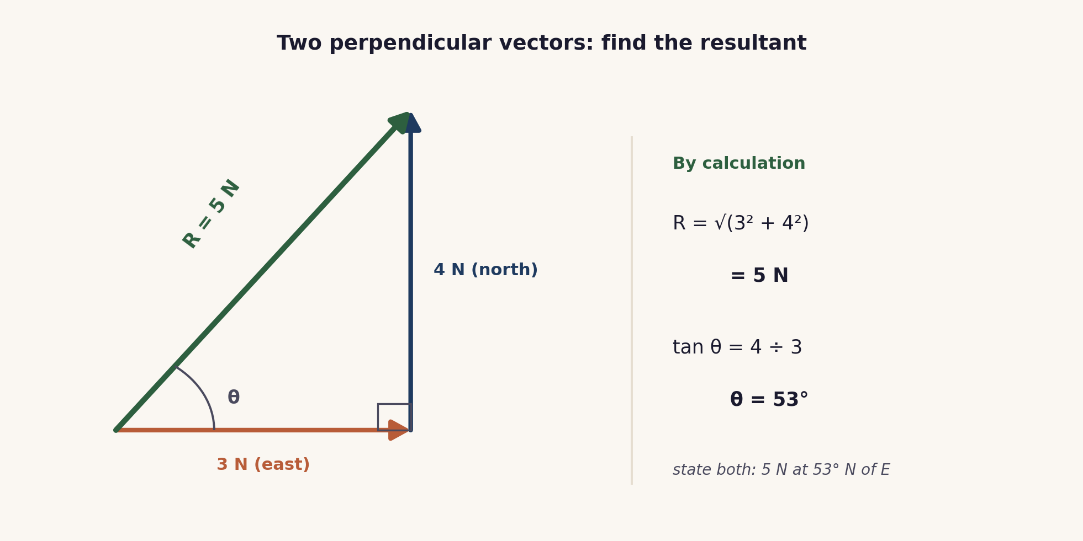
THE CORE MODEL
The vector triangle
Join the vectors tip to tail. The resultant runs from the start of the first to the tip of the second.
03 / Resultant vectors / 1.1 S

Slide 4
METHOD 1
By scale drawing
Choose a scale and write it down, for example 1 cm to 1 N.
Draw the first vector, then the second from its tip (tip to tail).
Draw the resultant from the start to the final tip.
Measure its length and convert with the scale; measure its angle with a protractor.
Accurate, but only as good as your ruler and protractor.
04 / Resultant vectors / 1.1 S

Slide 5
METHOD 2
By calculation
Magnitude: Pythagoras
R = √(3² + 4²)
R = √25 = 5 N
Direction: the tangent ratio
tan θ = 4 ÷ 3
θ = 53° north of east
A resultant always has both: 5 N at 53° north of east.
05 / Resultant vectors / 1.1 S

Slide 6
COOPERATIVE PRACTICE
Rally Coach
1 A solves
Partner A works the problem aloud, step by step.
2 B coaches
Partner B watches, checks each step, praises and corrects.
3 Swap
Swap roles for the next problem.
4 Check
Every answer carries a magnitude and a direction.
One pencil, one problem set: the coaching is where method slips are caught.
06 / Resultant vectors / 1.1 S

Slide 7
PRACTICE
Clean triples to build fluency
6 N and 8 N R = 10 N
5 N and 12 N R = 13 N
9 N and 12 N R = 15 N
8 N and 15 N R = 17 N
Then find each angle with the tangent ratio.
07 / Resultant vectors / 1.1 S

Slide 8
EXAMINER TRAPS
Four traps to avoid
Adding 3 + 4 = 7
Perpendicular vectors combine by Pythagoras: √(3²+4²)=5.
No direction
A resultant is a vector. State the angle as well as the size.
Wrong sides in tan
tan θ = opposite ÷ adjacent. Mark the angle first.
Unclear reference
Say what the angle is measured from: a bearing or from the horizontal.
08 / Resultant vectors / 1.1 S

Slide 9
PLENARY · EXIT TICKET
Show what you know
1. Two perpendicular forces of 9 N and 12 N act on a point. Find the resultant (magnitude and direction).
2. Explain in one line why 9 N and 12 N do not add to 21 N.
Self-check: I can ...
find a resultant by drawing · by Pythagoras and tan · and give its direction
09 / Resultant vectors / 1.1 S

Slide 10
magnitude and direction
Two perpendicular vectors combine by Pythagoras and the tangent ratio. 3 and 4 make 5, not 7.
TheLucidSTEM · created by the TheLucidSTEM team

