Slide 1
CAMBRIDGE IGCSE PHYSICS 0625 · 1.1 · EXTENDED
Scalars and vectors: a direction, or just a number?
Define a scalar and a vector, and classify quantities by asking one question of each: does it need a direction?
TheLucidSTEM · Teachers’ Portal

Slide 2
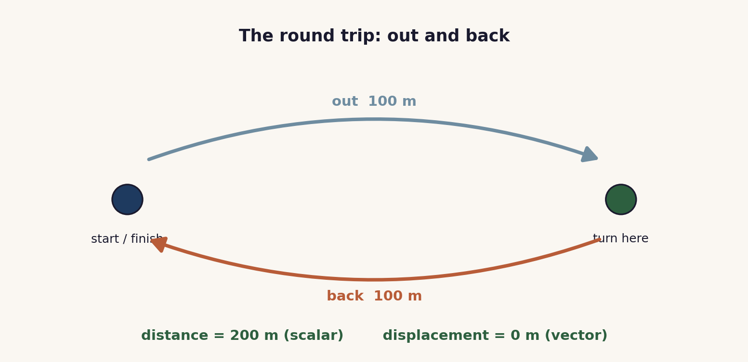
HOOK · THE ROUND TRIP
Same trip, two answers
Open the site simulation The Round Trip Trap (Unit 1). As the journey goes out and back, distance and speed keep climbing, but displacement and velocity carry a direction and fall back to zero. Which quantities need a direction?
02 / Scalars and vectors / 1.1 S

Slide 3
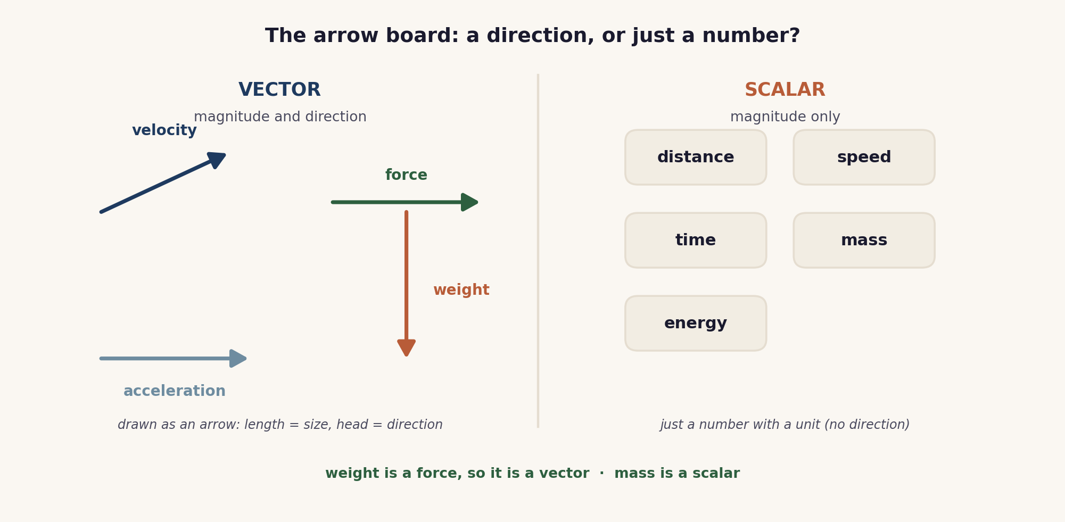
THE CORE MODEL
The arrow board
A vector is an arrow: length is the size, head is the direction. A scalar is just a number with a unit.
03 / Scalars and vectors / 1.1 S

Slide 4
WHY DIRECTION MATTERS
Distance and displacement
Distance is the whole path: a scalar. Here 200 m.
Displacement is start to finish, with direction: a vector. Here 0 m.
Speed is a scalar; velocity is speed with a direction.
04 / Scalars and vectors / 1.1 S

Slide 5
CLASSIFY
Sort by one question
SCALARS
magnitude only
distance · speed · time
mass · energy · temperature
VECTORS
magnitude and direction
displacement · velocity
acceleration · force
weight · momentum
Weight is a force, so it is a vector. Mass is a scalar.
05 / Scalars and vectors / 1.1 S

Slide 6
COOPERATIVE PRACTICE
Quiz-Quiz-Trade
1 Quiz
A asks B: scalar or vector, and why?
2 Quiz back
Swap roles. B asks A the same of their card.
3 Coach
Praise a right answer; coach a wrong one.
4 Trade
Swap cards, find a new partner, repeat.
A reason every time, not just a label. Any learner may be called after the sort.
06 / Scalars and vectors / 1.1 S

Slide 7
CHECKPOINT
Sort eight, then justify
In fours, sort these onto the scalar and vector mat:
distance · velocity · mass · force
time · displacement · energy · weight
A number is called. That learner justifies one placement for the group.
07 / Scalars and vectors / 1.1 S

Slide 8
EXAMINER TRAPS
Four traps to avoid
Speed is not velocity
Speed is a scalar; velocity is speed with a direction.
Distance is not displacement
A round trip has distance, but zero displacement.
Weight is a vector
Weight is a force and acts downwards. Mass is a scalar.
Vectors need a direction
State 5 N to the right, not just 5 N.
08 / Scalars and vectors / 1.1 S

Slide 9
PLENARY · EXIT TICKET
Show what you know
1. Classify: acceleration, mass, displacement, time. (scalar or vector)
2. Explain in one sentence why velocity is a vector but speed is a scalar.
Self-check: I can ...
define scalar and vector · classify a quantity · say why, using direction
09 / Scalars and vectors / 1.1 S

Slide 10
does it need a direction?
Yes: it is a vector, drawn as an arrow. No: it is a scalar, just a number with a unit.
TheLucidSTEM · created by the TheLucidSTEM team

