Slide 1
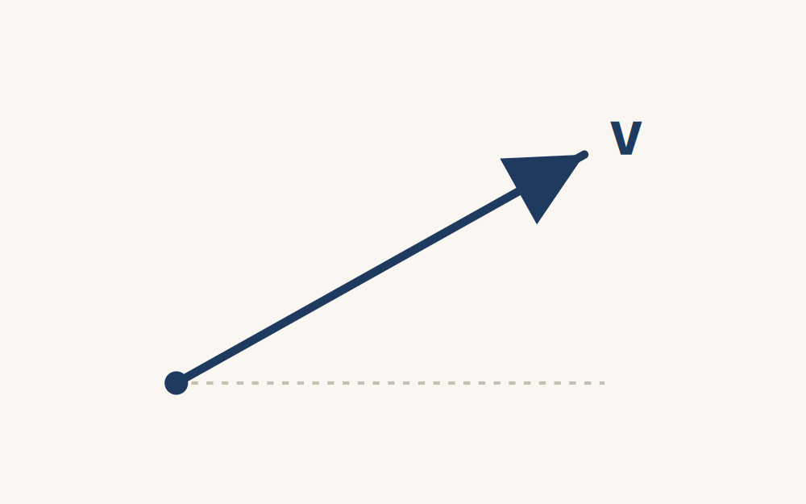
CAMBRIDGE IGCSE PHYSICS 0625 · 1.2 · CORE
Speed and velocity: how fast, and which way?
Define speed and velocity, and use v = s ÷ t fluently, including changing km/h to m/s.
TheLucidSTEM · Teachers’ Portal

Slide 2
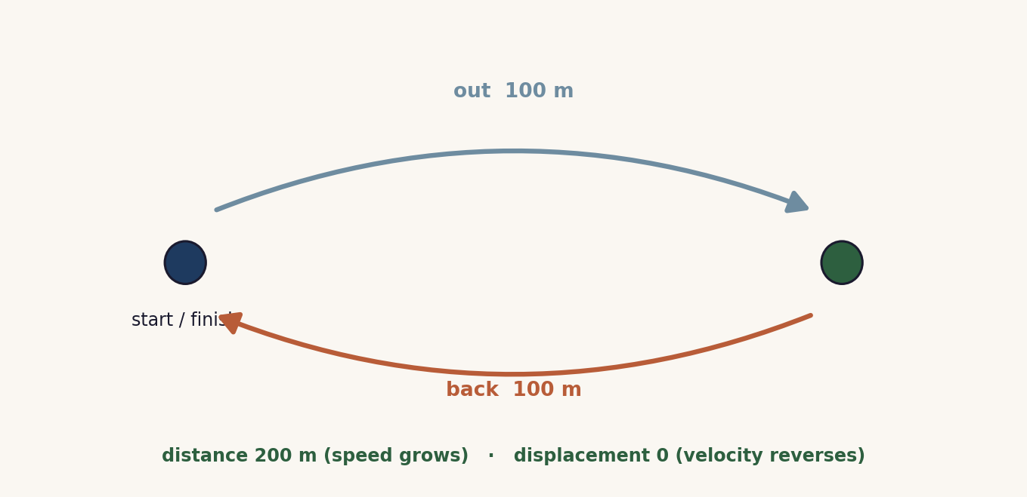
HOOK · THE ROUND TRIP
How fast, and which way?
Open the site simulation The Round Trip Trap (Unit 1). On a journey out and back, distance and average speed keep rising, but velocity carries a direction and reverses. What is speed, and how is velocity different?
02 / Speed and velocity / 1.2

Slide 3
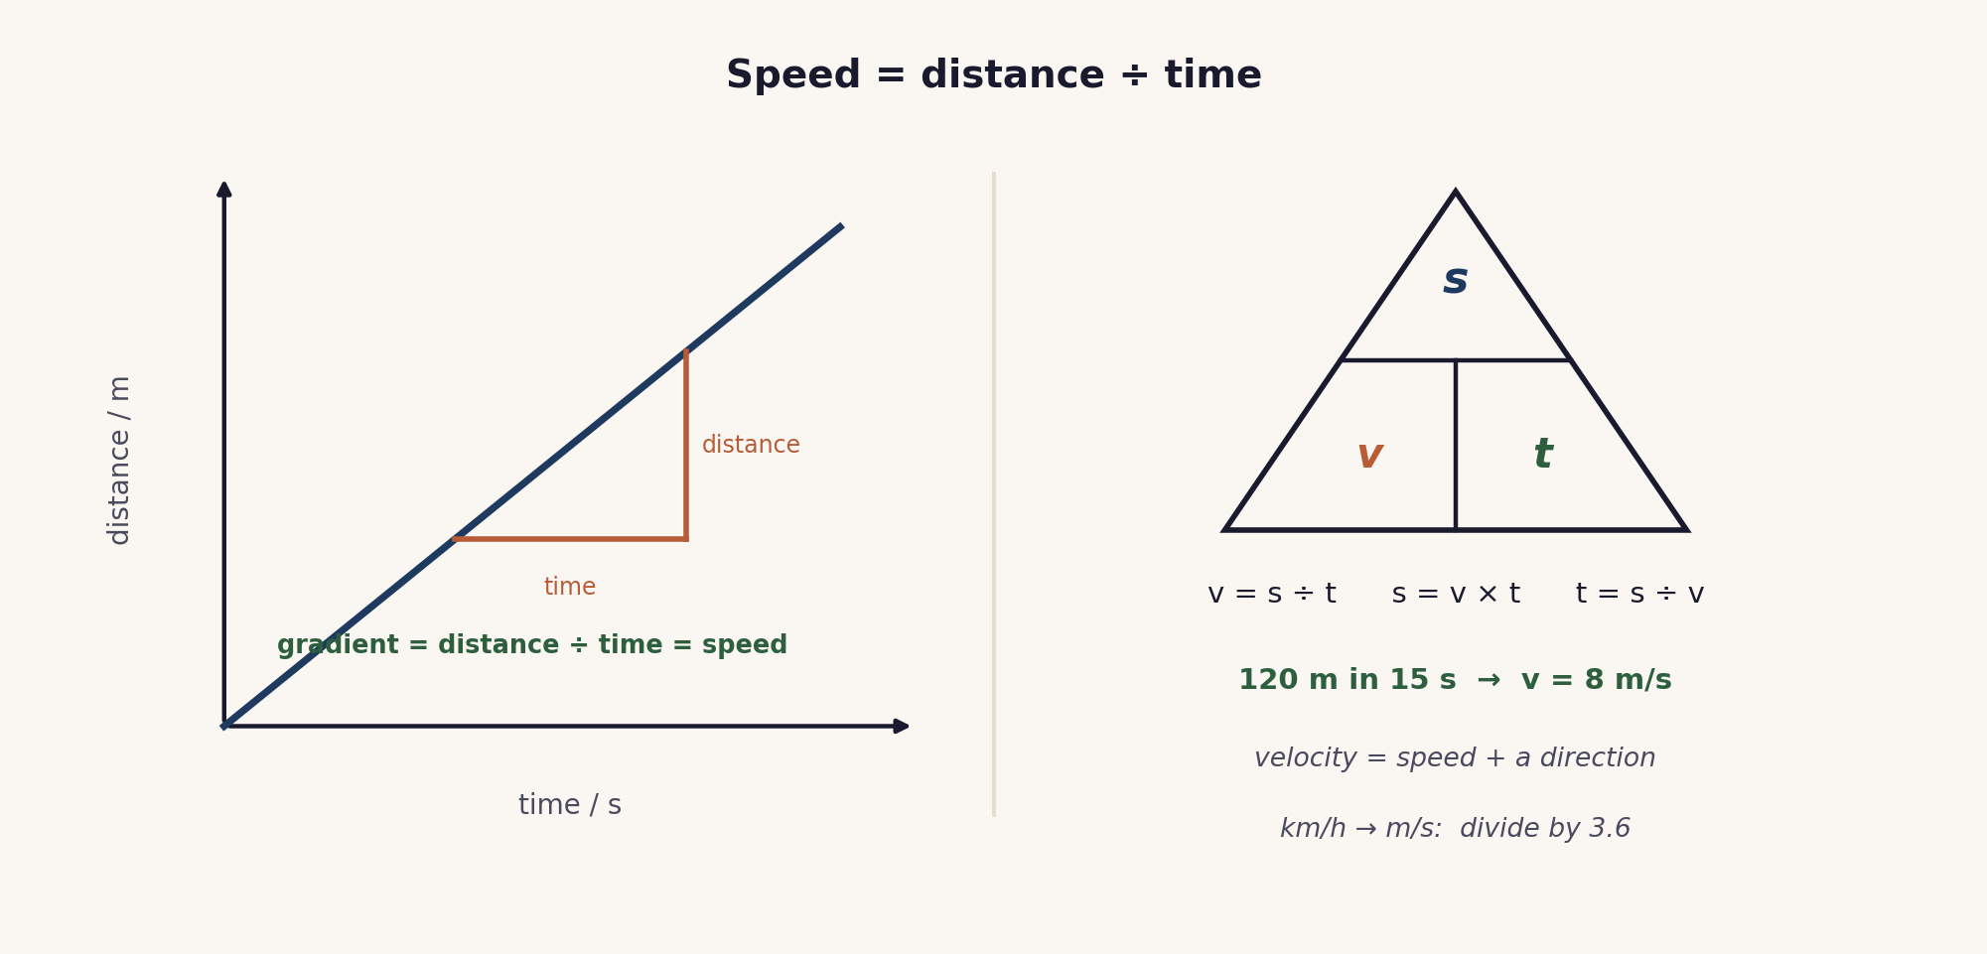
THE CORE TOOL
Speed = distance ÷ time
On a distance-time graph the gradient is the speed. The triangle rearranges v = s ÷ t.
03 / Speed and velocity / 1.2

Slide 4
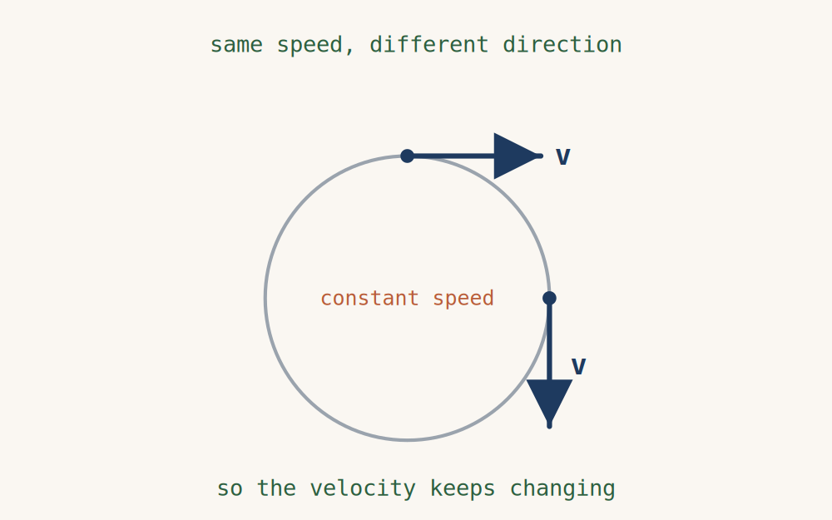
VELOCITY
Speed with a direction
Speed is a scalar: how fast only.
Velocity is a vector: speed in a stated direction, for example 8 m/s due east.
A car at a steady speed around a roundabout still has a changing velocity, because its direction changes.
04 / Speed and velocity / 1.2

Slide 5
UNITS
km/h and m/s
km/h → m/s
divide by 3.6
72 km/h = 20 m/s
m/s → km/h
multiply by 3.6
15 m/s = 54 km/h
The m/s value is always the smaller number, a quick sanity check.
05 / Speed and velocity / 1.2

Slide 6
WATCH OUT
Average speed is not the mean
Average speed = total distance ÷ total time.
600 m in 30 s, then 600 m in 60 s:
total = 1200 m in 90 s, so average speed = 13.3 m/s.
Not (20 + 10) ÷ 2 = 15 m/s. Add distances, add times, then divide.
06 / Speed and velocity / 1.2

Slide 7
COOPERATIVE PRACTICE
Rally Coach
1 A solves
Partner A works the calculation aloud, step by step.
2 B coaches
Partner B watches, checks each step, praises and corrects.
3 Swap
Swap roles for the next problem.
4 Units
Every answer carries its unit, m/s or m or s.
Full step-by-step facilitation, roles and teacher script: see the Rally Coach activity in this bundle.
07 / Speed and velocity / 1.2

Slide 8
EXAMINER TRAPS
Four traps to avoid
No direction on velocity
8 m/s is a speed; 8 m/s due east is a velocity.
Dropping or mixing units
Convert to m and s first; write the unit every step.
Averaging two speeds
Average speed = total distance ÷ total time.
Wrong way on conversion
km/h to m/s: divide by 3.6. m/s to km/h: multiply.
08 / Speed and velocity / 1.2

Slide 9
PLENARY · EXIT TICKET
Show what you know
1. A cyclist travels 180 m in 12 s. Find the speed.
2. Change 54 km/h into m/s.
3. In one line, why does velocity need a direction?
Self-check: I can ...
use v = s ÷ t · convert km/h and m/s · say how velocity differs from speed
09 / Speed and velocity / 1.2

Slide 10
how fast, and which way
Speed is distance ÷ time. Velocity is speed with a direction. Keep the units, every step.
TheLucidSTEM · created by the TheLucidSTEM team

