Slide 1
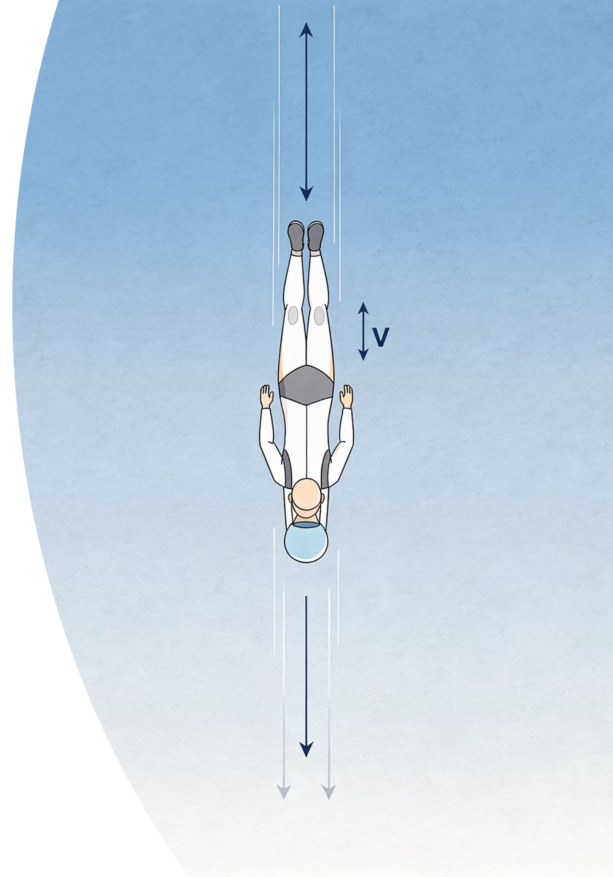
Terminal Velocity
When the Forces Balance
Cambridge IGCSE Physics 0625 | Extended / Supplement Level
THELUCIDSTEM.COM

Slide 2
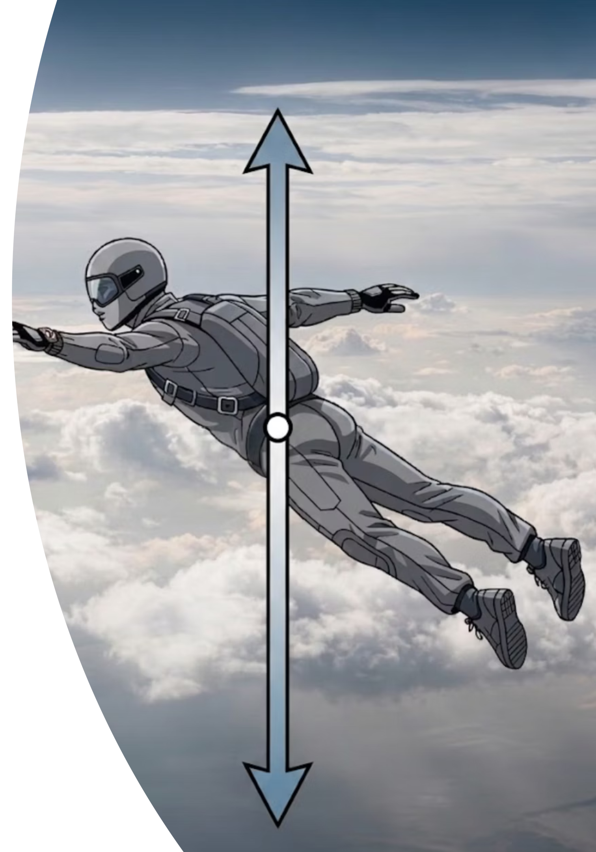

Predict: The Skydiver's Fall
Your Task
Coming Up
Look at the Anticipation Guide on your desk. Work through each statement on your own before we discuss anything as a class.
Once everyone has made their predictions, we will watch the simulation on the board to test your thinking. There are no wrong answers at this stage. What matters is that you commit to a position and are ready to justify it later.
Read all 6 statements about a falling skydiver carefully.
Tick Agree or Disagree in the Anticipation column.
Do not discuss with your partner yet. Trust your instincts.
Keep your Anticipation Guide safe. You will need it again in a few minutes.
thelucidstem.com

Slide 3
Topic
Terminal Velocity
By the end of this Extended lesson, you will be able to meet every objective below. These map directly onto IGCSE mark-scheme language, so read them carefully.
Describe the Motion
Explain with Forces
Describe how the speed of an object falling through a fluid changes over time from rest to terminal velocity.
Explain, using forces, why a falling object accelerates at first and then reaches a constant velocity.
State the Condition
Sketch and Interpret
State that at terminal velocity, air resistance equals weight, so the resultant force and acceleration are both zero.
Sketch and interpret the speed-time graph for an object reaching terminal velocity, including after a parachute opens.
thelucidstem.com

Slide 4

Core Concept
The Force Balance Story
Two forces act on every falling object: Weight (always downward, due to gravity) and Air Resistance (always upward, opposing motion). Their relative sizes change everything.
The Jump
Speeding Up
Terminal Velocity
Speed is zero, so air resistance is zero. The resultant force equals the full weight. Acceleration is at its maximum: g = 10 m/s².
As speed increases, air resistance increases. The resultant force gets smaller. Acceleration continues but at a decreasing rate.
Air resistance grows until it exactly equals weight. Resultant force is zero. By Newton's First Law, acceleration is zero: constant velocity.
Key equation: at terminal velocity, Weight = Air Resistance, therefore Resultant Force = 0, therefore Acceleration = 0.
thelucidstem.com

Slide 5
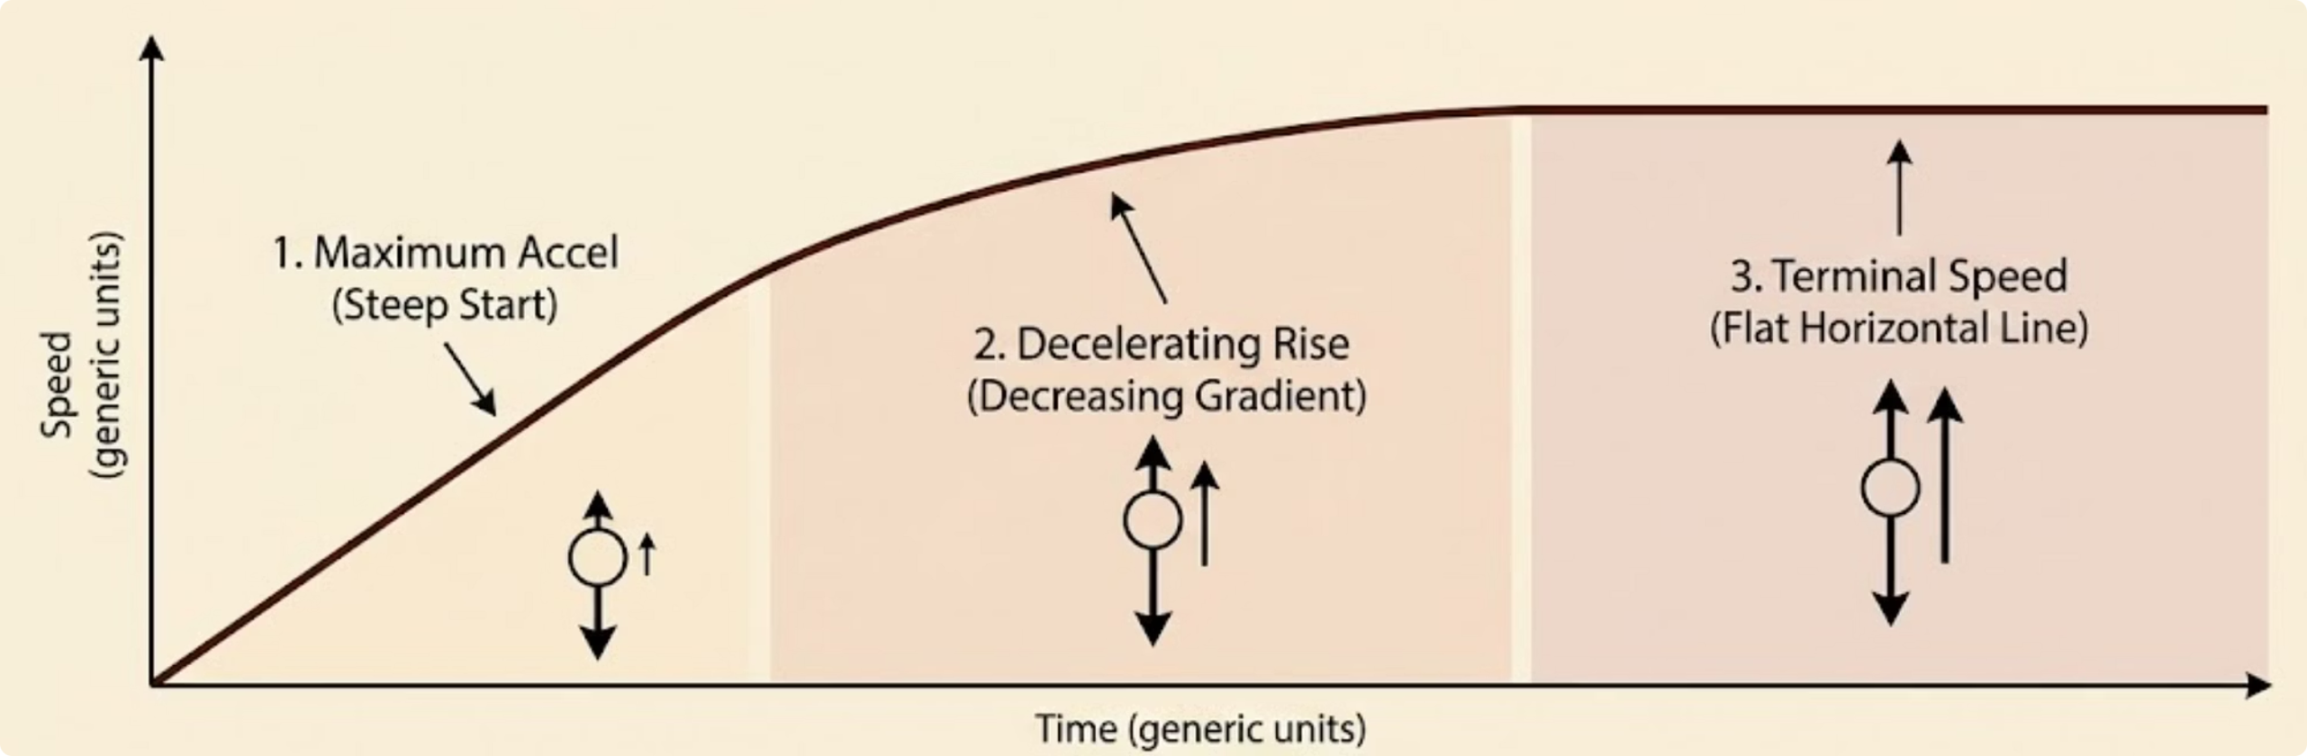
Reading the Evidence
The Speed-Time Graph
The shape of the speed-time graph is a visual record of how the resultant force changes throughout the fall. Every feature carries physical meaning that you must be able to explain in words.
Steep Start
Decreasing Gradient
Flat Horizontal Line
Large gradient means large acceleration. Air resistance is still very small compared to weight.
The curve is getting shallower. Air resistance is growing, so the resultant force and acceleration are both falling.
Zero gradient means zero acceleration. Air resistance now equals weight. This is terminal velocity.
thelucidstem.com

Slide 6
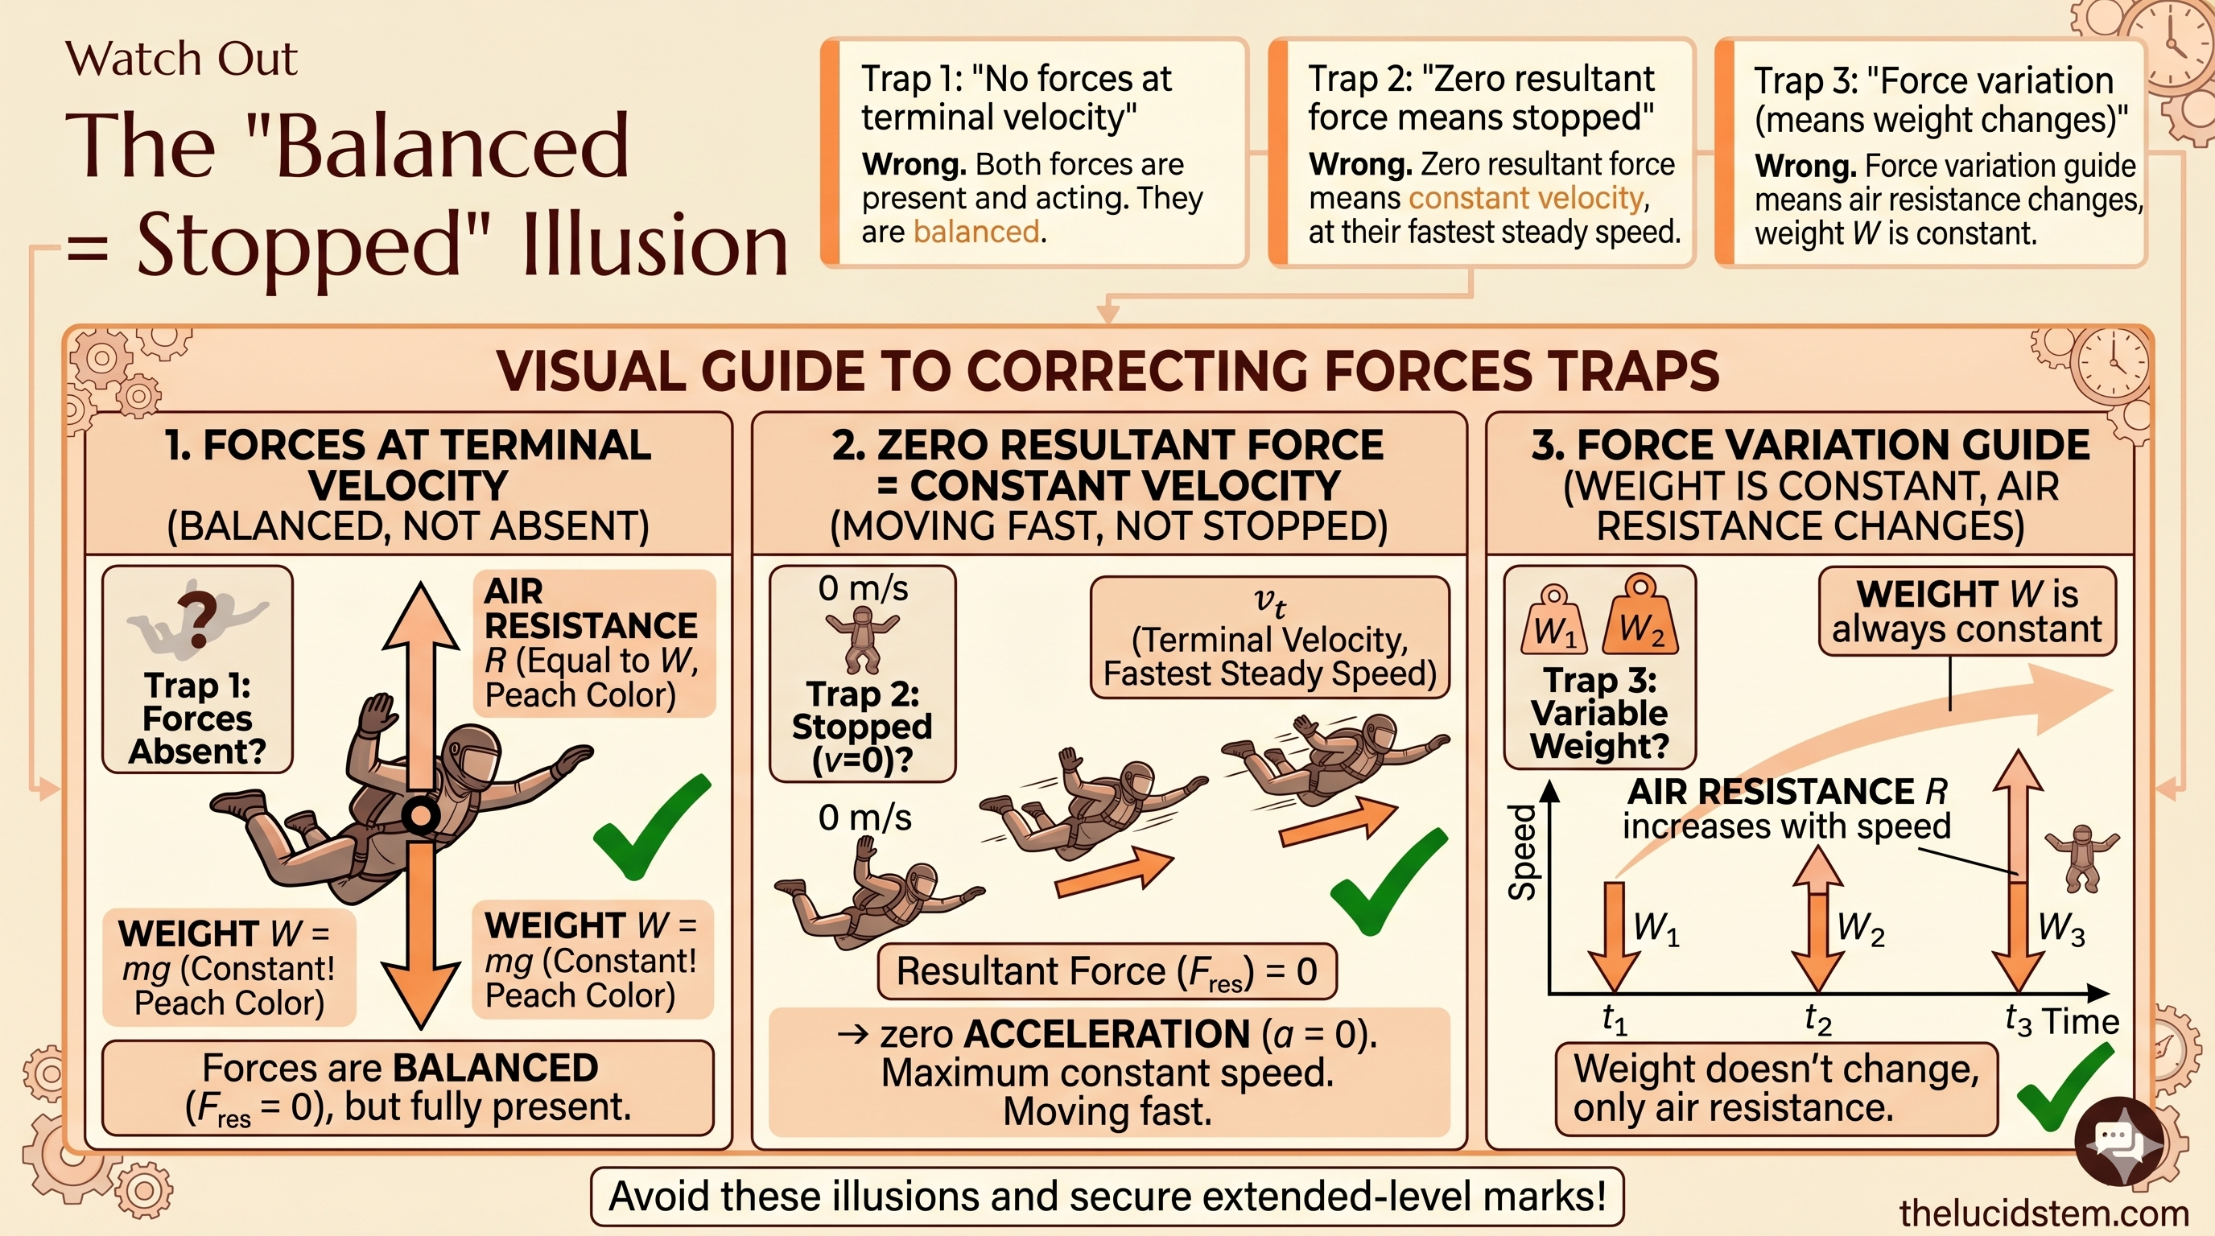

Slide 7

Active Learning
Cooperative Task: The Reaction Round
The Protocol
Key Vocabulary You Must Use
Return to your Anticipation Guide and work in pairs.
Fill in the Reaction column: Agree or Disagree NOW, after the lesson input?
For every statement, write a one-line reason using precise force vocabulary.
Be ready: pairs will be called on at random to explain their reasoning aloud.
Weight
Air Resistance
Resultant Force
Acceleration
Vague answers such as "it slows down" will not score marks. Always link force to acceleration to motion.
thelucidstem.com

Slide 8
Q1
Reaction 1: The Jump
"The moment the skydiver jumps, the air resistance on them is zero."
Discuss with your partner. You have 45 seconds. Do you Agree or Disagree? What is your exact force reason?
thelucidstem.com

Slide 9

Reaction 1
Answer: The Jump
AGREE. This statement is correct.
The Reasoning
In Mark-Scheme Language
At the exact moment of the jump, the skydiver's speed is zero. Air resistance depends on speed: no speed means no air resistance. Therefore, only the downward force of weight acts on the skydiver at this instant, and their acceleration equals g.
Speed = 0 at the instant of jumping.
Air resistance = 0 because there is no relative motion through the air yet.
Resultant force = Weight (downward only).
Acceleration = maximum, equal to g (approximately 10 m/s²).
thelucidstem.com

Slide 10
Q2
Reaction 2: Speeding Up
"The skydiver keeps speeding up at the same rate all the way down."
Discuss with your partner. You have 45 seconds. Do you Agree or Disagree? What is your exact force reason?
thelucidstem.com

Slide 11

Reaction 2
Answer: Speeding Up
DISAGREE. This statement is incorrect.
The Reasoning
In Mark-Scheme Language
As the skydiver speeds up, air resistance increases with speed. This means the resultant force (Weight minus Air Resistance) gets smaller. A smaller resultant force produces a smaller acceleration. The skydiver is still speeding up, but at a decreasing rate, not a constant one.
As speed increases, air resistance increases.
Resultant force = Weight minus Air Resistance, so resultant force decreases.
By F = ma, if F decreases and m is constant, then a decreases.
The gradient of the speed-time graph is getting shallower over time.
thelucidstem.com

Slide 12
Q3
Reaction 3: Terminal Velocity
"At terminal velocity, the skydiver has stopped moving."
Discuss with your partner. You have 45 seconds. Do you Agree or Disagree? What is your exact force reason?
thelucidstem.com

Slide 13
Reaction 3
Answer: Terminal Velocity
DISAGREE. This is the most common misconception in the topic.
The Reasoning
In Mark-Scheme Language
At terminal velocity, air resistance has grown until it exactly equals weight. The resultant force is zero. A zero resultant force means zero acceleration, which by Newton's First Law means the skydiver continues at a constant velocity. They are falling at their maximum steady speed, not stationary.
Air resistance = Weight, therefore Resultant force = 0.
Zero resultant force means zero acceleration (Newton's First Law).
Zero acceleration means constant velocity, NOT zero velocity.
The skydiver is moving at their maximum steady speed downward.
thelucidstem.com

Slide 14
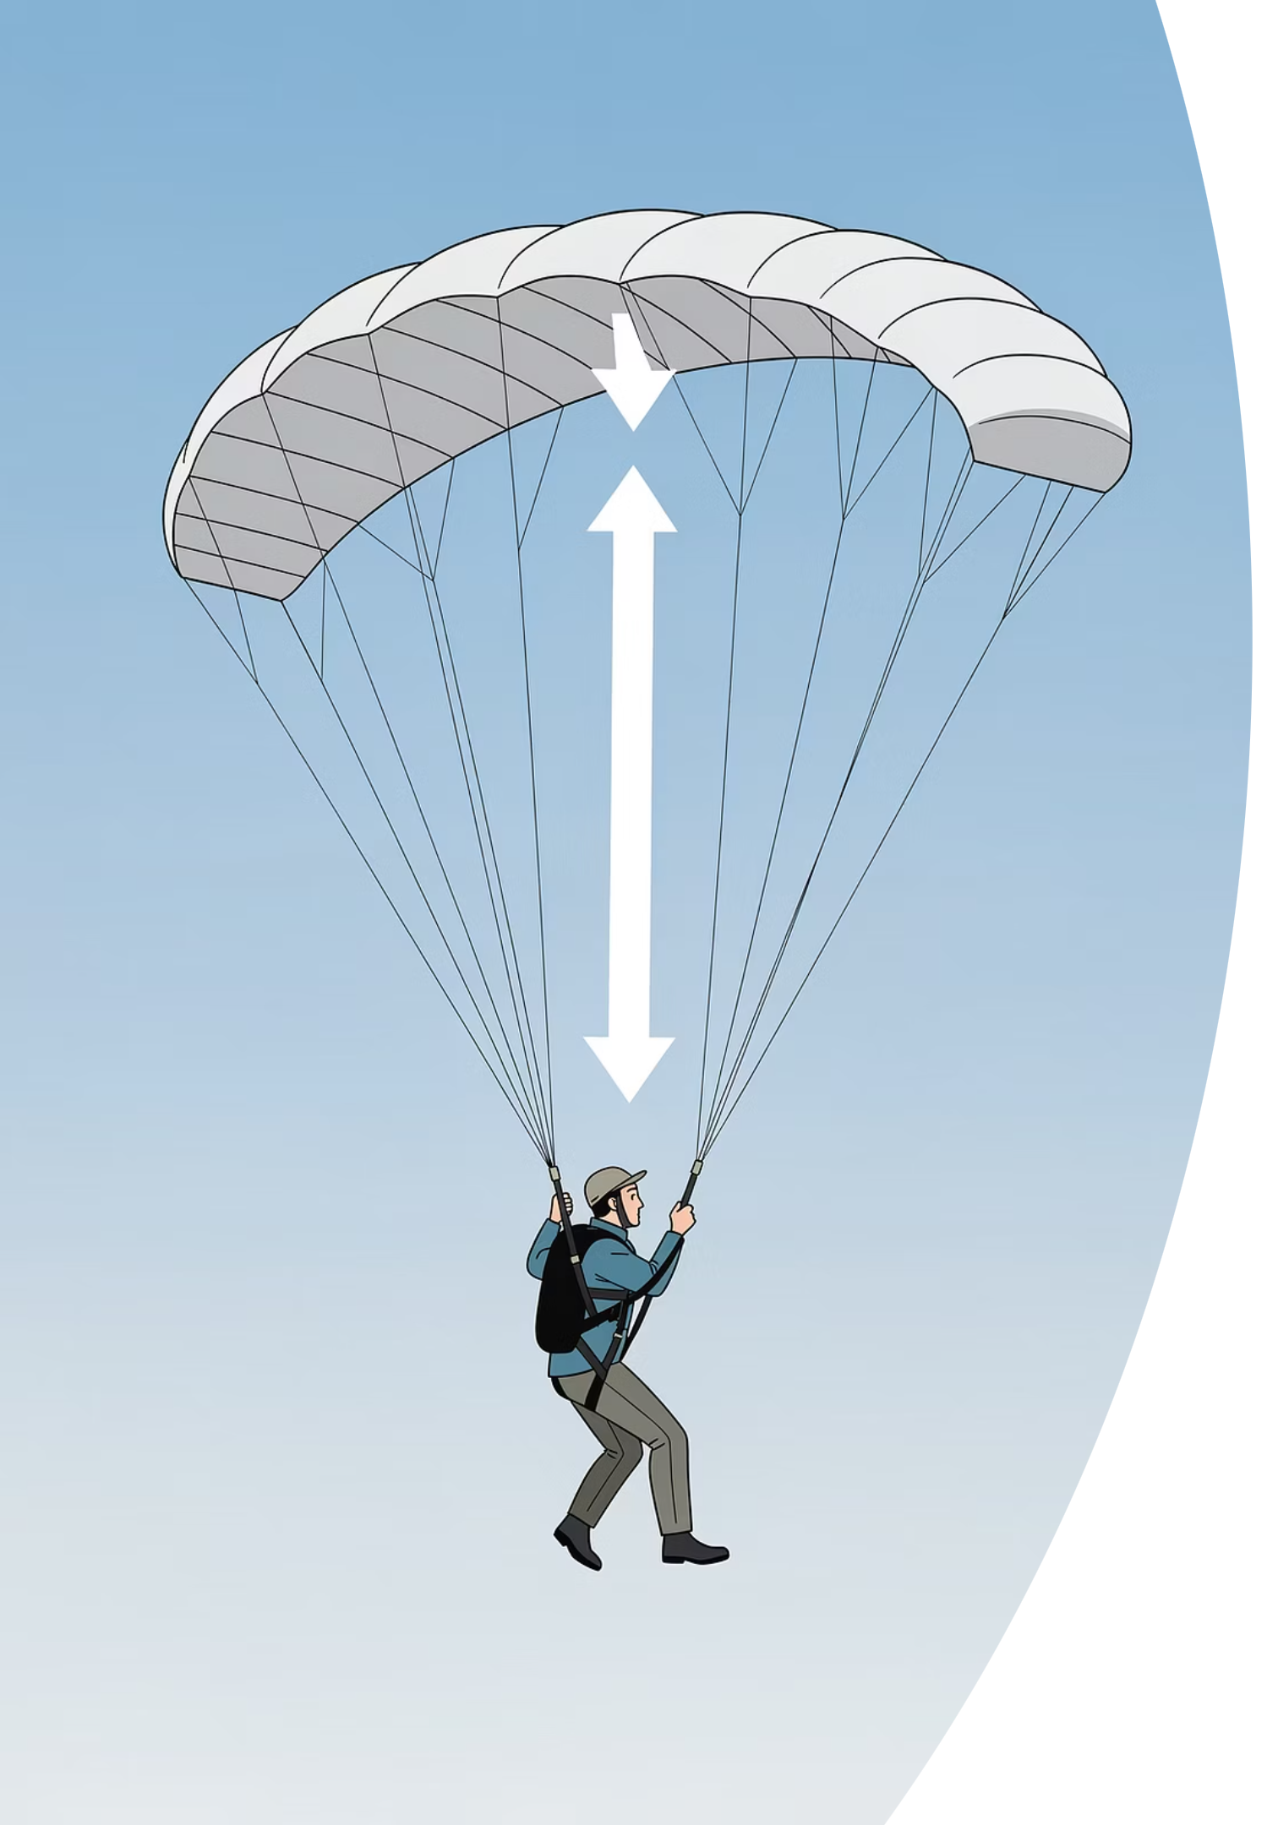
Q4
Reaction 4: The Parachute
"When the parachute opens, the skydiver speeds up."
Discuss with your partner. You have 60 seconds. Explain exactly what happens to the air resistance, the resultant force, and the speed.
thelucidstem.com

Slide 15
Reaction 4
Answer: The Parachute
DISAGREE. Opening the parachute causes the skydiver to slow down, not speed up.
The Sequence of Events
On the Speed-Time Graph
The parachute opens, greatly increasing surface area.
Air resistance suddenly becomes much larger than weight.
The resultant force now acts upward, causing deceleration.
The skydiver slows down until air resistance falls back to equal weight.
A new, lower terminal velocity is reached, safe for landing.
After the parachute opens, the speed-time graph shows a sudden steep fall in speed. This is rapid deceleration caused by the large upward resultant force. The graph then flattens out again at a much lower speed: the new terminal velocity.
The new terminal velocity is typically around 5 to 6 m/s, safe enough for landing.
thelucidstem.com

Slide 16
Formative Assessment
Prove It.
Silence in the room. Complete both tasks independently before you leave. Write in full sentences using precise physics vocabulary. This is your chance to show what you have understood today.
1
2
Written Explanation
Sketch the Full Graph
Explain, using the specific terms weight, air resistance, and resultant force, why a falling skydiver eventually reaches a constant speed. Your answer must link each term to the next in a logical chain.
Sketch the complete speed-time graph for a skydiver who: jumps from a plane, reaches terminal velocity, opens their parachute, and reaches a new lower terminal velocity before landing safely. Label every key feature and explain the gradient at each stage.
Hand your exit ticket to your teacher as you leave. Mark-scheme feedback will be shared at the start of next lesson.
thelucidstem.com

